Slide 1




Debunking
Investing
Myths
Released August 2026

Slide 2

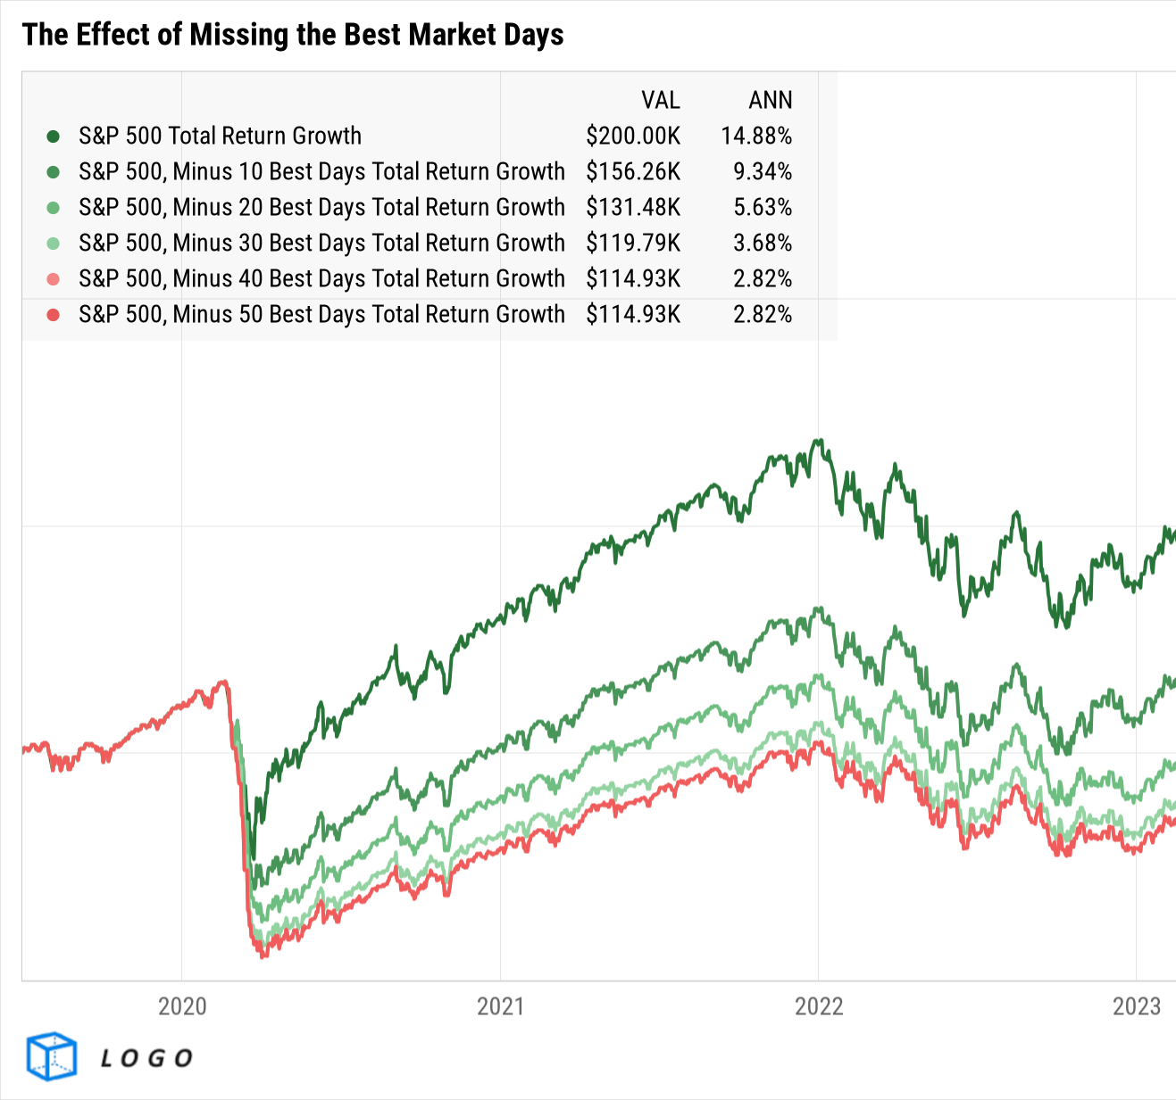



About this deck:
This deck explores common investing misconceptions, backed by data and actionable insights to help inform better financial decisions. Looking for a PowerPoint version of this deck? Download it here.
If you’ve uploaded a logo to YCharts, all visuals in YCharts will appear with that logo.
Not yet a YCharts user? Get started:
Start a Free Trial
Book a Demo
YCharts clients: have your
logo added to all charts!
Released August 2026

Slide 3

Table of Myths
Select a myth to navigate directly to its slide
“Sell in May and Go Away”
“Market Timing is Key to High Returns”
“Holding Cash is Better Than Investing”
“Stocks Are Too Risky”
“Investing is Only for the Rich”
“Investing Is Like Gambling”
“Fallen Stocks Will Always Bounce Back”
“The More You Own, The Better Diversified You Are”
“Successful Investors Take Big Risks”
“Percentage Gains and Losses are Equivalent”
“Gold is a Safe Haven”
“A High Dividend Yield Means a Safe Investment”
“Bonds Are Risk-Free Investments”

Slide 4
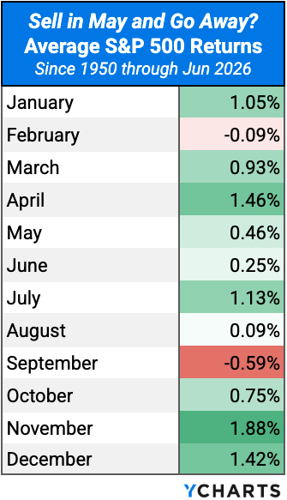
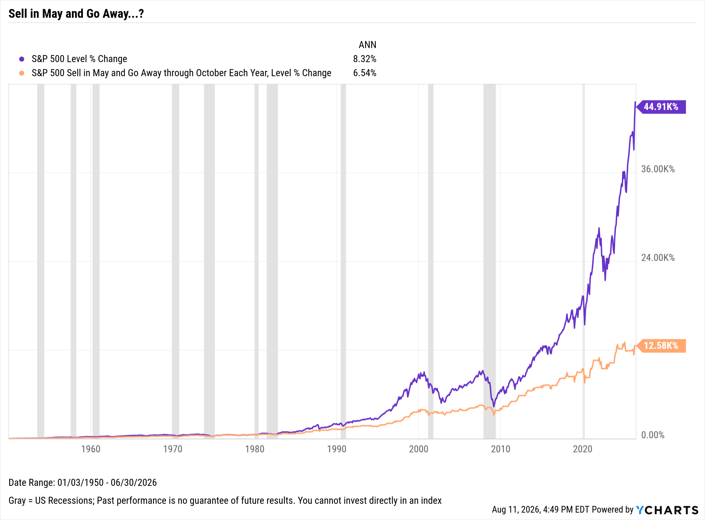
“Sell in May and Go Away”
This seasonal adage claims markets underperform during summer months, but historical data consistently disproves this notion.
View & Modify in YCharts →

Slide 5
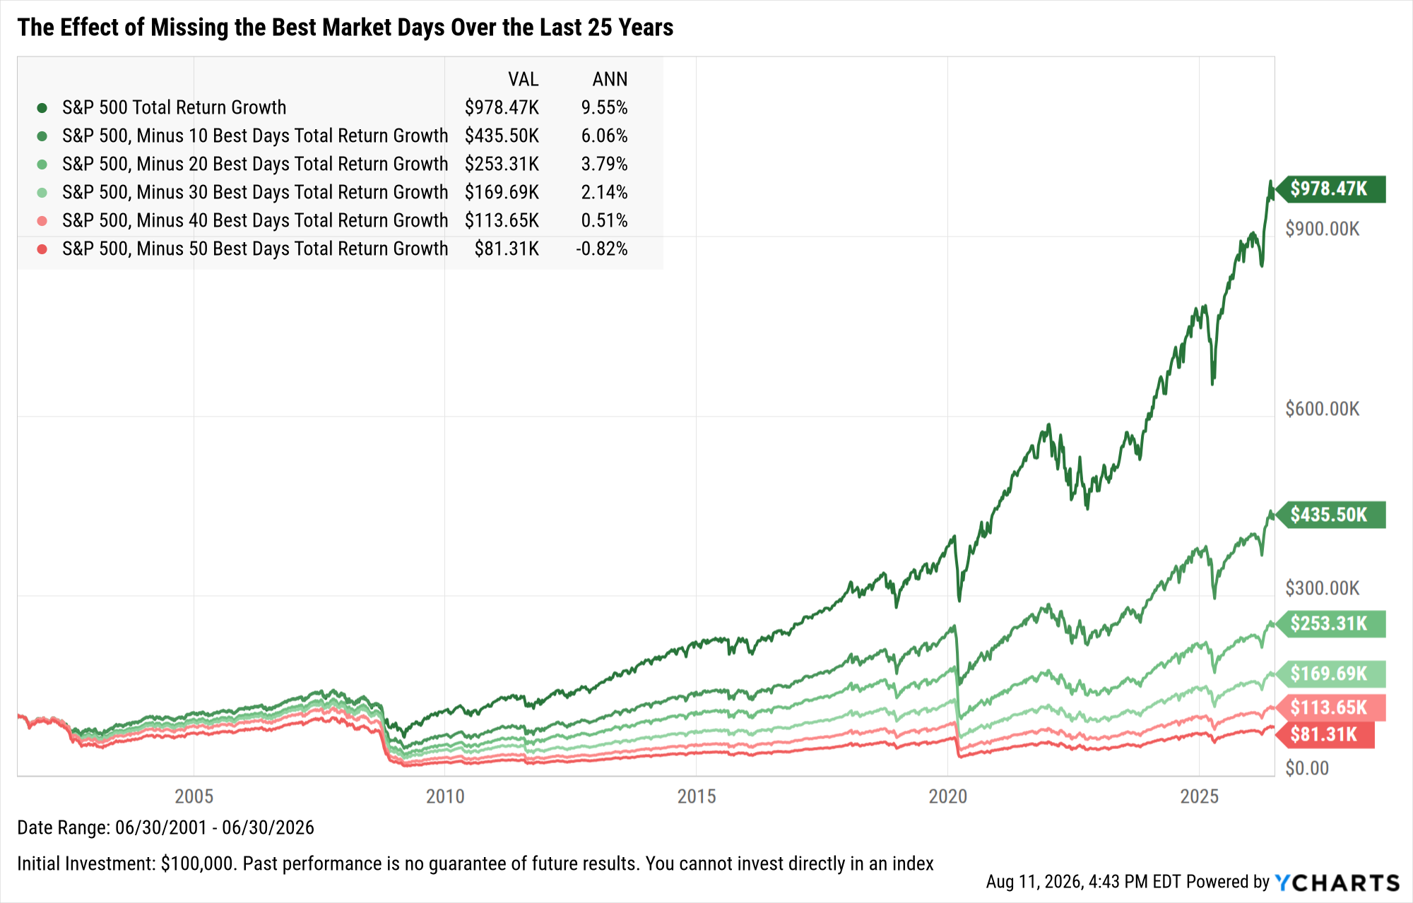
“Market Timing is Key to High Returns”
Many believe timing is key, but missing just a few top-performing days significantly impacts long-term returns.
Annualized returns over the last 25 years, when missing the best…
0 days: 9.55%
10 days: 6.06%
20 days: 3.79%
30 days: 2.14%
40 days: 0.51%
50 days: -0.82%
Missing just the 10 best market days over 25 years cuts returns by more than half.
Staying fully invested ensures you maximize long-term growth potential.
View & Modify in YCharts →

Slide 6
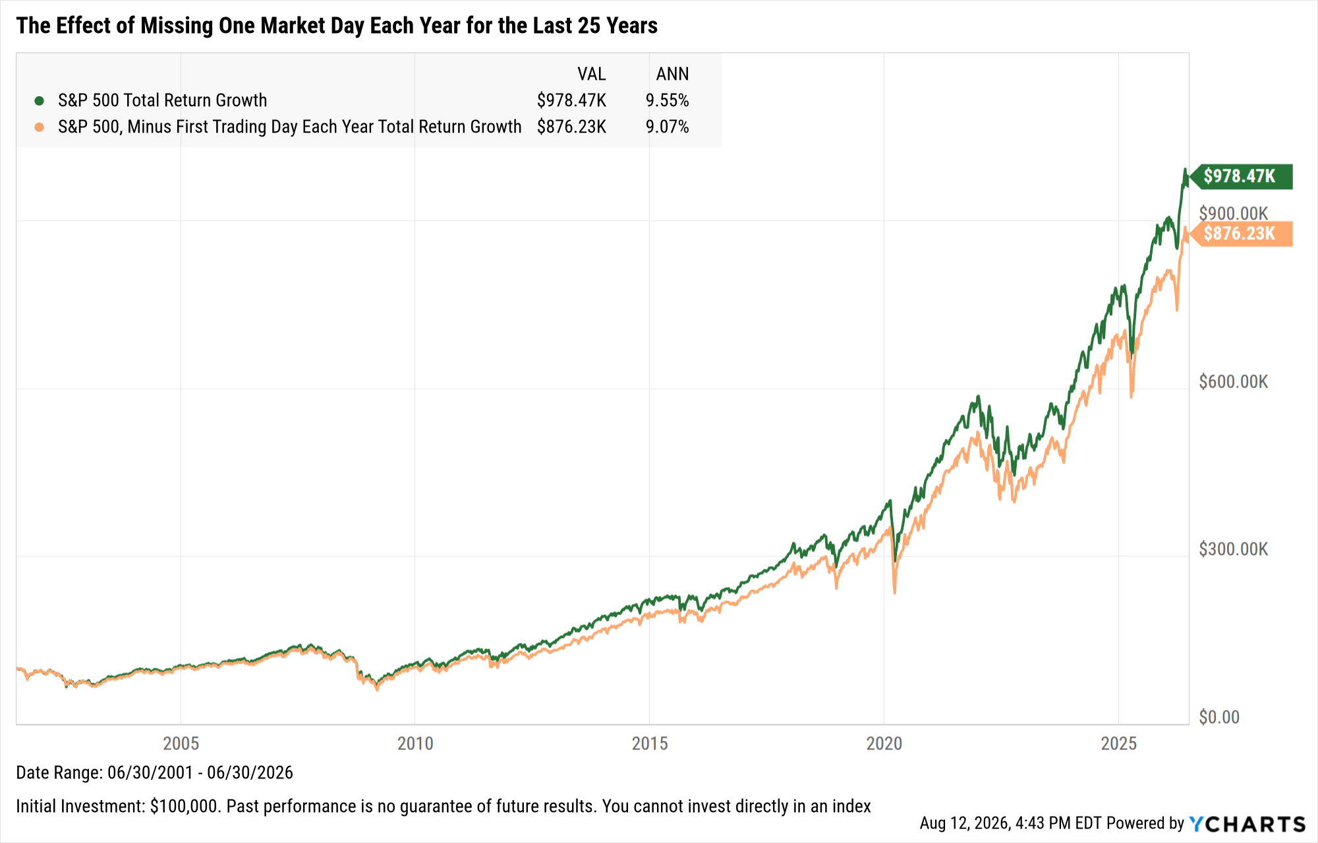
“Market Timing is Key to High Returns” (cont.)
Missing even a single day each year can significantly impact portfolio performance over time.
Even brief periods of being out of the market can significantly impact long-term portfolio returns.
Staying consistently invested is critical to maximizing growth and avoiding the compounding effects of missed opportunities.
View & Modify in YCharts →

Slide 7
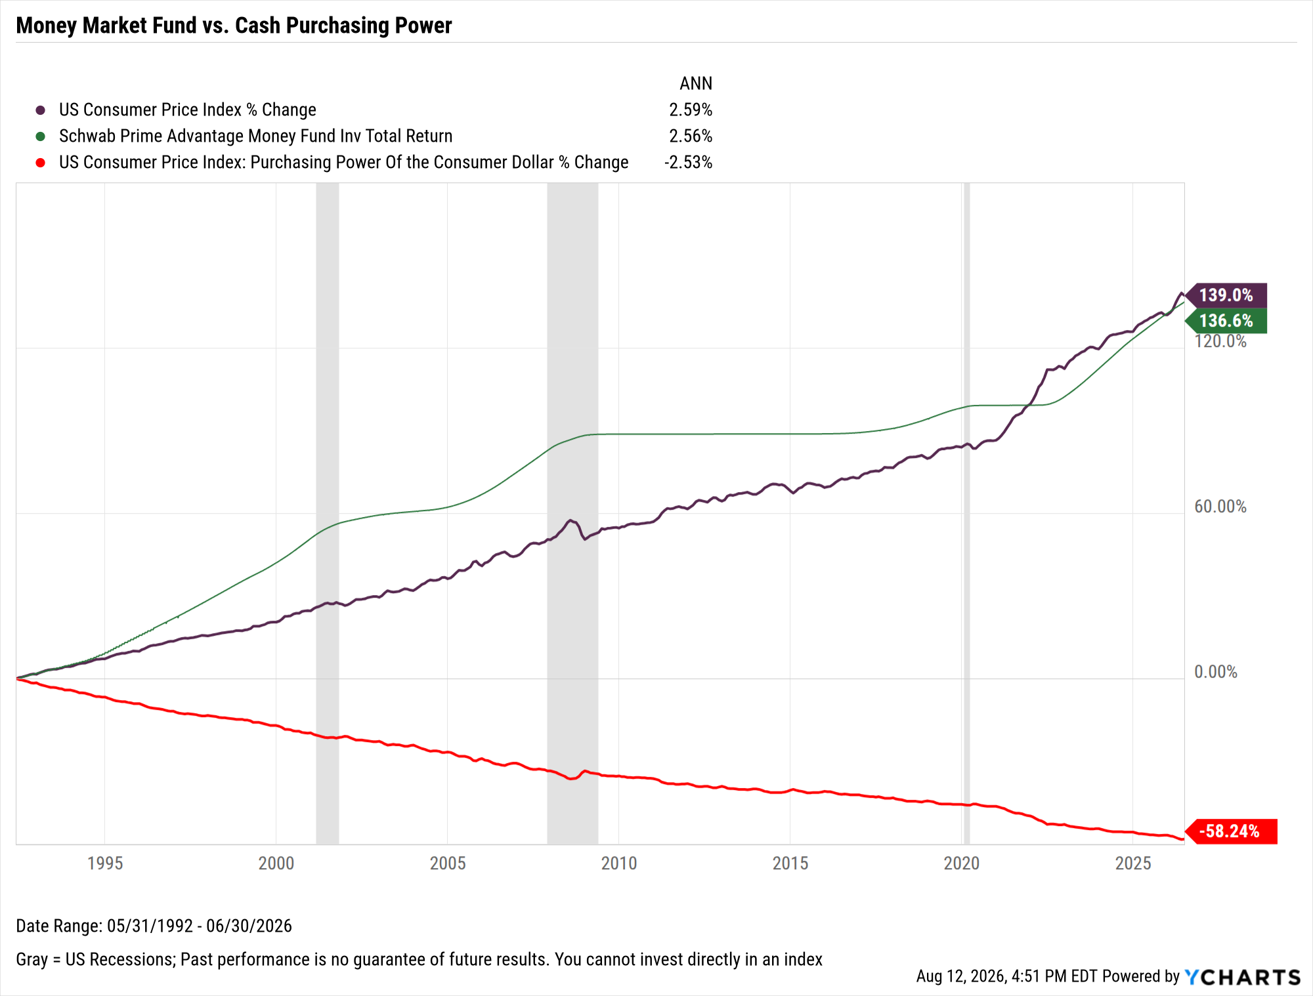
“Holding Cash is Better Than Investing”
Holding cash feels safe, but inflation erodes its purchasing power.
Investing cash in a money market fund can help mitigate the effects of inflation, but it doesn’t generate significant growth.
Over time, uninvested cash loses value due to diminished purchasing power.
View & Modify in YCharts →

Slide 8
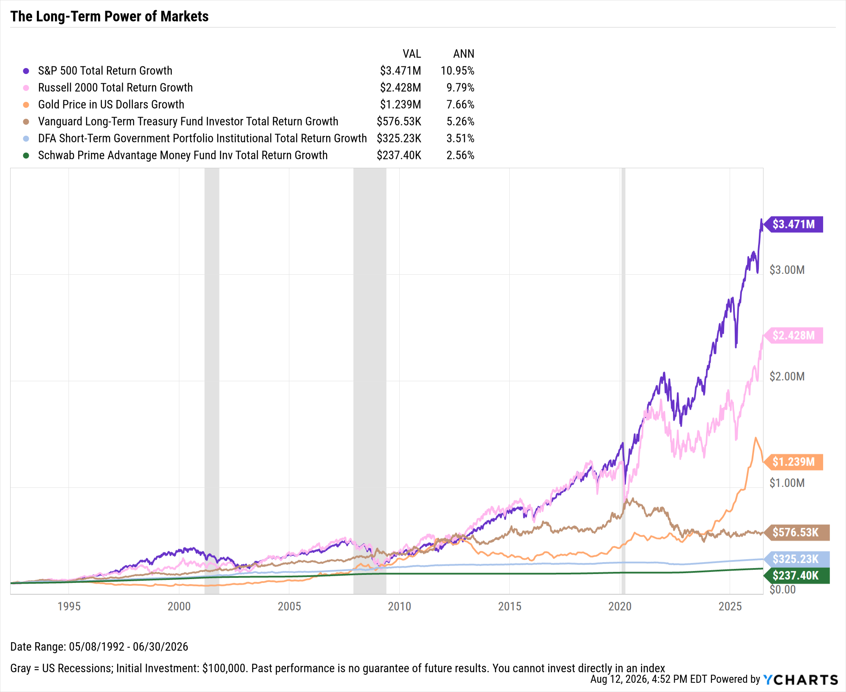
“Holding Cash is Better Than Investing” (cont.)
Over time, investing typically outperforms cash savings, especially after inflation.
Investing in growth assets far outpaces cash savings in the long term.
Growth of an initial $100K
investment in 1992 through Q2 2026:
S&P 500: $3.471M
Russell 2000: $2.428M
Gold: $1.239M
Long-term Bonds: $576,530
Short-term Bonds: $325,230
Money Market: $237,400
View & Modify in YCharts →

Slide 9
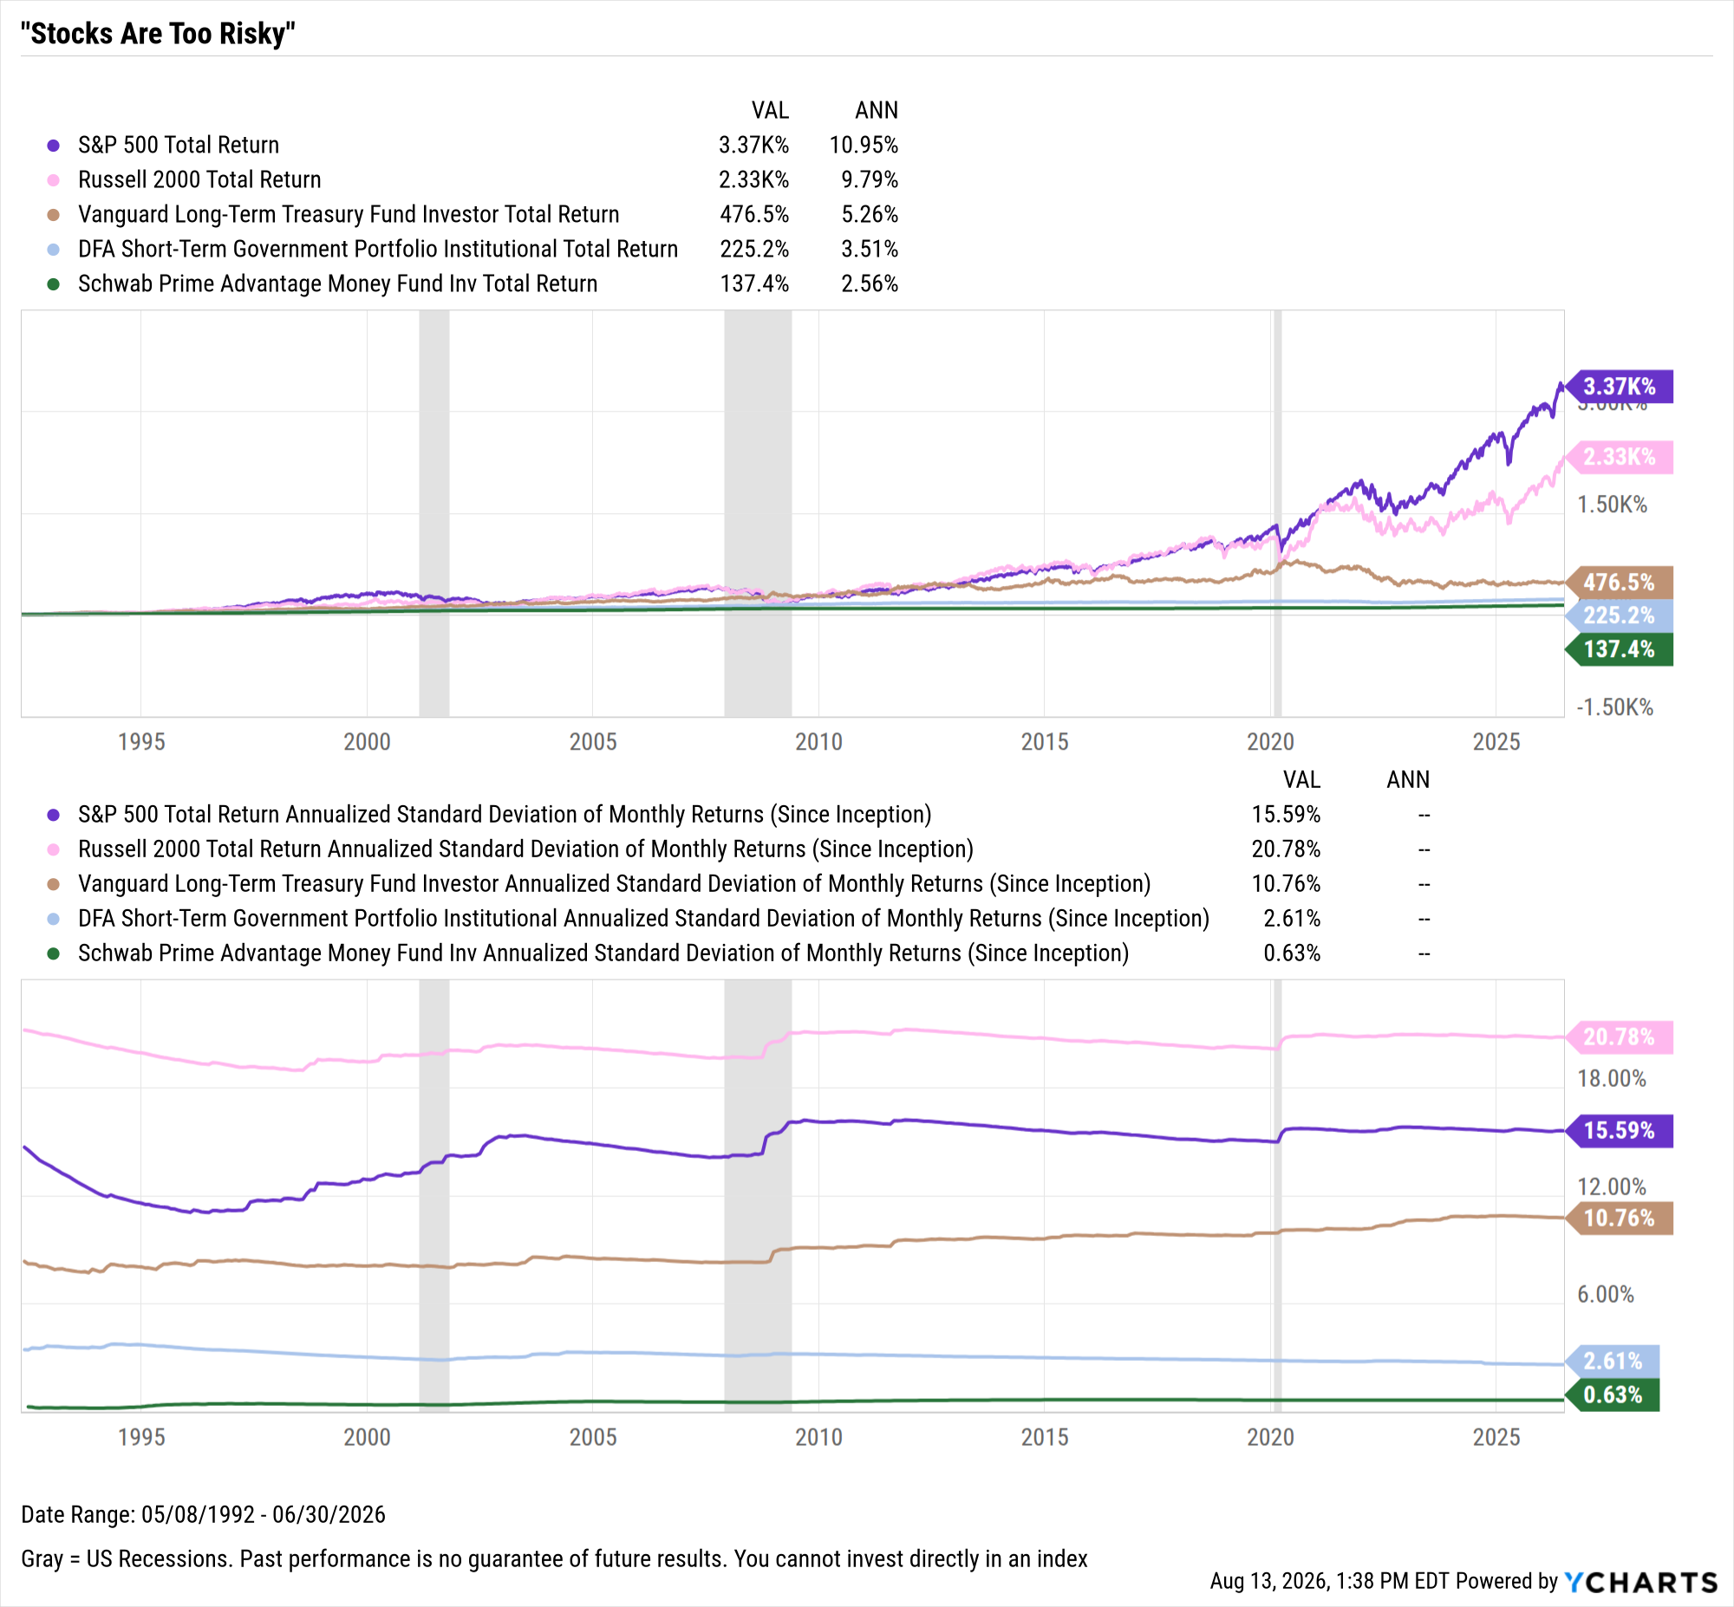
“Stocks Are Too Risky”
Volatility is often misunderstood as excessive risk. Over time, volatility may lead to growth potential.
Equities carry higher levels of risk/reward than bonds or cash. While standard deviation of the S&P 500 is about 50% higher than long-term treasuries, annualized return of the U.S. stock index is almost double that of the long-term fixed income fund.
View & Modify in YCharts →

Slide 10
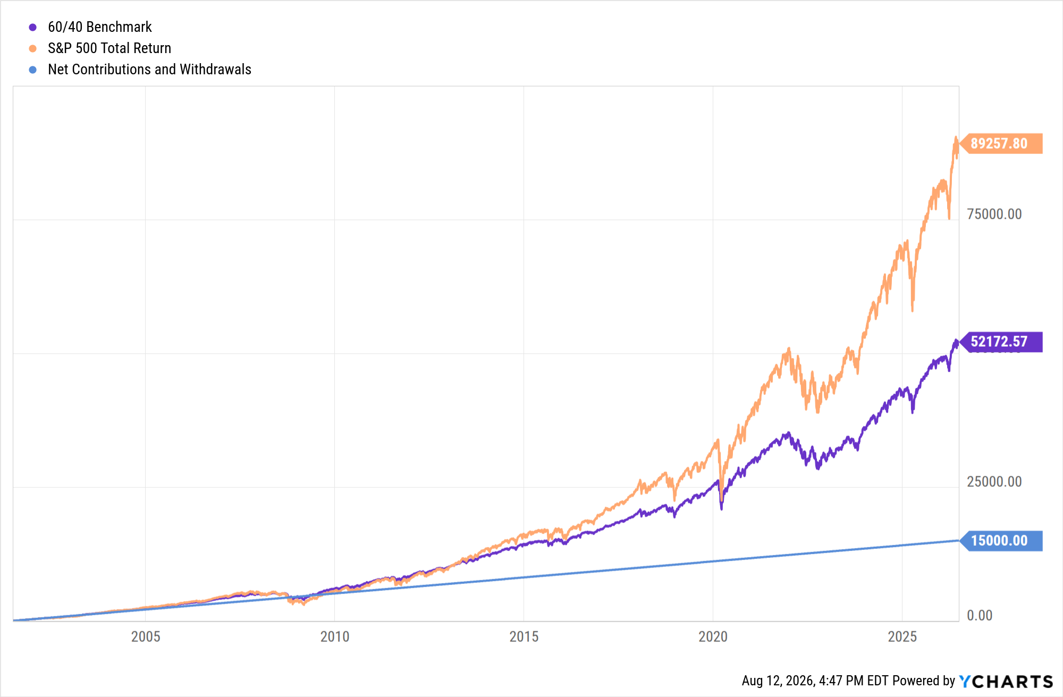
“Investing is Only for the Rich”
The power of compounding can grow small, regular investments over time, making investing accessible to a wide range of income levels.
By investing just $50 a month for the last 25 years, you would contribute a total of $15,000.
The power of long-term investing can grow that $15,000 into $52,000 with a 60/40 portfolio.
If the same $50 monthly contributions were invested in an all-S&P 500 portfolio, your total would grow to more than $89,000 — nearly 6x your original investment.
View & Modify in YCharts →

Slide 11
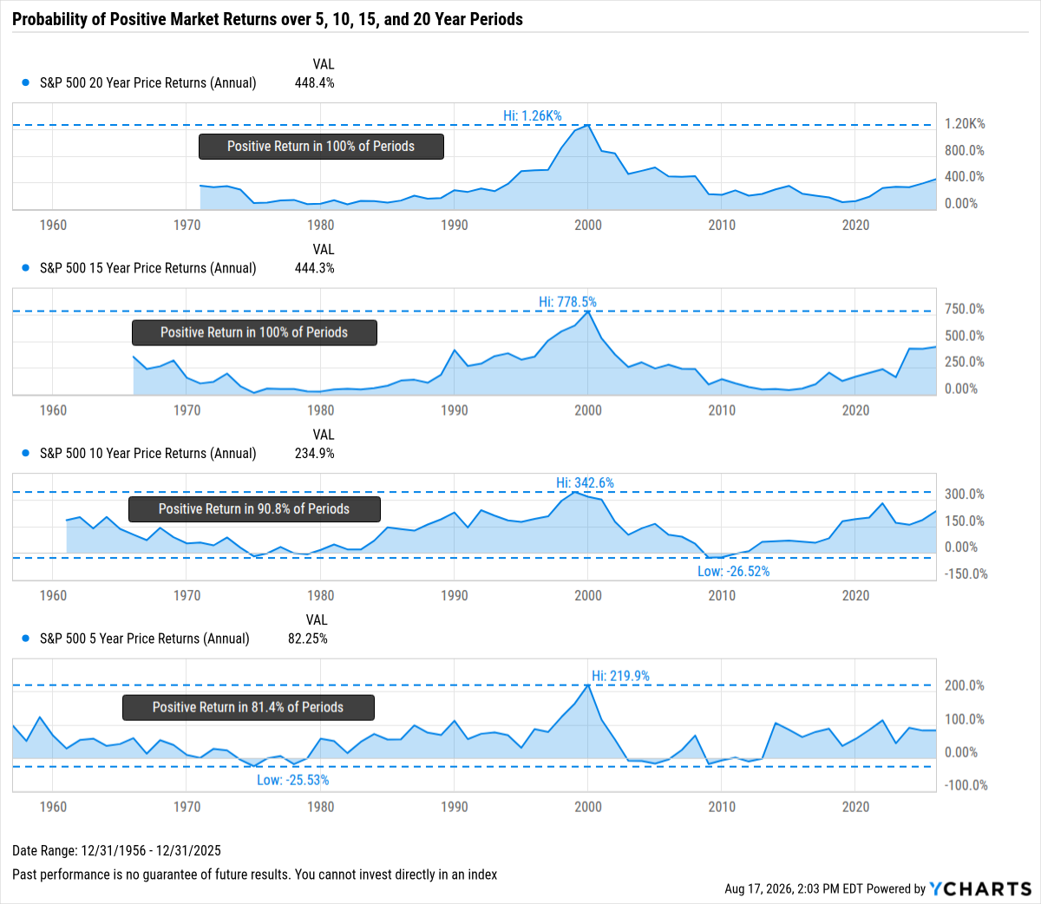




“Investing is Like Gambling”
Unlike gambling, which relies on chance, investing is about compounding growth and has historically rewarded long-term commitment with positive returns.
Probability of Winning Casino Games:
Craps: ~50%
Blackjack: ~49%
Roulette: ~47% to 49%
Baccarat: ~44% to 46%
Source: Action Network
View & Modify in YCharts →

Slide 12
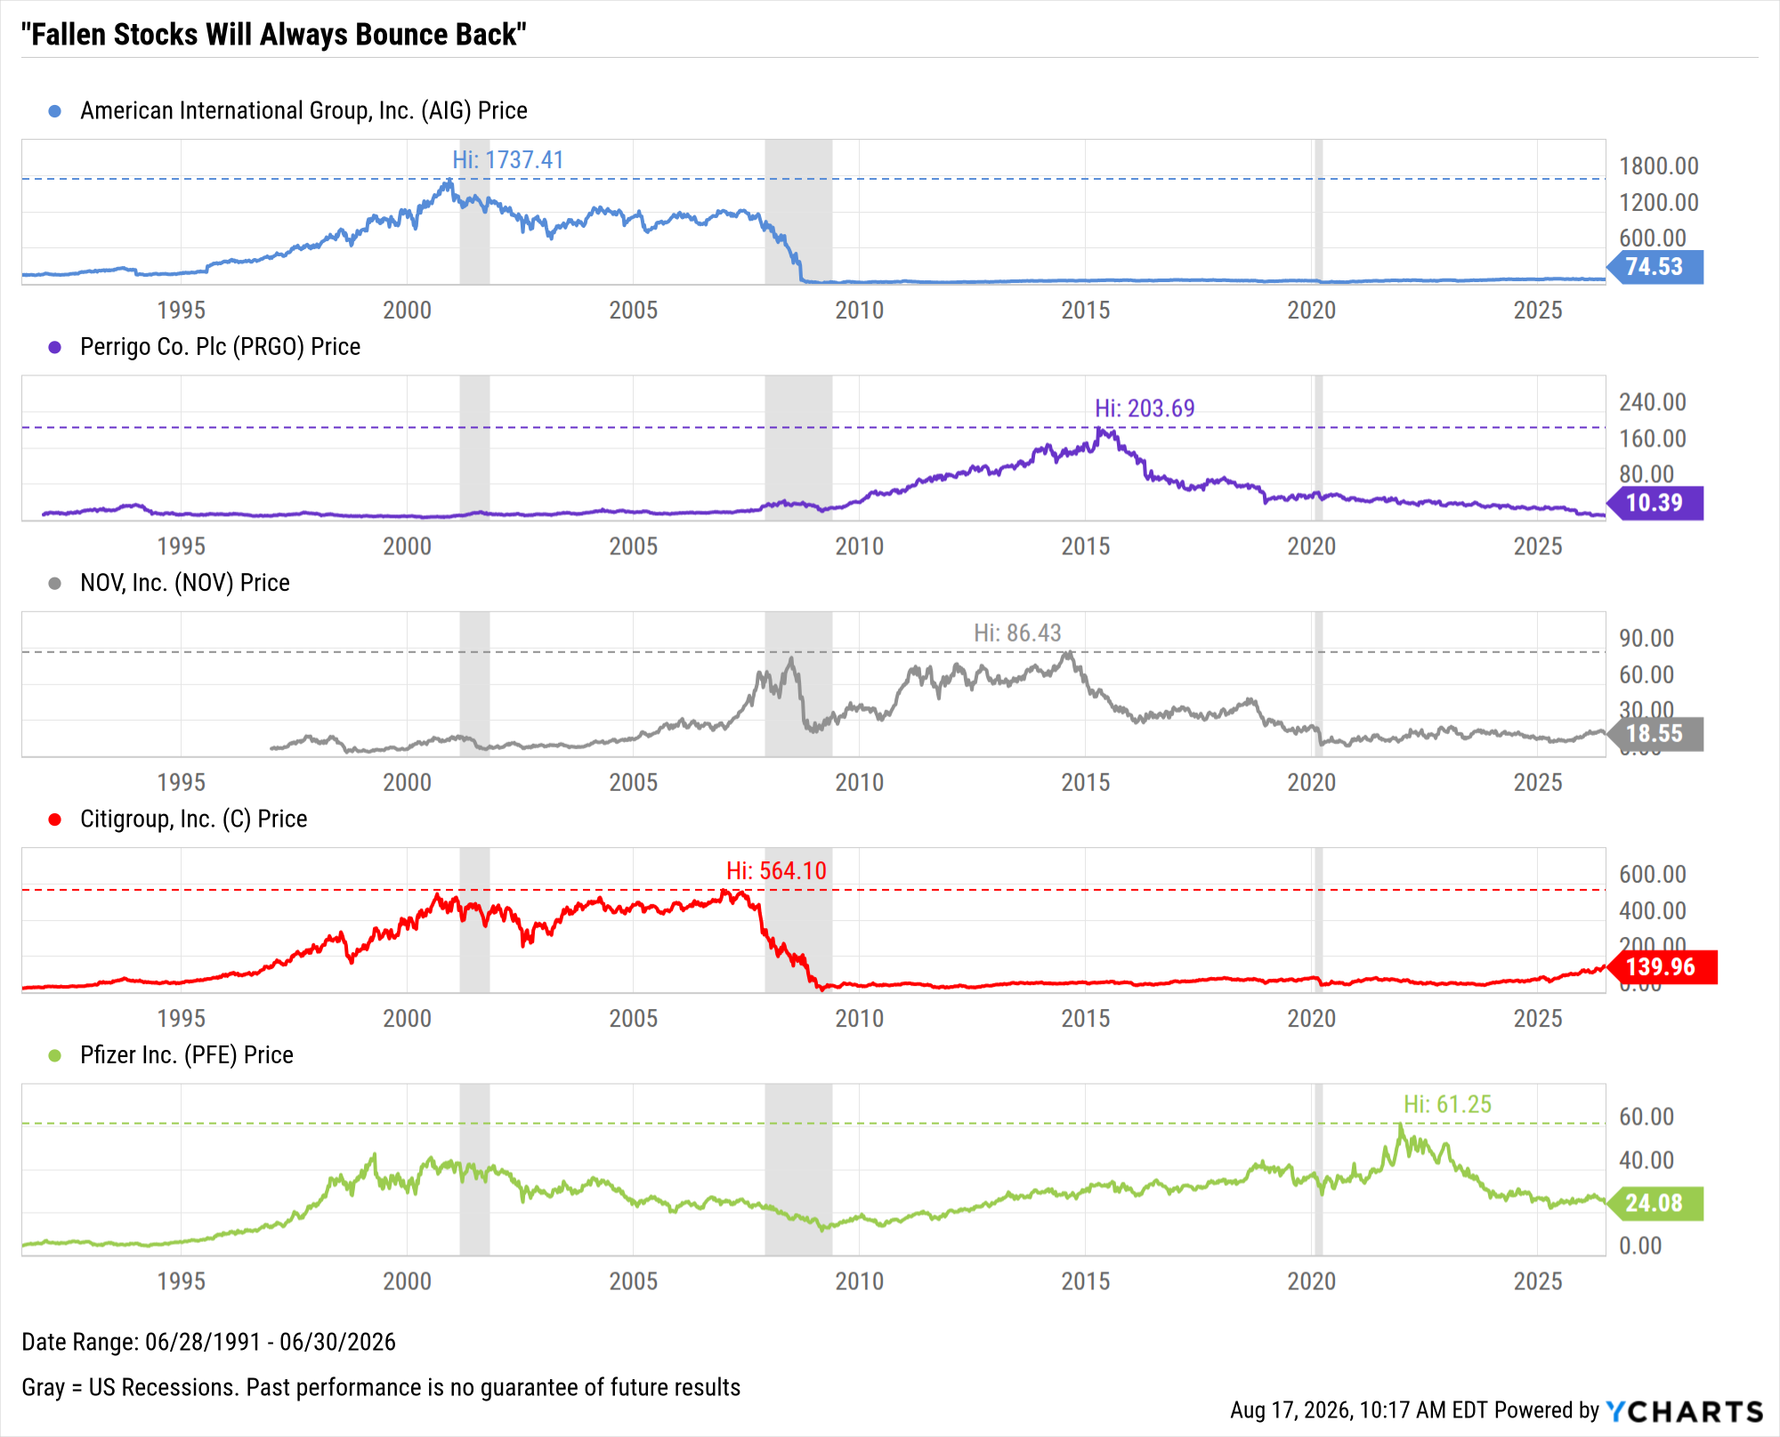
“Fallen Stocks Will Always Bounce Back”
Contrary to the belief that they must rebound at some point, some stocks might never recover.
AIG
-95.7% below all-time high
-94.9% below all-time high
-78.5% below all-time high
-75.2% below all-time high
-60.7% below all-time high
PRGO
NOV
C
PFE
View & Modify in YCharts →

Slide 13
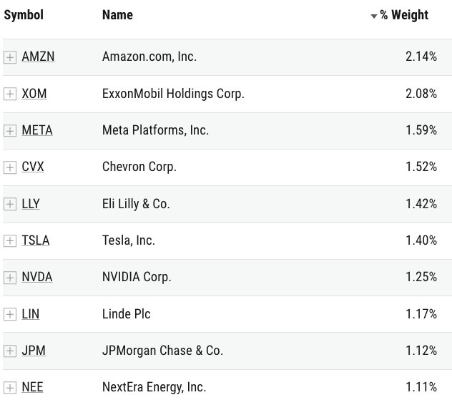
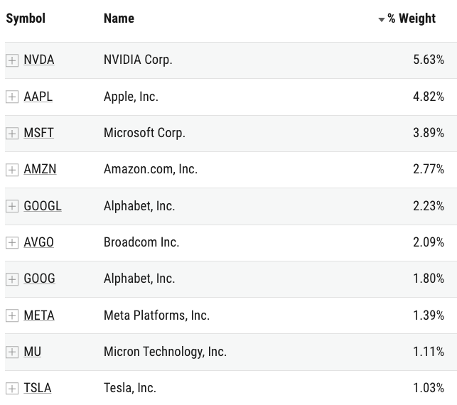
“The More You Own, The Better Diversified You Are”
Rather than just increasing holdings, true diversification reduces concentration risk without increasing overlap.
Sector ETFs Model Portfolio: 9.09% allocation
to each of the 11 SPDR® Select Sector ETFs
531 total holdings; 14.80% in Top 10 Holdings
Broad Index Model Portfolio: 16.666% allocation
to each of IWD, IWF, IWN, IWO, SPY, OEF
2,935 total holdings; 26.76% in Top 10 Holdings

Slide 14
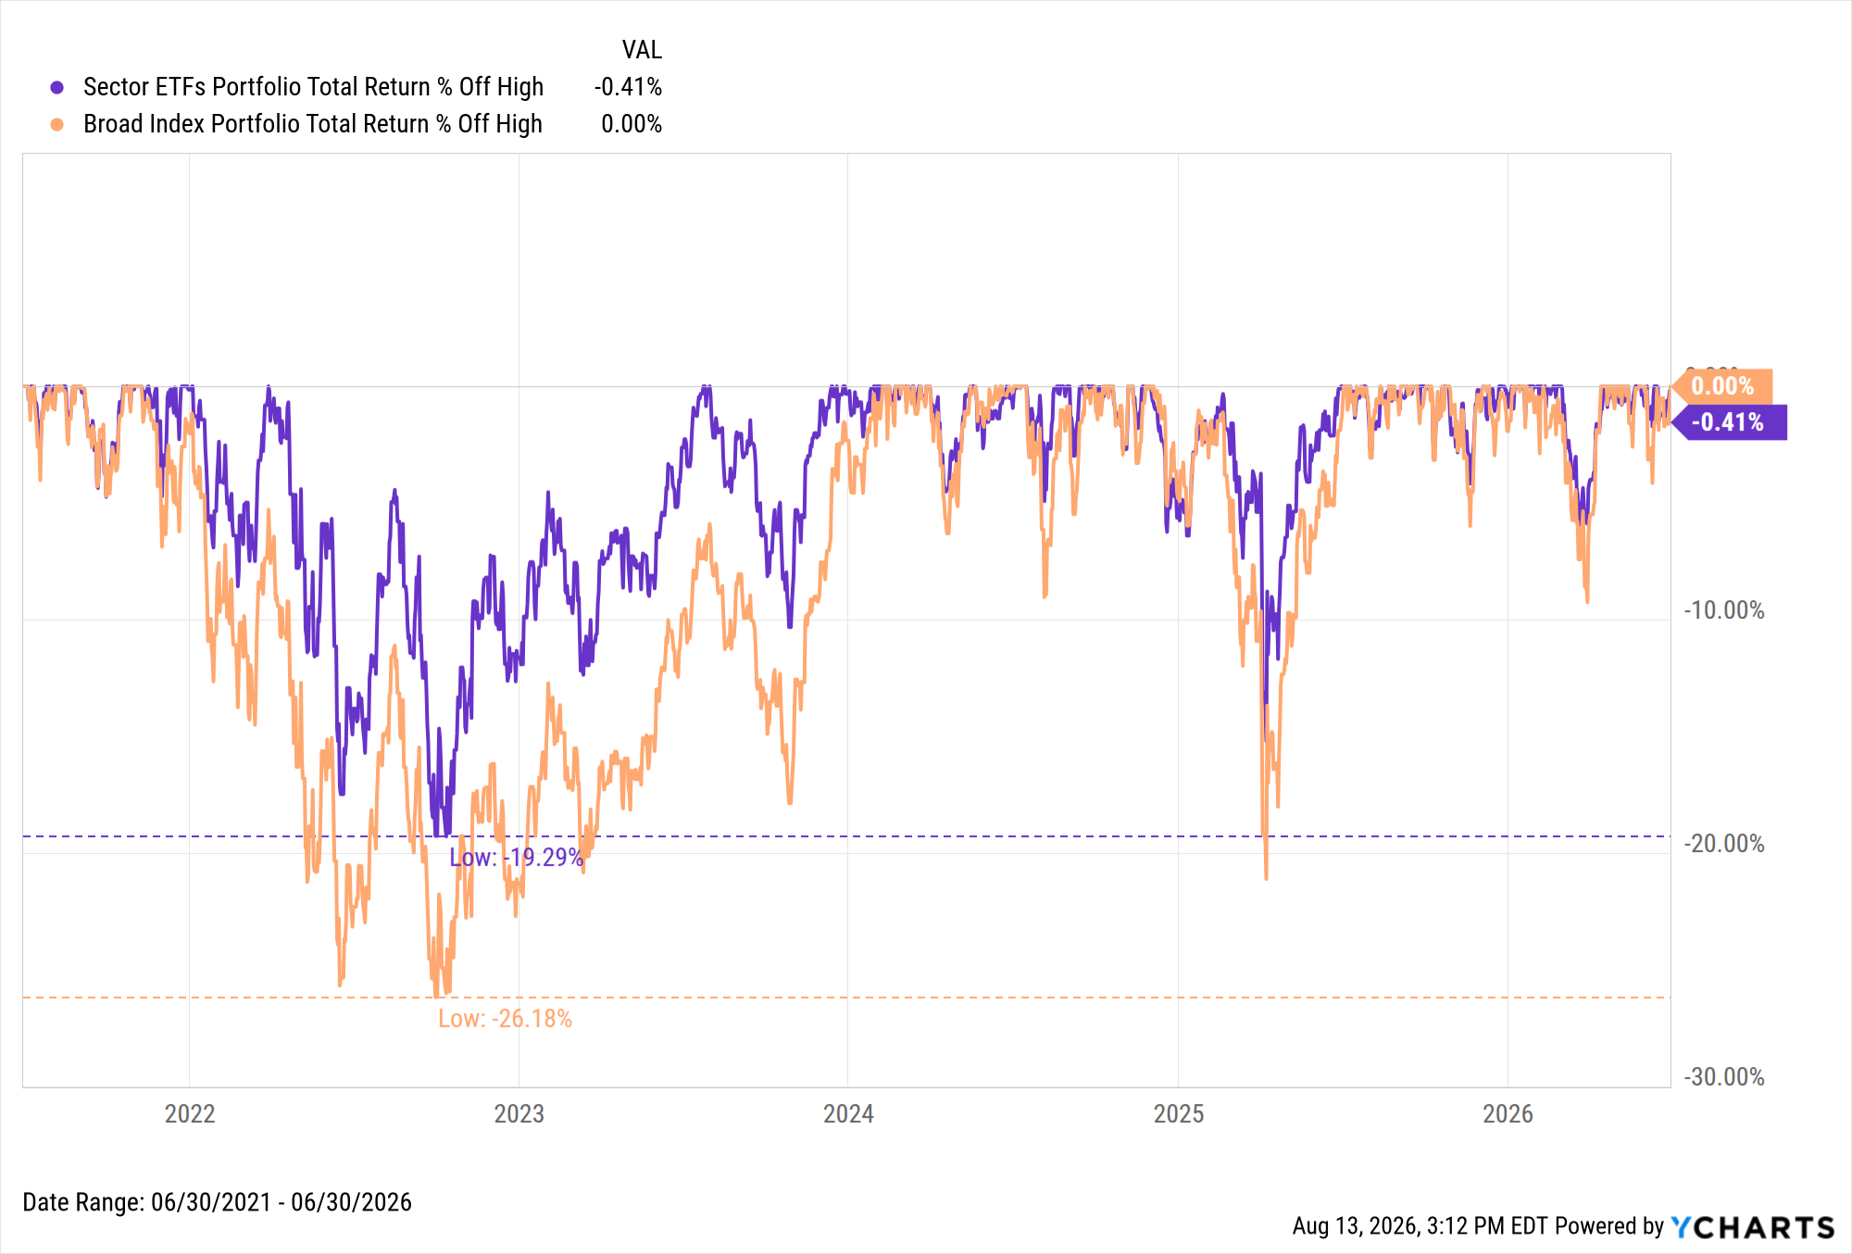
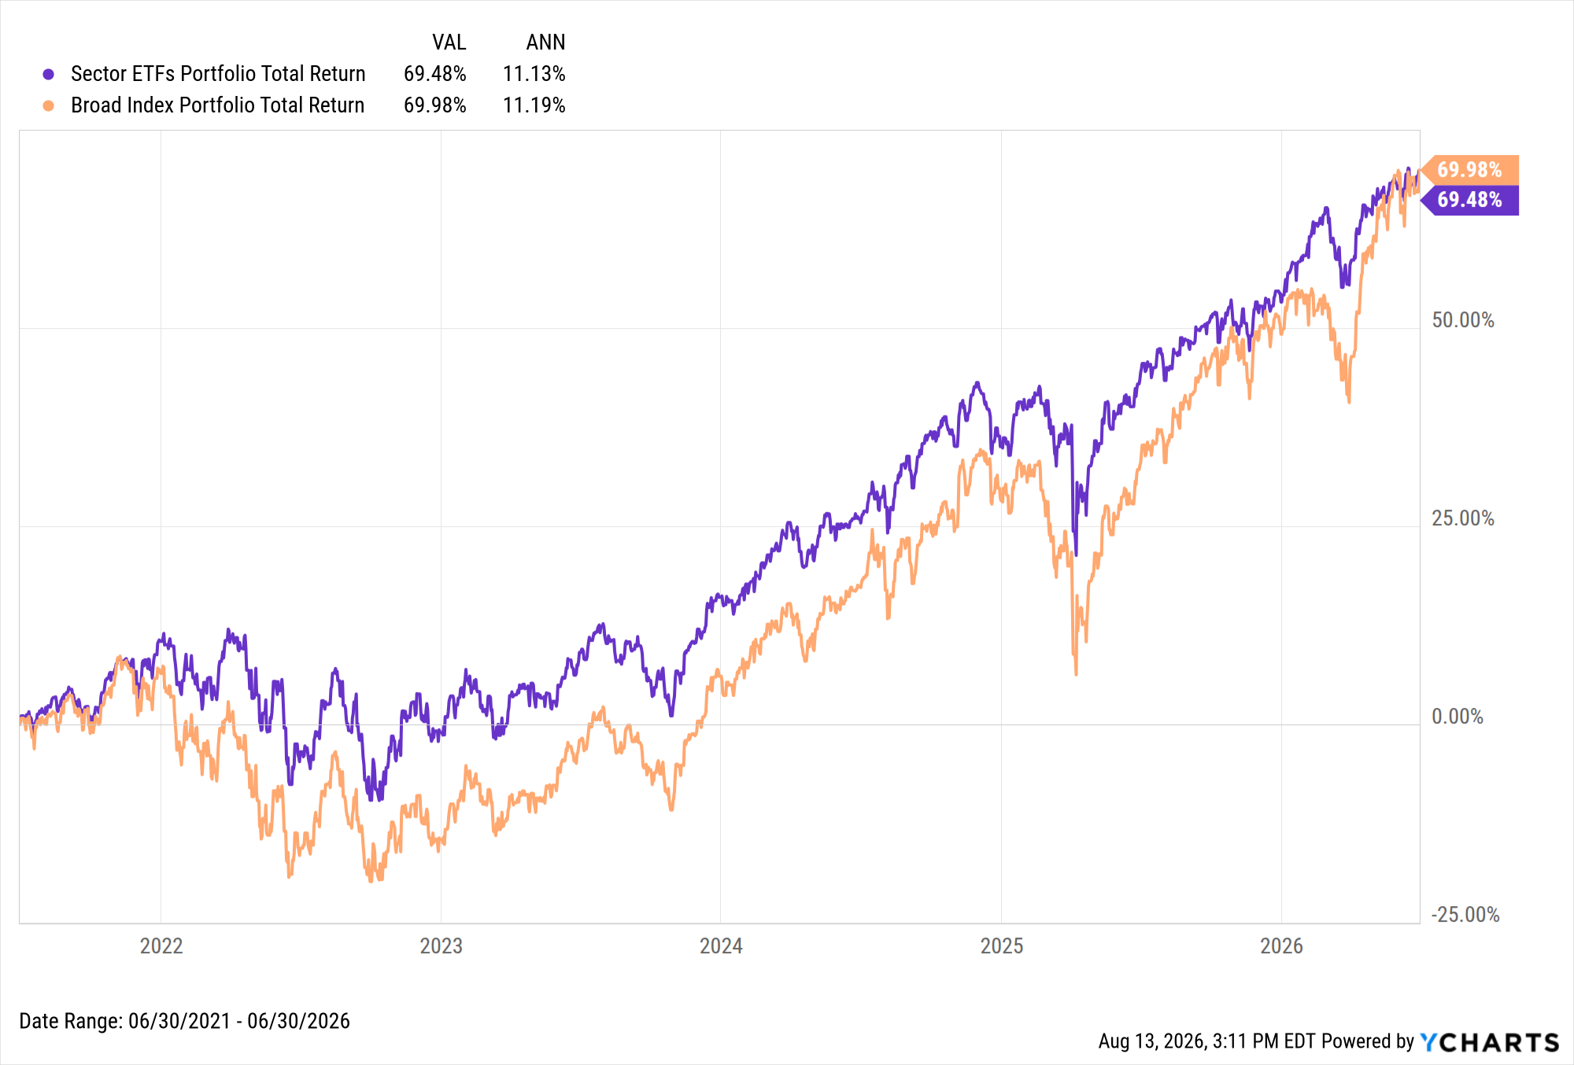
“The More You Own, The Better Diversified You Are” (cont.)
Excessive overlap can reduce returns and increase the severity of drawdowns.
“Sector ETFs Portfolio” with 531 total holdings: -19.29% max drawdown
“Broad Index Portfolio” with 2,935 total holdings:
-26.18% max drawdown
Nearly identical annualized returns since June 2021 don't tell the full story
Sector ETFs led for 59 consecutive months before losing the advantage in June 2026
View & Modify in YCharts →
View & Modify in YCharts →

Slide 15
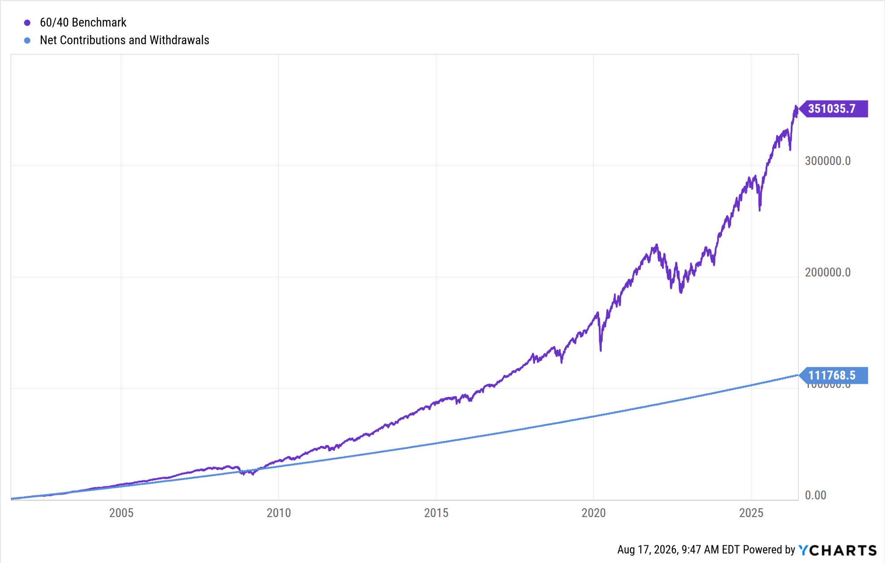
“Successful Investors Take Big Risks”
Akin to avoiding “putting all your eggs in one basket” up front, contributing over time often provides for a smoother–and more rewarding–investing journey.
The chart illustrates an example 25-year investment in a 60/40 portfolio:
Initial Investment: $1,000, made in July 2001
Ongoing Contributions: $250 monthly, with a 3% annual increase, from August 2001 through June 2026
Total Contribution: $111,768.50
View & Modify in YCharts →

Slide 16
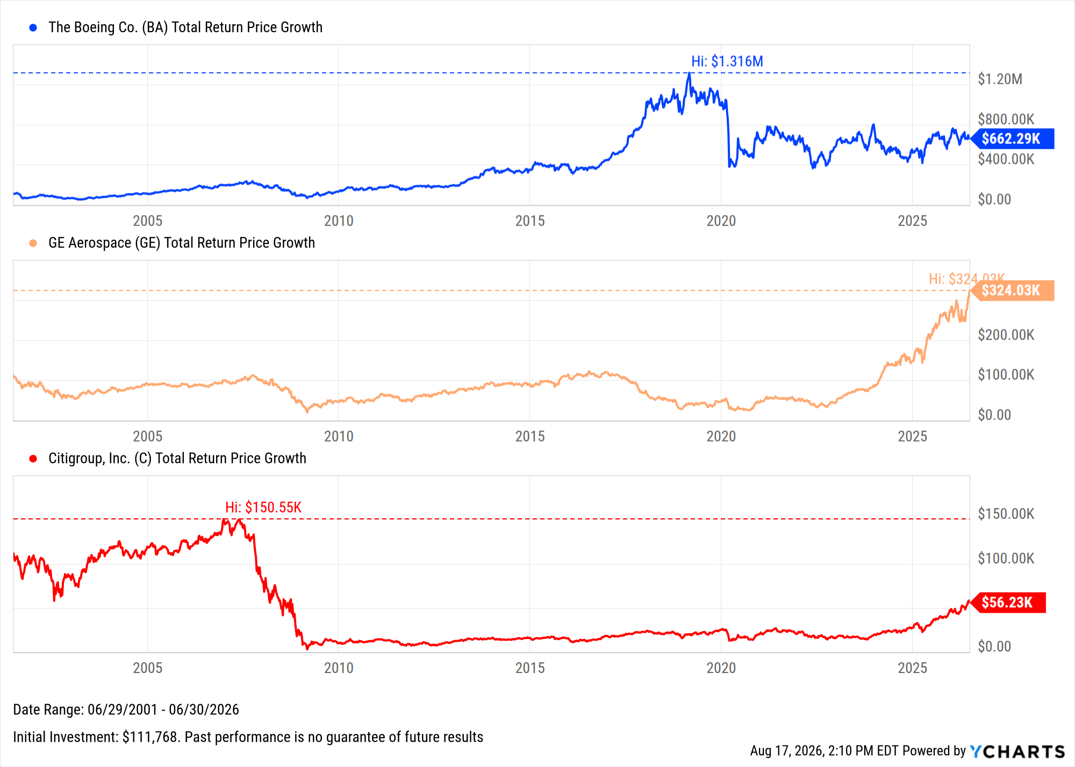
“Successful Investors Take Big Risks” (cont.)
Akin to avoiding “putting all your eggs in one basket” up front, contributing over time often provides for a smoother–and more rewarding–investing journey.
Investing that lump sum of $111,768 into a single stock on July 1, 2001, would have resulted in the following outcomes:
Boeing (BA)
  High: $1.316M
  Current value: $662,290
  Current % off high: -49.7%
General Electric (GE)
  High: $324,030
  Current value: $324,030
  Current % off high: 0%
Citigroup (C)
  High: $150,550
  Current value: $56,230
  Current % off high: -62.7%
View & Modify in YCharts →

Slide 17
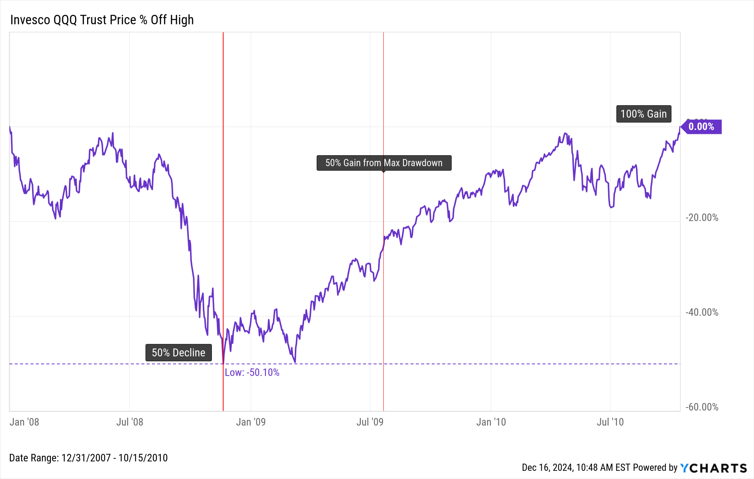
“Percentage Gains and Losses are Equivalent”
Higher levels of positive returns are required in order to fully counterbalance losses.
Between January 1 and November 20, 2008, the Invesco QQQ Trust (QQQ), an ETF tracking the Nasdaq-100 Index, experienced a 50% decline in value.
To recover from this loss, the ETF needed a 100% gain, which it achieved by October 15, 2010.
View & Modify in YCharts →

Slide 18
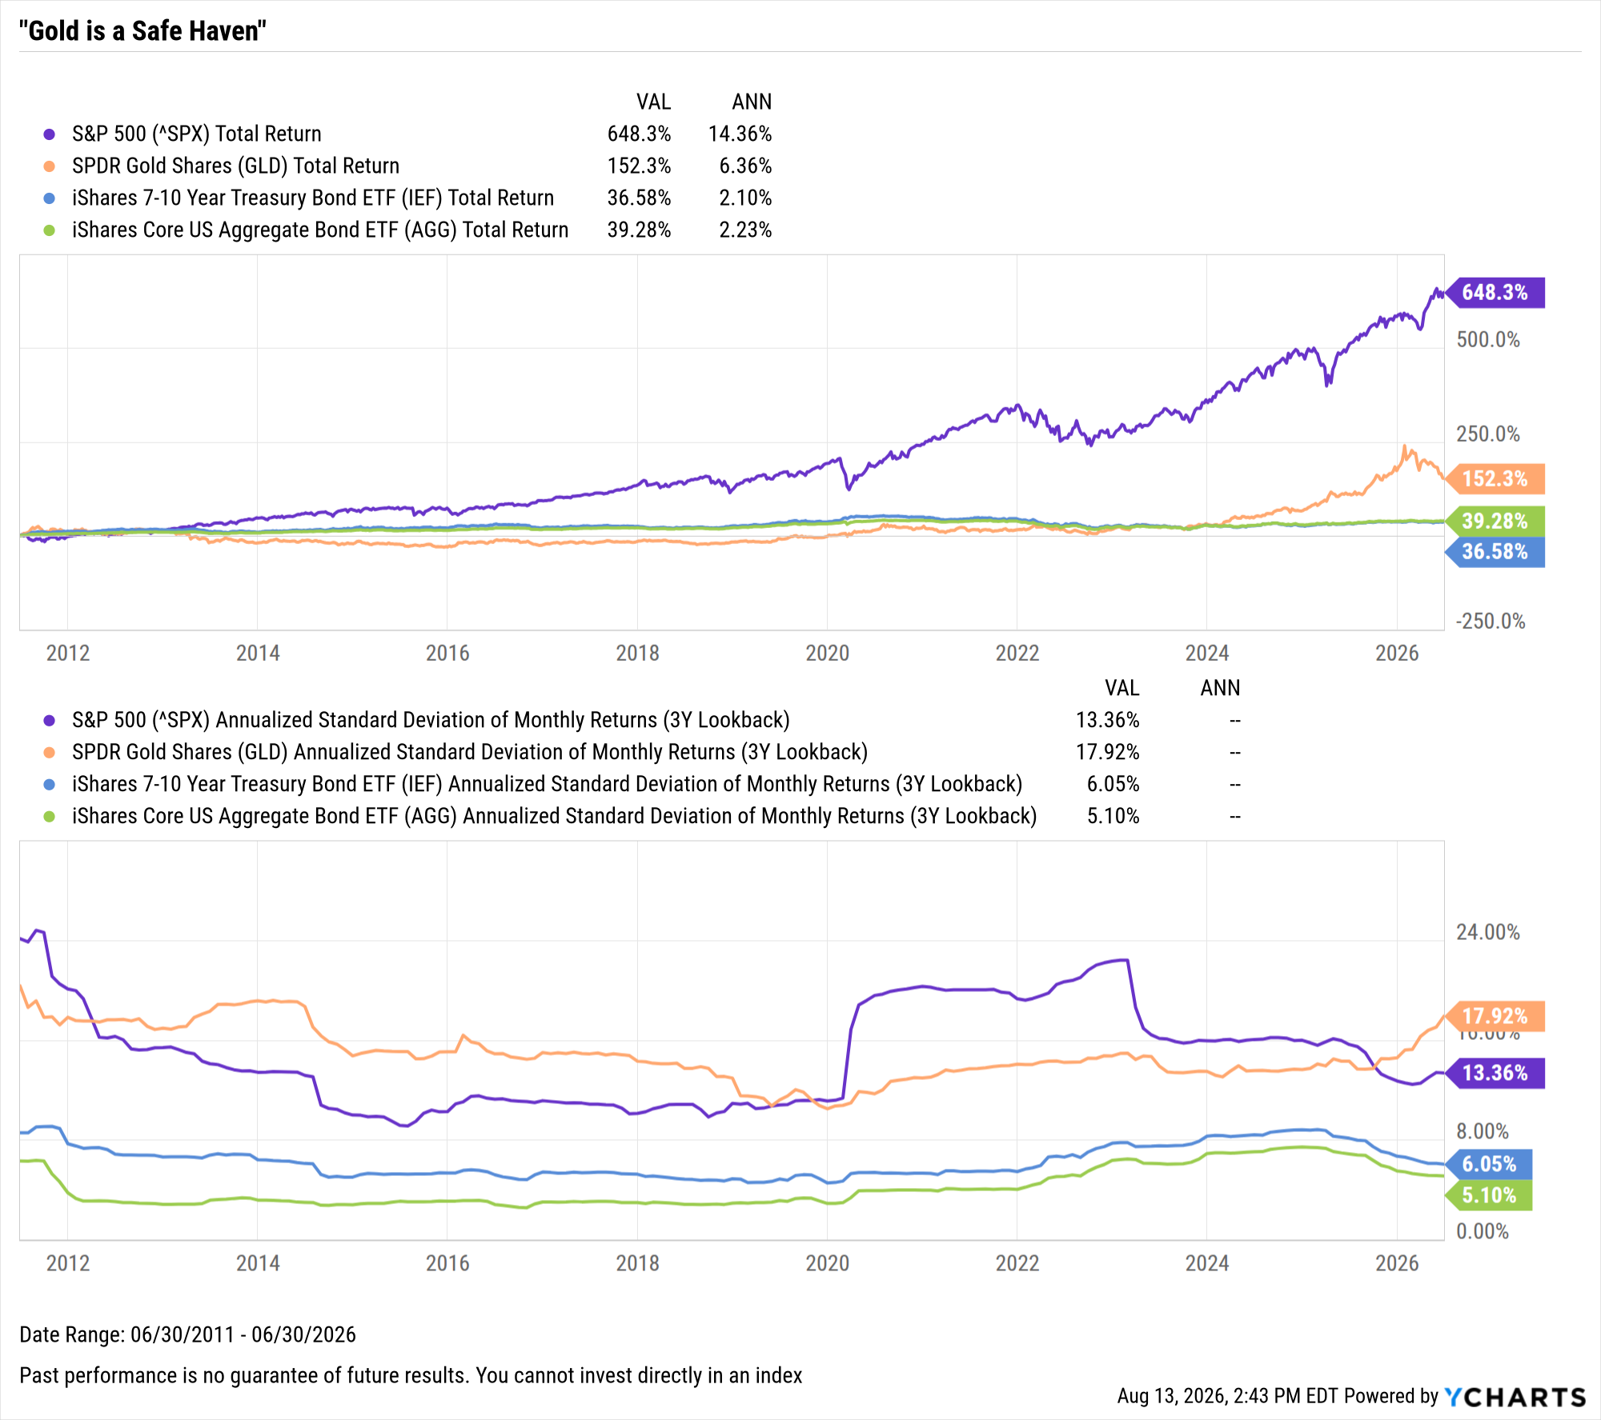
“Gold is a Safe Haven”
Although gold has traditionally been considered a safe-haven asset, its recent risk/reward metrics suggest it may not always serve this role effectively.
15Y Return and Risk Metrics:
S&P 500:
  14.4% Annualized Return
  13.4% Standard Deviation
GLD:
  6.4% Annualized Return
  17.9% Standard Deviation
AGG:
  2.2% Annualized Return
  6.1% Standard Deviation
The annualized return of gold, represented by SPDR® Gold Shares (GLD), is less than half as much as stocks since 2010, yet carries more volatility than the S&P 500.
View & Modify in YCharts →

Slide 19
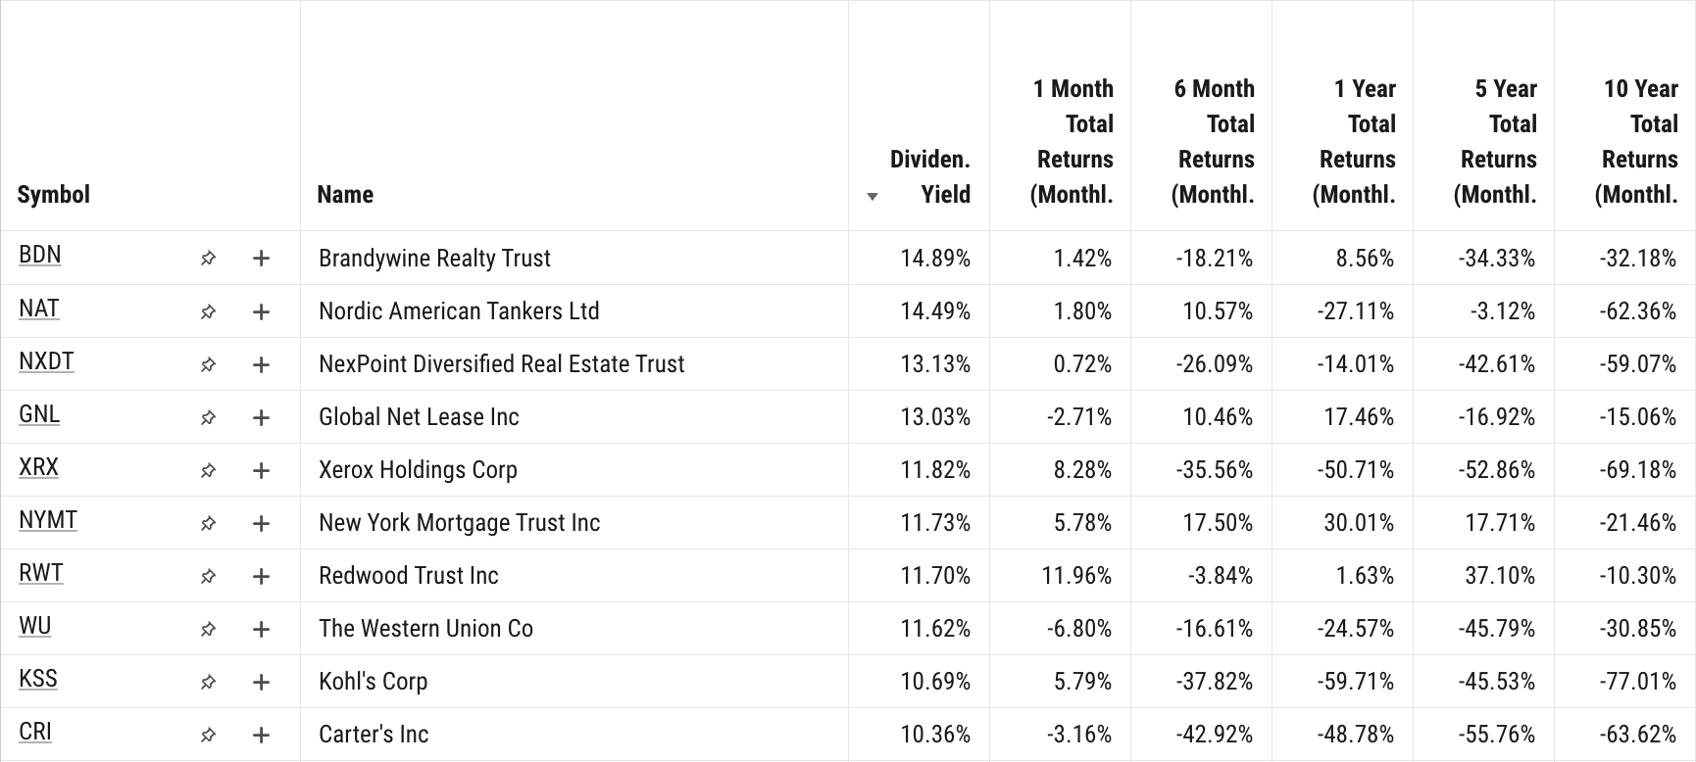
“A High Dividend Yield Indicates a Safe Investment”
Investors often consider dividends as indicators of secure investments. However, elevated yields can be a signal of underlying company challenges, potentially becoming “dividend traps” that threaten long-term performance.

Slide 20
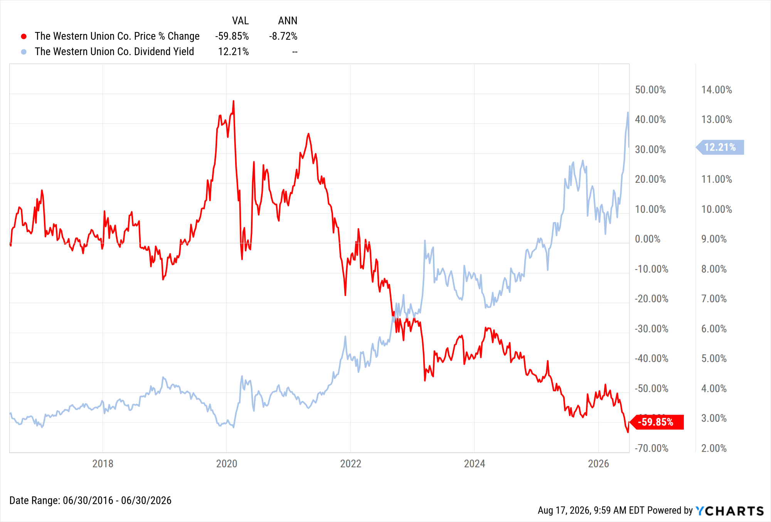
“A High Dividend Yield Indicates a Safe Investment” (cont.)
Some investors perceive high dividend yields as indicators of secure investments. However, elevated yields can sometimes signal underlying company challenges, potentially affecting long-term stability.
Dividend yields by nature lend themselves to denominator bias, a stock's price falling elevates the dividend yield.
For example, Western Union (WU) shows a high current yield paired with a significant long-term decline in total return, reinforcing the risks of relying solely on dividend yields as an indicator of investment safety.
View & Modify in YCharts →

Slide 21
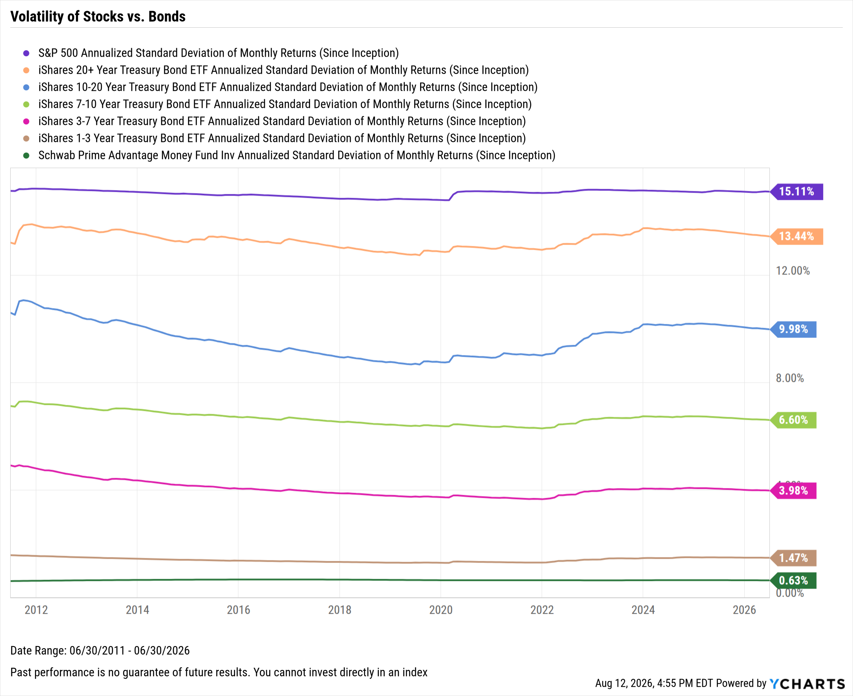
“Bonds are Risk-Free Investments”
Bonds are not entirely risk-free; they can be affected by inflation, interest-rate, and default risks.
Bonds vary significantly in risk depending on their maturity (as illustrated by standard deviation), with longer-term bonds exhibiting higher volatility compared to shorter-term bonds.
While bonds generally have lower volatility than stocks, they are not entirely risk-free.
Cash remains the least volatile asset, but its returns are minimal, highlighting the trade-off between risk and potential reward.
View & Modify in YCharts →

Slide 22
YCharts is not registered with the U.S. Securities and Exchange Commission (or with the securities regulatory authority or body of any state or any other jurisdiction) as an investment adviser, broker-dealer or in any other capacity, and does not purport to provide investment advice or make investment recommendations by or through the Content found on the Site or otherwise. The Site and the Content are provided for the sole purpose of enabling you to conduct investment research. Other uses of the Site and the Content are expressly prohibited. Full disclosure: https://ycharts.com/about/disclosure
Help your clients
invest smarter with
insights from YCharts.
Book a Demo
Start a Free Trial

