Slide 1
June 2025:
Fund Flows
Visuals Recap
Published July 2025

Slide 2
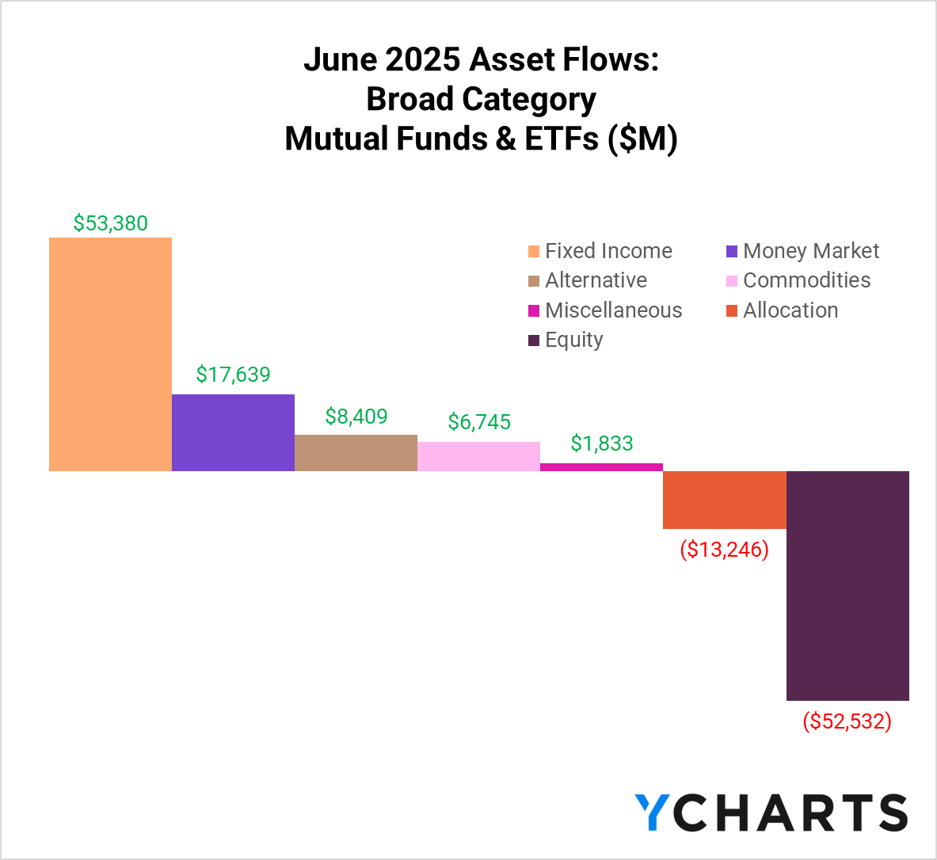

Slide 3
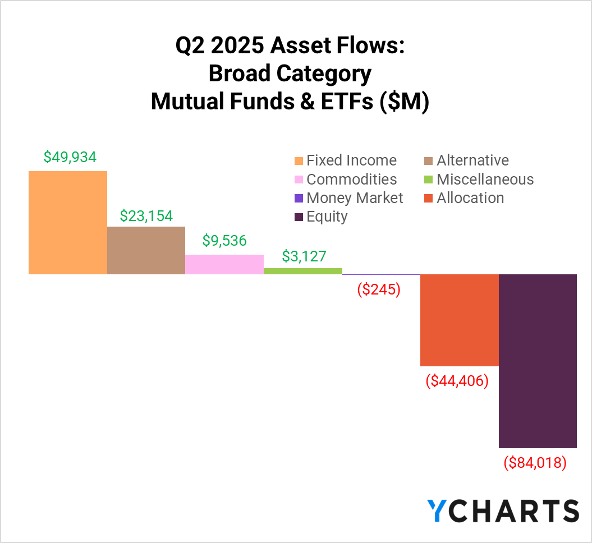

Slide 4
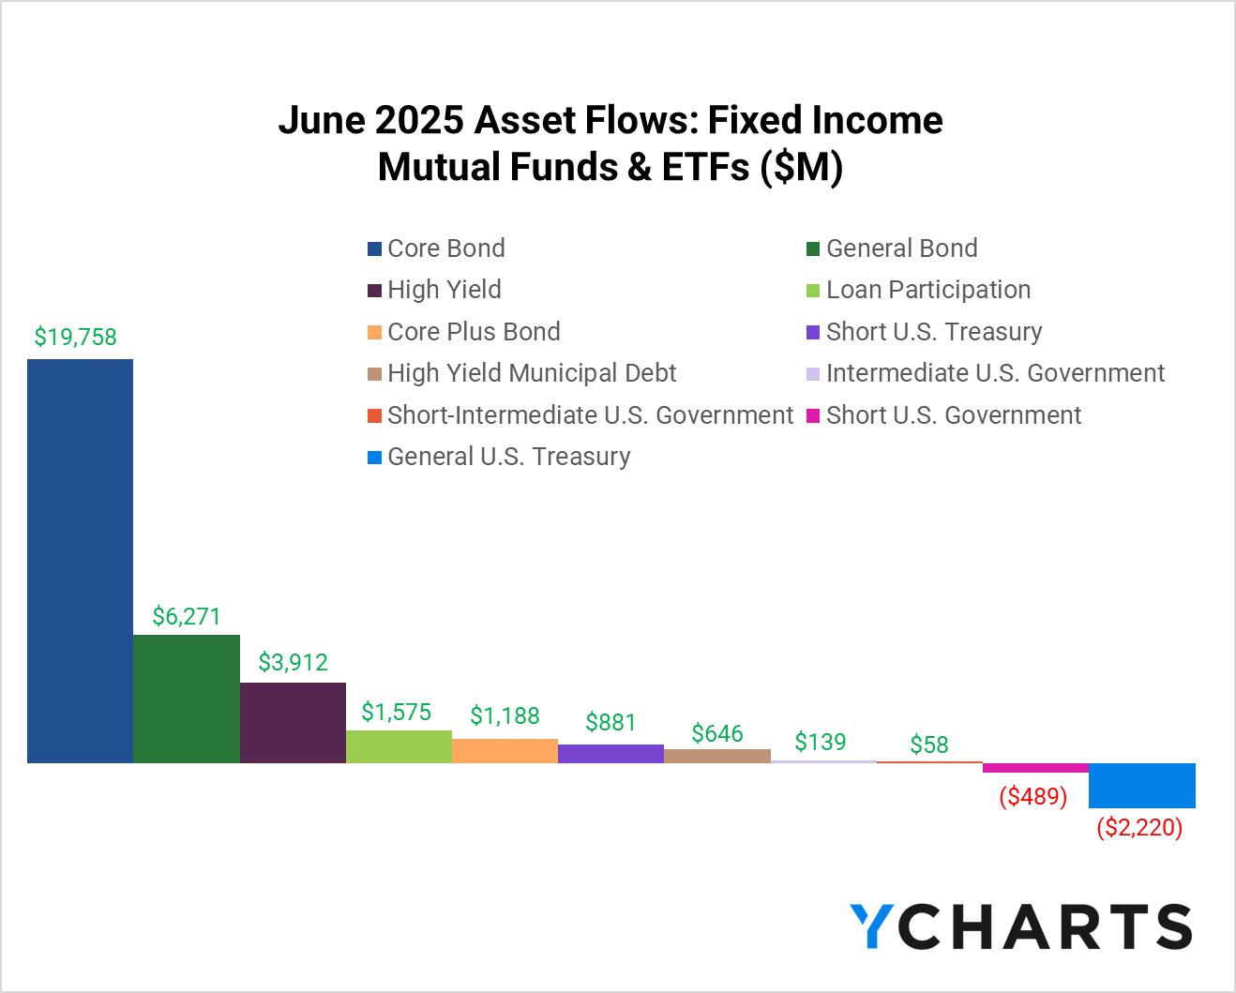

Slide 5
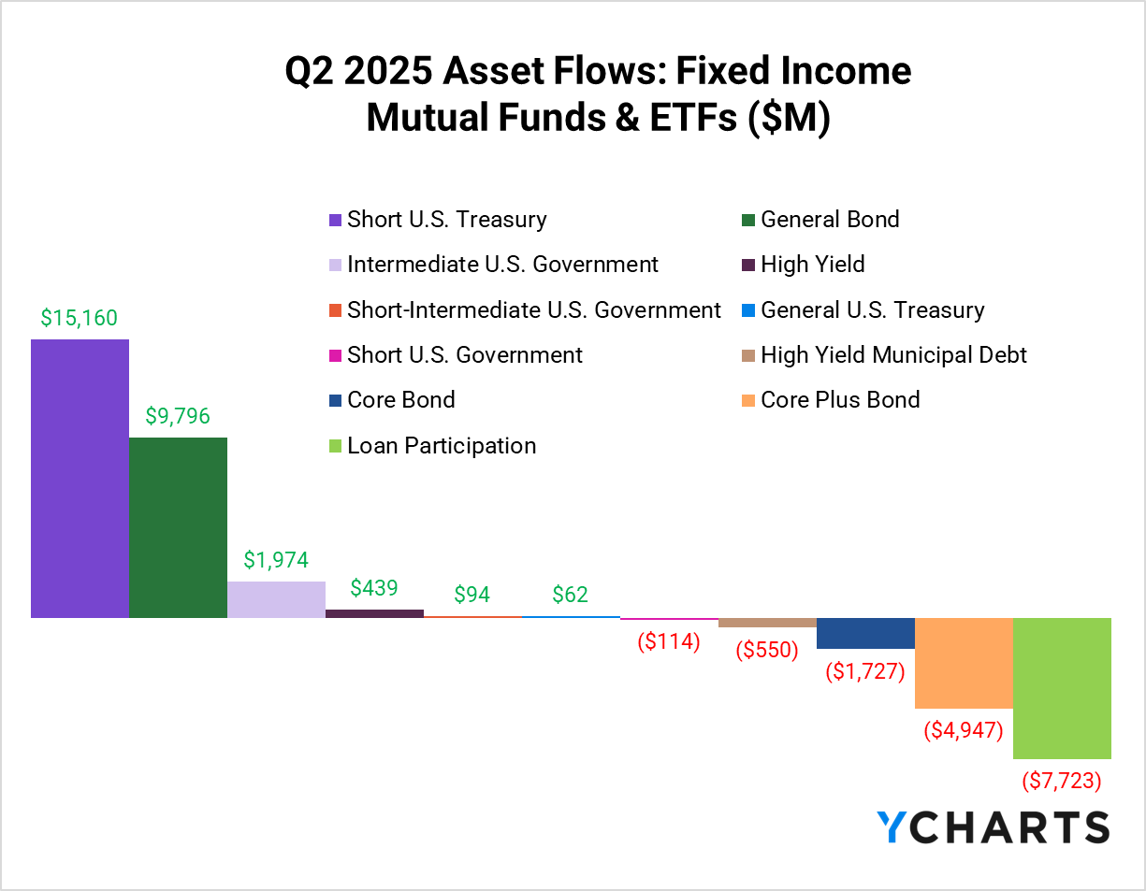

Slide 6
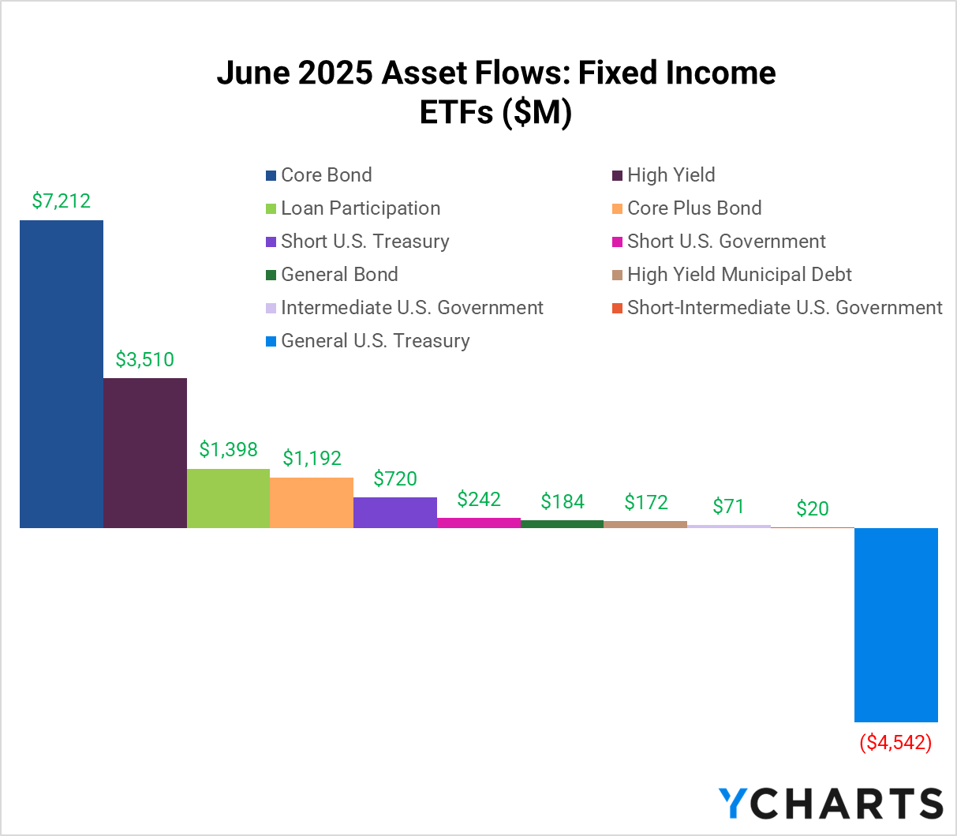

Slide 7
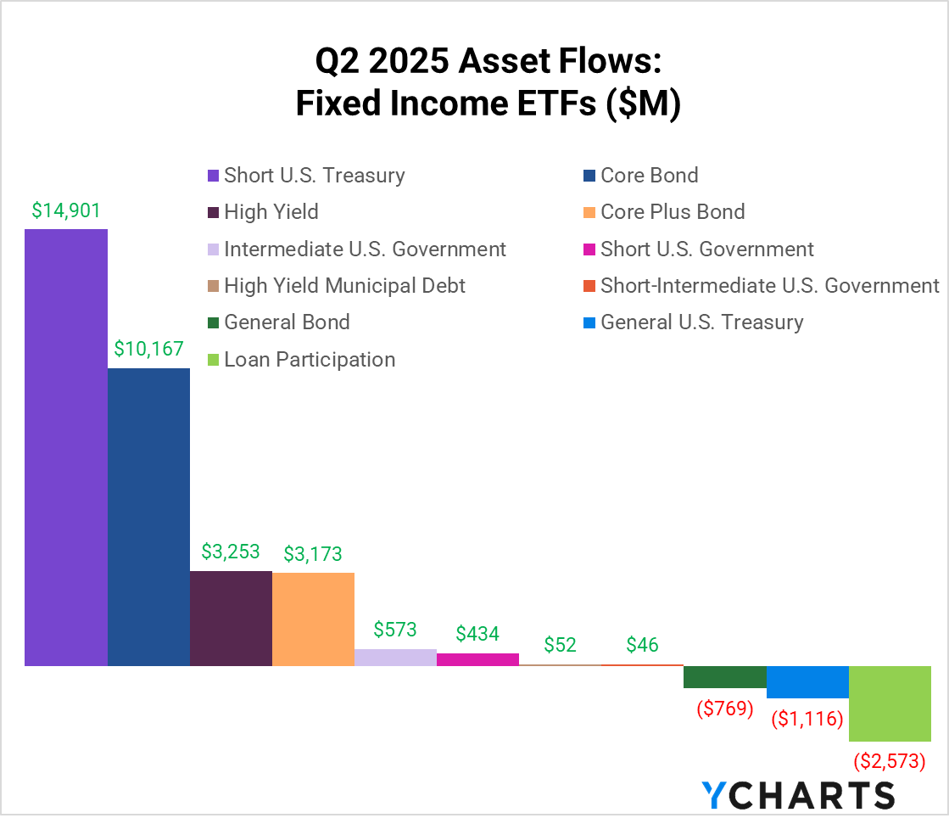

Slide 8
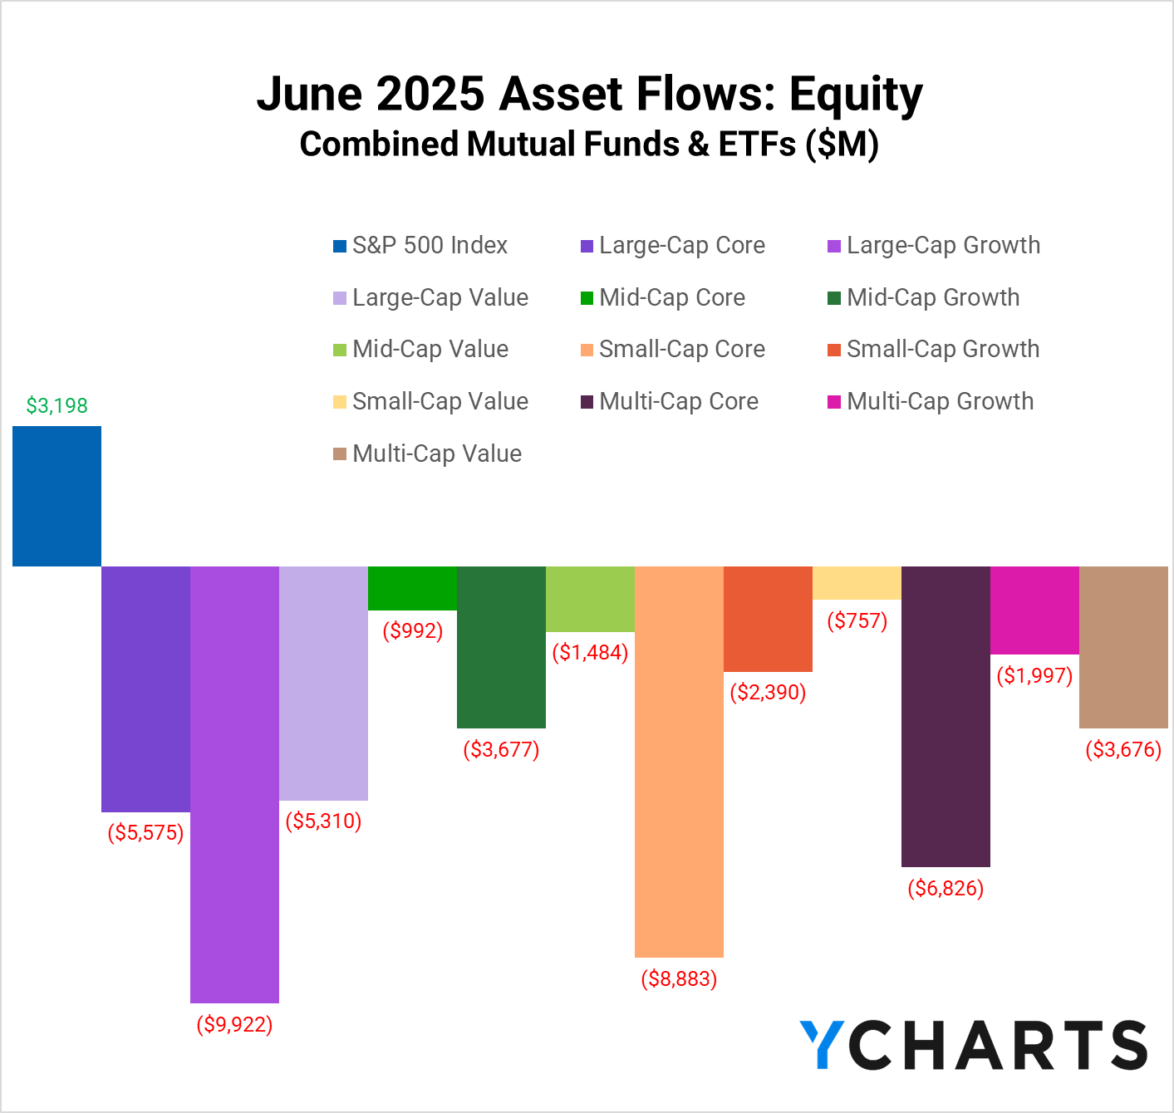

Slide 9
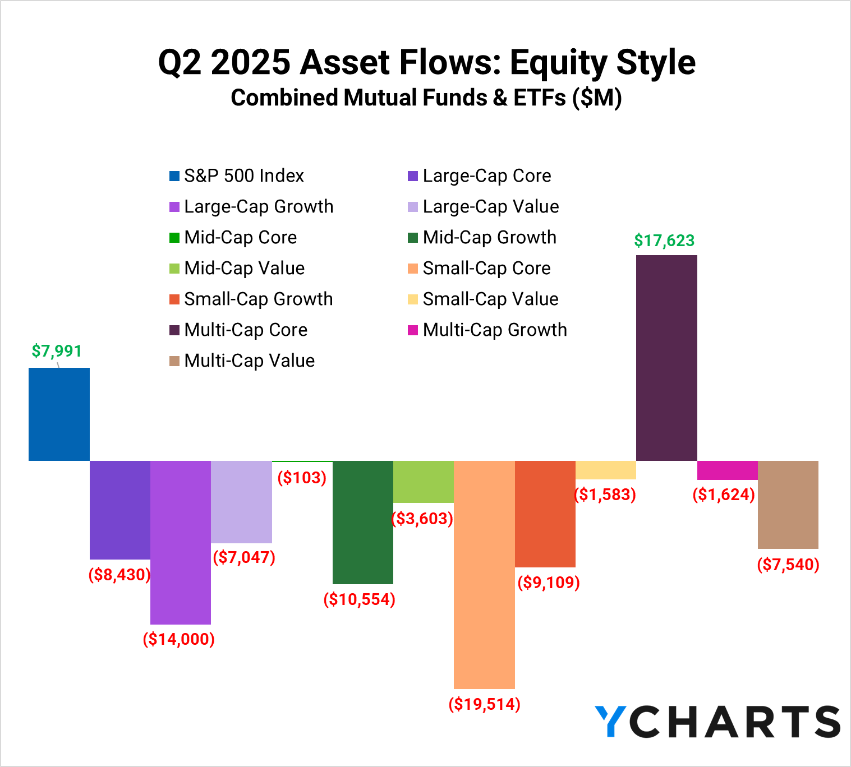

Slide 10
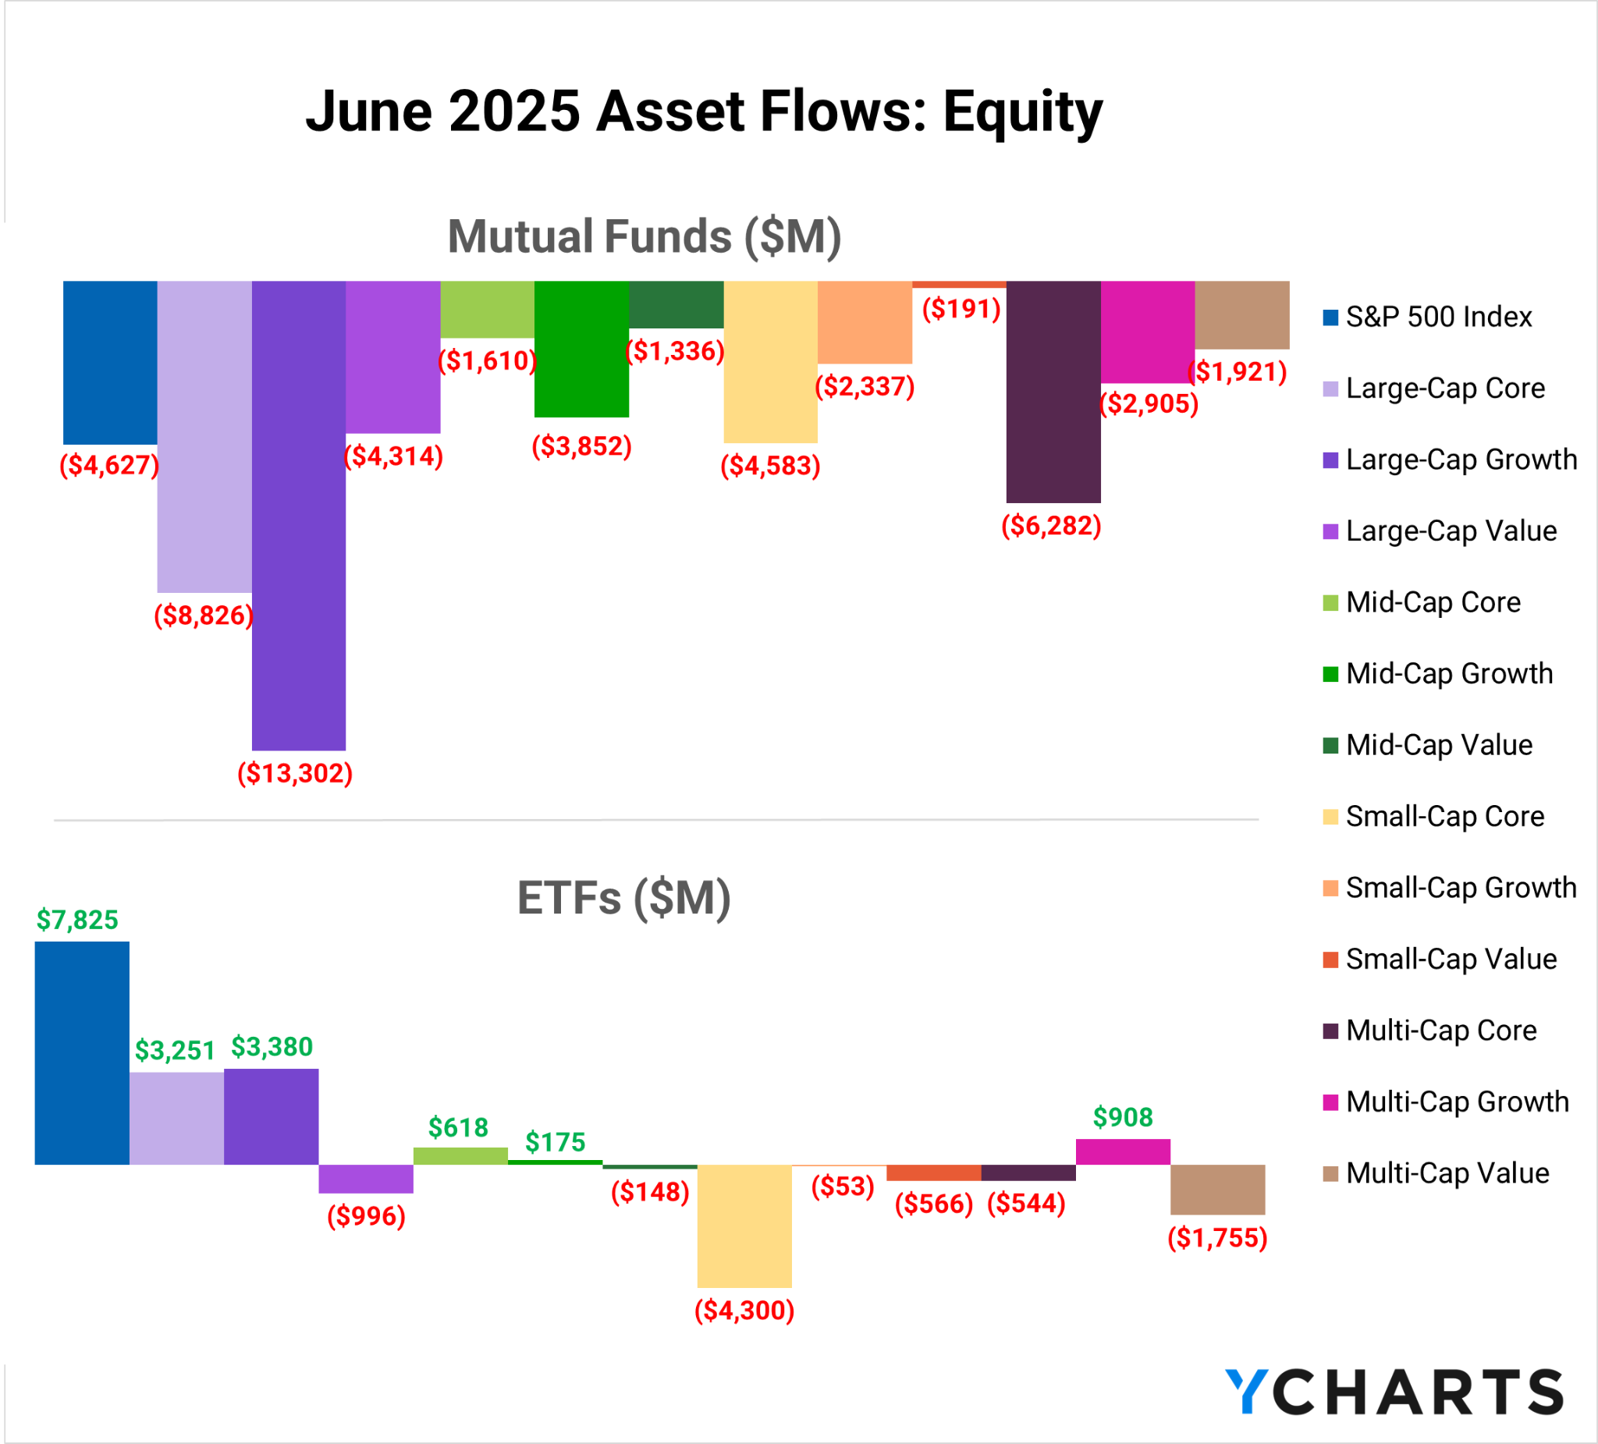

Slide 11
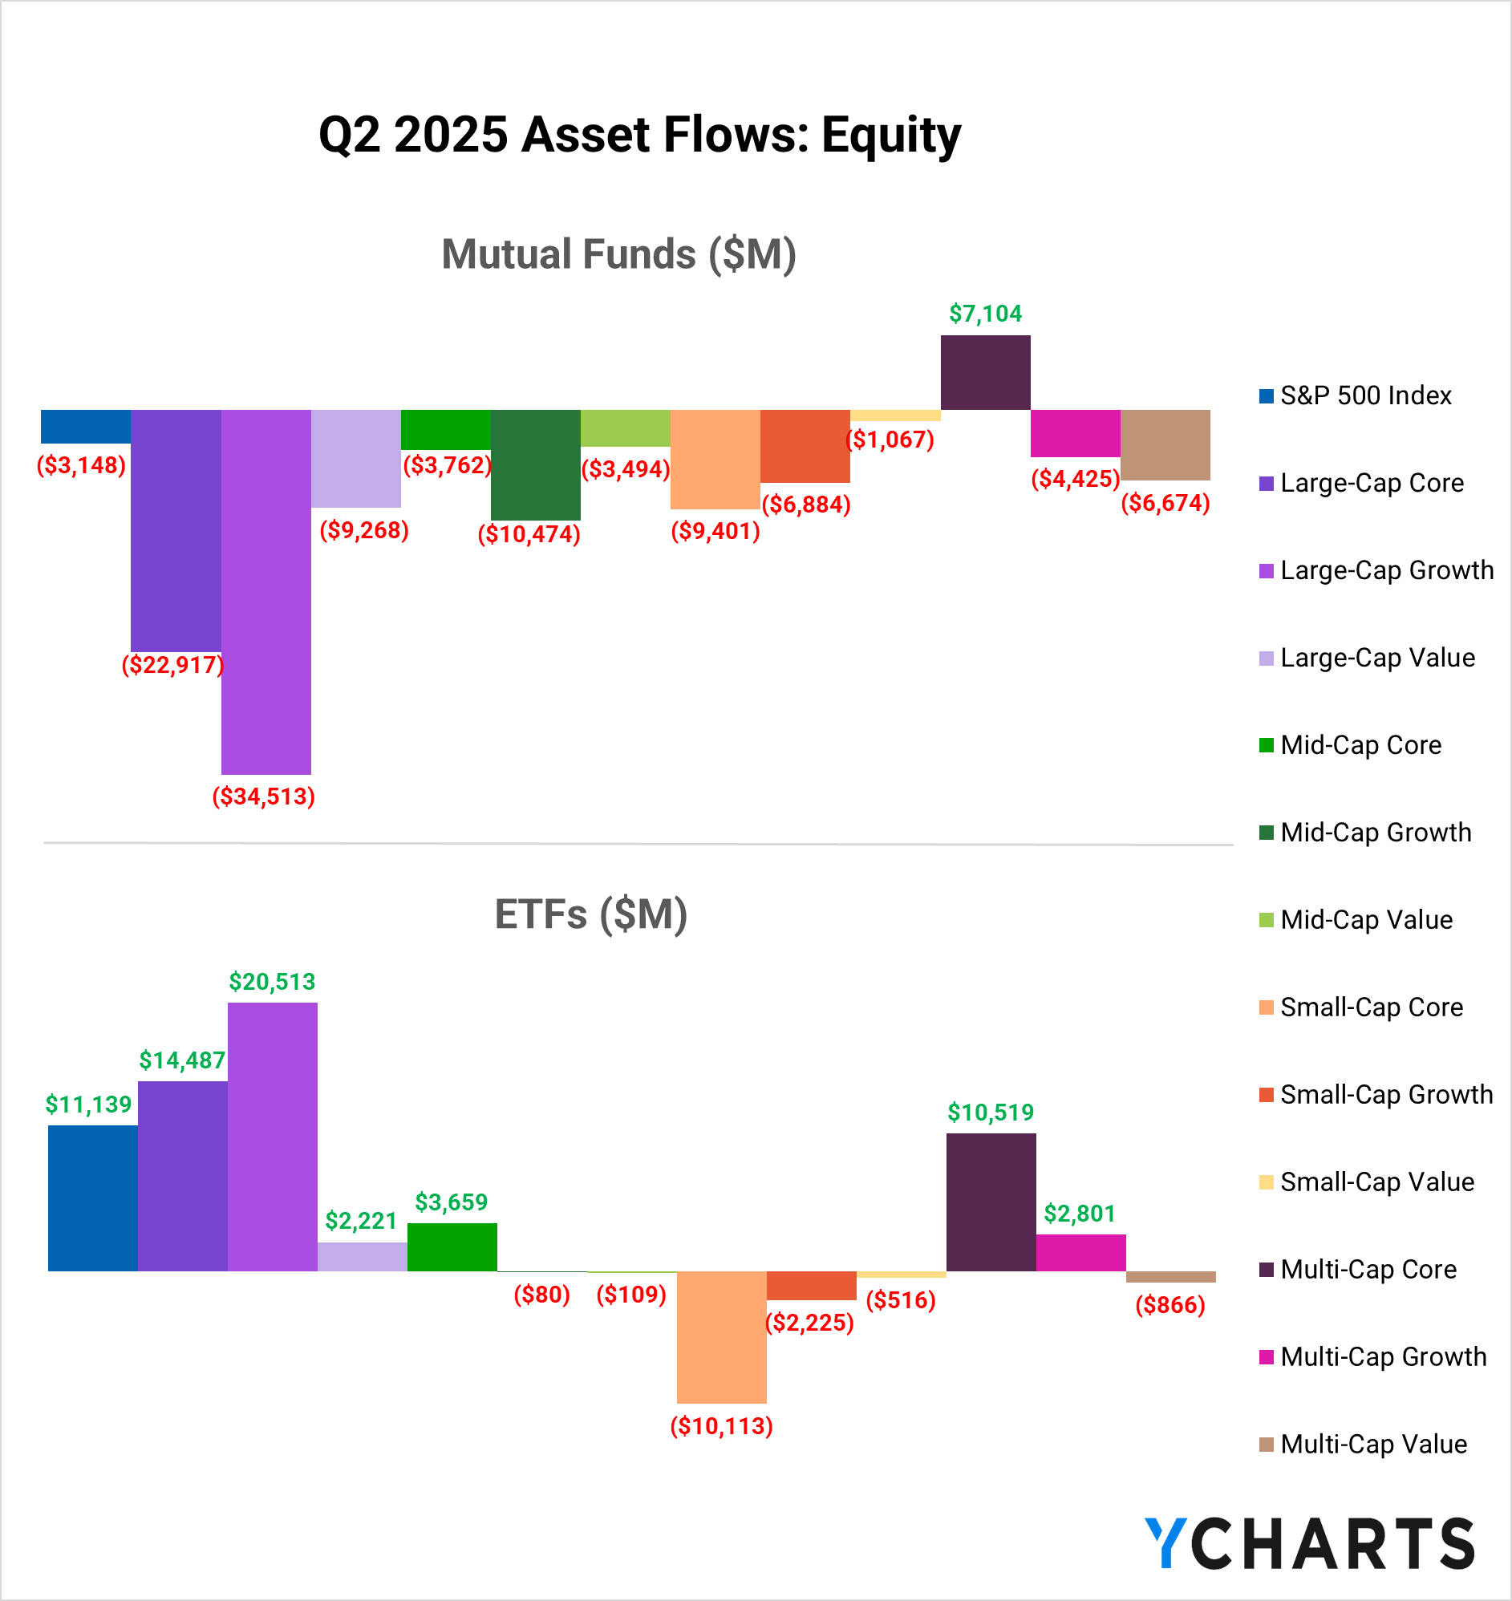

Slide 12
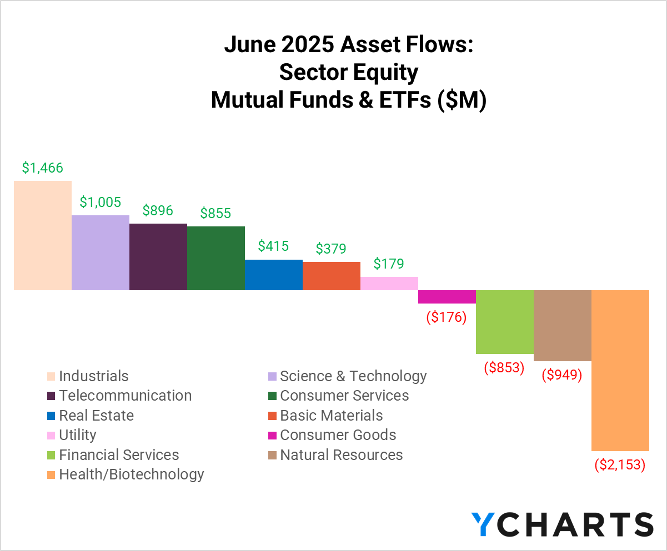

Slide 13
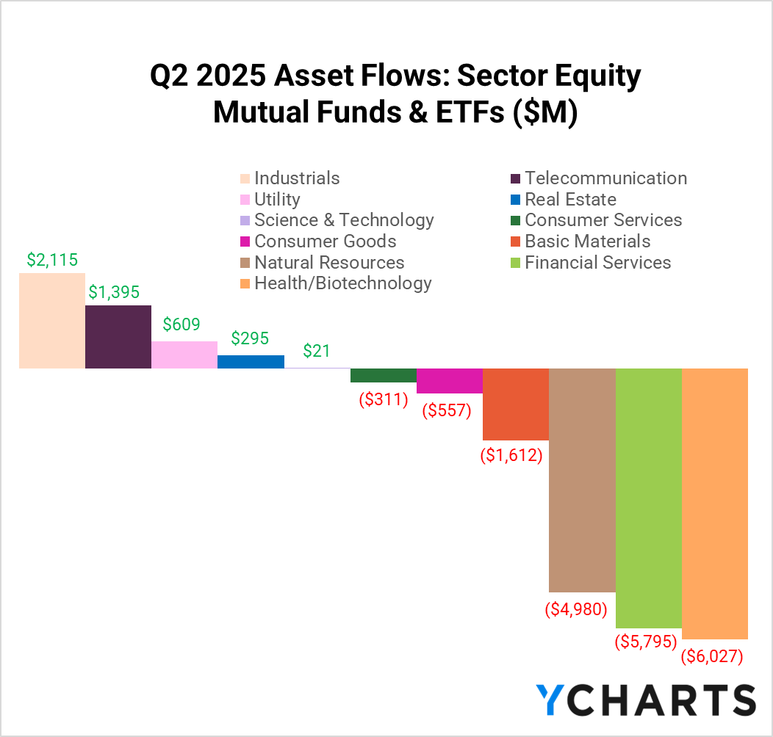

Slide 14
Other Client Resources
Subscribe to receive the latest monthly fund flows report sent directly to your inbox here: https://go.ycharts.com/fund-flows-opt-in
For previous period fund flows, check out the Fund Flows Report Library: https://ycharts.com/insights-and-visuals#fund_flow_reports

