Slide 1


Monthly Market Wrap
July 2026

Slide 2

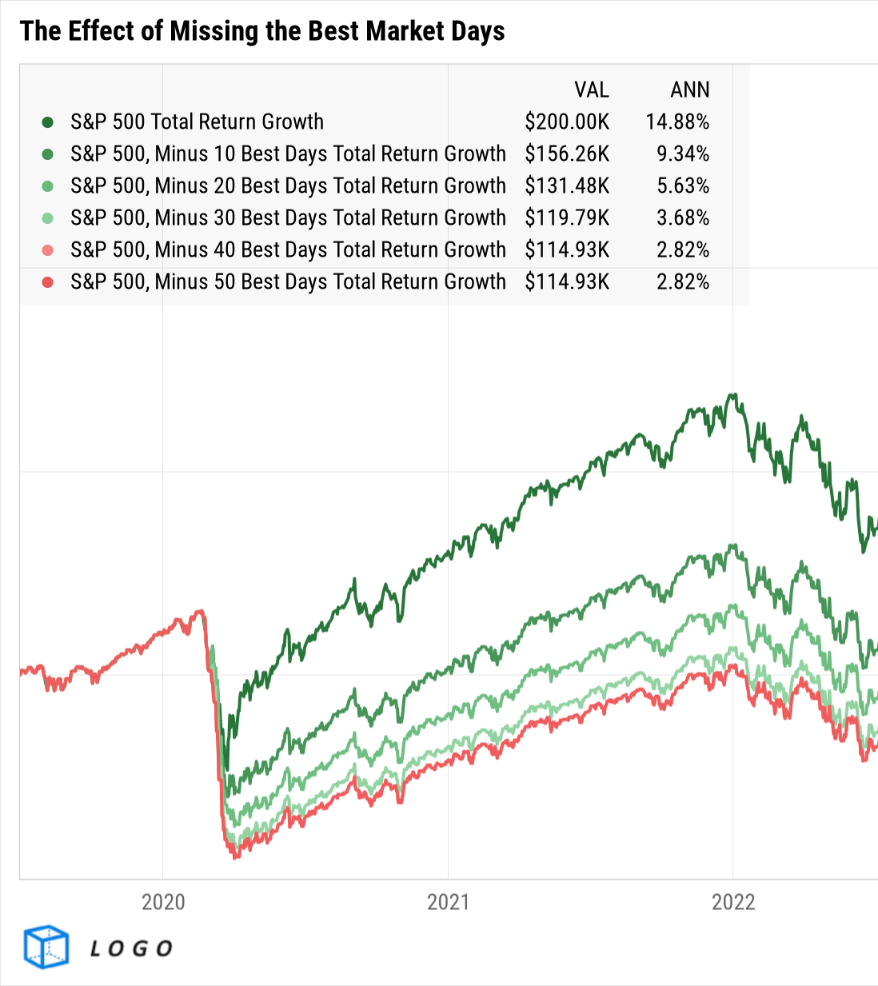



About this deck:
Use these visuals about important investing concepts in your own presentations; share with clients, prospects, colleagues, or followers online! Looking for a PDF version of this deck? Download it here.
If you’ve uploaded a logo to YCharts, all visuals in YCharts will appear with that logo.
Not yet a YCharts user? Get started today:
Start a Free Trial
Book a Demo
YCharts clients: have your
firm logo added to all charts!
Released August 4, 2026
Notes:
→ Don’t forget to expand and leverage the commentary provided in the speaker notes section for more details on each slide!

Slide 3

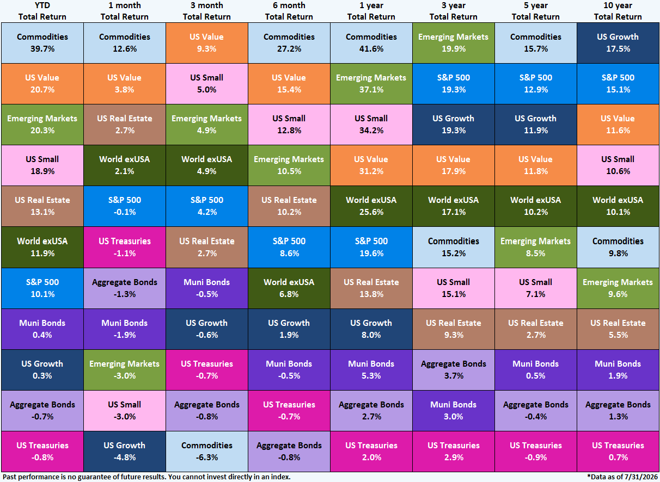
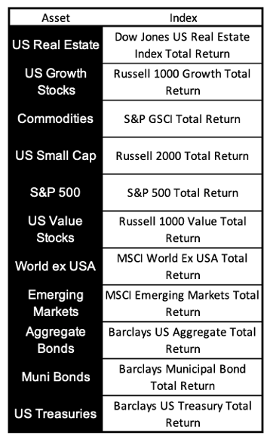
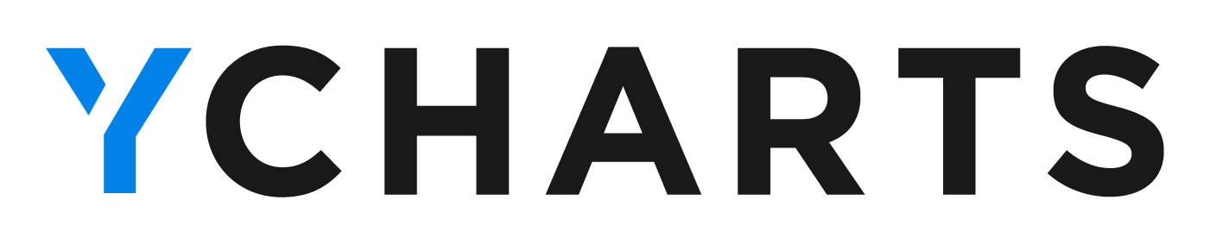
Asset Class Performance

Slide 4
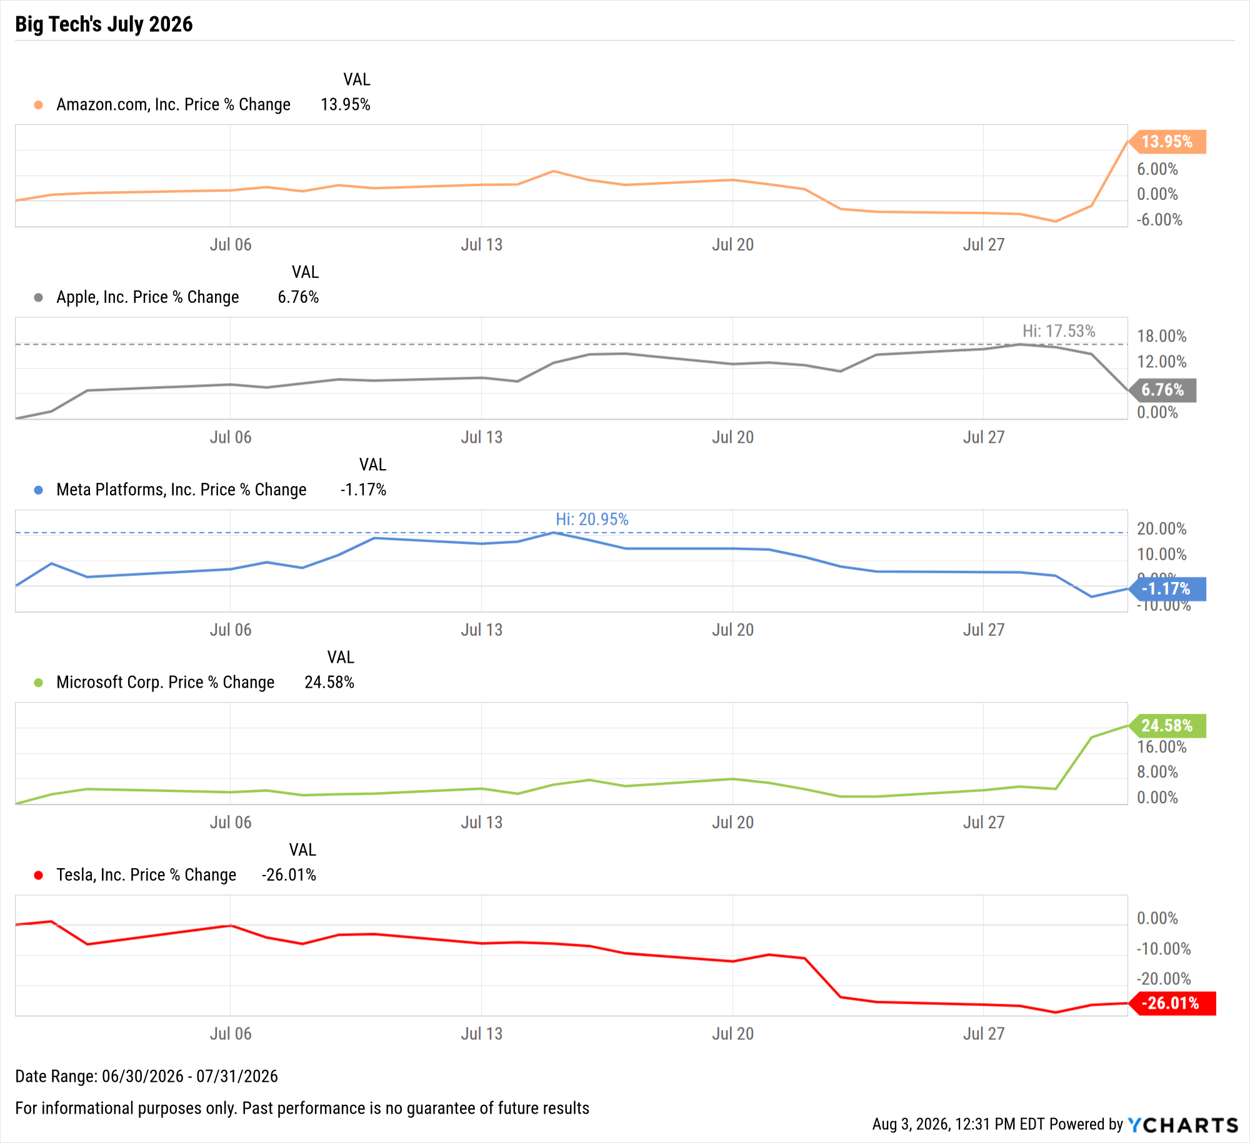
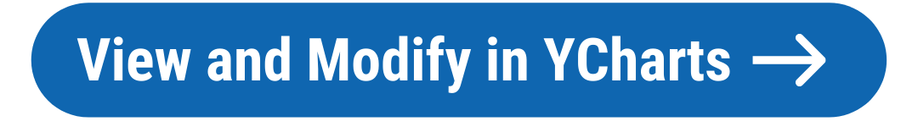
Off the YCharts! Big Tech’s Volatile July 2026
Notes:
July was a big month for Q2 earnings, and at the forefront of this earnings season were the quarterly reports from some of the largest public companies.
Below are the one-month performances of five of the largest companies in July, further illustrating how the slew of big tech earnings reports in the final week of July contributed to performance volatility:
Amazon (AMZN): +14%
Apple (AAPL): +6.8% (rose as high as 17.5%)
Meta Platforms (META): -1.2% (rose as high as 21.0%)
Microsoft (MSFT): +24.6%
Tesla (TSLA): -26.0%

Slide 5
Equity Performance
Charts and tables highlighting the performance of stock market indices, sectors, and individual securities
Notes:
Markets posted mixed results in July. International Developed Markets rose 2%, while Emerging Markets fell 3% in the opposite direction. The blue-chip Dow Jones Industrial Average logged a 0.4% increase, the S&P 500 was off a slight 0.1%, and the tech-heavy Nasdaq was the largest laggard for the second straight month, slipping 3.2% in July.
Sector performance was split rather evenly for the second consecutive month, with six of the eleven sectors ending the month higher. Energy led with a 12.1% gain, followed by Financials up 6.2% and Health Care rising 2.5%. Technology was the largest laggard in July, slipping 8%.

Slide 6
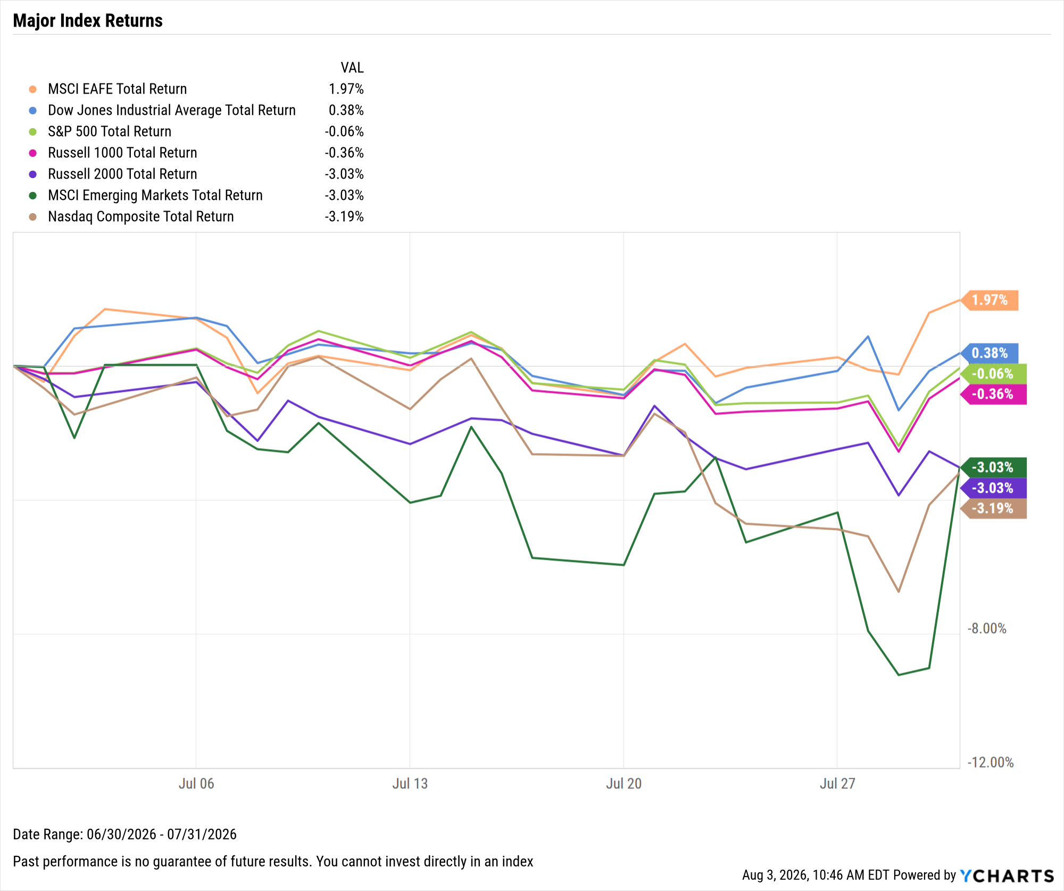
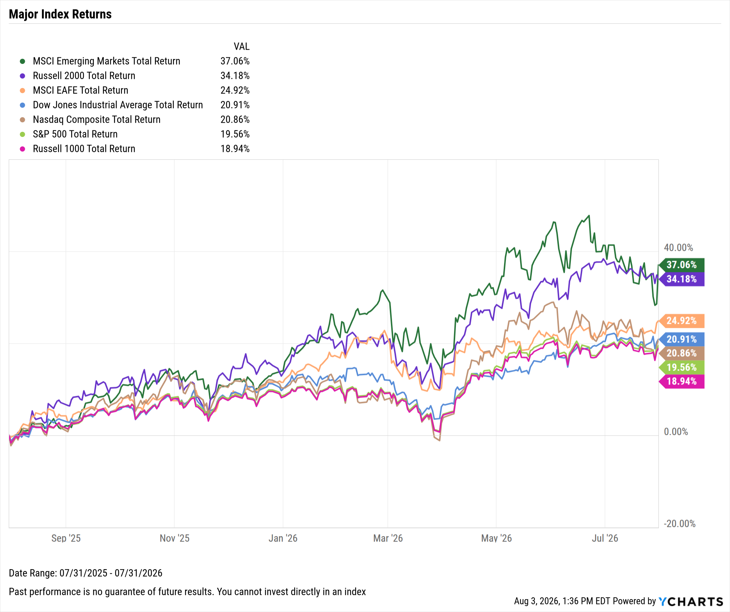
Key Stock Market Index Performance
July 2026:
EAFE Leads with 2% gain; Russell 2K, Nasdaq down 3%
Trailing Twelve Months (TTM):
Emerging Markets lead with 37.1% gain, Dow up 20.9%
Notes:
1M Returns:
Developed Markets: 1.97%
Dow Jones: 0.38%
S&P 500: -0.06%
Russell 1000: -0.36%
Russell 2000: -3.03%
Emerging Markets: -3.03%
Nasdaq: -3.19%

Slide 7
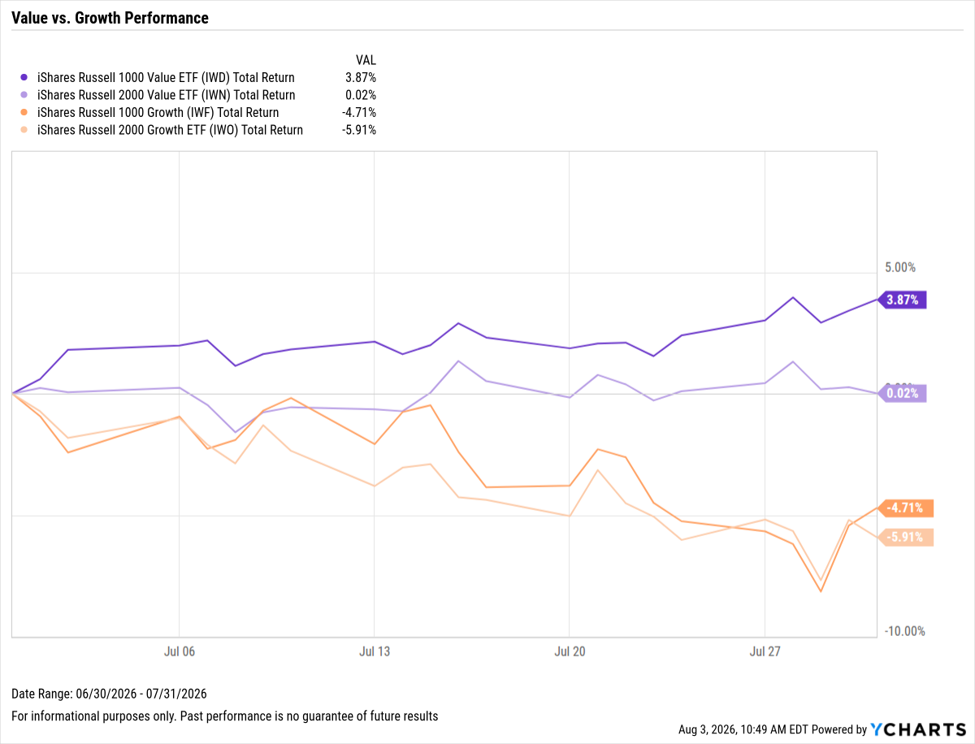
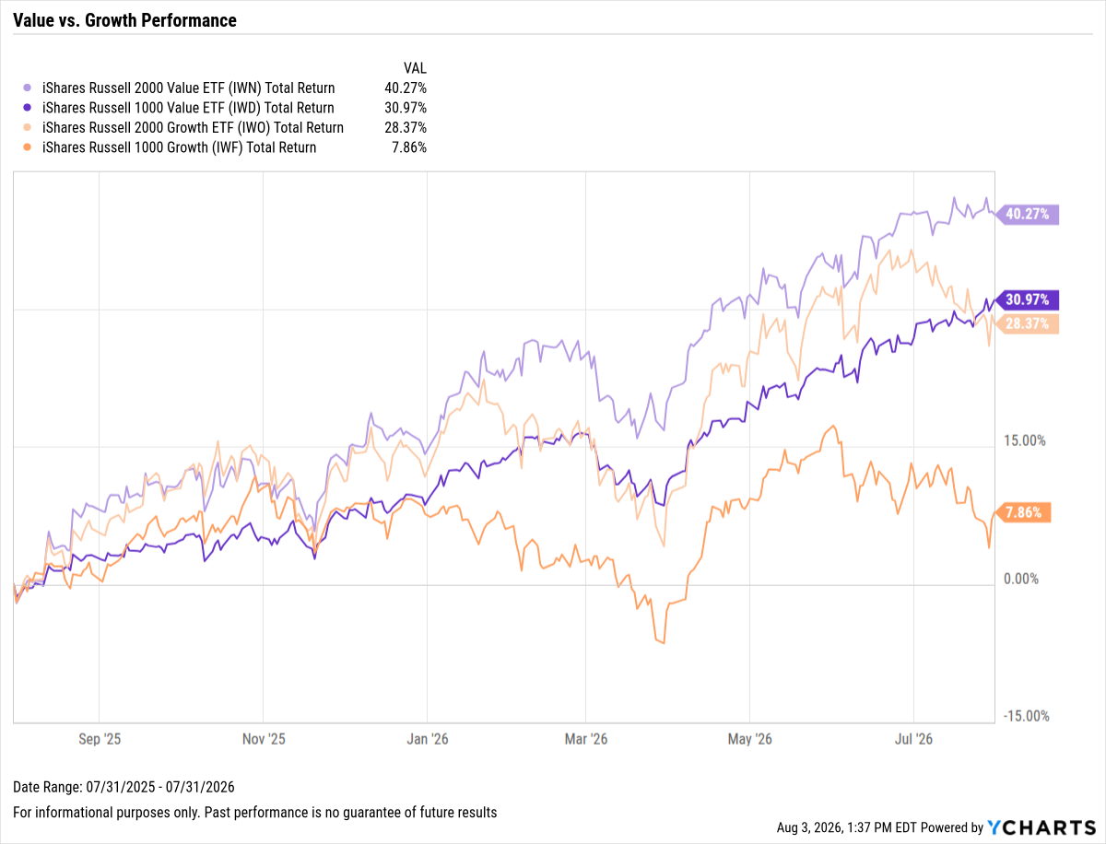
Value vs. Growth Performance
July 2026:
Large-cap Value leads with 3.9% gain, Large-Cap Growth and Small-Cap Growth slump 4.7% and 5.9% respectively
Trailing Twelve Months (TTM):
Small-cap Value leads up 40.3%, Large-cap Growth’s gain of 7.9% is a relative lag
Notes:
1M Returns:
Large-Cap Value 1-Month: 3.87%
Small-Cap Value 1-Month: 0.02%
Large-Cap Growth 1-Month: -4.71%
Small-Cap Growth 1-Month: -5.91%

Slide 8
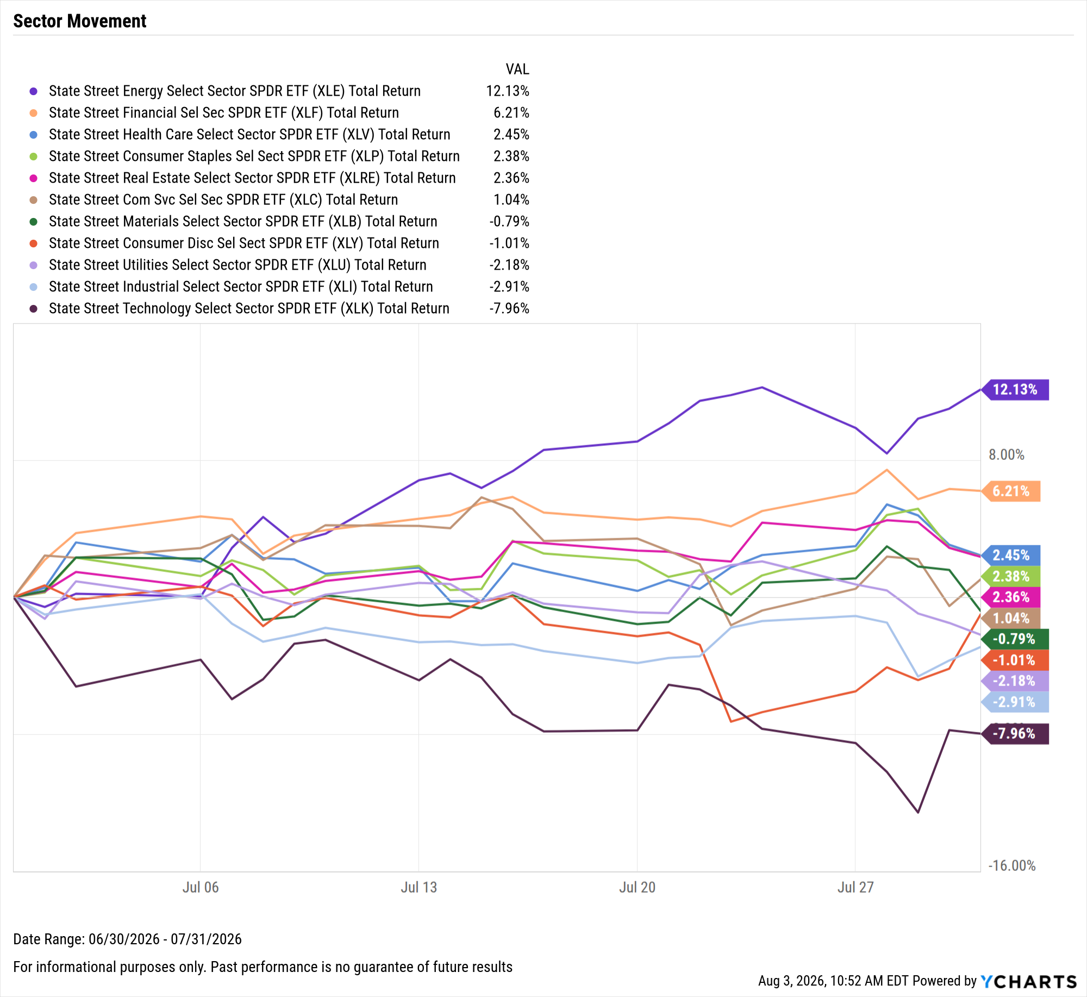
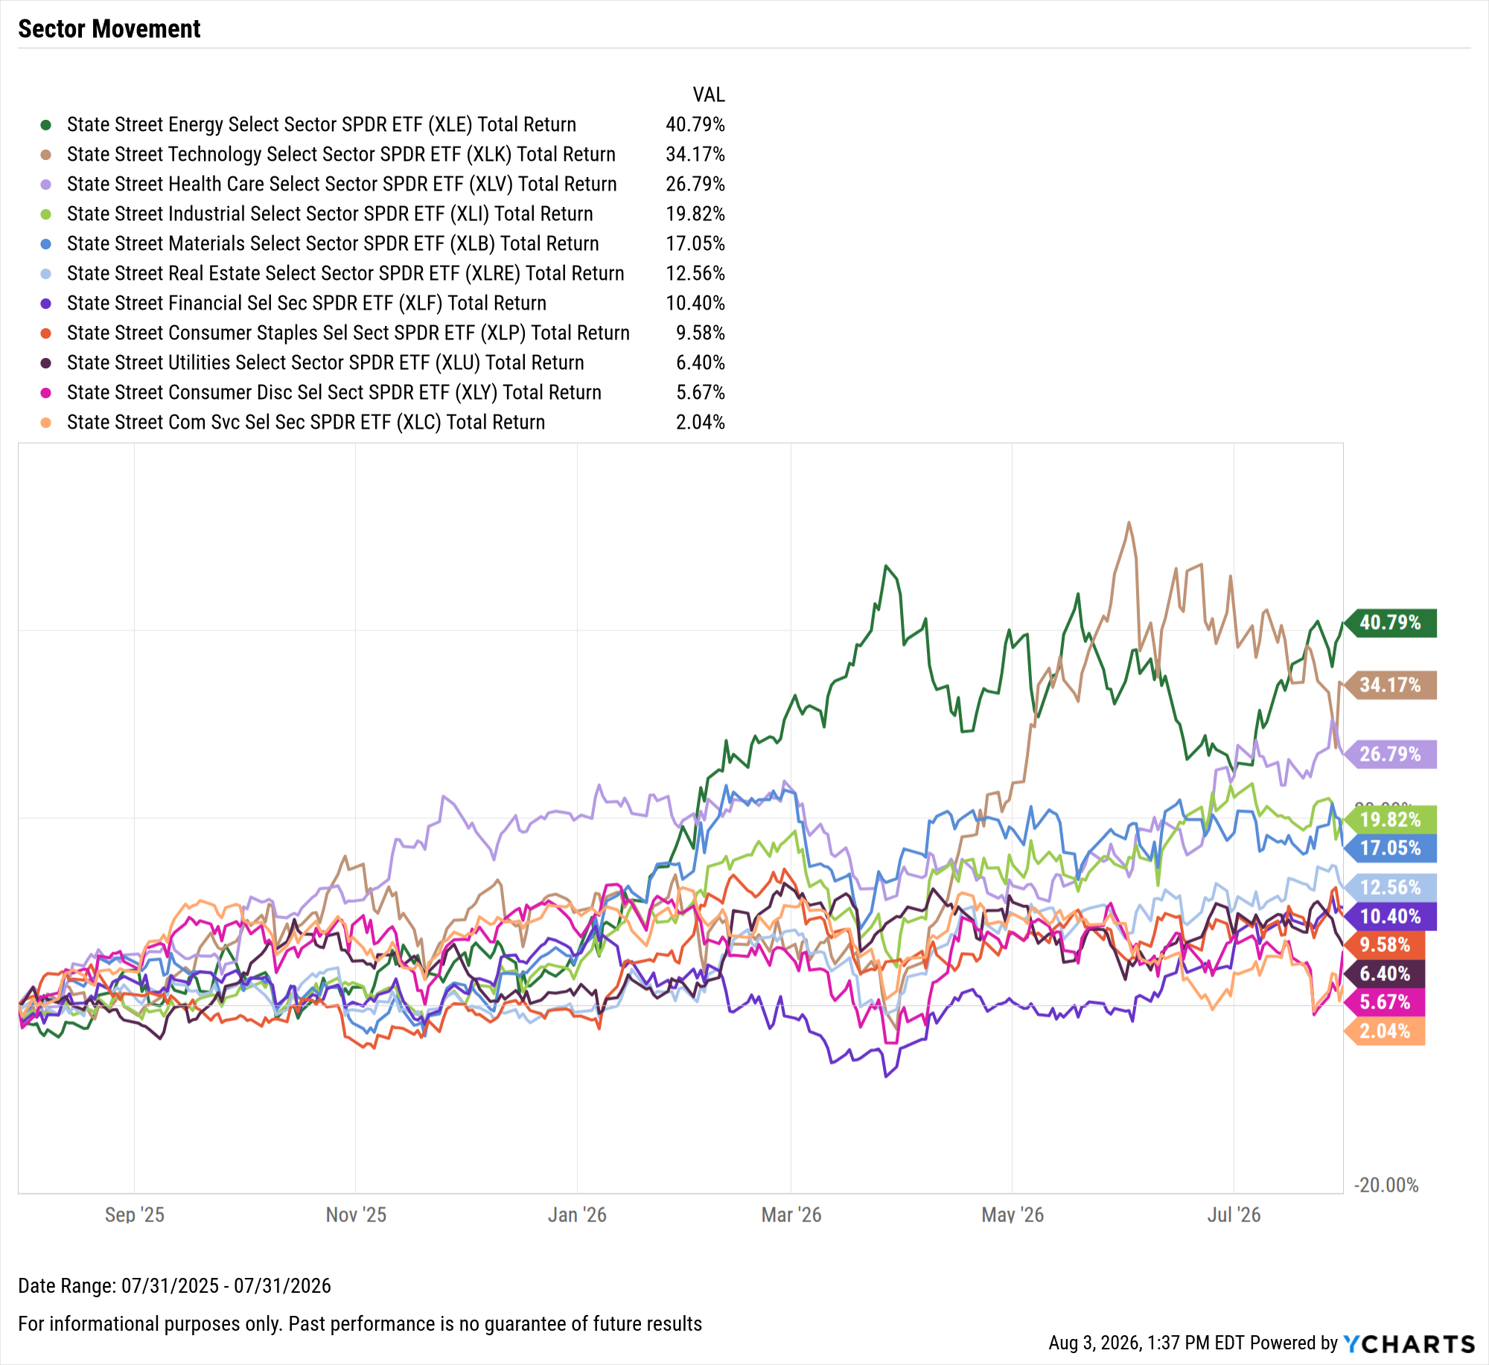
Domestic Sector Performance
July 2026:
Energy soars 12.1%, Tech lags with 8% decline
Trailing Twelve Months (TTM):
All eleven sectors higher, Energy leads with 40.8% gain
Notes:
1M Returns:
Energy: 12.13%
Financials: 6.21%
Health Care: 2.45%
Consumer Staples: 2.38%
Real Estate: 2.36%
Communication Services: 1.04%
Materials: -0.79%
Consumer Discretionary: -1.01%
Utilities: -2.18%
Industrials: -2.91%
Technology: -7.96%

Slide 9
Best-Performing S&P 500 Stocks of the Month
Ticker | Name | July Price Returns | YTD Price Returns | Industry | Sector
CTSH | Cognizant Technology Solutions | ▲ 42.9% | ▼ -33.3% | IT Services | Information Technology
ACN | Accenture Plc | ▲ 33.3% | ▼ -38.2% | IT Services | Information Technology
PYPL | PayPal Holdings, Inc. | ▲ 32.5% | ▼ -2.0% | Financial Services | Financials
WDAY | Workday, Inc. | ▲ 31.0% | ▼ -25.4% | Software | Information Technology
WTW | Willis Towers Watson Plc | ▲ 28.5% | ▲ 2.2% | Insurance | Financials
CBOE | Cboe Global Markets, Inc. | ▲ 27.8% | ▲ 23.6% | Capital Markets | Financials
PSX | Phillips 66 | ▲ 25.2% | ▲ 64.0% | Oil, Gas & Consumable Fuels | Energy
MSFT | Microsoft Corp. | ▲ 24.6% | ▼ -3.9% | Software | Information Technology
HPQ | HP, Inc. | ▲ 24.3% | ▲ 22.4% | Tech Hardware, Storage & Peripherals | Information Technology
DXCM | DexCom, Inc. | ▲ 23.9% | ▲ 25.7% | Health Care Equipment & Supplies | Health Care
Notes:
1M Returns:
Cognizant Technology Solutions Corp. (CTSH): 42.9%
Accenture Plc (ACN): 33.3%
PayPal Holdings, Inc. (PYPL): 32.5%
Workday, Inc. (WDAY): 31.0%
Willis Towers Watson Plc (WTW): 28.5%
Cboe Global Markets, Inc. (CBOE): 27.8%
Phillips 66 (PSX): 25.2%
Microsoft Corp. (MSFT): 24.6%
HP, Inc. (HPQ): 24.3%
DexCom, Inc. (DXCM): 23.9%

Slide 10
Worst-Performing S&P 500 Stocks of the Month
Ticker | Name | July Price Returns | YTD Price Returns | Industry | Sector
SNDK | Sandisk Corp. | ▼ -46.6% | ▲ 411.8% | Tech Hardware, Storage & Peripherals | Information Technology
GLW | Corning, Inc. | ▼ -45.9% | ▲ 57.9% | Electronic Equipment, Instruments, Components | Information Technology
KLAC | KLA Corp. | ▼ -39.4% | ▲ 50.5% | Semiconductors & Semi. Equipment | Information Technology
MRVL | Marvell Technology, Inc. | ▼ -37.0% | ▲ 120.7% | Semiconductors & Semi. Equipment | Information Technology
INTC | Intel Corp. | ▼ -35.4% | ▲ 144.4% | Semiconductors & Semi. Equipment | Information Technology
COHR | Coherent Corp. | ▼ -33.4% | ▲ 42.4% | Electronic Equipment, Instruments, Components | Information Technology
GNRC | Generac Holdings, Inc. | ▼ -32.7% | ▲ 44.5% | Electrical Equipment | Industrials
LRCX | Lam Research Corp. | ▼ -32.4% | ▲ 71.2% | Semiconductors & Semi. Equipment | Information Technology
FLEX | Flex Ltd. | ▼ -29.8% | ▲ 88.3% | Electronic Equipment, Instruments, Components | Information Technology
AMAT | Applied Materials, Inc. | ▼ -29.8% | ▲ 97.5% | Semiconductors & Semi. Equipment | Information Technology
Notes:
1M Returns:
Sandisk Corp. (SNDK): -46.6%
Corning, Inc. (GLW): -45.9%
KLA Corp. (KLAC): -39.4%
Marvell Technology, Inc. (MRVL): -37.0%
Intel Corp. (INTC): -35.4%
Coherent Corp. (COHR): -33.4%
Generac Holdings, Inc. (GNRC): -32.7%
Lam Research Corp. (LRCX): -32.4%
Flex Ltd. (FLEX): -29.8%
Applied Materials, Inc. (AMAT): -29.8%

Slide 11
Economic Data
Select charts and data highlighting the major economic events of the past month
Notes:
Oil prices shot higher in July after plummeting in June. The price of Brent crude soared 30.3% in July to $91.82 per barrel, while WTI ended July up 19.4% to finish the month at $84.25. Mortgage rates logged incremental increases in July as inflation reversed course after three consecutive monthly increases.

Slide 12
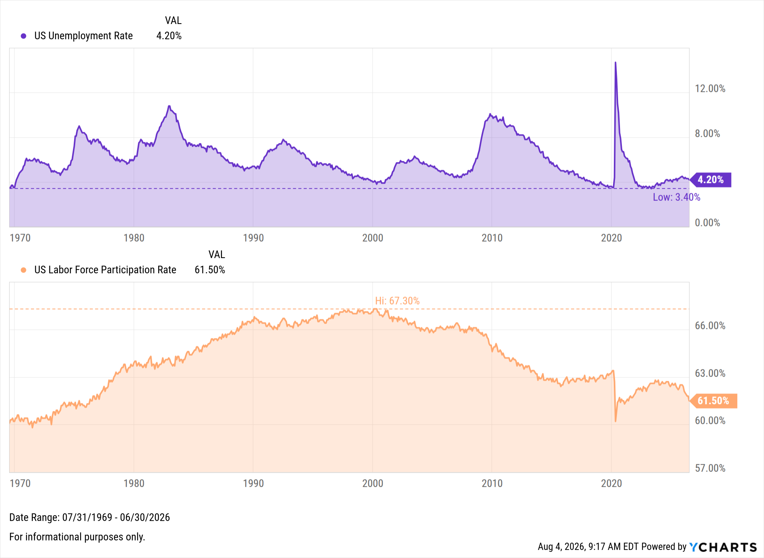
Employment
Notes:
The unemployment rate ticked down 0.1 percentage point to 4.2% in June, the lowest level in one year, and the U.S. economy added 57,000 jobs according to the most recent nonfarm payrolls report, well below the Dow Jones consensus forecast of 115,000. The US Labor Force Participation Rate decreased another 0.3 percentage points to 61.50% in June, reaching a five-year low.

Slide 13
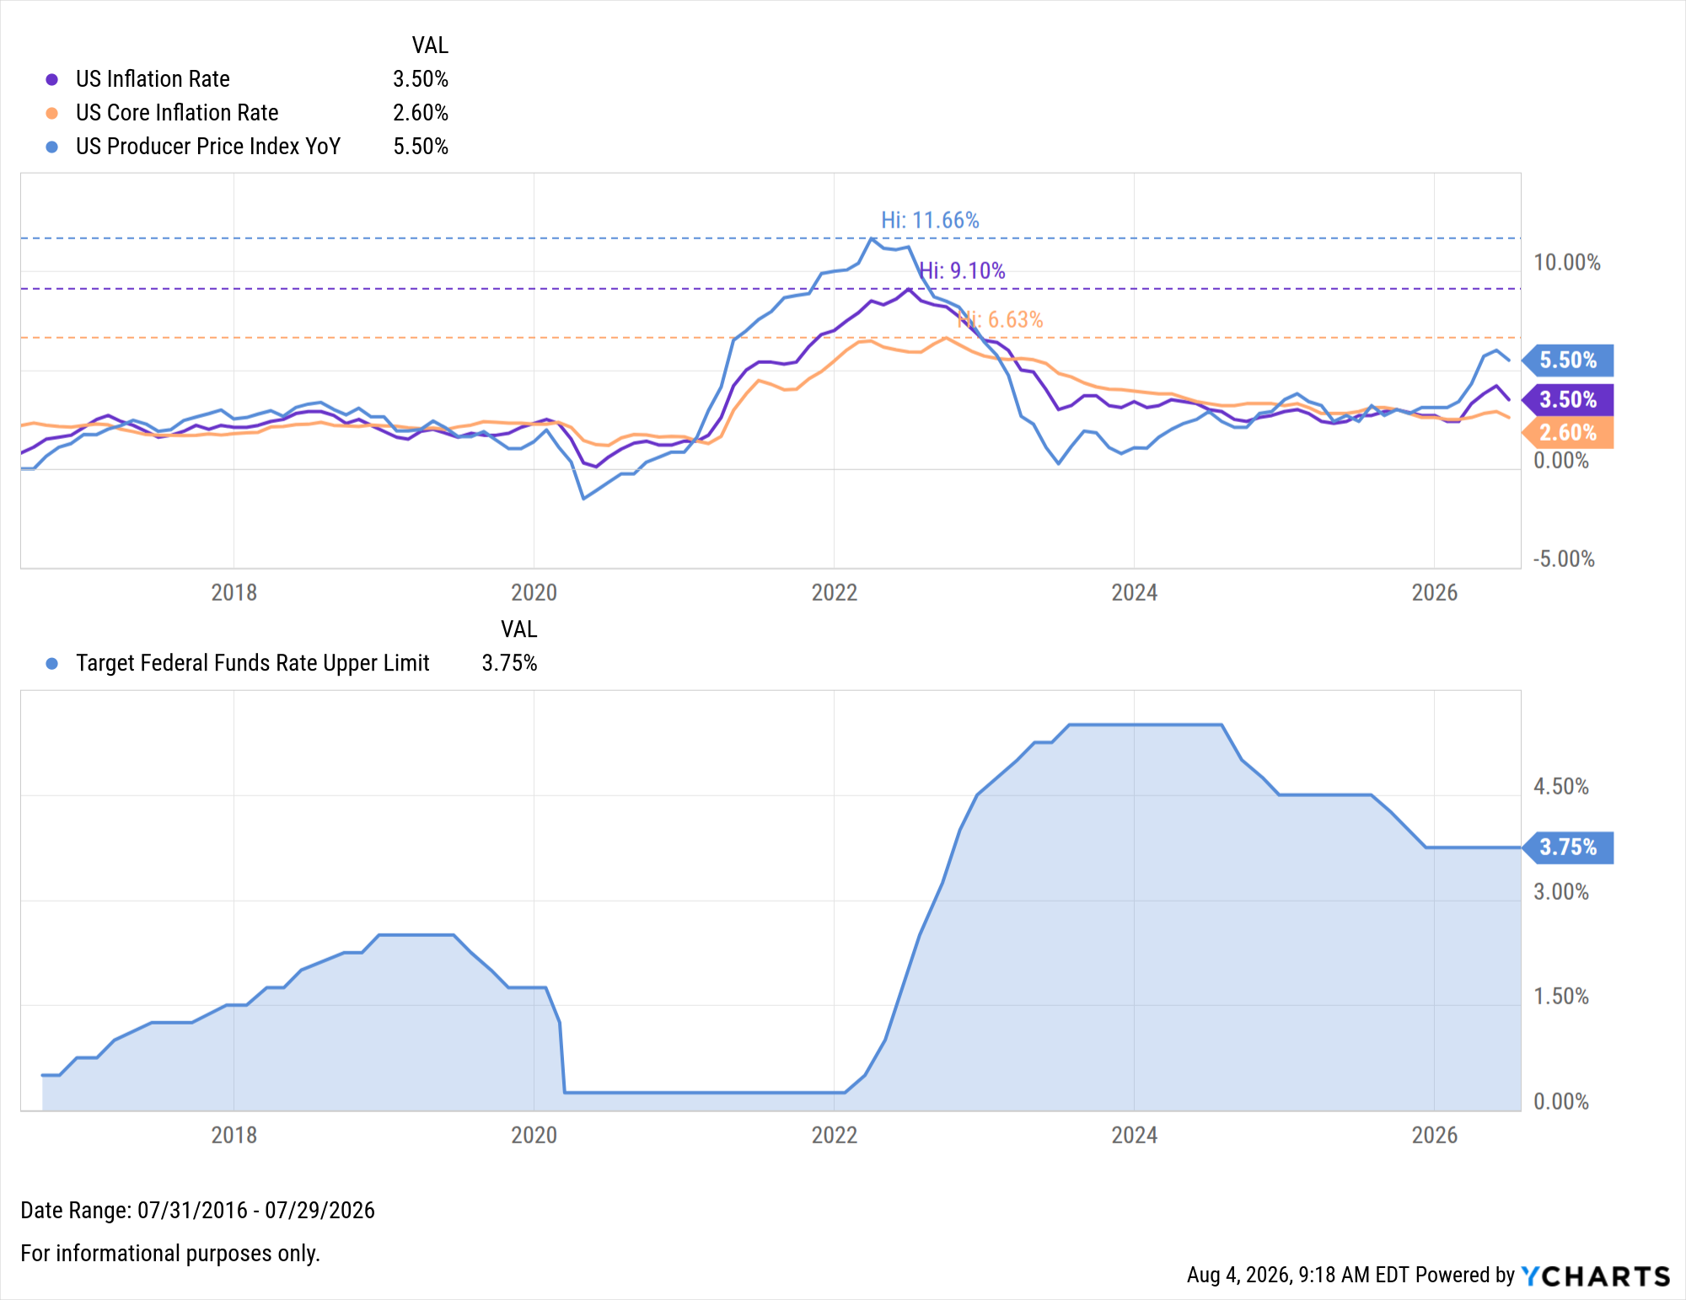
Inflation vs. Fed Funds Rate
Notes:
The US inflation rate declined 0.7% MoM to 3.5%, ending a streak of three straight monthly increases and coming off its highest level since May 2023. Core inflation decreased by 0.30% MoM to 2.60%. The CME FedWatch tool indicates a 64.5% chance that the FOMC will raise the Fed Funds Rate by 25 basis points to 3.75–4.00% during its next meeting on September 16th, with market pricing increasingly reflecting the possibility of additional hikes in the back half of 2026.

Slide 14
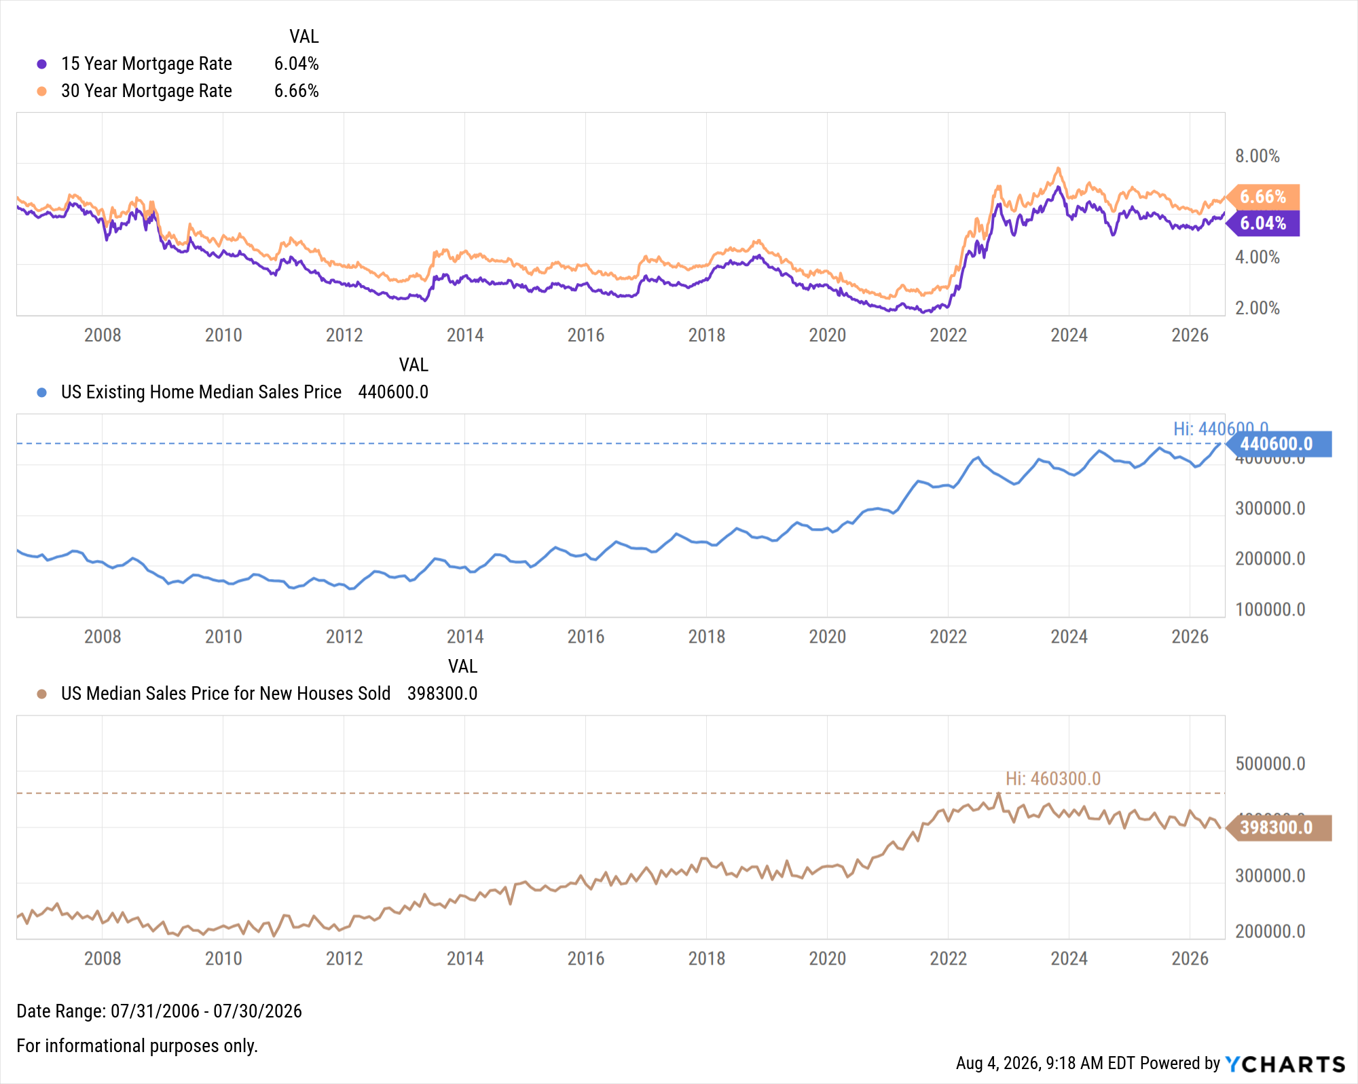
Housing Prices and Mortgage Rates
Notes:
Existing Home Sales declined -2.4% MoM in June, while the Median Sales Price of Existing Homes reached a new all time high of $440,600, an increase of 2.2%, or $9,400, MoM.
Mortgage rates rose gradually in July, with the 15-year rising to 6.04% and the 30-year reaching 6.66%, both as of July 30th. US New Single-Family Home Sales increased MoM by 1.62% in June.

Slide 15
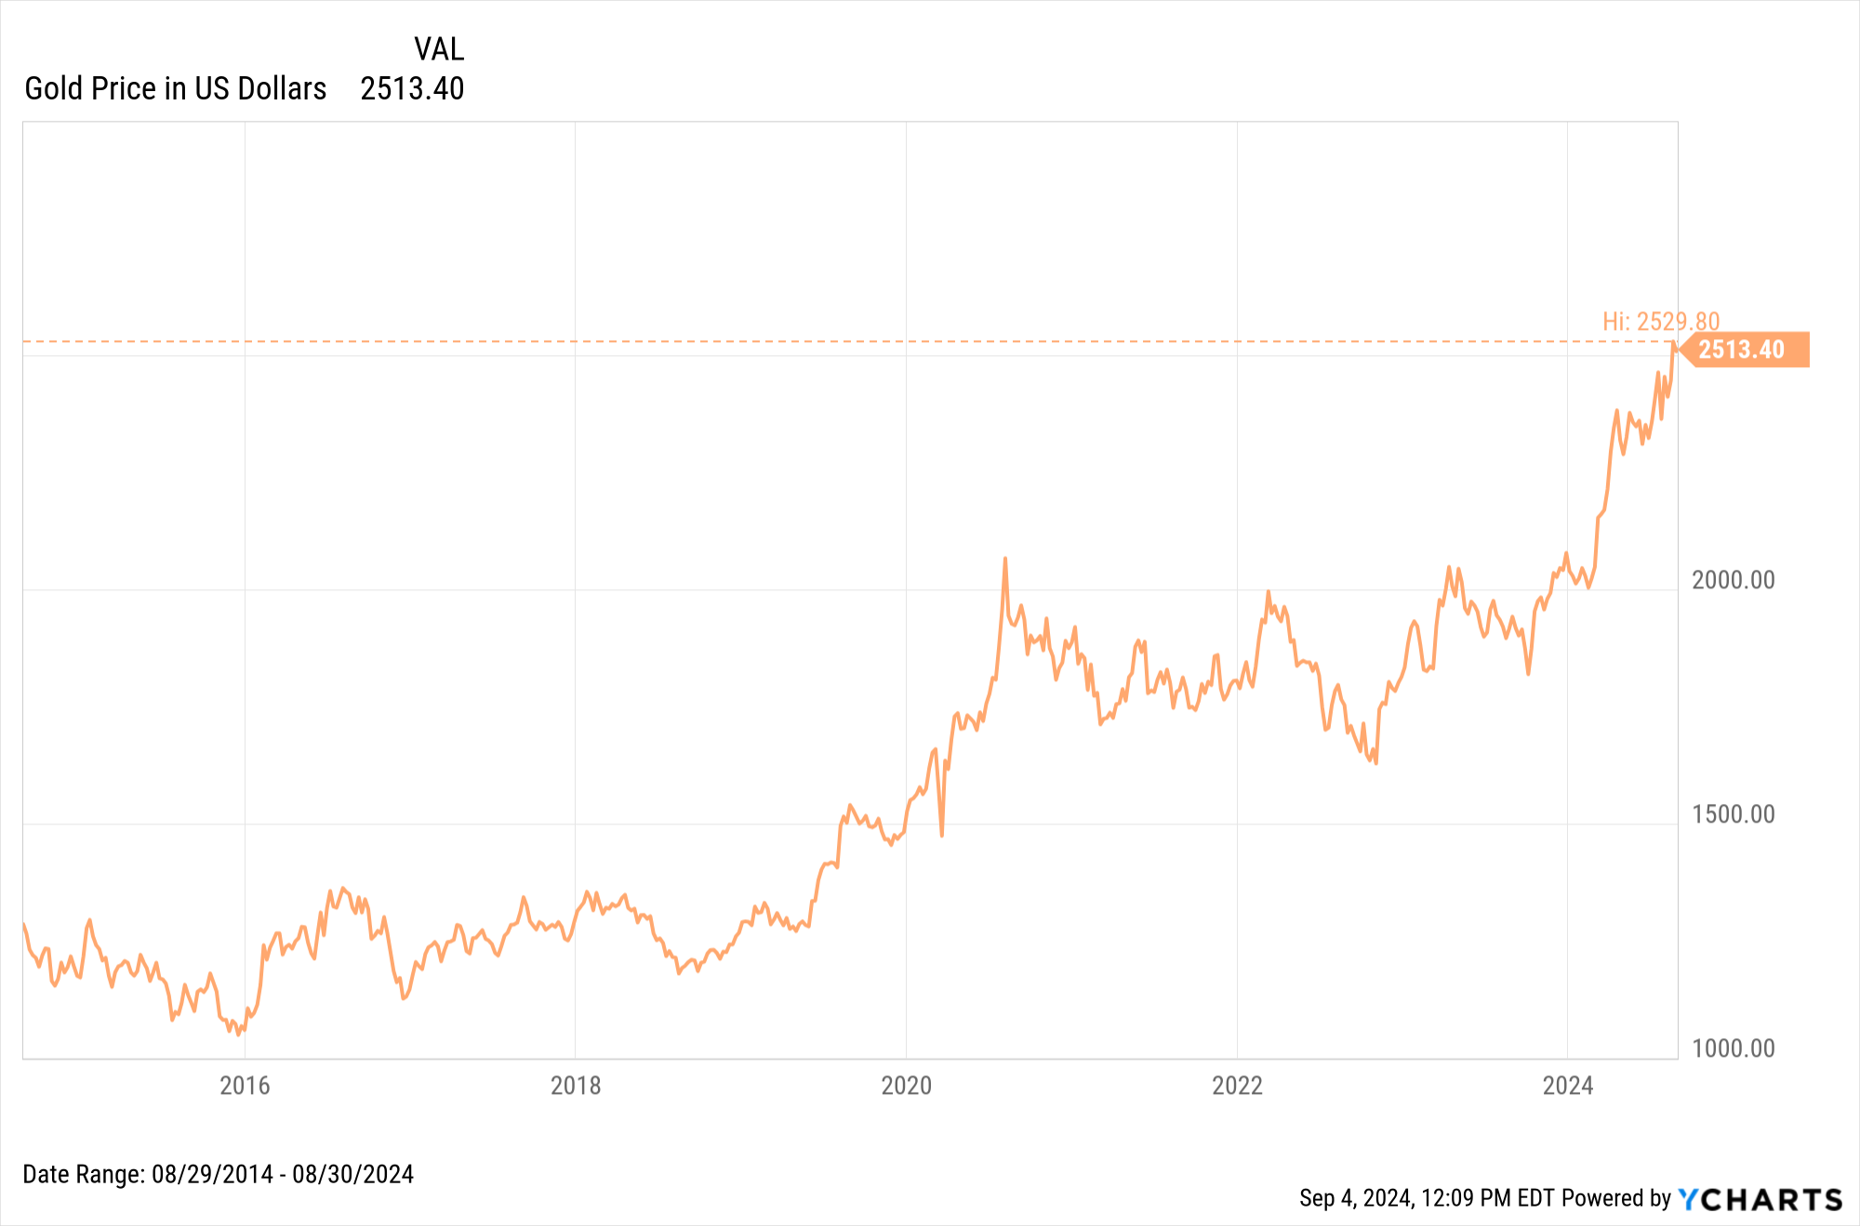
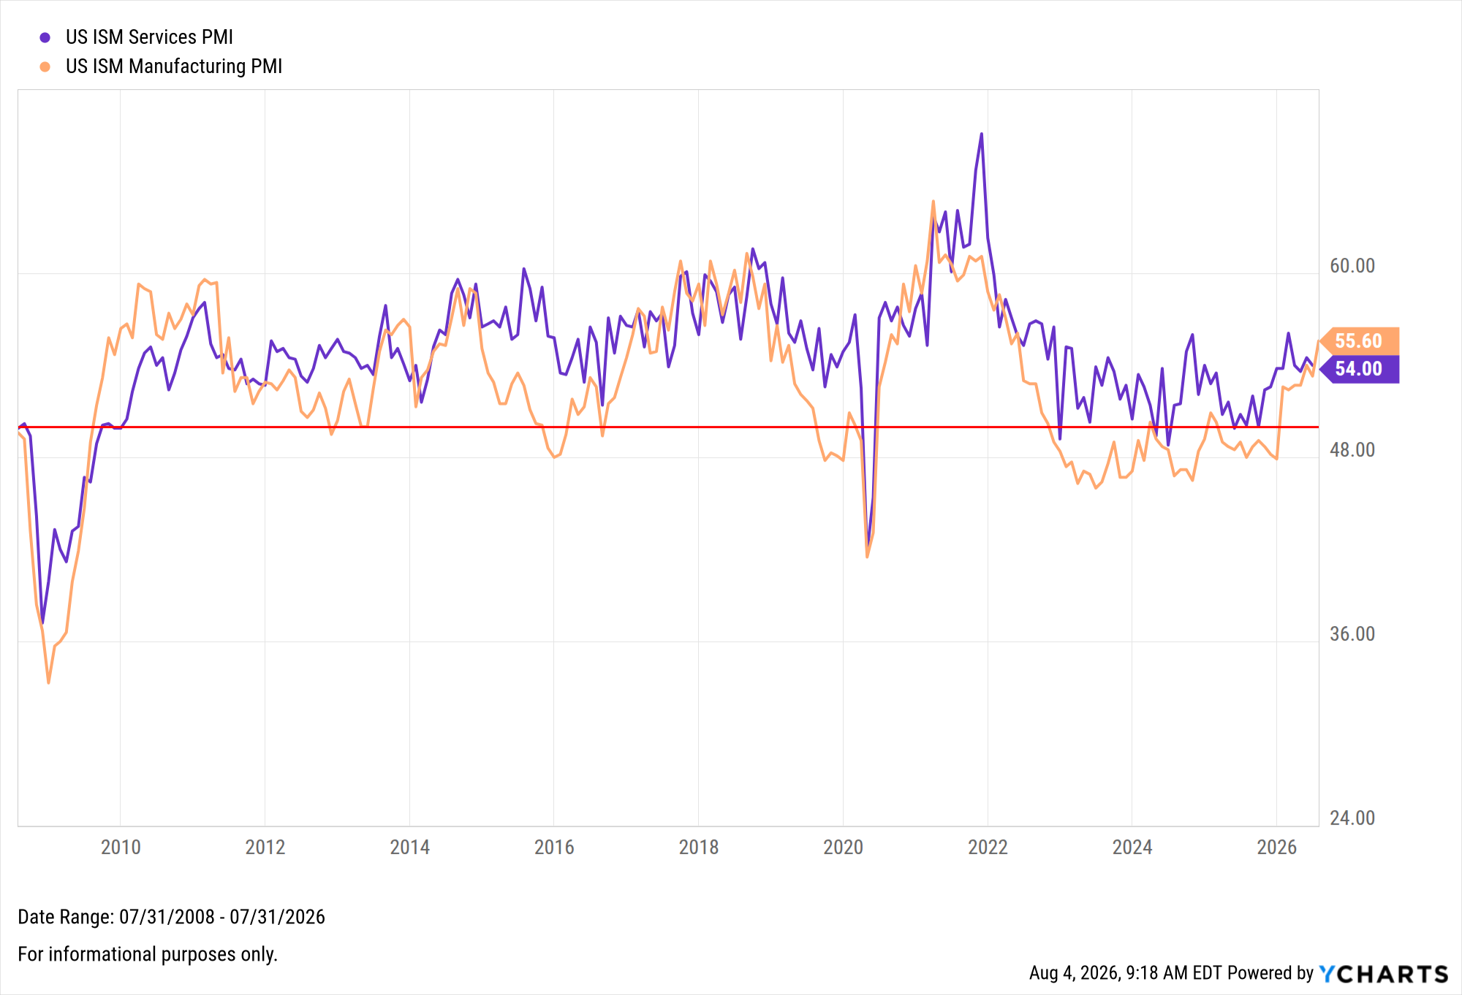
Services and Manufacturing Sectors Signal Further Expansion
Notes:
The US ISM Manufacturing PMI rose 2.3 points in July to 55.60, the highest level in four years. The Services PMI moved in the opposite direction by 0.5 points in June to 54.00. The YoY US Producer Price Index remained at an elevated level of 5.5% in June, its highest reading since December 2022, while US Retail and Food Services Sales logged a fifth-straight positive reading of 0.22% MoM in June.

Slide 16
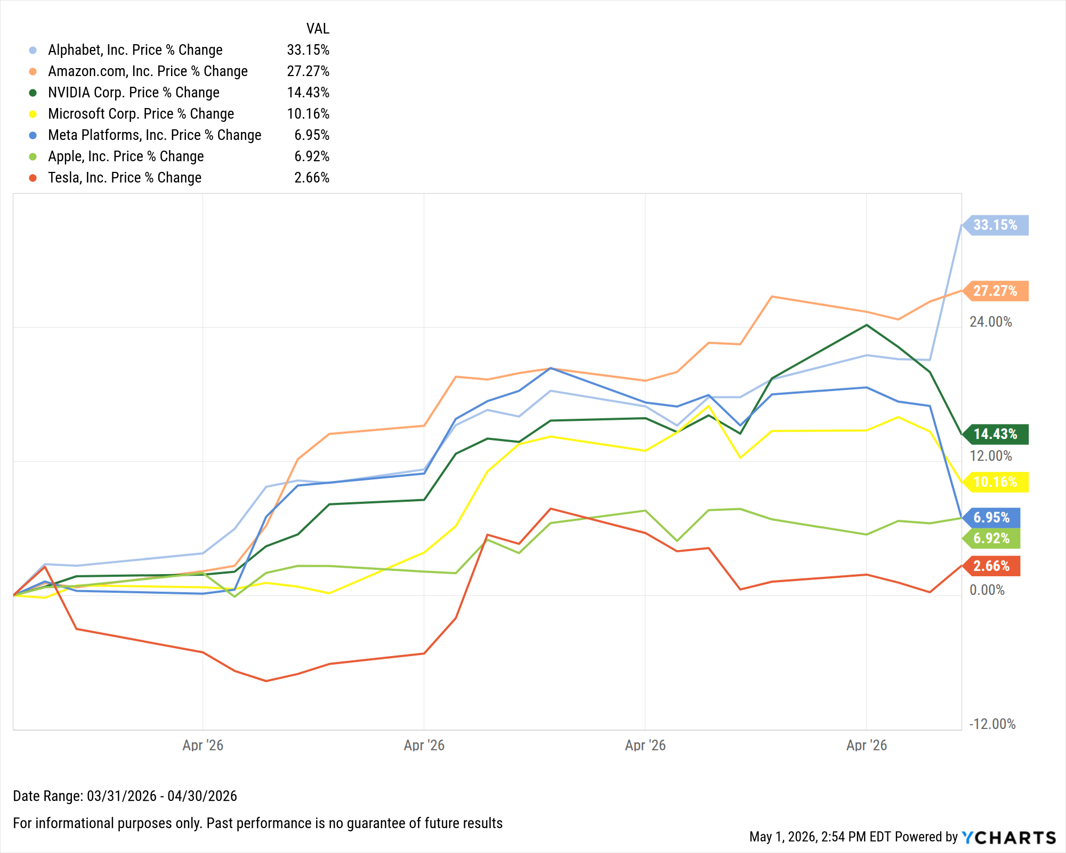
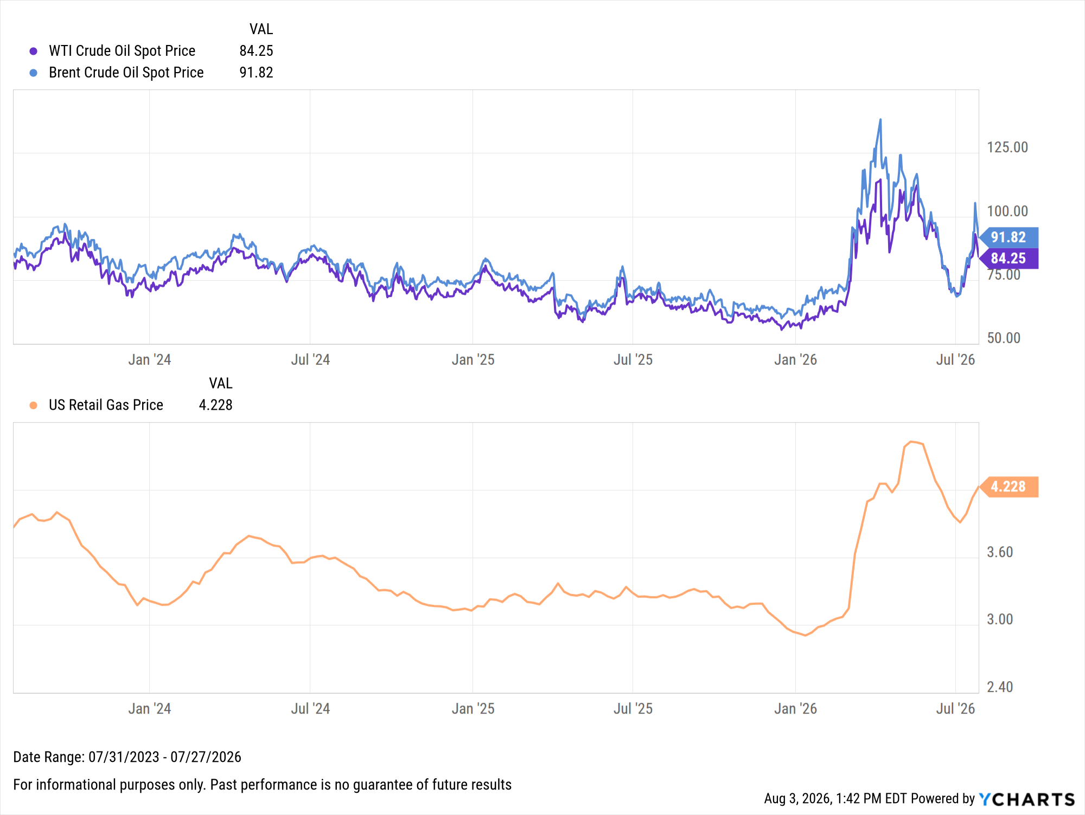
Oil Prices Spike, Continuing Whipsaw Trend
Notes:
Oil prices continued to whipsaw in July as escalating Middle East conflict, blocked shipping lanes, and tighter global fuel supplies re-applied pressure on prices. Brent crude surged 30.3% in July after plummeting 22.9% in June to $91.82 per barrel as of July 27th. However, Brent remains 33.6% below the high of $138.21 set in early April. The price of WTI ended July 19.4% higher at $84.25 per barrel and 26.5% its recent high of $114.58 reached in early April. The higher oil prices added pressure at the pump, with the US Retail Gas Price rising by 26 cents to $4.23 per gallon in July.

Slide 17
Fixed Income
Featuring the US Treasury Yield Curve, plus performance of select bond ETFs
Notes:
Treasury yields had mixed movements in June as yields on shorter-term treasuries increased while those of longer-term instruments decreased. The 3-month, 6-month, and 1-year rose 18, 23, and 19 basis points, respectively. The 20-year declined 5 basis points, and the 30-year slipped 8 bps. Bond funds were up across the board in June, as the iShares 20+ Year Treasury Bond ETF (TLT) led with a 1.2% gain.

Slide 18
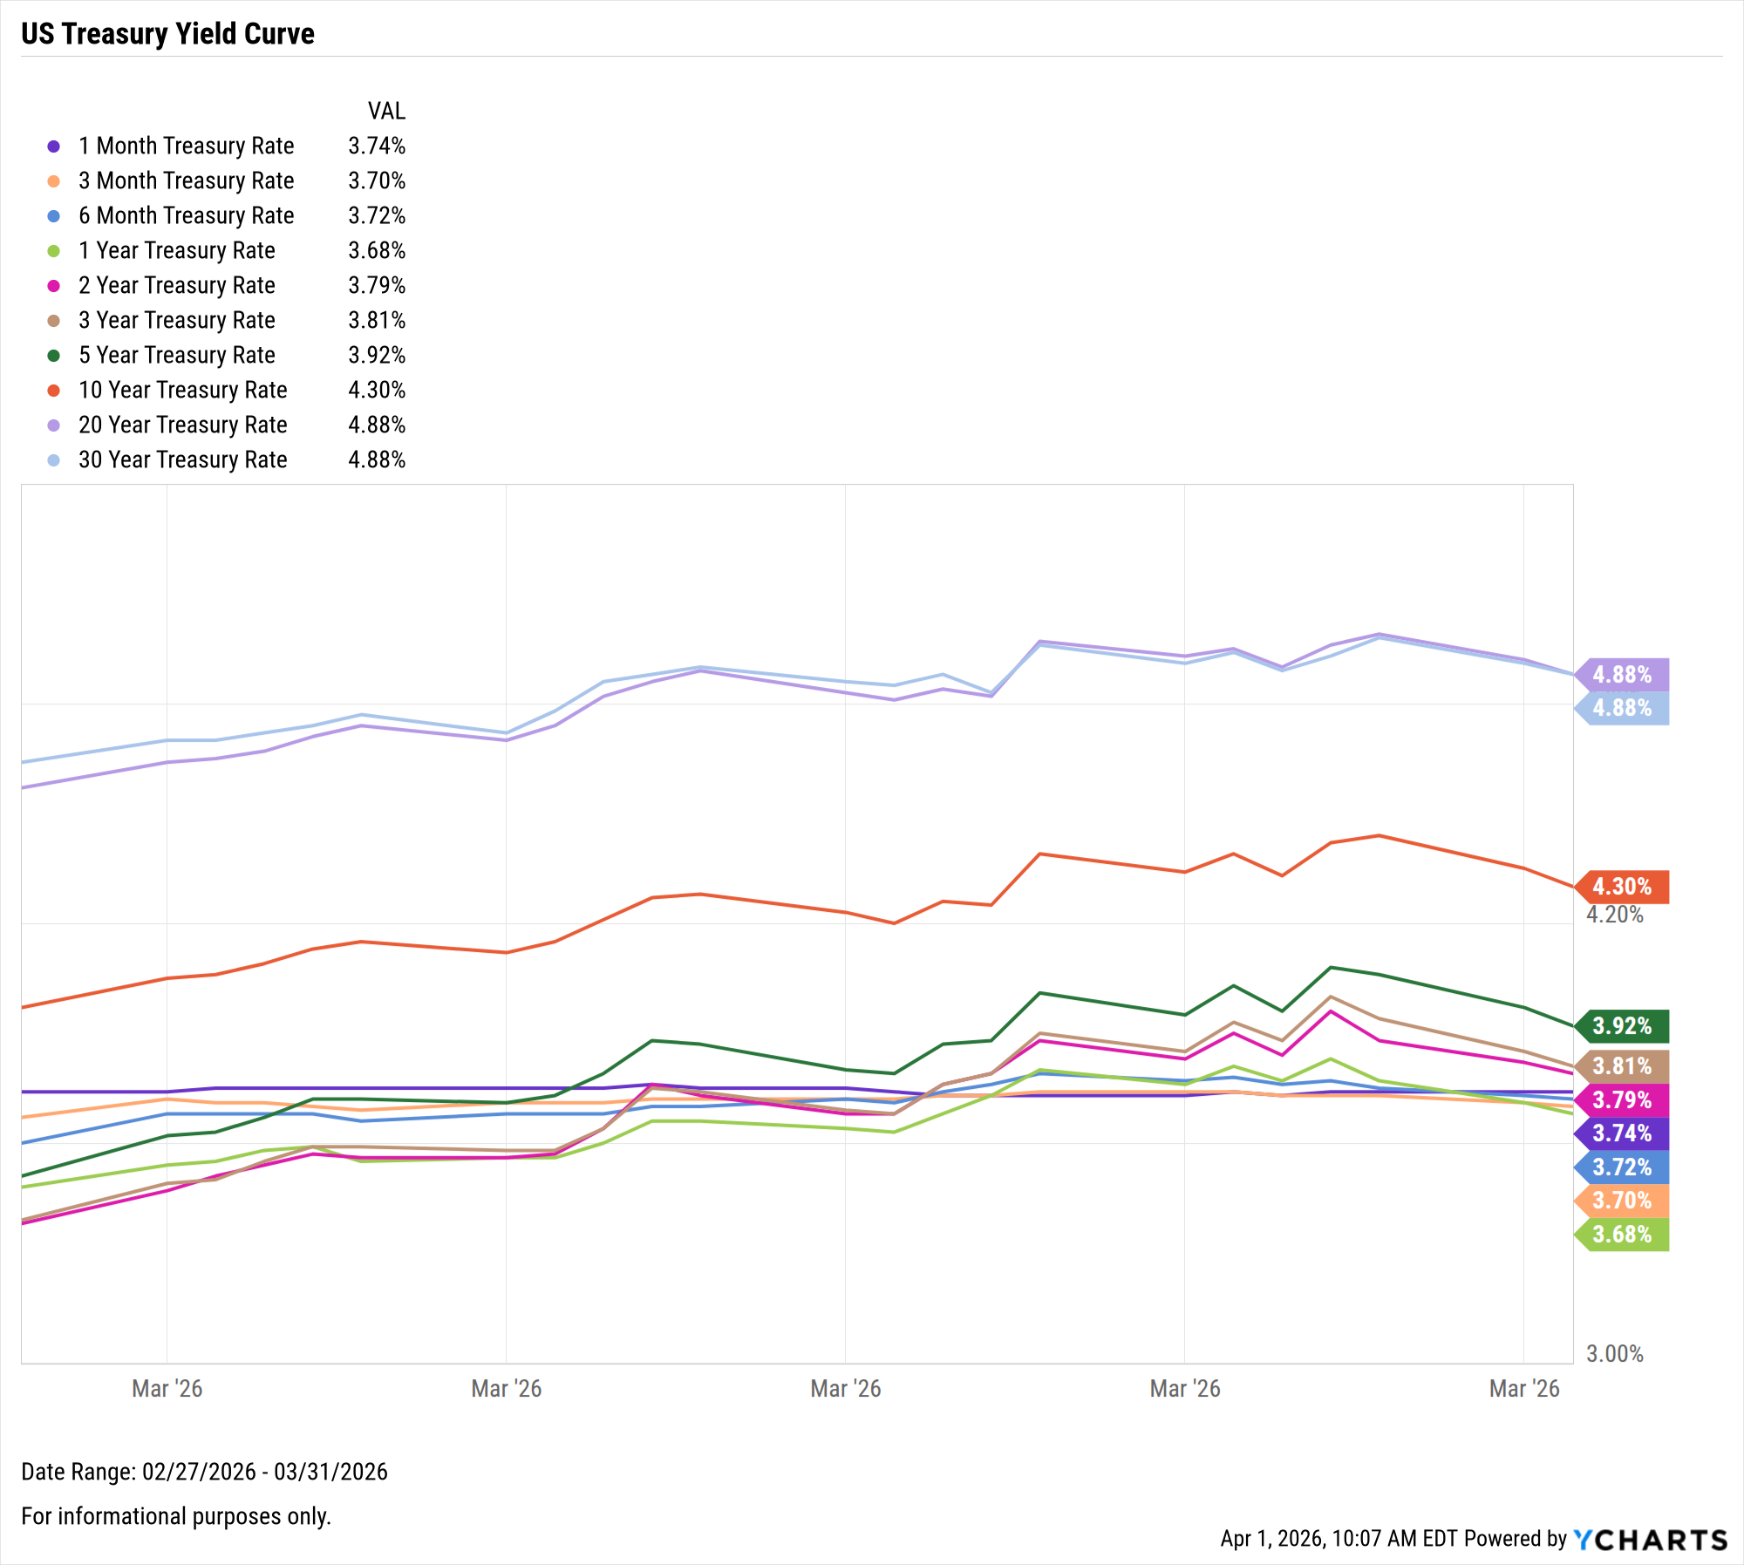
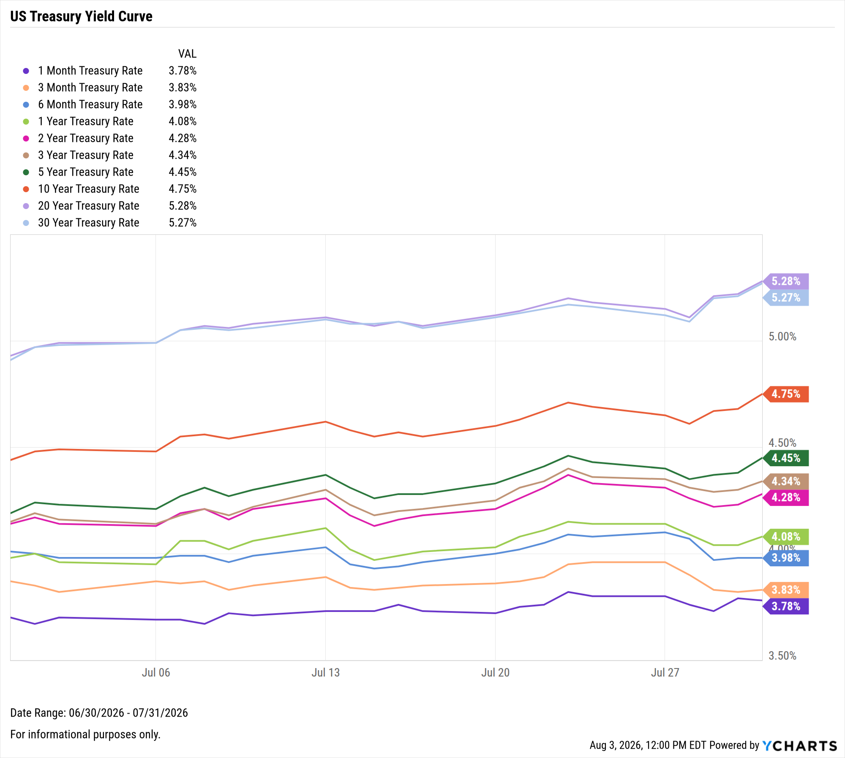
US Treasury Yield Curve
Duration | Rate | MoM Δ
1-Month | 3.78% | ▲ 8 bps
3-Month | 3.83% | ▼ 4 bps
6-Month | 3.98% | ▼ 3 bps
1-Year | 4.08% | ▲ 10 bps
2-Year | 4.28% | ▲ 14 bps
3-Year | 4.34% | ▲ 19 bps
5-Year | 4.45% | ▲ 26 bps
10-Year | 4.75% | ▲ 31 bps
20-Year | 5.28% | ▲ 35 bps
30-Year | 5.27% | ▲ 36 bps
Notes:
Treasury yields moved higher at the longer end of the curve. The 10-year, 20-year, and the 30-year spiked 31, 35, and 36 basis points, respectively.

Slide 19
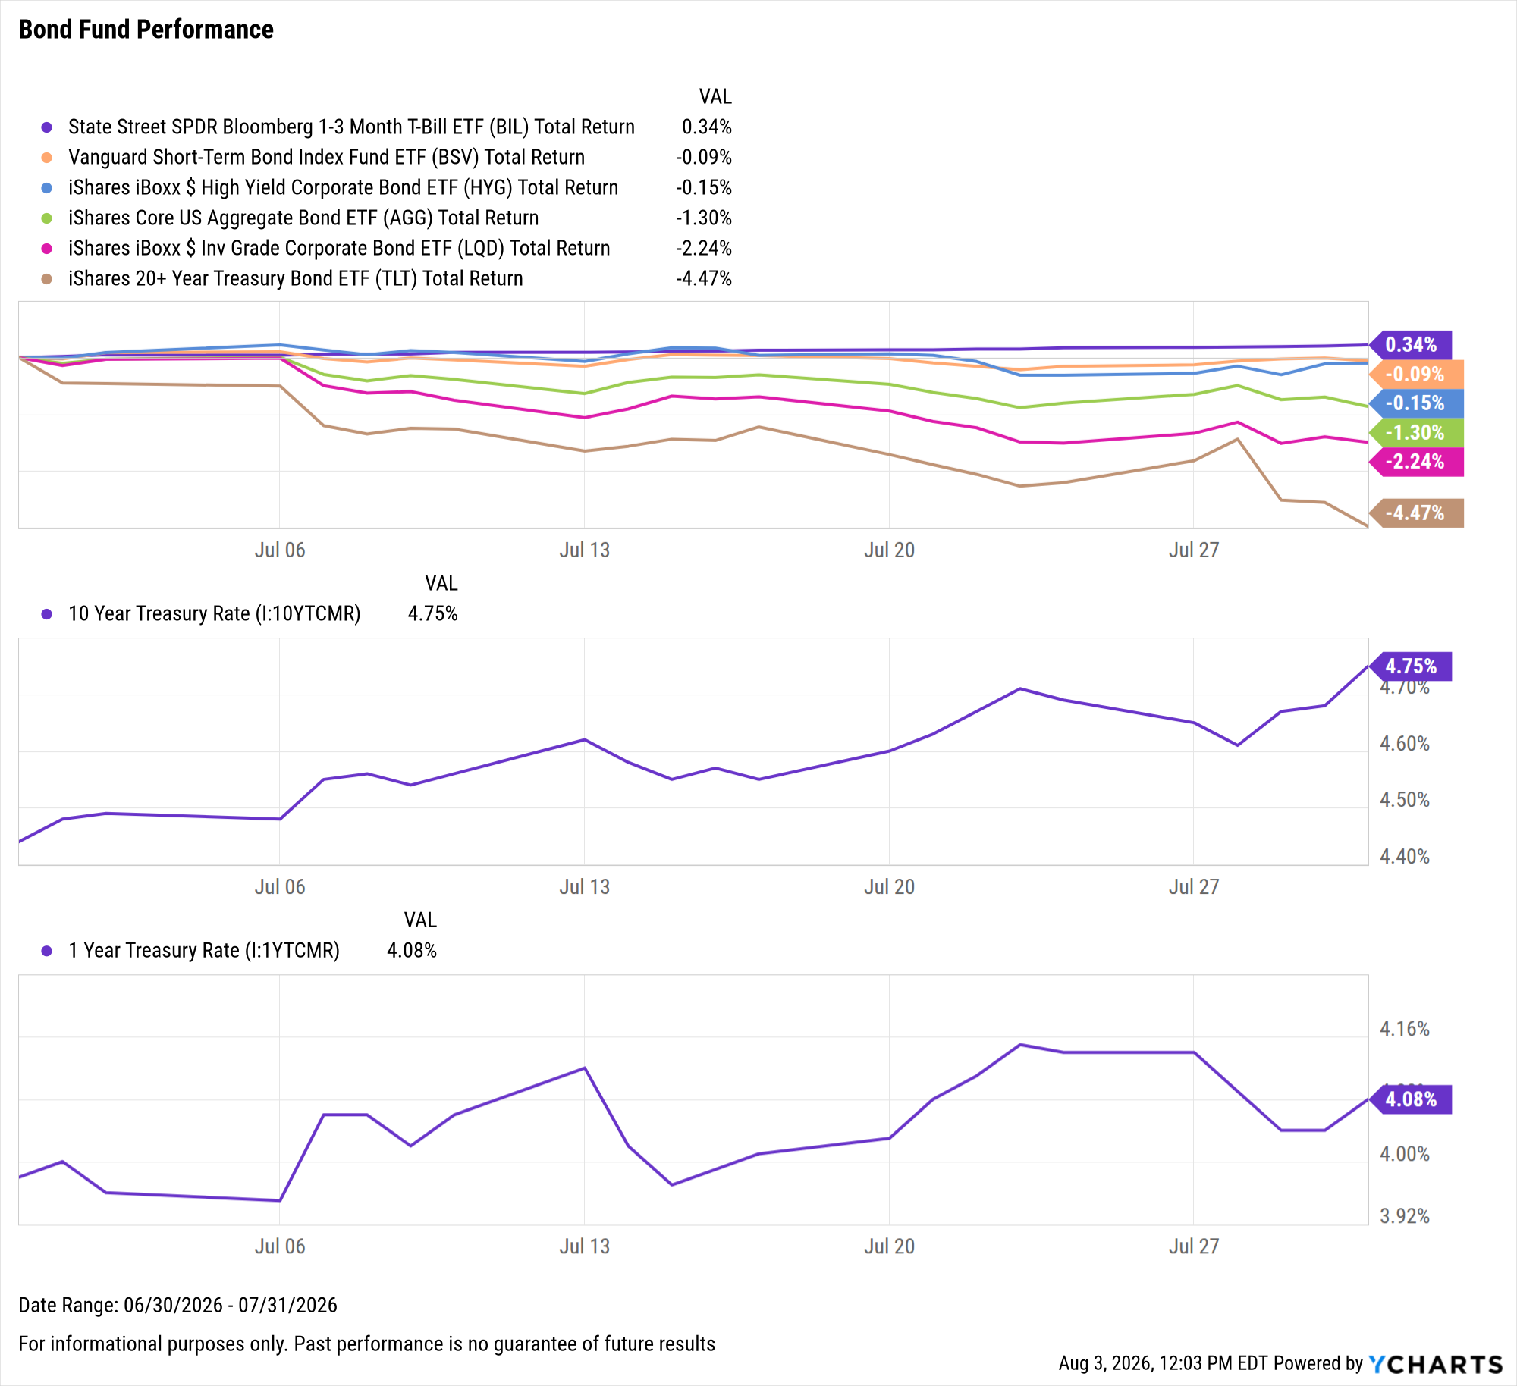
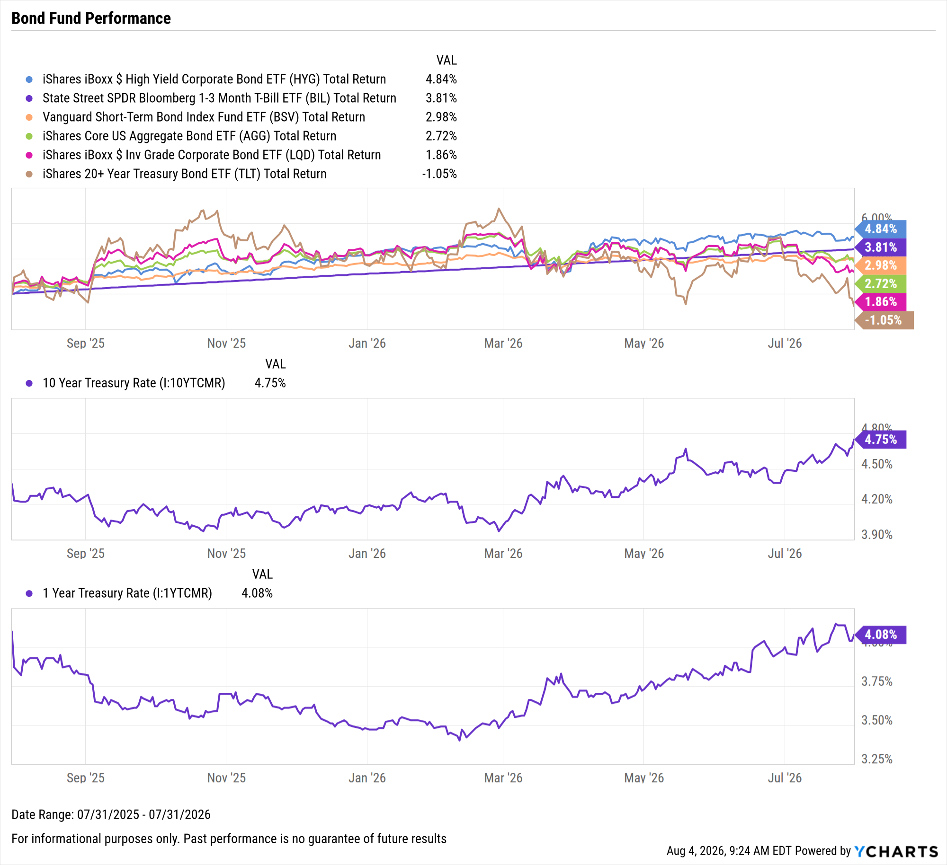
Bond Fund Performance
July 2026:
Short-term BIL up 0.3%, all other bond funds negative
Trailing Twelve Months (TTM):
High Yield Corporate up 4.8%, TLT down 1.1%
Notes:
Bond funds slipped, with the exception of the shorter-term State Street SPDR Bloomberg 1-3 Month T-Bill ETF (BIL) which rose 0.3% in July. The iShares 20+ Year Treasury Bond ETF (TLT) sank 4.5% in July.

Slide 20

YCharts is not registered with the U.S. Securities and Exchange Commission (or with the securities regulatory authority or body of any state or any other jurisdiction) as an investment adviser, broker-dealer or in any other capacity, and does not purport to provide investment advice or make investment recommendations by or through the Content found on the Site or otherwise. The Site and the Content are provided for the sole purpose of enabling you to conduct investment research. Other uses of the Site and the Content are expressly prohibited. Full disclosure: https://ycharts.com/about/disclosure
For more information or to start a free trial,
please visit www.ycharts.com

