Slide 1
Economic Update
Q1 2019

Slide 2

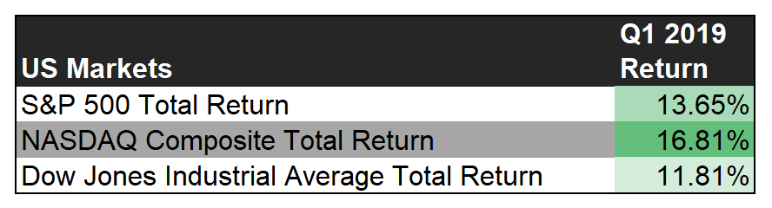
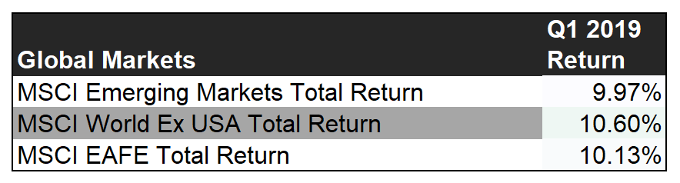
Stock Markets Performance
Notes:
This slide shows the total returns for key markets in the US and abroad. Stocks had a very strong Q1 2019 after a slow finish to 2018. The Nasdaq, led by strong gains in technology, had the highest returns: up nearly 17% for the quarter. Domestic stocks outpaced the rest of the world and developed markets outpaced emerging.

Slide 3
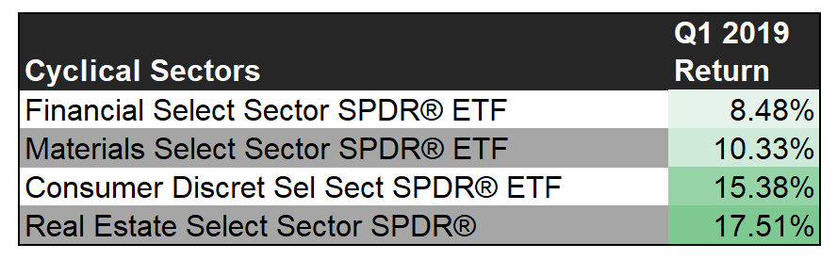
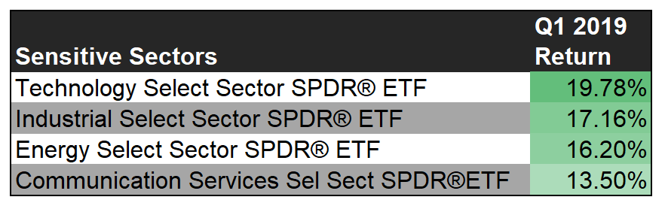
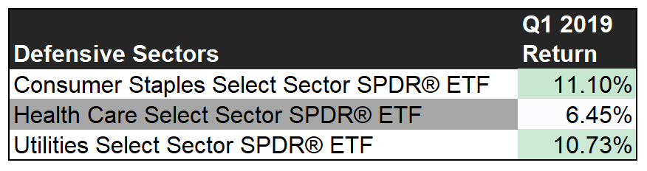
US Sector Performance
Notes:
Q1 2019 was positive for all US stock sectors. The 3 “super” sectors, Cyclical, Sensitive, and Defensive, describe how the sectors tend to react to economic cycles. Cyclical sectors tend to be very correlated with economic cycles while Defensive sectors are more resilient to slowdowns but may underperform in bullish times. Sensitive sectors are less affected by economic cycles than Cyclical Sectors, but also have offered less safety than Defensive sectors during economic downturns. Overweighting Cyclical and/or Sensitive Sectors could make sense if bullish on the economy; conversely, overweighting Defensive stocks could be a strategy to employ if concerned about economic slowdown.
Financials, especially weighed on by poor performance from Exchange Stocks (CME, Cboe) and some large Banks (JPM and Wells Fargo), and Health Care, where Healthcare Plans companies struggled, lagged the most in Q1. Technology, where semiconductor stocks bounced back in a big way, posted the biggest gains.

Slide 4
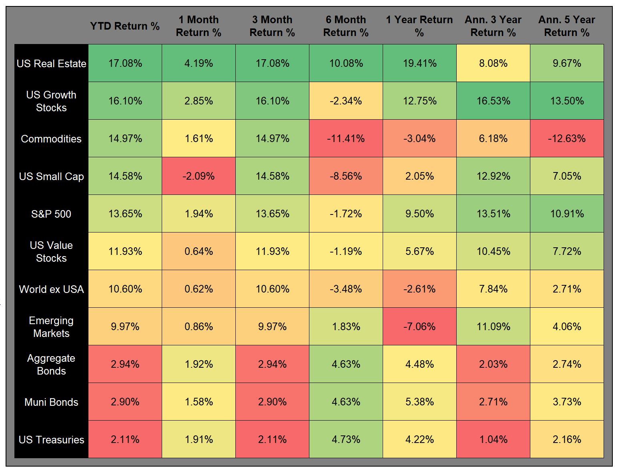
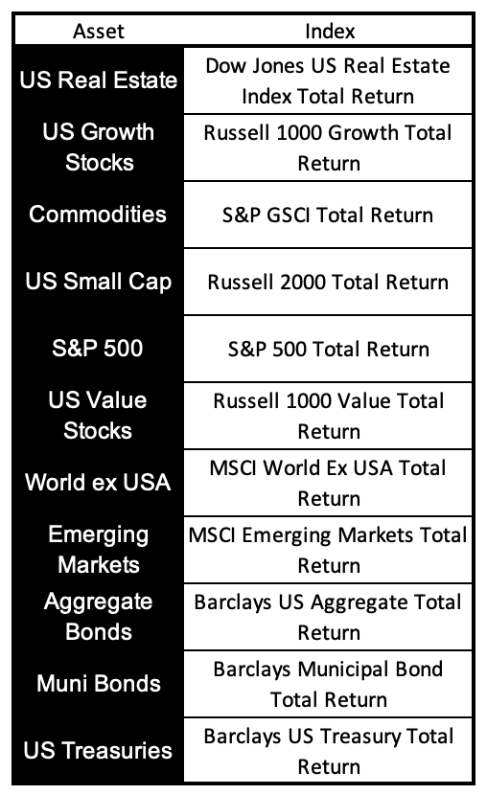
Asset Class Performance – Trailing Periods
Notes:
All major asset classes posted positive returns in Q1 2019. Real Estate and Commodities saw strong returns but still lag growth stocks over the last 3-5 years. US value stocks continue to lag behind small companies and growth stocks, possibly a result of the long lasting bull market. Value did provide a level of safety in Q4 2018 when stocks posted negative returns. The table on this slide shows how correlated asset classes have been over different time periods. Varieties of bonds have shown high levels of correlation to one another. Stocks have shown significant variance between cap sizes and US vs non-US.

Slide 5
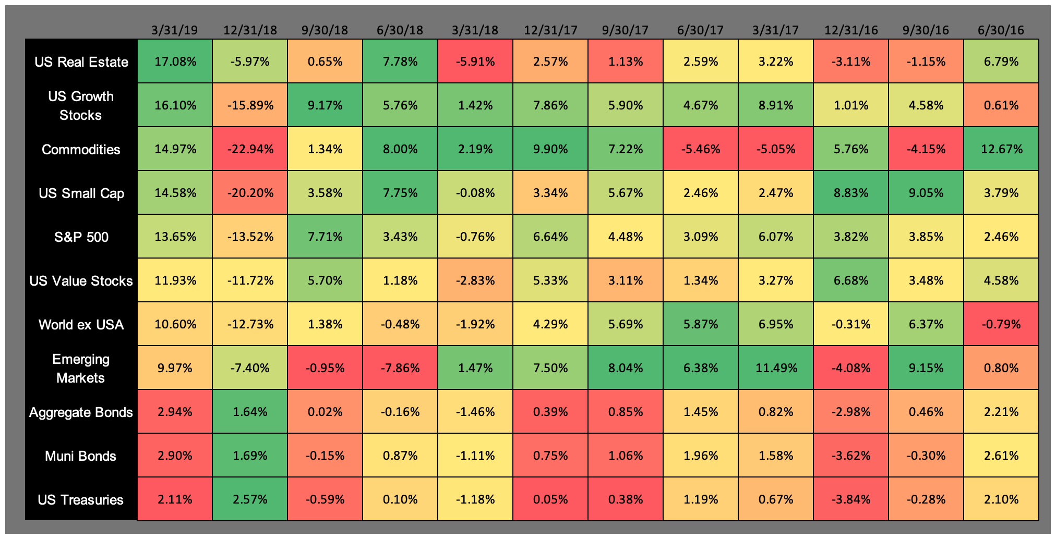
Asset Class Performance – Quarter by Quarter
Notes:
Similar to the table on the prior slide, however, this view shows the performance of each asset class for each of the last 12 calendar quarters. Real Estate’s recent strong performance has it leading the way in many trailing periods but here you can see the volatility quarter to quarter. With very few negative quarters for equity categories over the last few years, bonds have provided the lowest returns many quarters since 2016 but have tended to provide positive returns when stocks do not.

Slide 6
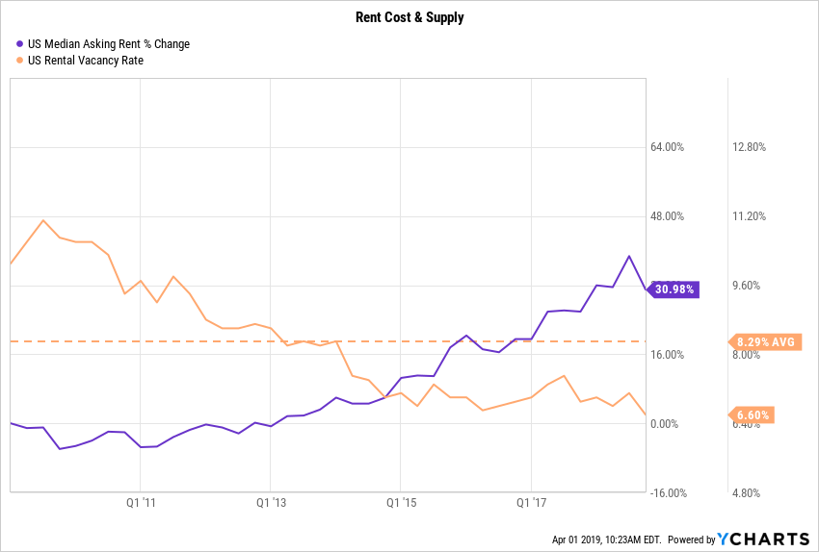
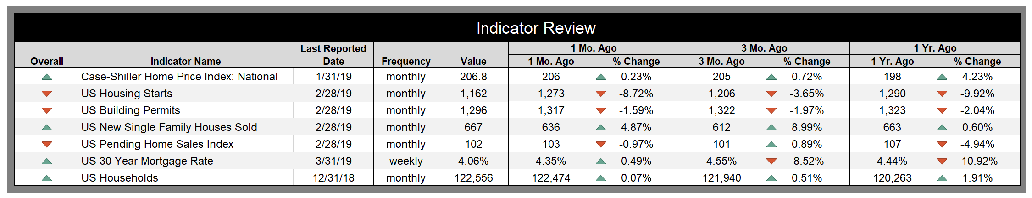
Housing Indicators
Notes:
Housing indicators were somewhat mixed in Q1 2019. House price indicators continued to increase across the country while starts, permits, and pending sales decreased. Home ownership rates remain below average despite increasing since lows in 2016. Low supply may be causing affordability concerns in both rental and purchasing situations but historically low interest rates could still be encouraging buyers.

Slide 7
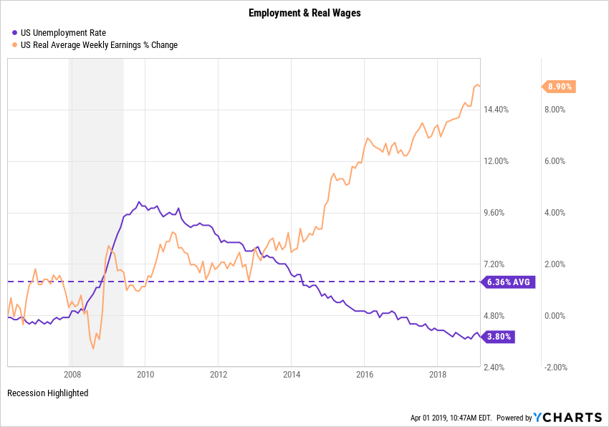
Employment & Wages
Notes:
Unemployment rates continue to decline and remain historically very low. Average wages also increased in Q1 and have outpaced CPI and economic growth. This chart illustrates the strength in these indicators since the latest recession. If labor continues to become more expensive it may require more economic growth to maintain the low unemployment rate.

Slide 8
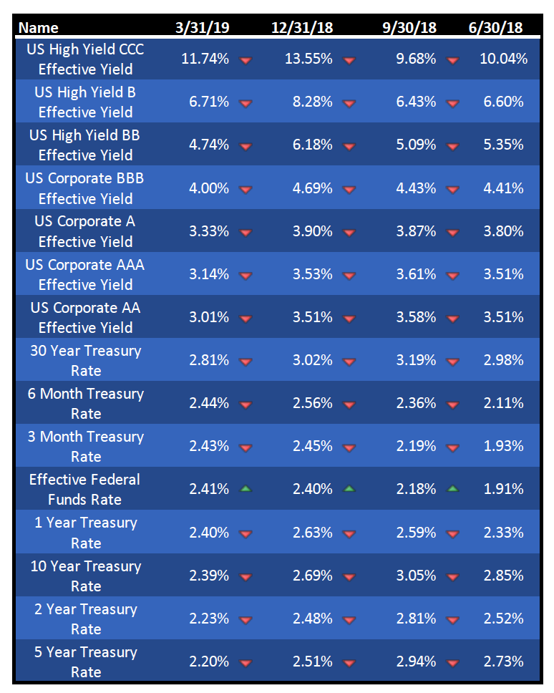
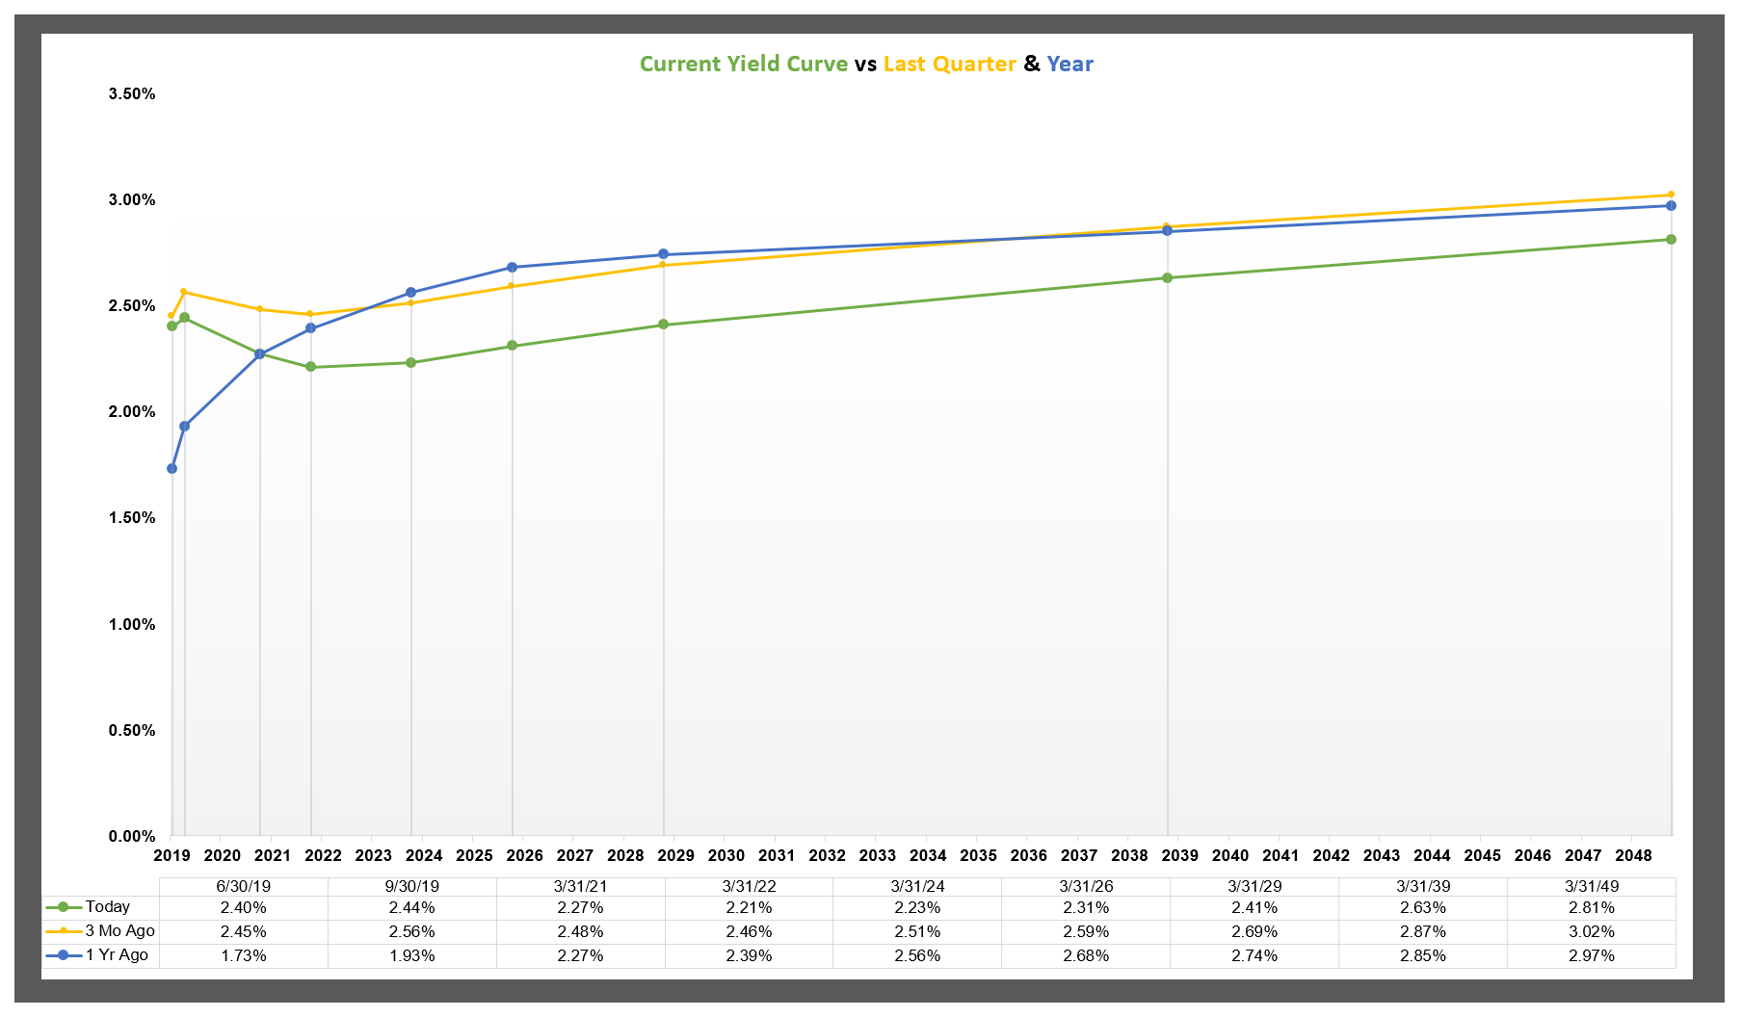
Interest Rates
Notes:
Despite the effective Fed Funds rate being higher than last quarter, other yield are lower across the board. The yield curve has been well covered in the news as the 10-2 spread approached 0 and the 3 month – 10 year spread inverted. Last time this part of the curve was inverted was in 2007, but at that time the 10 year note was yielding about 4.5%, 2 full percentage points more than it is now. Investors are needing to look further and further into the credit rating depths to find higher yields.

Slide 9
Consumer Behavior
Notes:
Consumer sentiment remained relatively strong in Q1. Despite a low print in January, the number strengthened in Feb and again in March. The personal saving rate jumped a bit in Q1 but remains in the middle of it’s recent range. Retail sales printed slightly higher than December 2018, but lower than highs from last October and November. Slowing retail sales and increased savings rates could indicate that consumers have less confidence in the economy, so these trends are worth keeping an eye on.

Slide 10
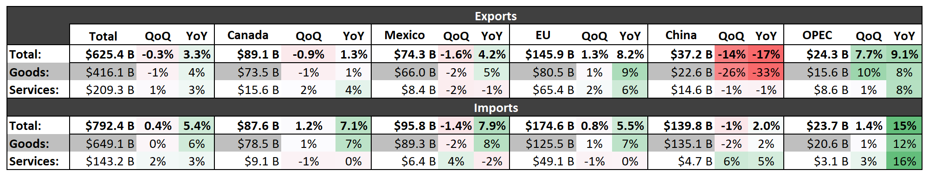
Trade & Dollar Strength
Notes:
China is standing out in topmost chart here showing trade balances with selected nations. The amount of goods exported from the US to China has declined sharply while overall exports from the US were down slightly QoQ and up YoY. This implies that trade declines with China have been made up for elsewhere, especially Europe. The strength of the dollar against the Euro could have a positive impact on imports to the US from Europe but might also make US goods more expensive for EU nations to import. Despite Brexit woes, the Pound strengthened against the US Dollar in Q1, as did the Chinese Yuan. Compared to the Euro and the Yen, the US Dollar increased in value.

Slide 11
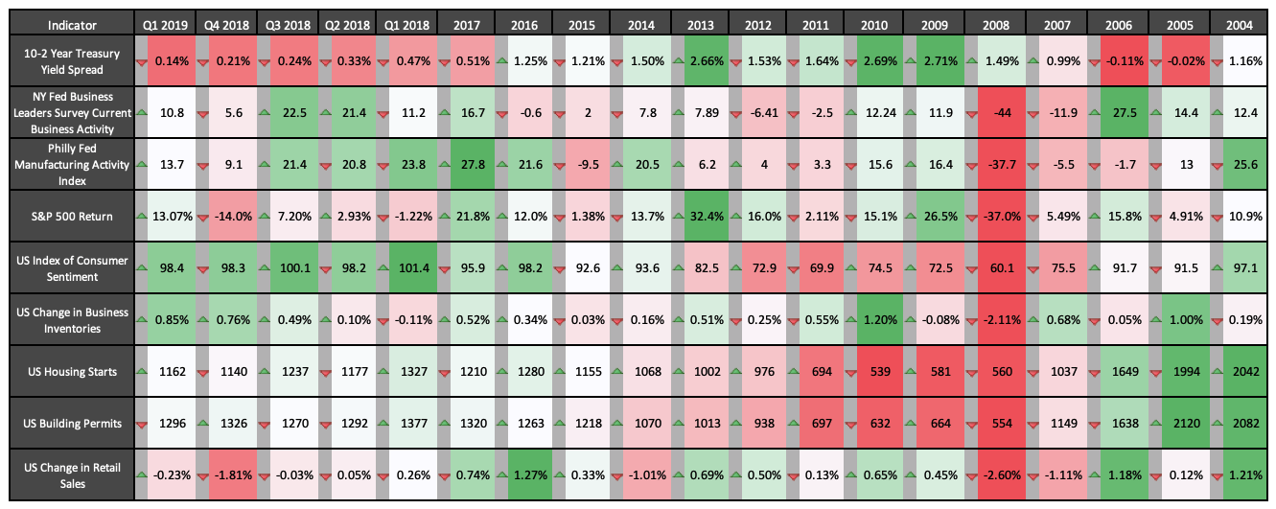
Leading Indicator Summary & Trends
Notes:
This table shows several “leading” economic indicators and how they’ve trended over recent quarters and past years. While the 10-2 spread is nearing lows from 2006, some other indicators seem to be pointing towards continued strength in the economy.

Slide 12
YCharts is not registered with the U.S. Securities and Exchange Commission (or with the securities regulatory authority or body of any state or any other jurisdiction) as an investment adviser, broker-dealer or in any other capacity, and does not purport to provide investment advice or make investment recommendations by or through the Content found on the Site or otherwise. The Site and the Content are provided for the sole purpose of enabling you to conduct investment research. Other uses of the Site and the Content are expressly prohibited. Full disclosure: https://ycharts.com/about/disclosure
For more information please visit www.ycharts.com
Q1 2019

