Slide 1
Economic Update
A Closer Look at Q4 2019 Data
Released January 2020

Slide 2

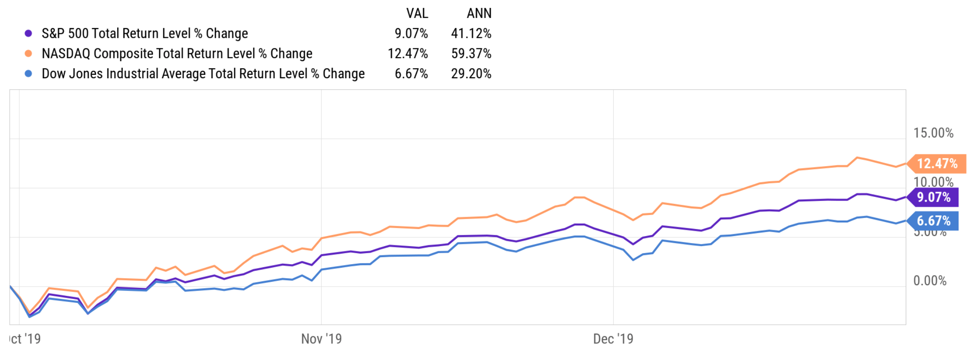
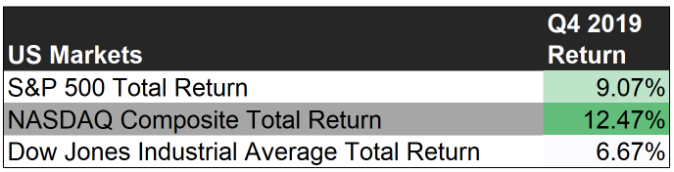
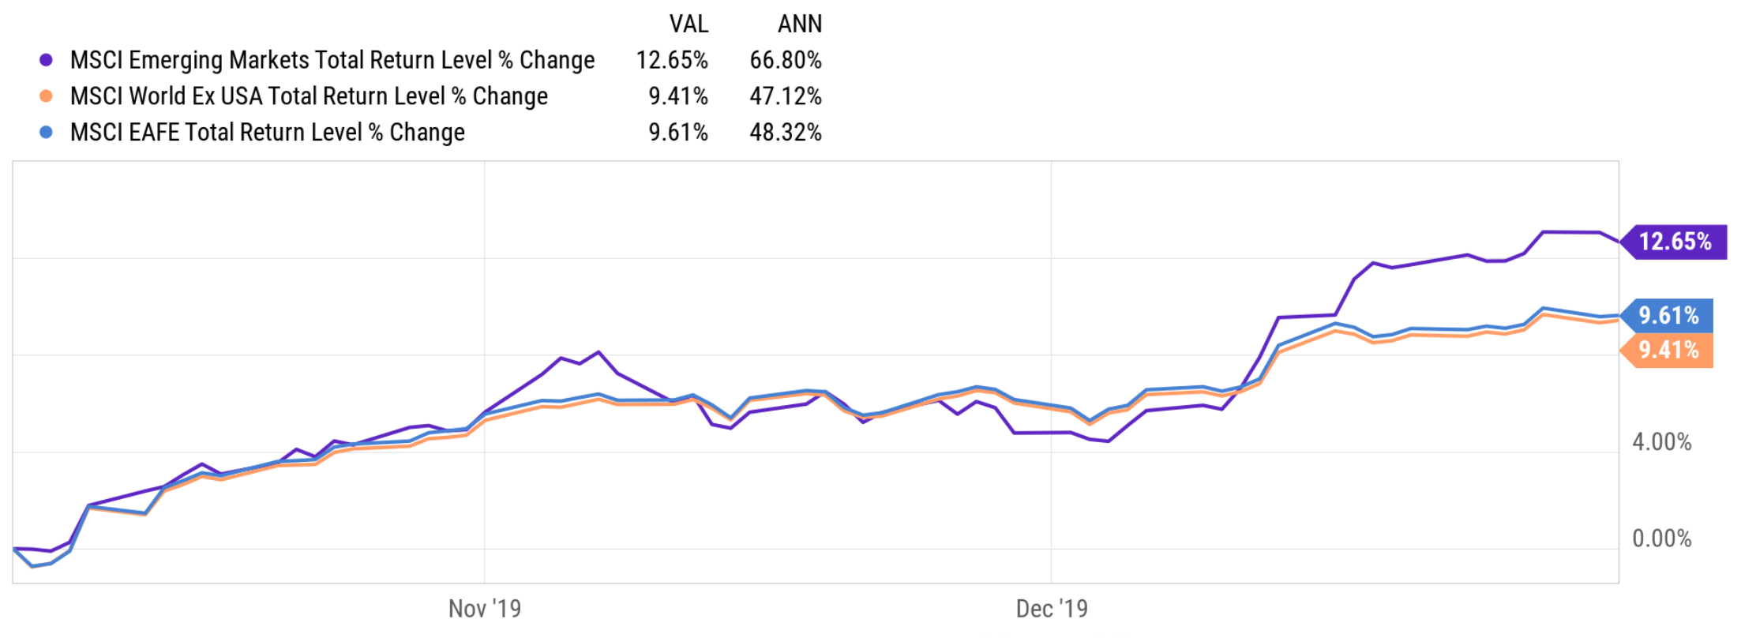
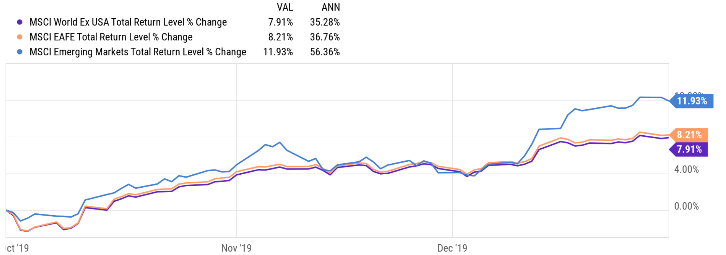
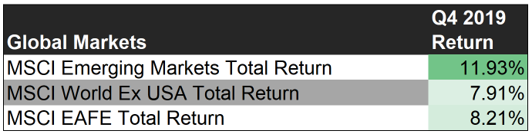
Stock Markets Performance
Notes:
This slide shows the total returns for key markets in the US and abroad. Q4 2019 proved be a very good one for investors that were long stocks from pretty much anywhere in the world. Domestically, standout returns in the quarter were posted by the Nasdaq Composite Index. After lagging The S&P 500 for the prior 2 quarters, the tech heavy index was lifted by big gains in TSLA, AMD, and relative overweighting in technology and healthcare companies. Outside of the US, emerging markets had their best quarter since 2012! Russia, China, Brazil, South Africa, and South Korea all posted gains >10% to give the broader emerging indices a boost. Decreased macro risk, stabilizing interest rates, and optimism from a US/China trade agreement likely helped the emerging countries growth.

Slide 3
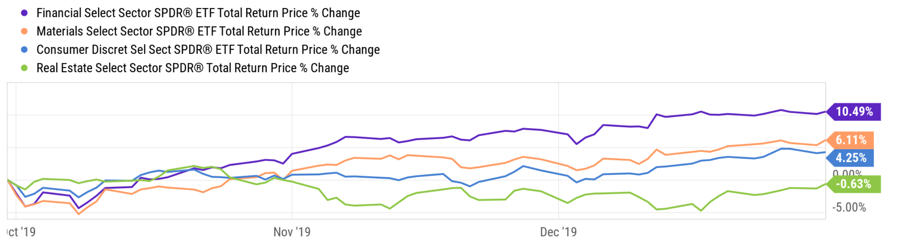
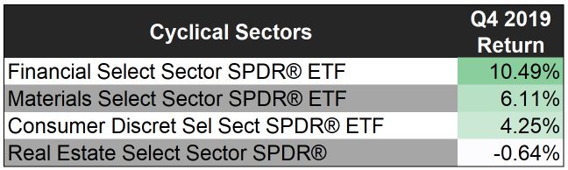
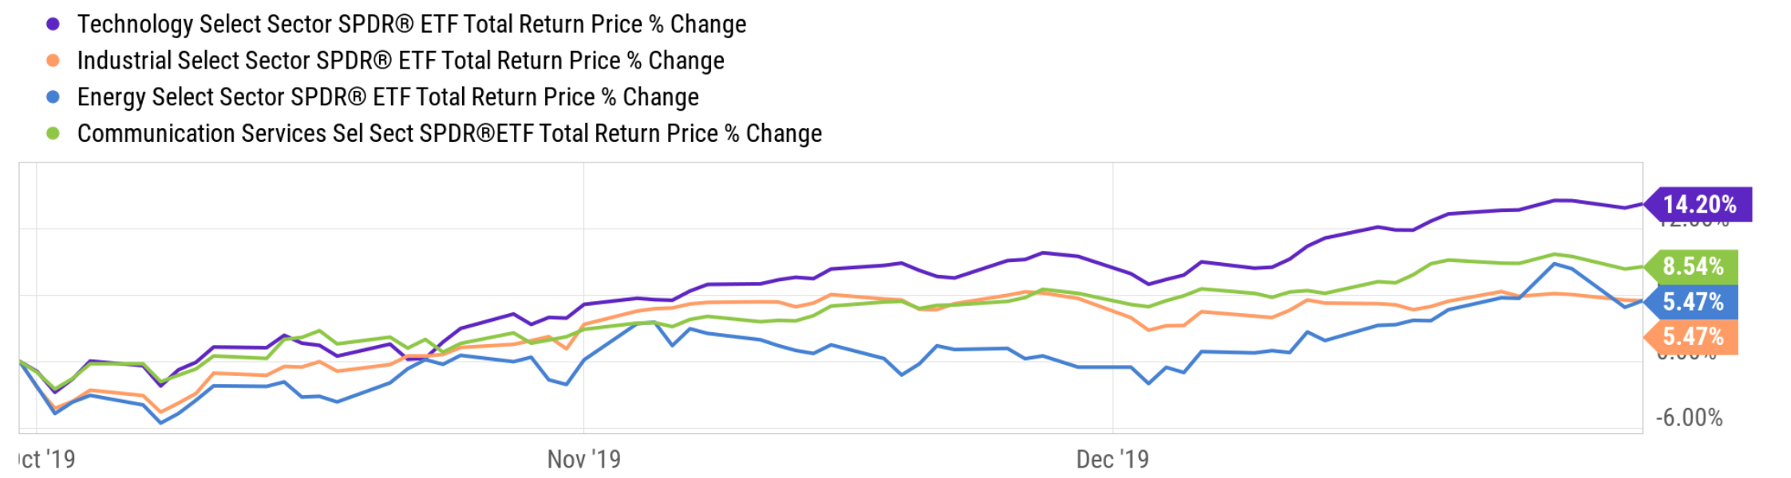
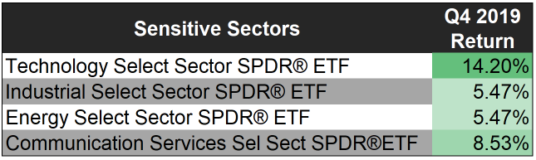
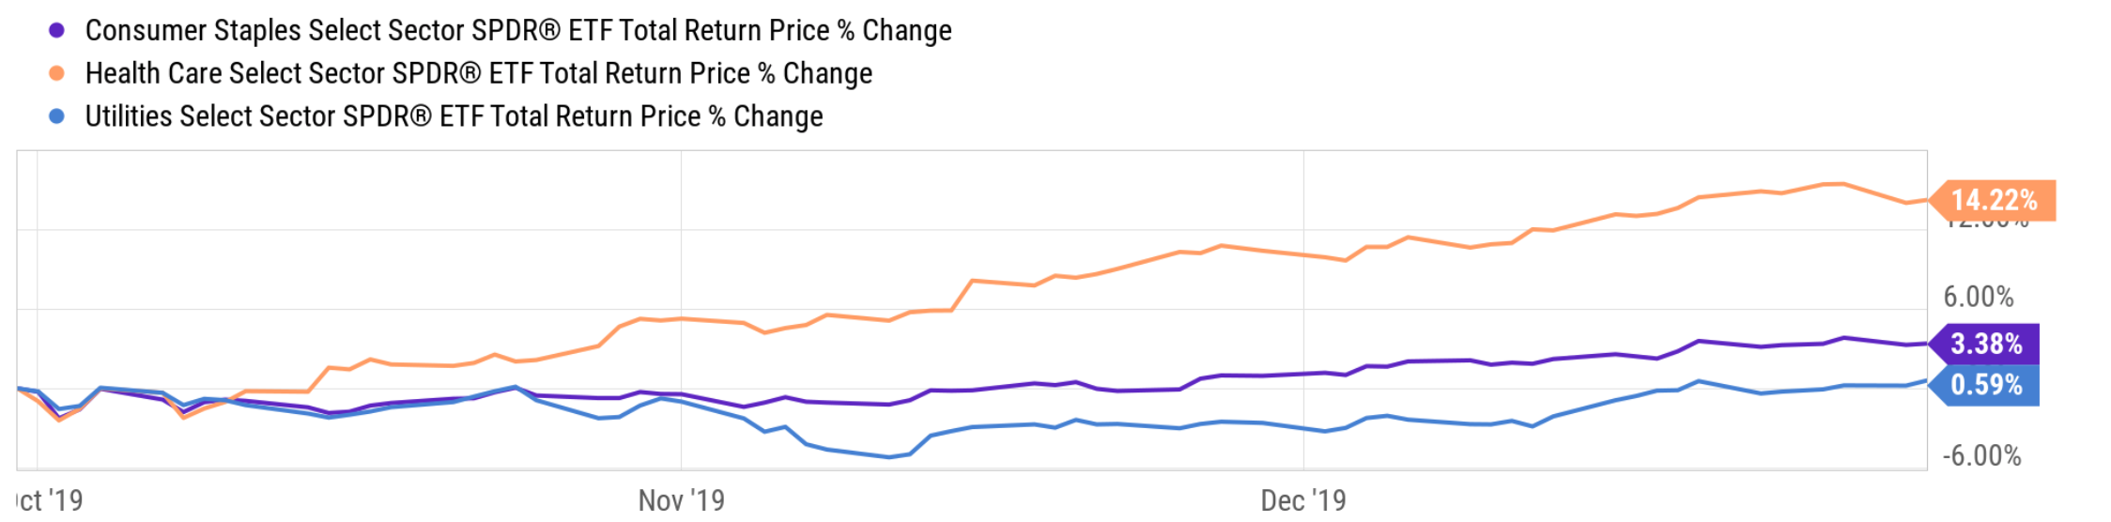
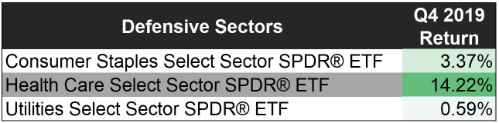
US Sector Performance
Notes:
Nearly every stock sector posted positive returns in Q4 2019. The sole decliner was real estate, retracting to it’s mean perhaps, after finishing near the top for 2 of the prior 3 quarters. Technology and health care companies had the biggest gains on average especially benefitting from the performance or semiconductor and biotech companies. Historically, stocks in the cyclical supersector have higher betas than those in the sensitive supersector. Over the last year, however, the average beta for sensitive stocks has been about 25% higher than the average cyclical company’s beta. It will be interesting to see if this trend persists, especially in any prolonged bear market. Defensive supersector companies remained in their typical range this past year with an average beta well below 1.

Slide 4
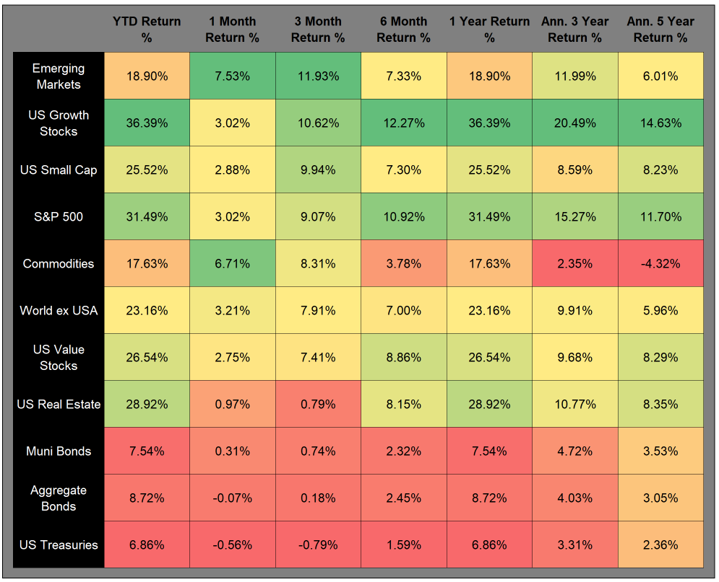
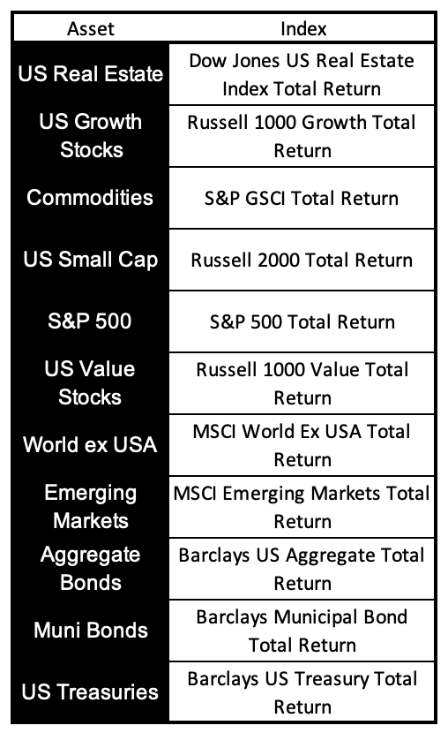
Asset Class Performance – Trailing Periods
Notes:
The only asset class in our chart that declined in value over the 4th quarter of 2019 was US Treasuries. For the most part, risk on was a good position as emerging markets outperformed developed, growth outperformed value, small cap outperformed large, and corporate bonds outperformed treasuries. 2019 came to an end with the S&P 500 up more that 31%. The best year since 2013 and only the 5th time in the last 30 years that the index finished greater than +30%. As our chart here shows, only commodities has a negative return over the trailing 5 years, feeling the effect of a prolonged slouch in the energy – especially natural gas - and grains commodities markets.

Slide 5
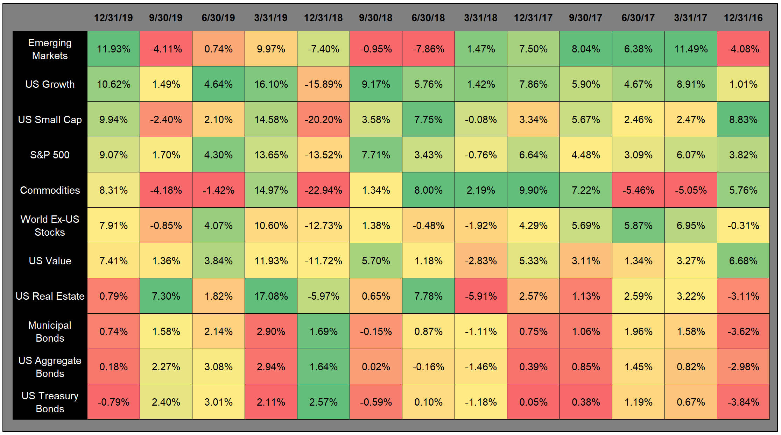
Asset Class Performance – Quarter by Quarter
Notes:
Similar to the table on the prior slide, however, this view shows the performance of each asset class for each of the last 12 calendar quarters. The inconsistency of any single asset class to remain at the top of the performance scale consistently is a strong endorsement for a properly diversified portfolio. However, the long-lasting bull market is apparent in the history shown in our chart here with equity categories dominating the green shaded squares. The lower returns of the fixed income assets are paired with less volatility, however.

Slide 6
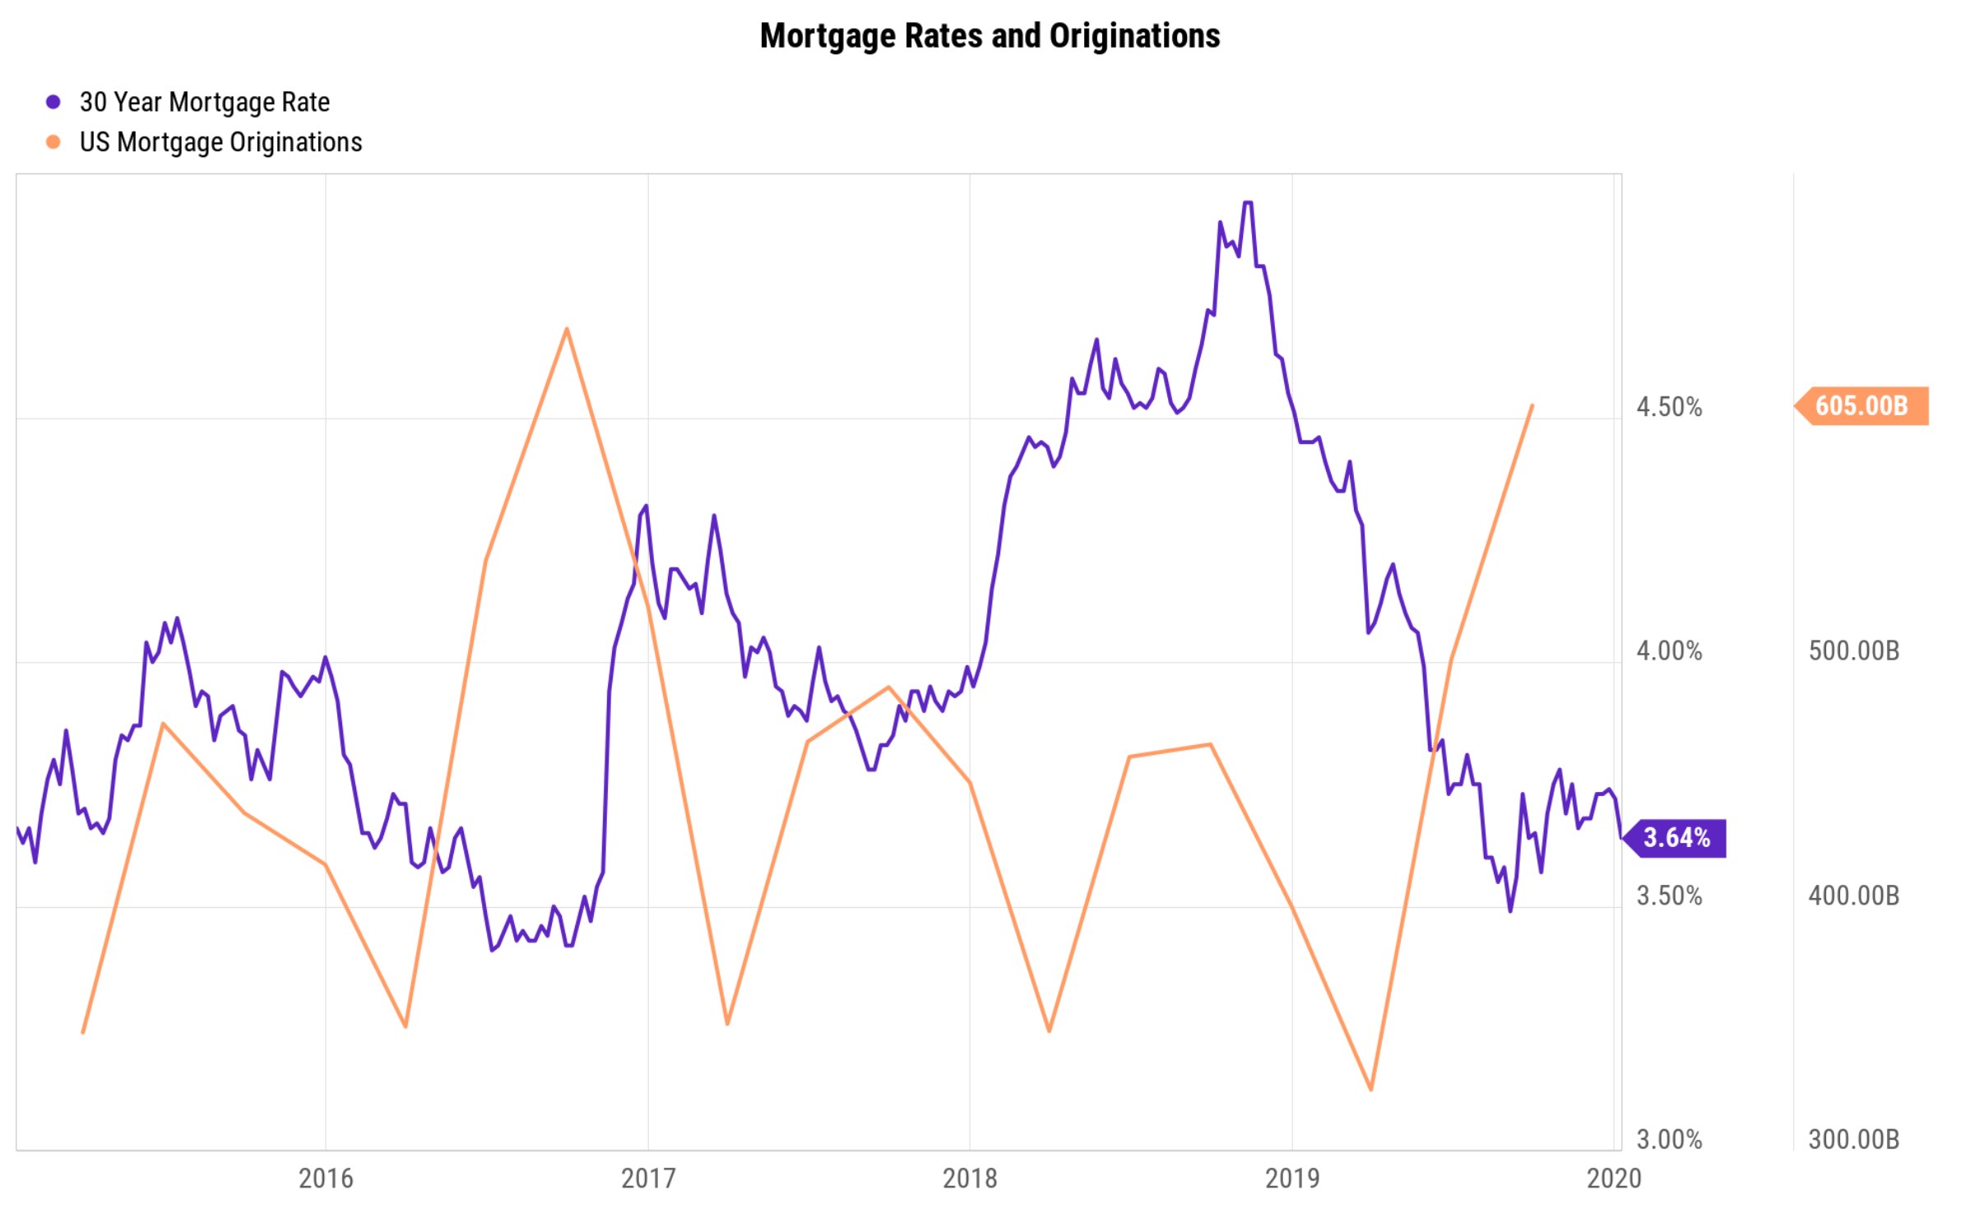
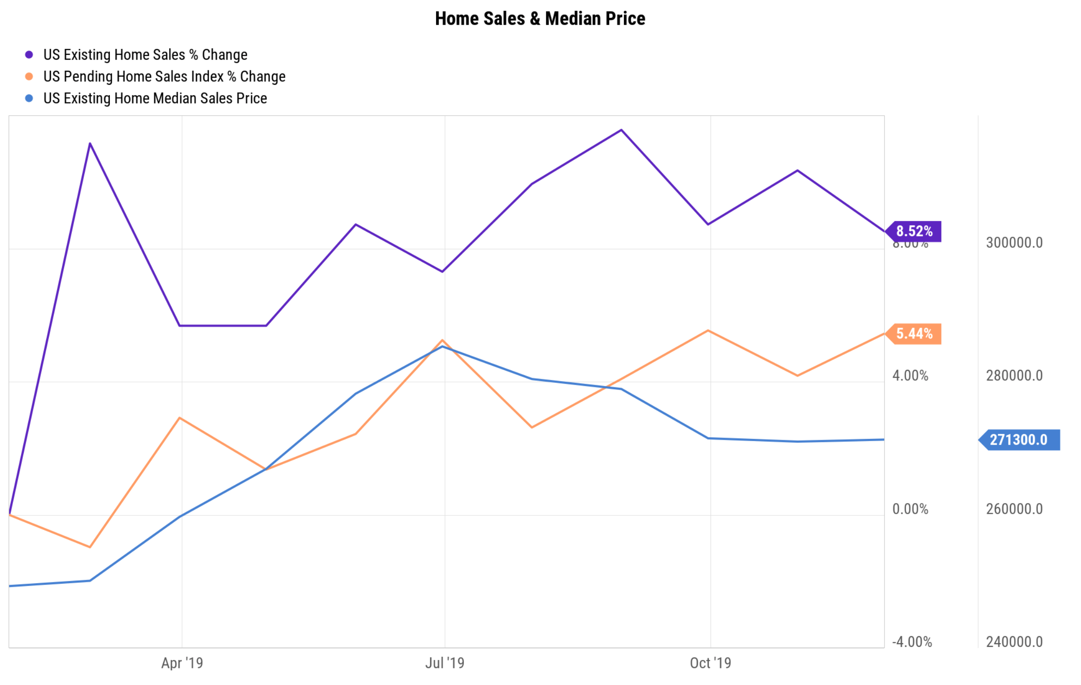
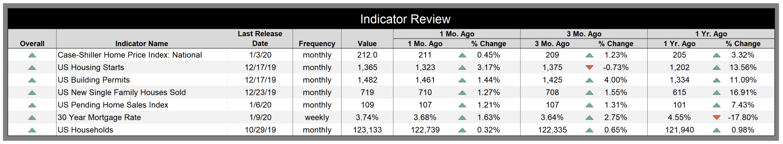
Housing Indicators
Notes:
Mortgage rates have continued to stay low, coupled with a strong economy, have led to the housing market remaining strong. Fear of rising rates may have led to a significant increase in mortgage originations in Q4 2019 – refinancing activity was especially high. Indicators across the board for the housing sector posted positive data.

Slide 7
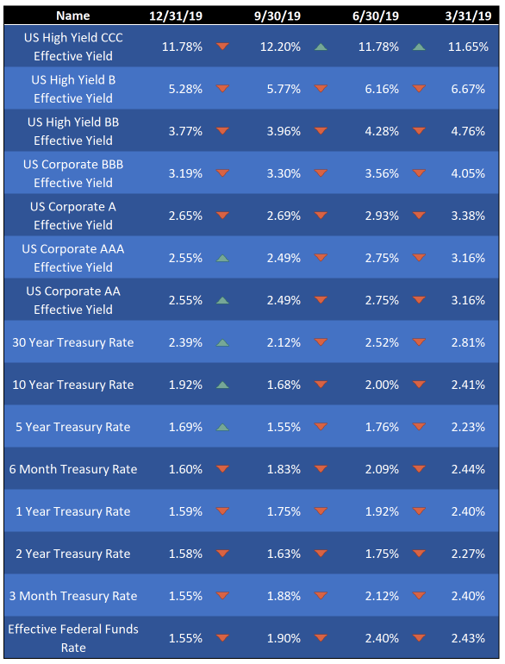
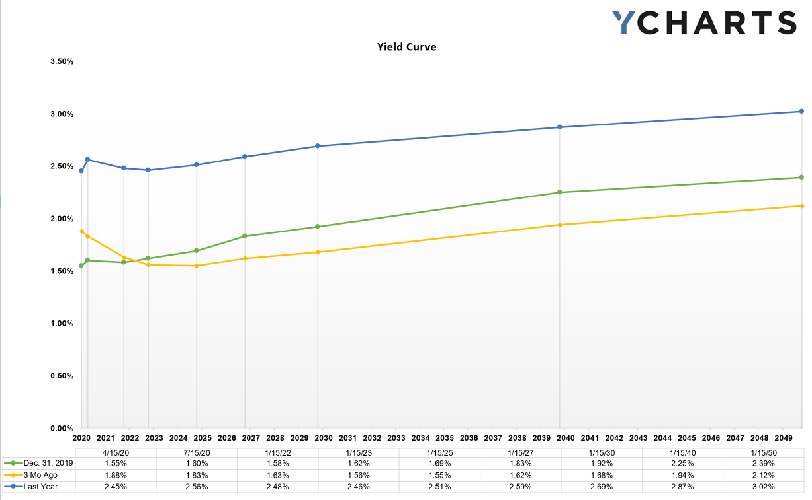
Interest Rates
Notes:
Remember all that chatter about the inverted yield curve and the pending doom which it forecasted? The last several months have seen the curve move back towards a more traditional shape, with longer maturity issues yielding more than their shorter-term counterparts. Notably, however, yields are still at very low values compared to long term historical averages. The recent “steepening” of the curve (when longer maturity yields rise faster or fall slower than the shorter maturities) came from a combination of long-term rates rising and short term rates dropping. Often yields move up or down in tandem, but at different paces causing the curve to flatten or steepen. It will be worth keeping an eye on the curve still to see which direction yield trend in general.

Slide 8
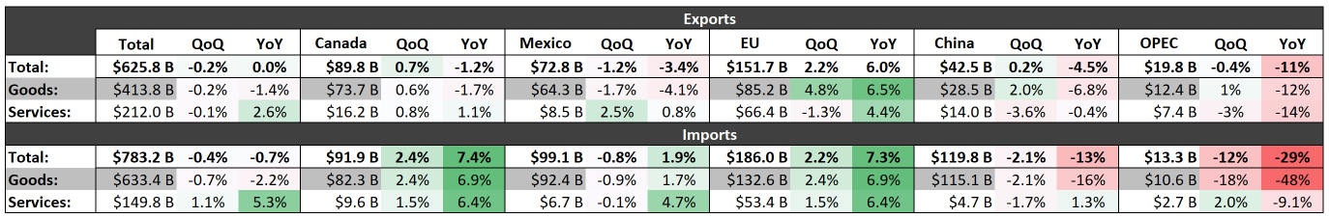
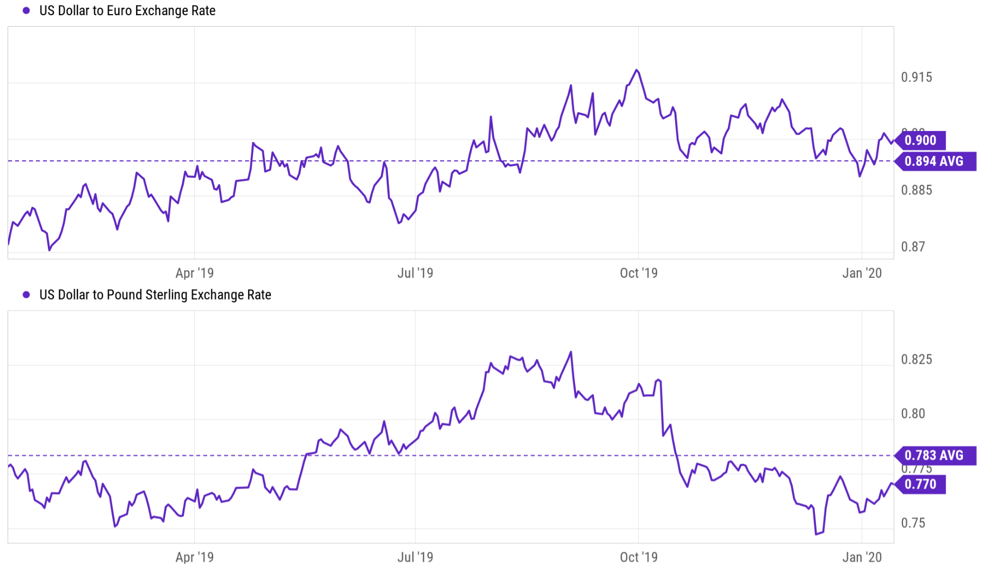
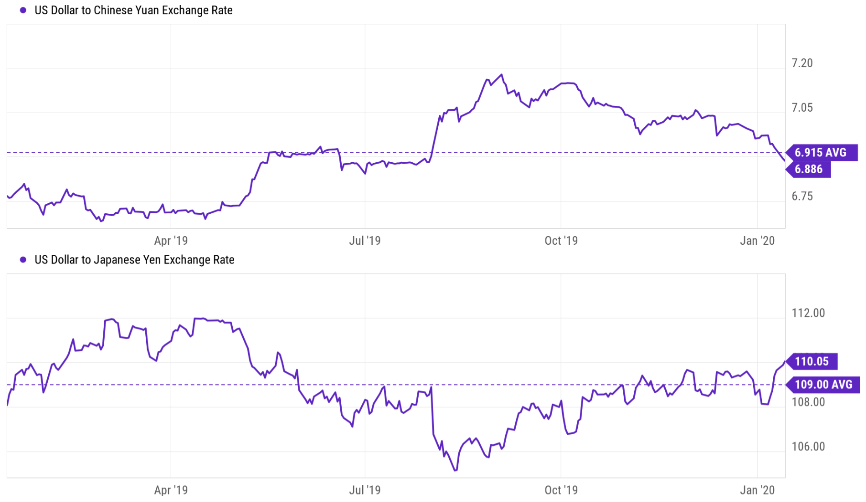
Trade & Dollar Strength
Notes:
Trade data published in the 4th quarter of 2019 showed a modest decline in both exports and imports for the US from the prior quarter. Year over year change on exports was essentially zero while imports saw a rare, albeit modest, decline. Especially notable is the continued trend in declined trade between China and the US. With the signing of the recent trade agreement it should be interesting to see how this data trends moving forward. Imports of goods from OPEC nations also continued the trend lower as US oil production continues to increase to new all-time highs. With the escalating tensions between US and Iran expect to see the how dependent (or not so) the US is on OPEC as a trending topic.
The dollar ended the year pretty close to it’s average for that same period compared to most major currencies. Despite some slowing over the 2nd half of 2019 the dollar remains historically strong after a decade of steady gains.

Slide 9
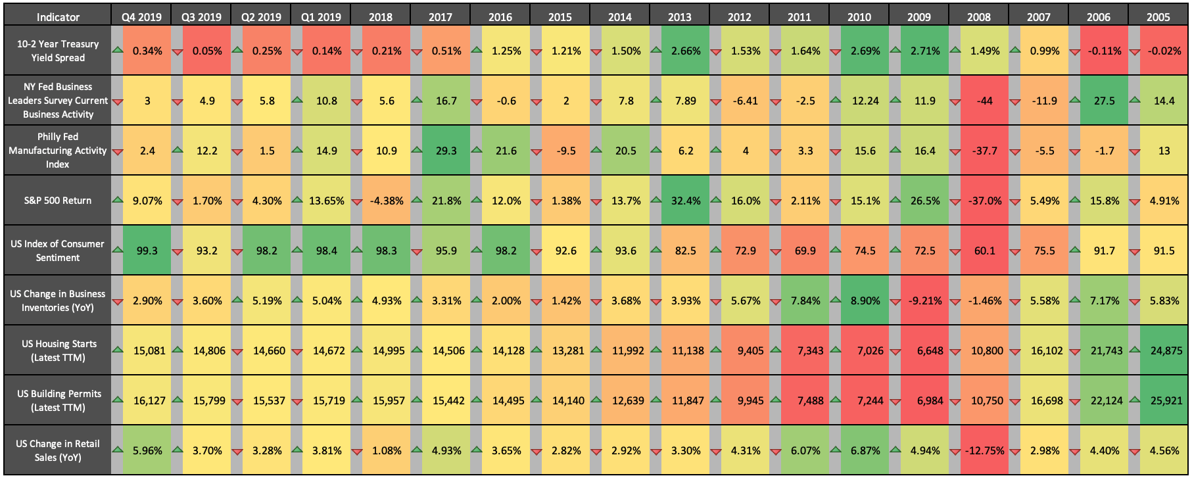
Leading Indicator Summary & Trends
Notes:
This table summarizes some of the most commonly tracked indicators for forecasting economic cycles. The arrows indicate whether an indicator improved or weakened since the prior period while the color shading indicates how strong any value is compared to the displayed historical range of that indicator. The latest data has presented some positive signs but also some concerns for upcoming economic expansion. Housing, retail sales, and consumer confidence all trended upward and posted very strong results. Business and manufacturing activity, however, posted weaker results and are showing a bit of a downtrend. Treasury yield spreads are widening, but still historically low while the stock market had a very strong quarter ending one of the best years ever.

Slide 10
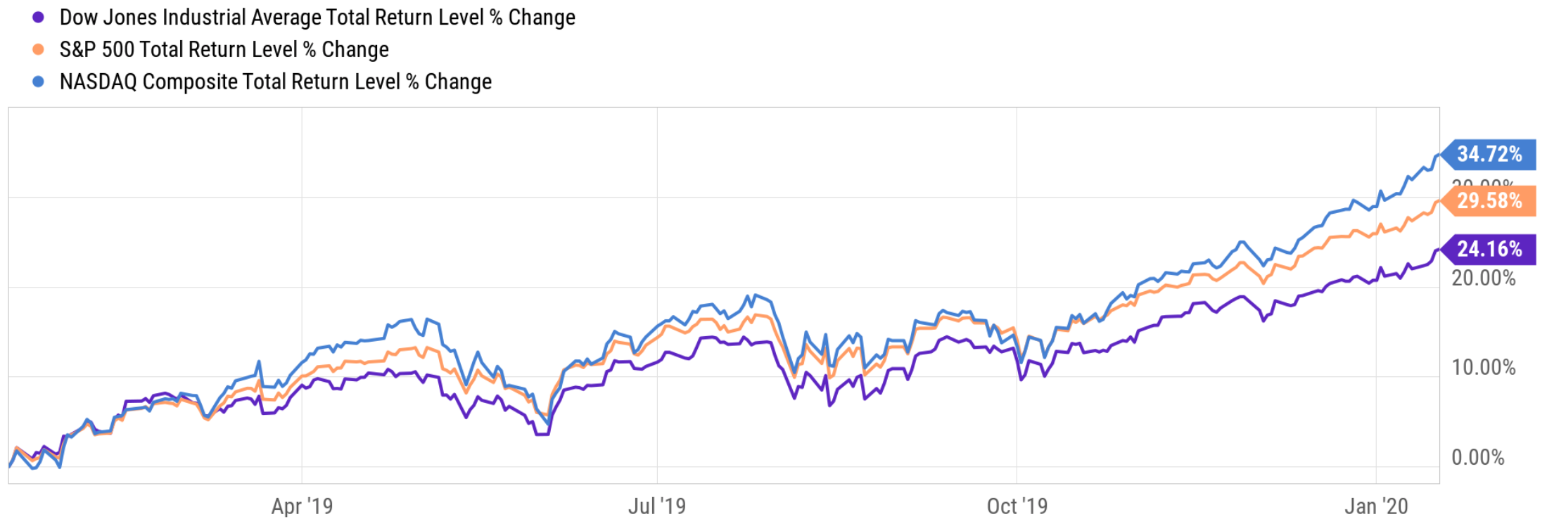
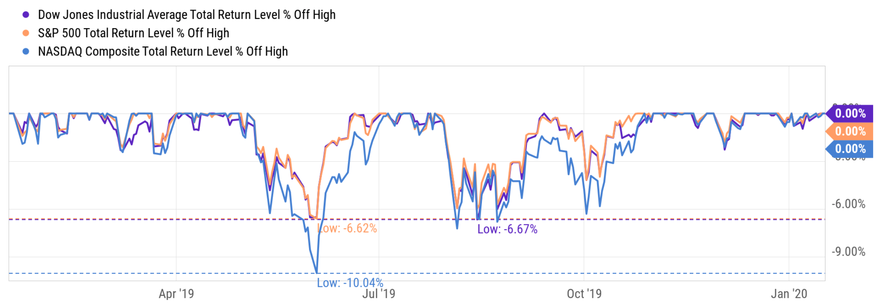
All-Time Highs
Major stock market indices soared to all-time highs…
…and spent much of 2019 making new highs with modest drawdowns.

Slide 11
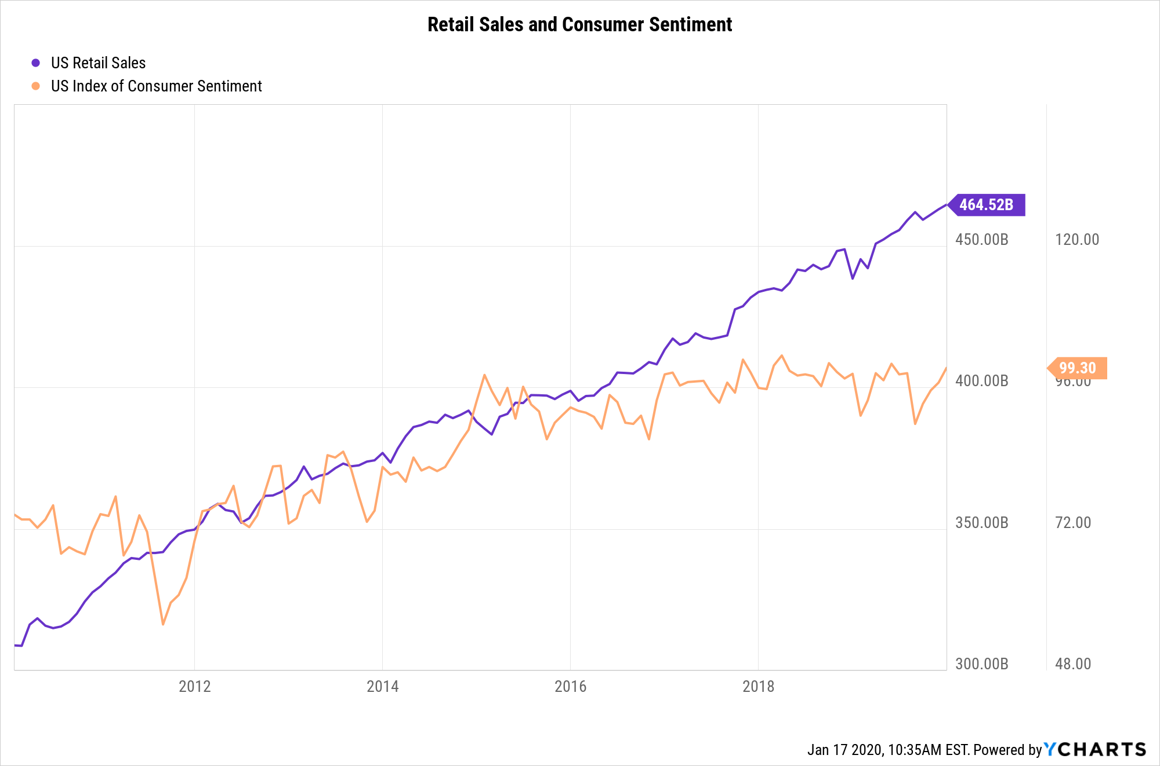
Strong Sales and Consumer Sentiment

Slide 12
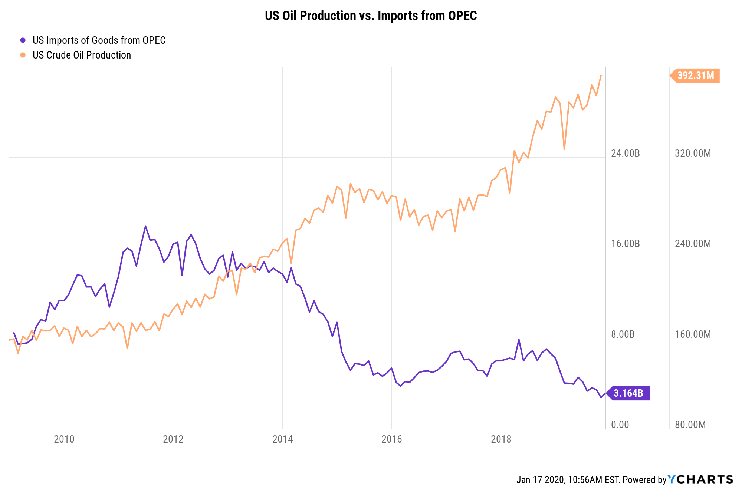
Closer Look at Trade w/ OPEC

Slide 13
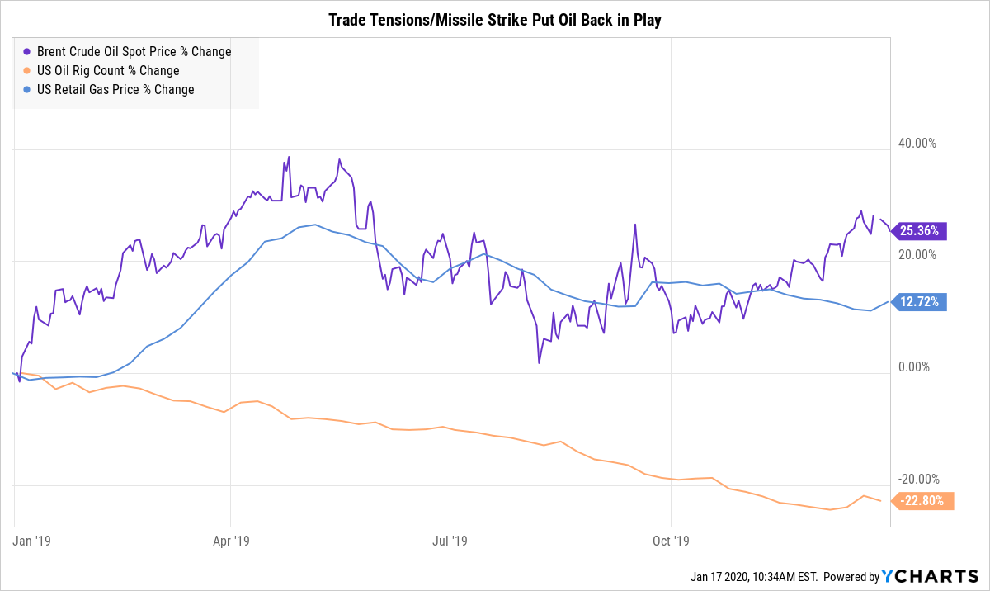
Action in Oil Markets
Notes:
While oil has taken a backseat to rallies in other sectors, 2020 should be an interesting year for oil overall. With recent events like the China trade deal and tensions with Iran, oil prices have risen. In 2019 specifically, the Brent Crude Oil Spot price rose 25.36%, while supply decreased as well. Additionally, the consumer has been affected by this with the US Retail Gas Price also increasing by 12.72%.

Slide 14
A look back at the 2010s
A few charts that summarize some trends from the last decade.

Slide 15
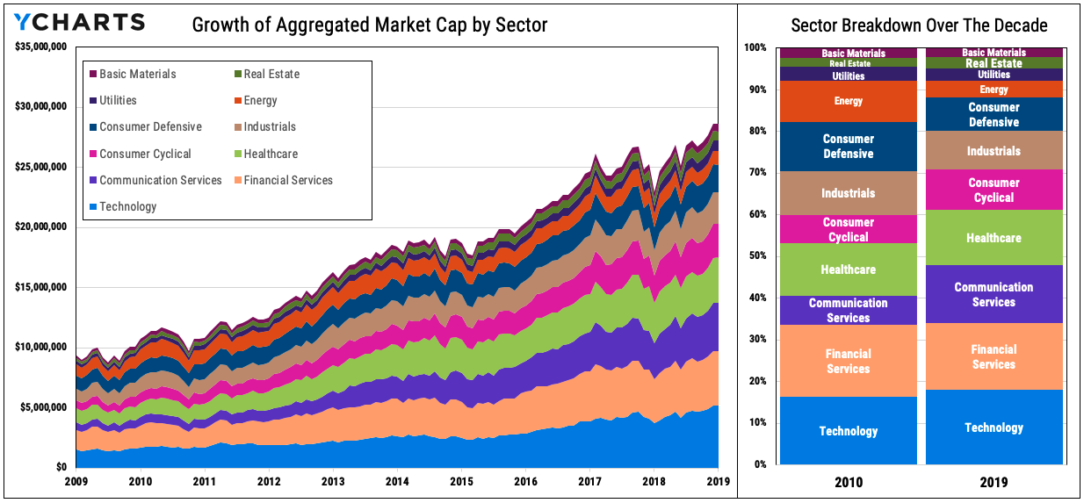
Charts of the Decade
Notes:
The current S&P 500 constituents have grown quite a bit in the last decade. When breaking it down by each sector that these constituents are in, you can see how Energy has shrunk the most, while Communication Services and Consumer Cyclical have grown over the decade.

Slide 16
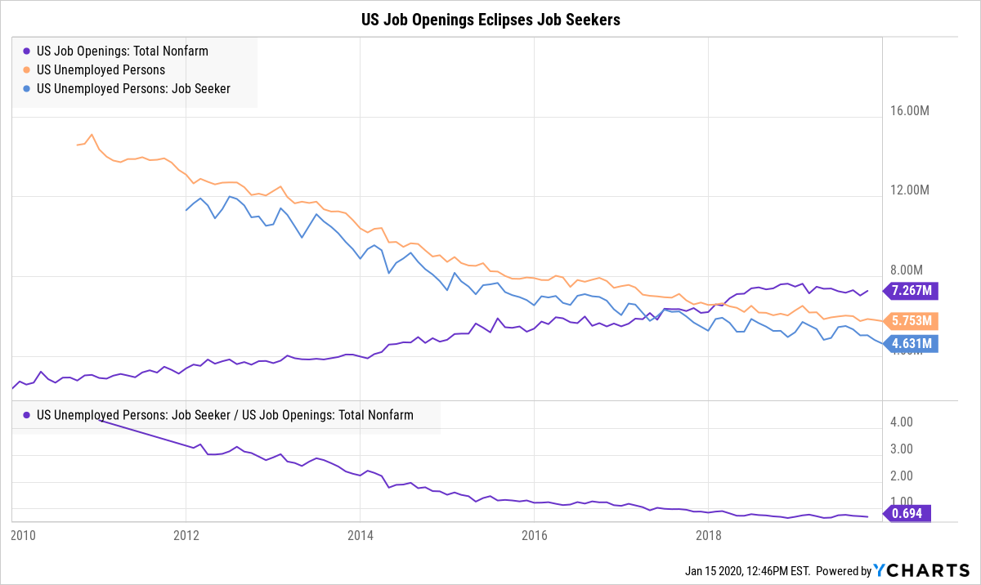
Charts of the Decade
Notes:
The US unemployment rate was 9.7% in January 2010 but steadily decreased to 3.5% at the end of 2019. Even so, US Job Openings eclipsed US Job Seekers in mid 2017, a sign there is room for the US workforce to continue to grow
The bottom ratio of US Job Seekers to US Job Openings shows that in December 2011, there were 3.3 job seekers for every job opening. Today, there are only 0.7 job seekers for every job opening (More jobs than job seekers).

Slide 17
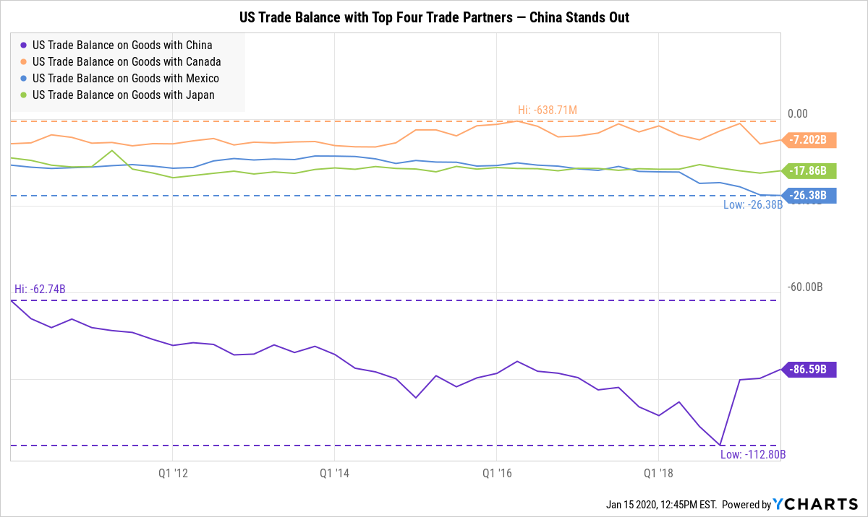
Charts of the Decade
Notes:
The United States’ top trade partners, in order: China, Canada, Mexico, and Japan
While trade deficits with its 2nd through 4th largest partners stayed largely unchanged throughout the decade, the US trade deficit with China was much more volatile. The US-China deficit consistently increased until Q4 2018 before reversing its trend and decreasing in each quarter of 2019 thus far
Despite the recent narrowing, the US trade deficit with China increased 49% during the 2010’s decade

Slide 18
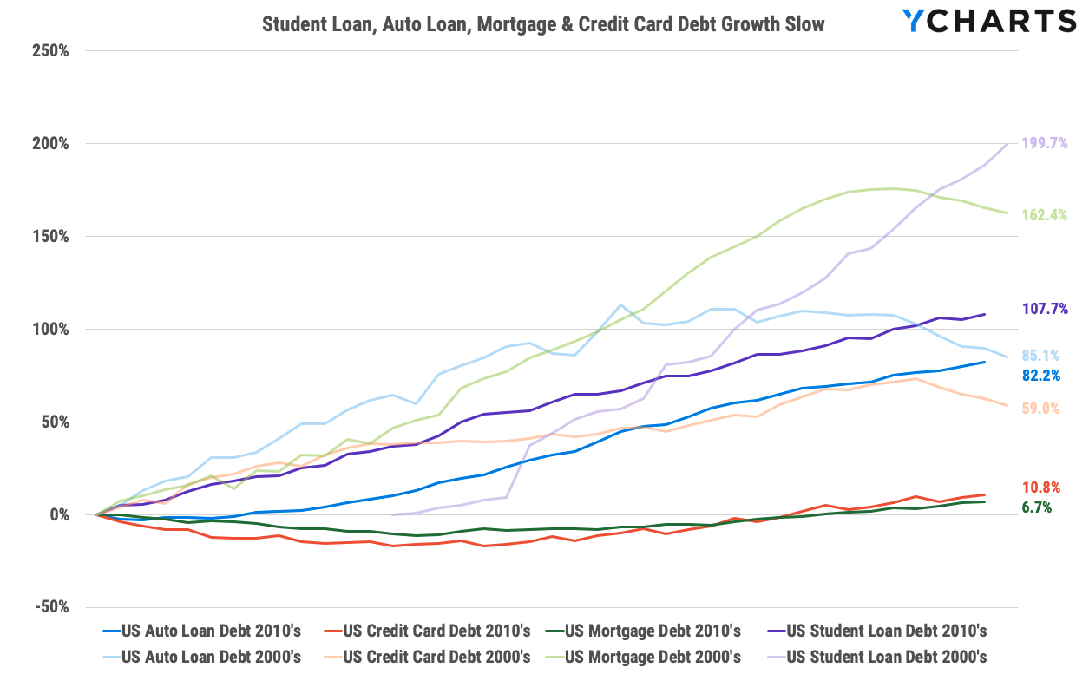
Charts of the Decade
Notes:
Growing consumer debt, specifically from student loans, has been identified as a cause of concern for the US economy; but growth in four categories of consumer debt slowed over the last decade
Student Loan Debt increased 199.7% from 2000-09, and 107.7% from 2010-19
Mortgage Debt increased 162.4% from 2000-09, and only 6.7% from 2010-19 (most likely due to the housing crisis in the previous decade, but this illustrates the consumers’ rising preference to rent, rather than buy a house)
Auto Loan Debt increased 85.1% from 2000-09, and 82.2% from 2010-19

Slide 19
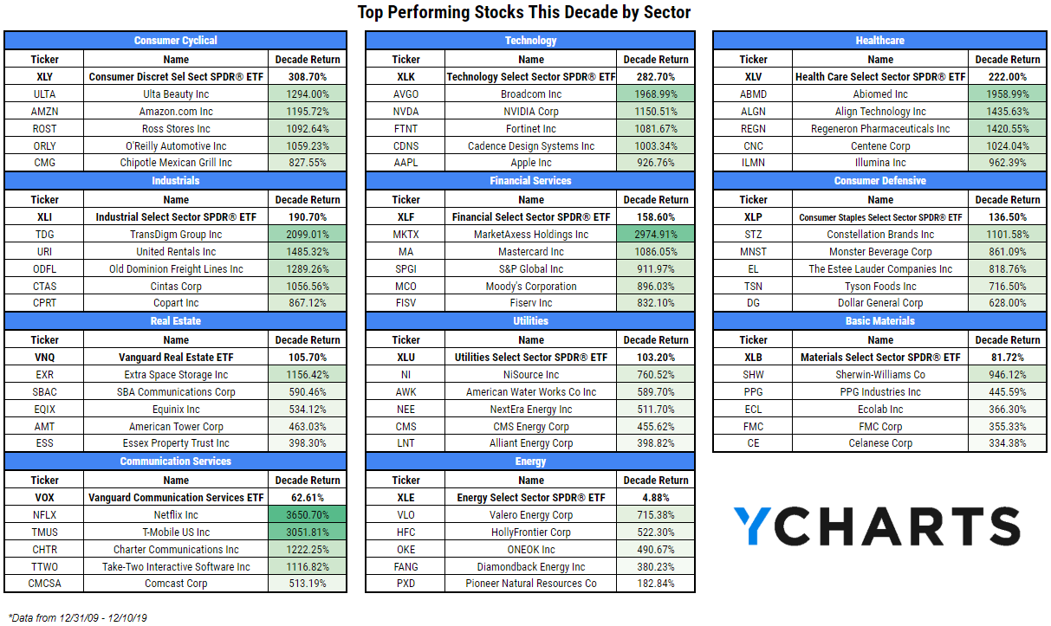
Charts of the Decade
Notes:
The 2010’s decade was particularly kind to the Consumer Cyclical and Technology, the only two sectors to outperform the S&P 500’s total return of 248.2%
The best stock of the decade was Netflix (NFLX), up 3650.7% over just less than 10 years, with an annualized return of nearly 44%; even so, the stocks that make up the new Communication Services sector (sourced mostly from the Telecom and Tech sectors) returned only 62.6% on the decade in combination
Energy far underperformed the rest of the sectors, posting only a 4.88% decade return, 0.6% annualized

Slide 20
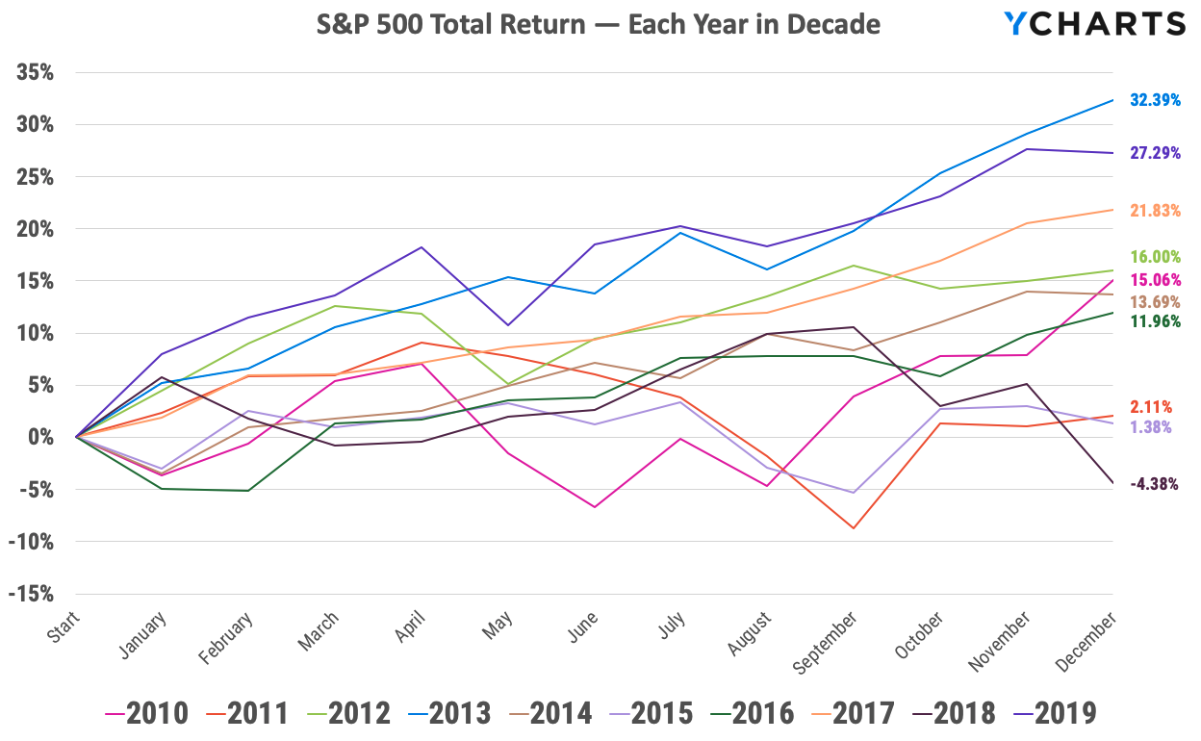
Charts of the Decade
31.49%
Notes:
This chart plots the S&P 500 Total Return for each year of the 2010’s decade
In those 10 calendar years, the S&P 500 finished lower only one time, losing 4.4% in 2018
3 years had gains in excess of 20% (‘13, ‘17, ‘19)
7 years had gains in excess of 10% (‘10, ‘12, ‘13, ‘14, ‘16, ‘17, ‘19)
4 years went lower in January, but the S&P went on to gain more than 10% in 3 of those years

Slide 21
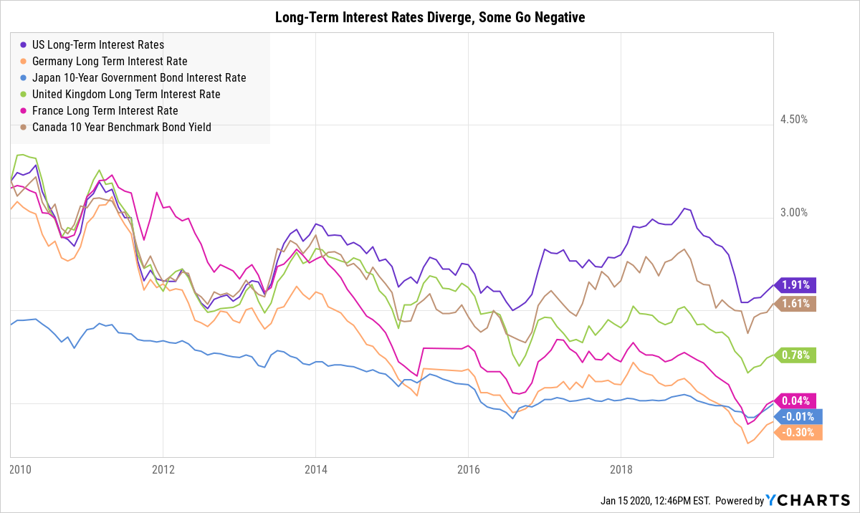
Charts of the Decade
Notes:
Interest rates around the world were largely consistent to start the decade, when the US, Germany, UK, France, and Canada all offered long-term interest rates in the 3.1% to 3.6% range (Japan’s was at ~1.3%)
Over the decade, several countries (Japan, France, Germany, etc.) moved to negative interest rate policies and the spread between different governments’ rates widened

Slide 22
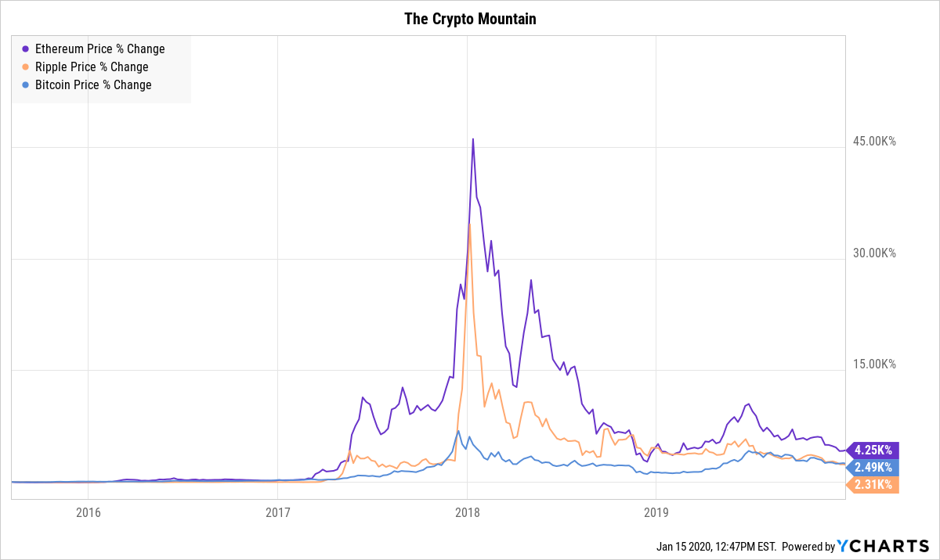
Charts of the Decade
Notes:
Cryptocurrencies forever changed the regulatory landscape of financial markets when we asked, “is this a security?”
Bitcoin, Ethereum, and Ripple, three of the largest cryptos, had their heyday in H2 2017 and H1 2018
While the chart shows a huge spike then fall from grace, Bitcoin is still up 2.5K% since mid-2015

Slide 23
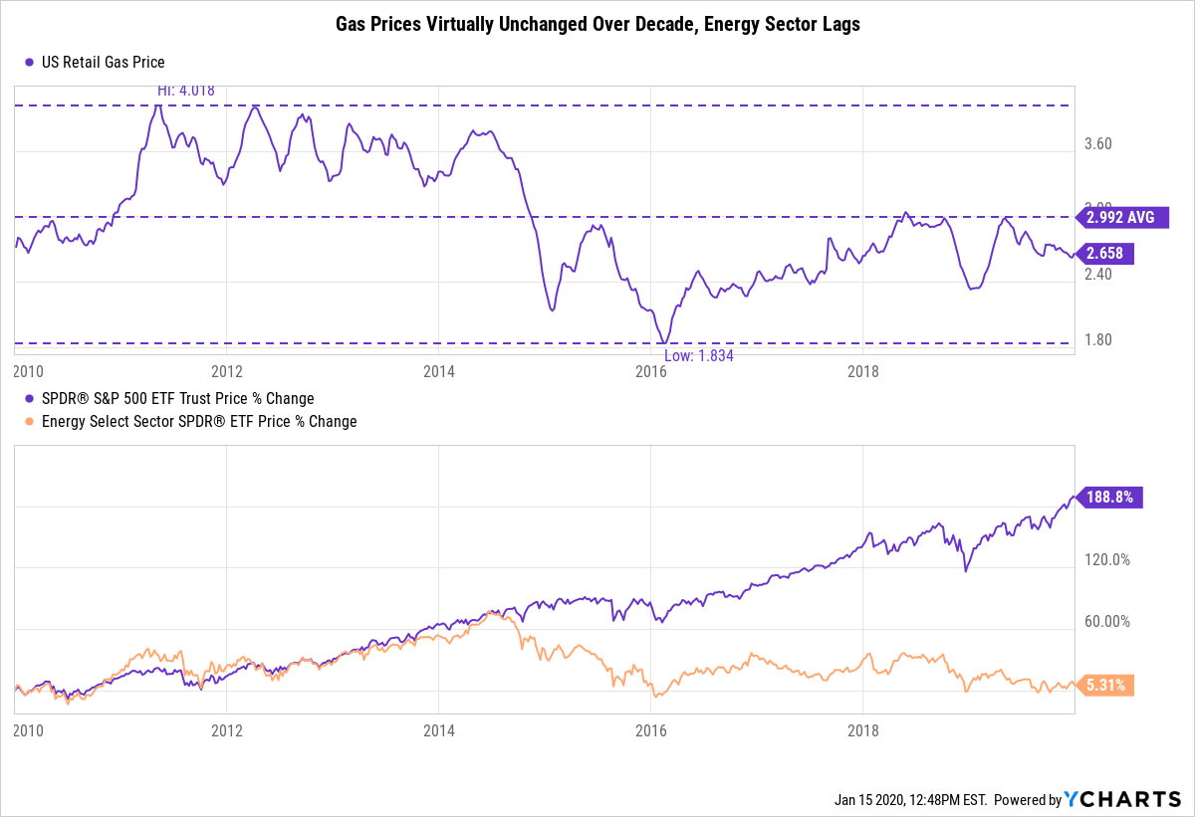
Charts of the Decade
Notes:
While some people might say “everything went up this decade”, the outlier in the bunch is energy.
US Retail Gas Prices per gallon ended pretty much right where they started.
While the SPDR S&P 500 ETF gained about 184.4% over the last decade, the energy sector was pretty much flat through the same time frame.

Slide 24
YCharts is not registered with the U.S. Securities and Exchange Commission (or with the securities regulatory authority or body of any state or any other jurisdiction) as an investment adviser, broker-dealer or in any other capacity, and does not purport to provide investment advice or make investment recommendations by or through the Content found on the Site or otherwise. The Site and the Content are provided for the sole purpose of enabling you to conduct investment research. Other uses of the Site and the Content are expressly prohibited. Full disclosure: https://ycharts.com/about/disclosure
For more information please visit www.ycharts.com
Q4 2019
Released January 2020

