Slide 1

Economic Update
A Closer Look at Q1 2025 Data
Released April 2025

Slide 2

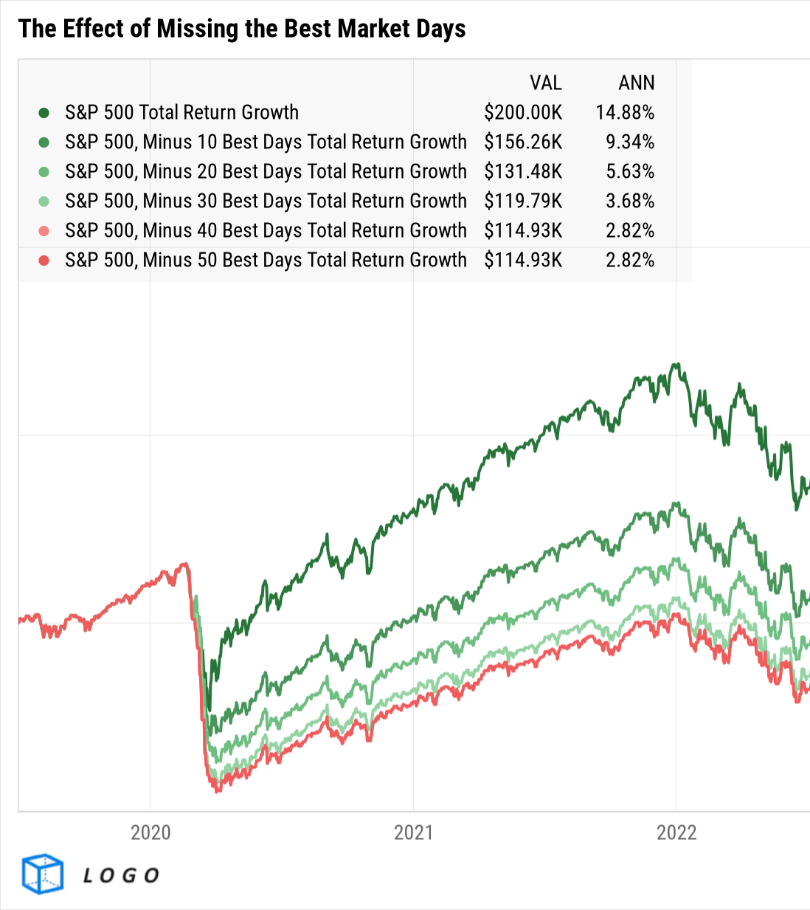




About this deck:
Use these visuals about important investing concepts in your own presentations; share with clients, prospects, colleagues, or followers online! Looking for a PDF version of this deck? Download it here.
If you’ve uploaded a logo to YCharts, all visuals in YCharts will appear with that logo.
Not yet a YCharts user? Get started today:
Start a Free Trial
Book a Demo
YCharts clients: have your
firm logo added to all charts!
Released April 2025

Slide 3
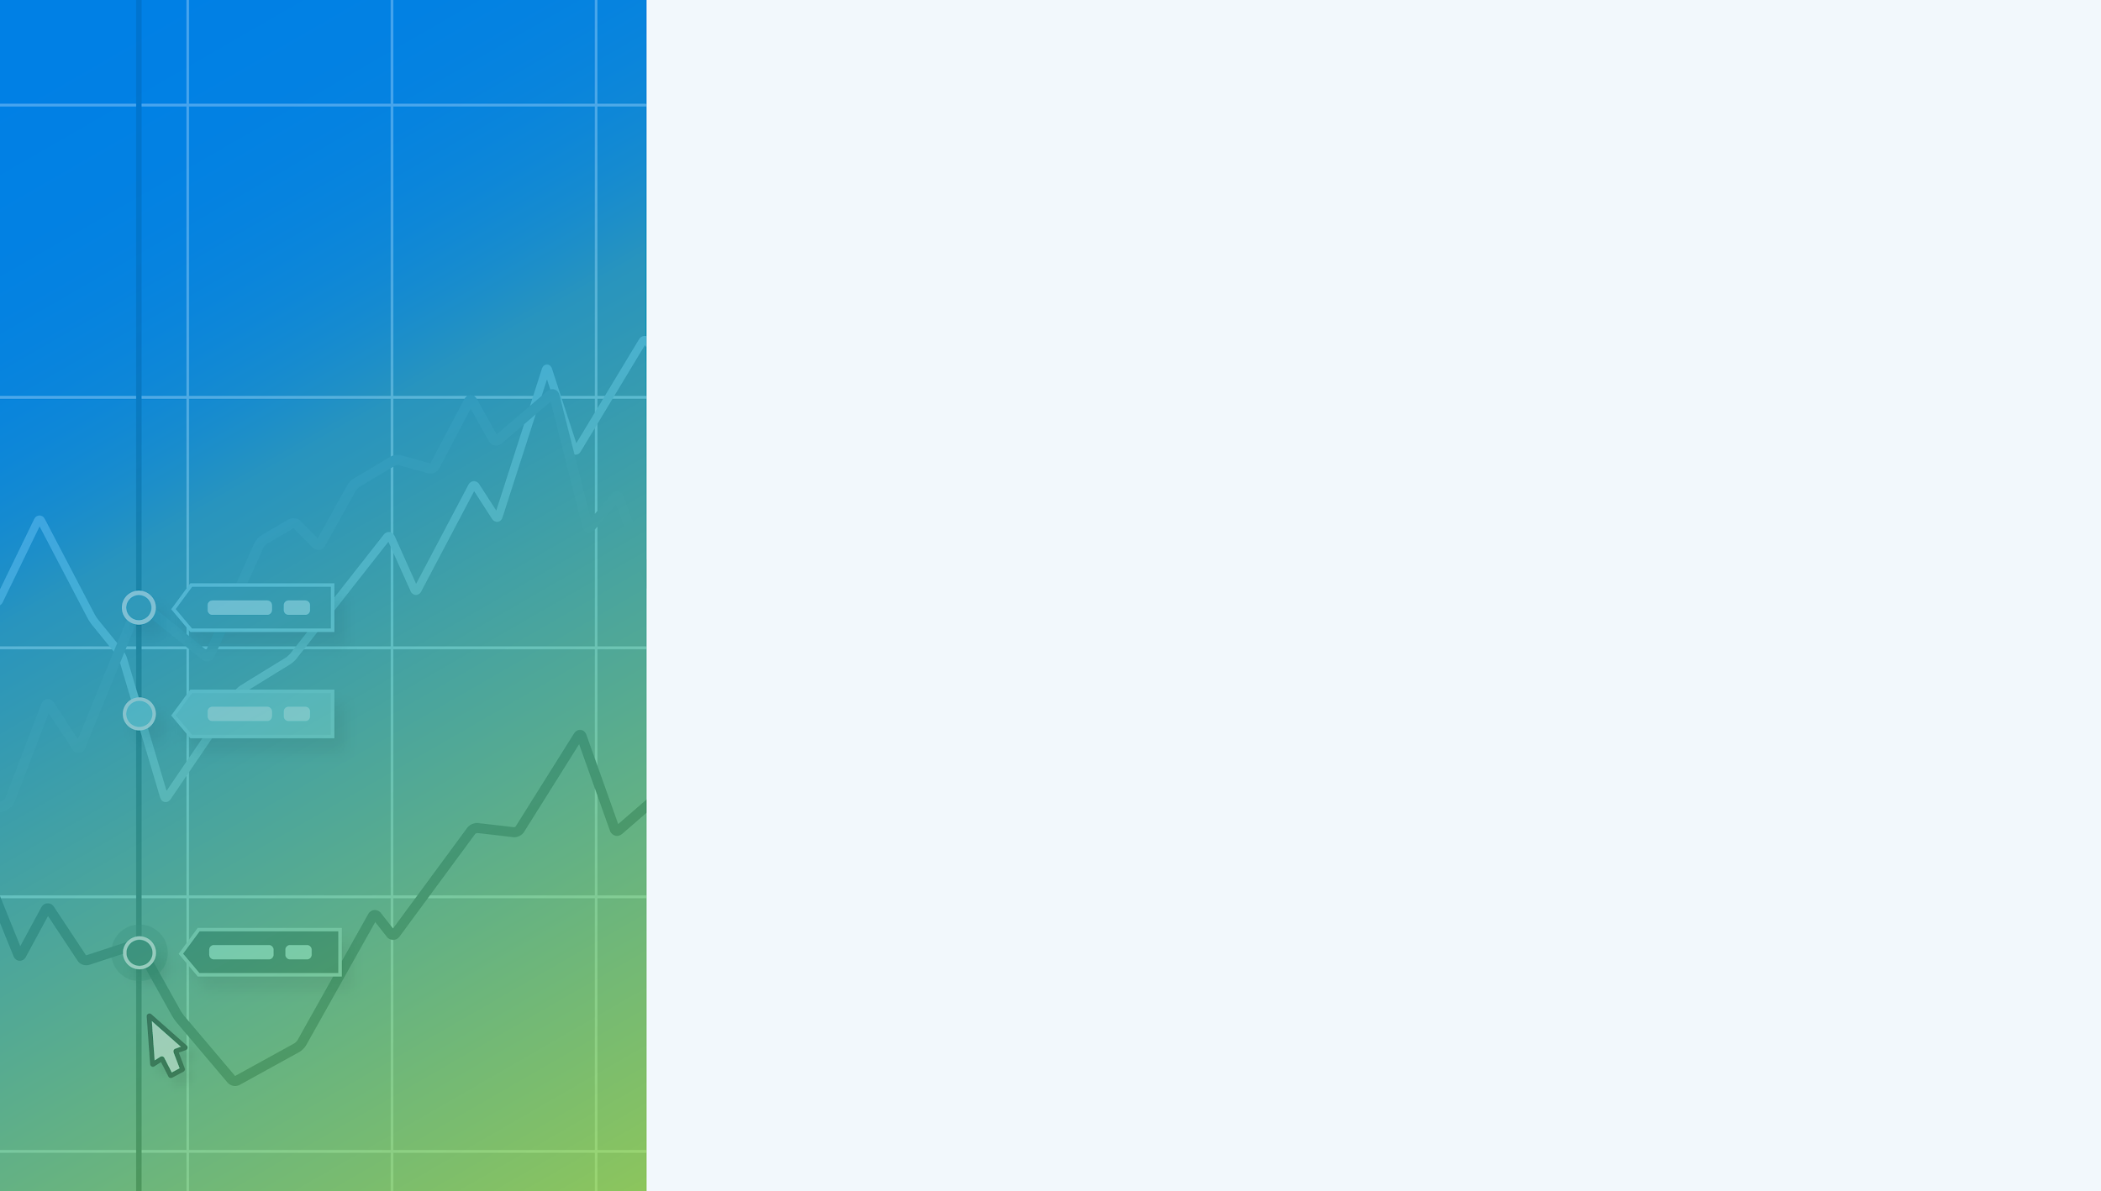

Jump to Section…
Market Data
Charts and Tables Highlighting the Performance of Stock Market Indicators and Asset Classes over the Latest Quarter
Macroeconomic Data
Leading and Lagging Economic Data and Trends from Key Economic Reports Published Recently
Bonds & Interest Rates
Collection of Data Summarizing Moves in the Fixed Income Markets over the Last Quarter
Charts of the Moment
Visuals Depicting Trends that are Impacting the Markets
and Investments
Notes:
→ Don’t forget to expand and leverage the commentary provided in the speaker notes section for more details on each slide!

Slide 4
Market Data
Charts and Tables Highlighting the Performance of Stock Market Indicators and Asset Classes over the Latest Quarter

Slide 5
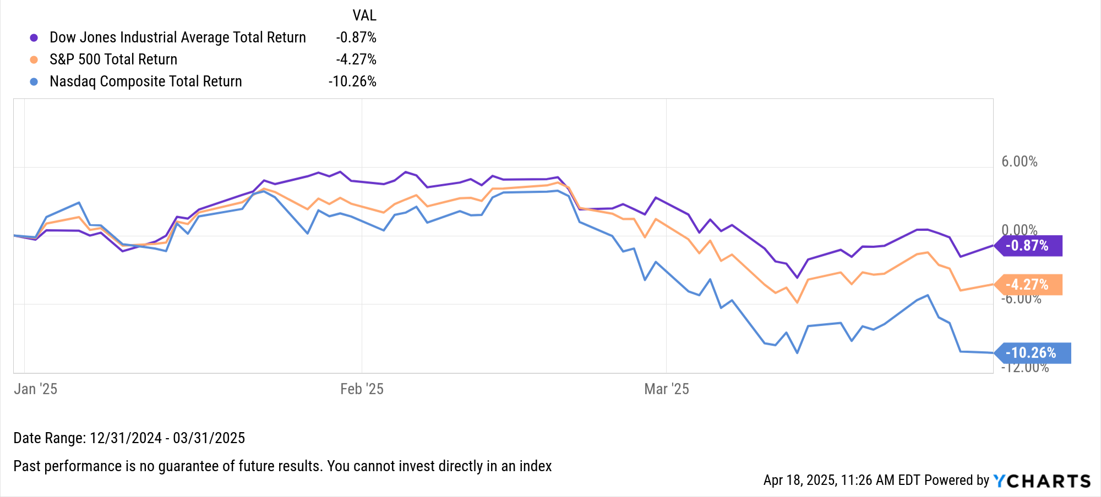

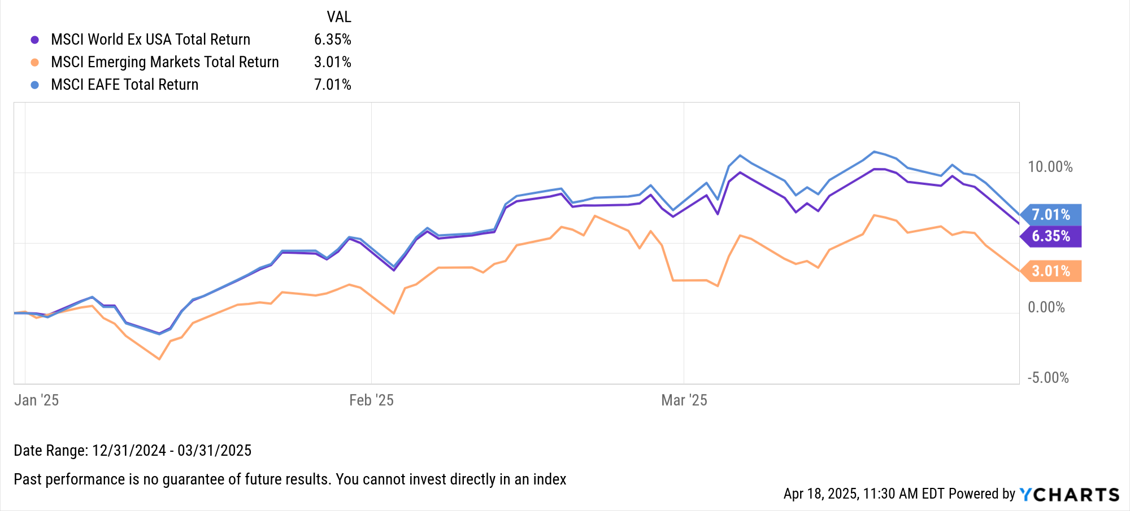
Key Stock Market Index Performance
US Markets | Q1 2025 Return
Dow Jones Industrial Average Total Return | -0.87%
S&P 500 Total Return | -4.27%
Nasdaq Composite Total Return | -10.26%
Global Markets | Q1 2025 Return
MSCI World Ex USA Total Return | 6.35%
MSCI Emerging Markets Total Return | 3.01%
MSCI EAFE Total Return | 7.01%
Notes:
Index Total Returns for Q1 2025:
US Indices:
Dow Jones Industrial Average Total Return: -0.87%
S&P 500 Total Return: -4.27%
Nasdaq Composite Total Return: -10.26%
Global Indices:
MSCI World Ex USA Total Return: +6.35%
MSCI Emerging Markets Total Return: +3.01%
MSCI EAFE Total Return: +7.01%

Slide 6
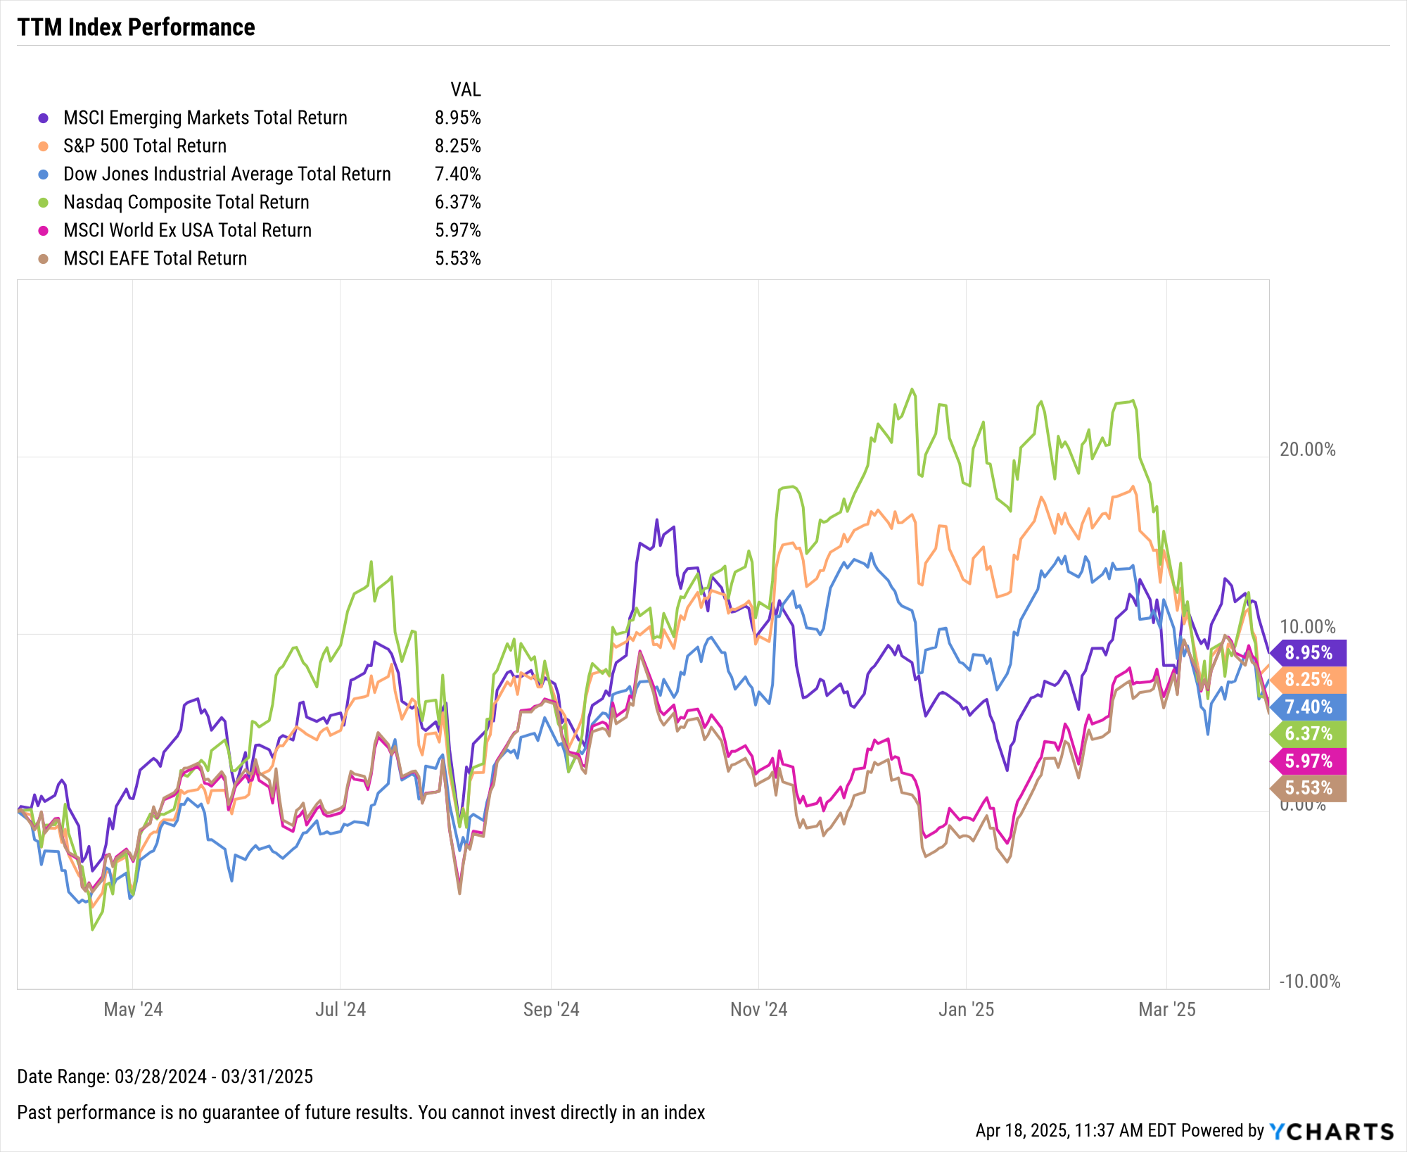
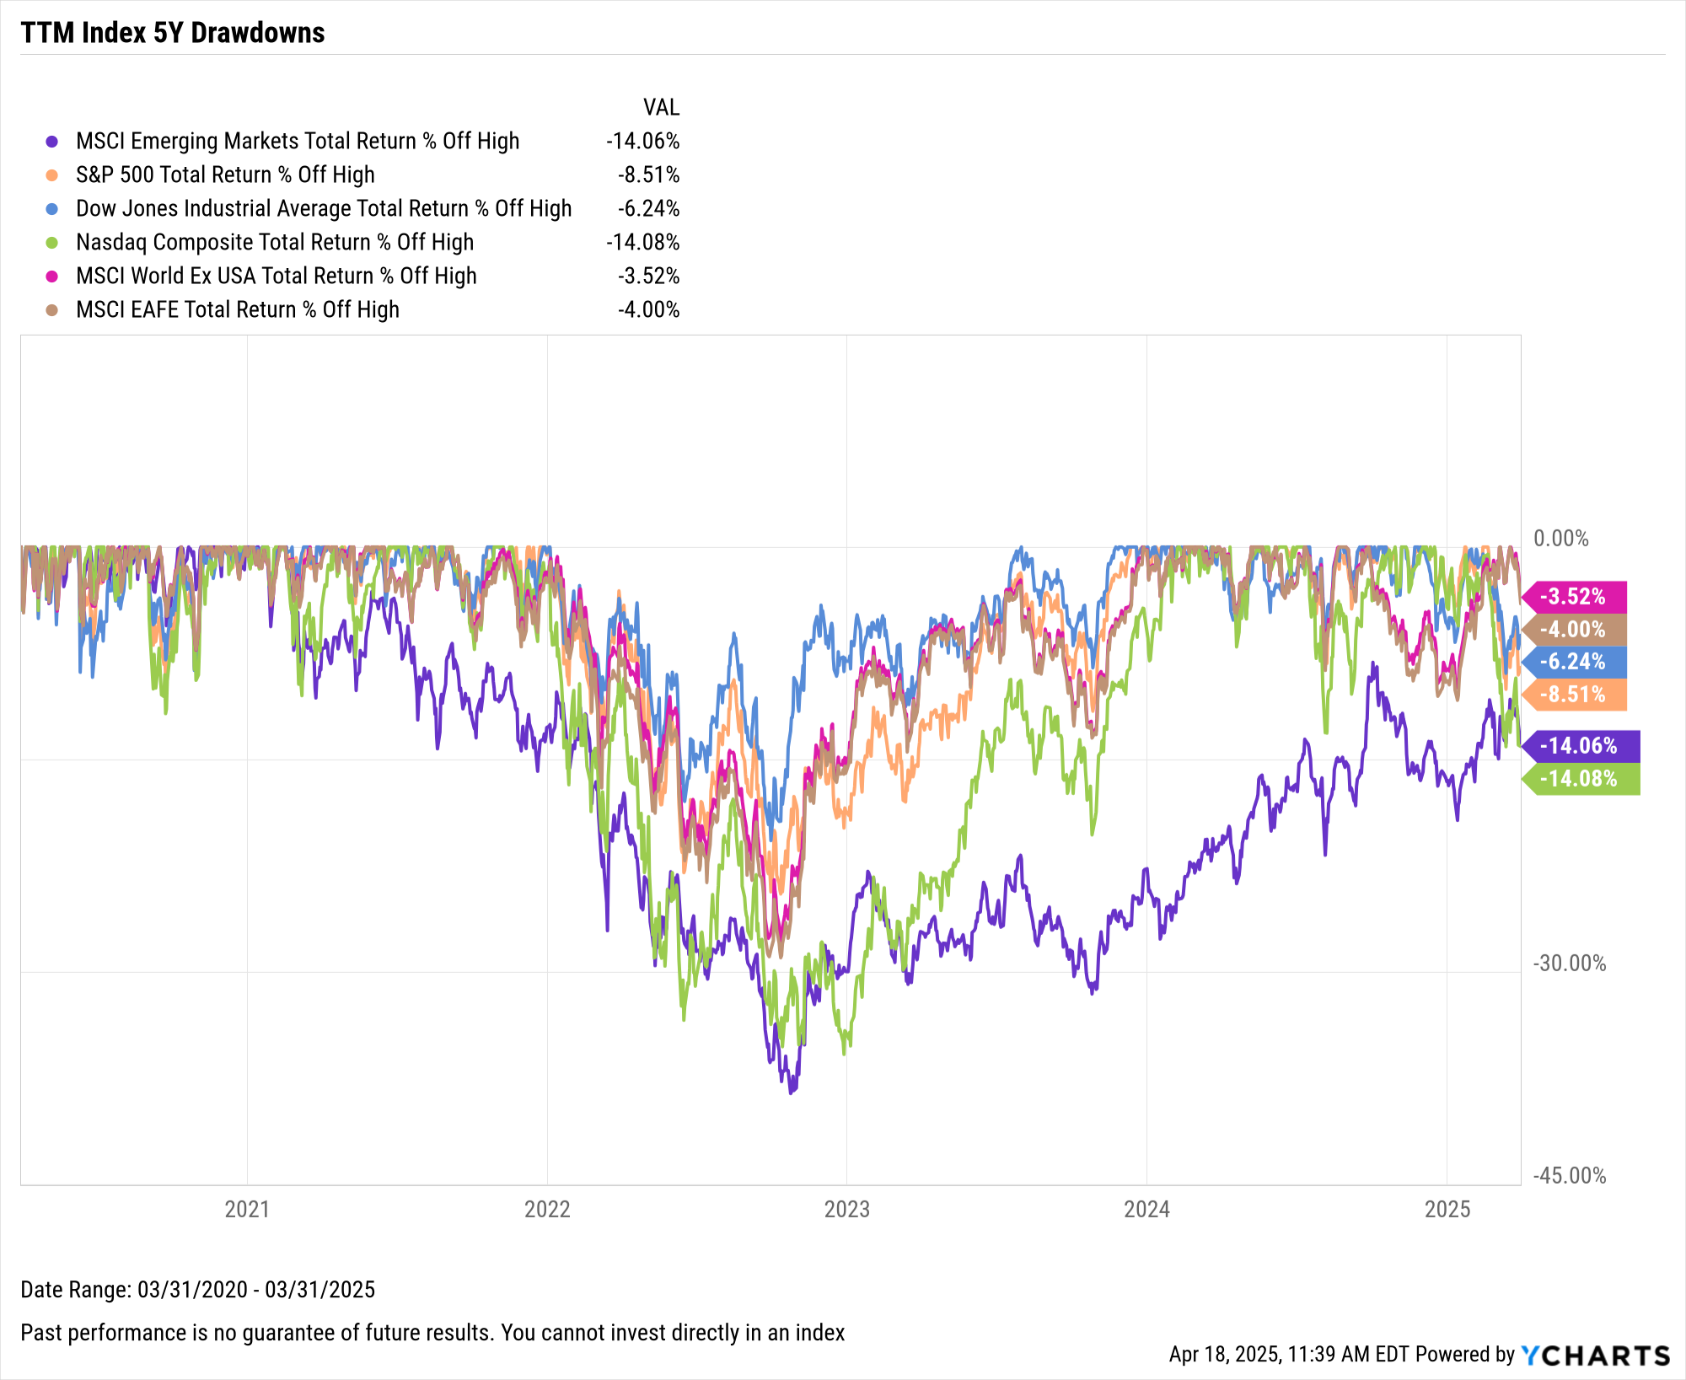
Key Stock Market Index Performance (cont.)
Notes:
L: TTM Index Returns, 3/31/2024 – 3/31/2025:
MSCI Emerging Markets Total Return: +8.95%
S&P 500 Total Return: +8.25%
Dow Jones Industrial Average Total Return: +7.40%
Nasdaq Composite Total Return: +6.37%
MSCI World Ex USA Total Return: +5.97%
MSCI EAFE Total Return: +5.53%
R: A market downturn to start 2025 forced the Nasdaq down 14% off of its all-time high while the tariff-induced correction actually helped bring Emerging Markets back to that same level.

Slide 7
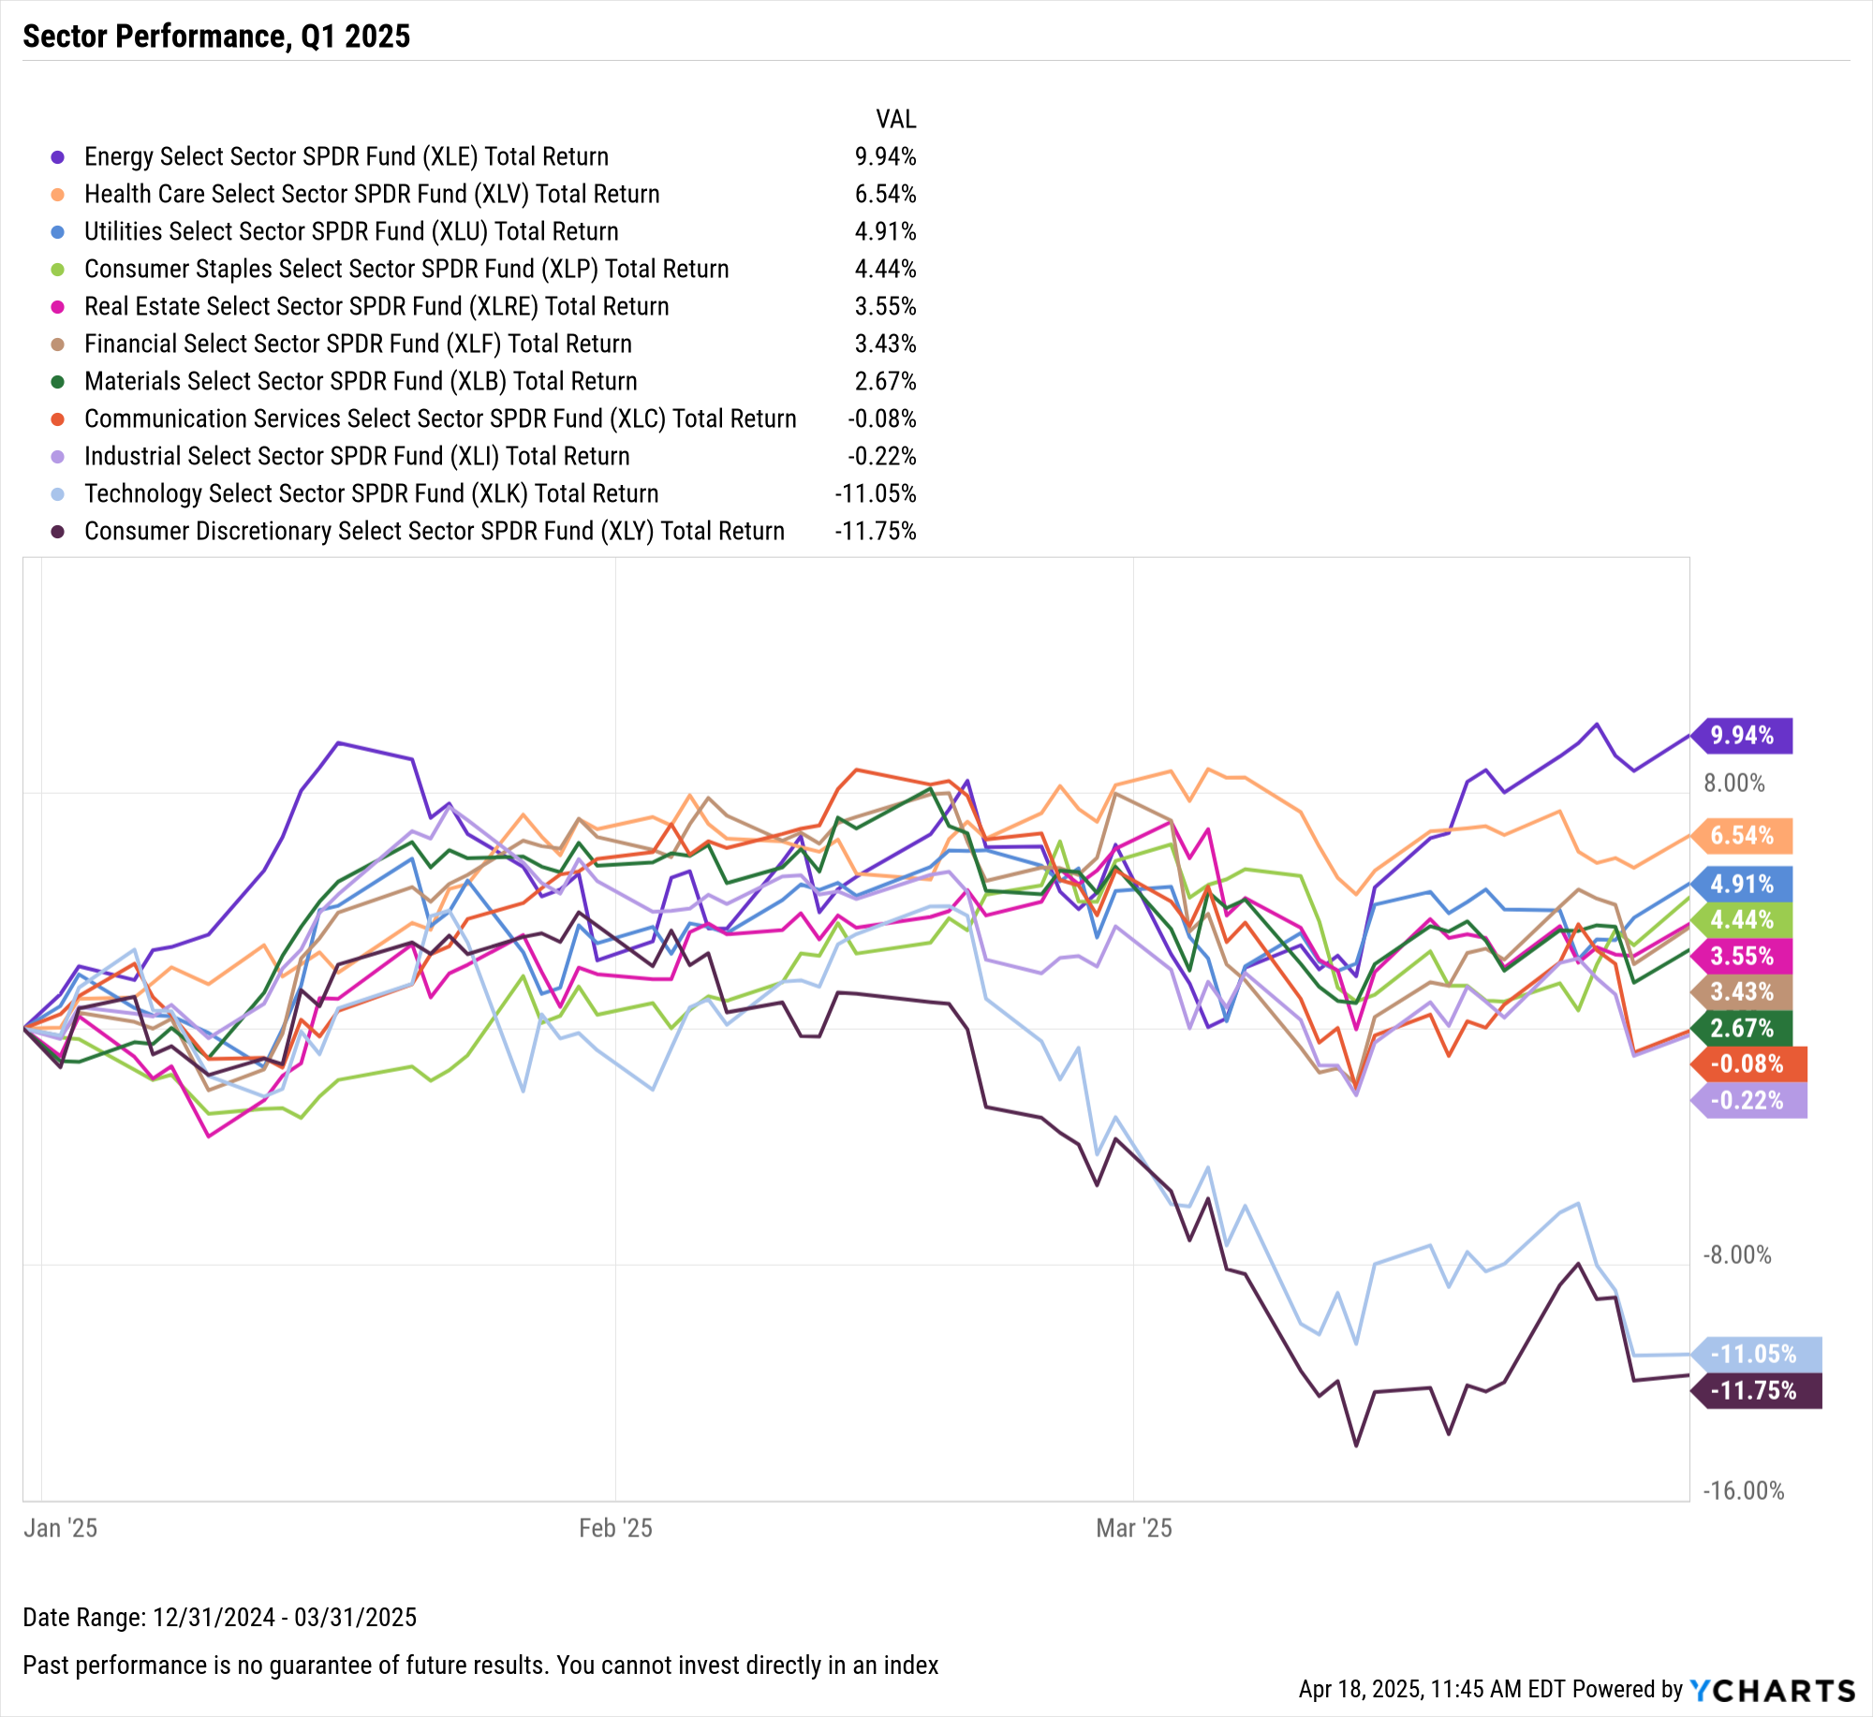
US Stock Sector Performance
Sensitive Sectors | Q1 2025 Return
Communication Services Select Sector SPDR® ETF | -0.08%
Energy Select Sector SPDR® ETF | 9.94%
Industrial Select Sector SPDR® ETF | -0.22%
Technology Select SPDR® ETF | -11.05%
Defensive Sectors | Q1 2025 Return
Consumer Staples Select Sector SPDR® ETF | 4.44%
Health Care Select Sector SPDR® ETF | 6.54%
Utilities Select Sector SPDR® ETF | 4.91%
Cyclical Sectors | Q1 2025 Return
Consumer Discretionary Select SPDR® ETF | -11.75%
Financial Select Sector SPDR® ETF | 3.43%
Materials Select Sector SPDR® ETF | 2.67%
Real Estate Select Sector SPDR® ETF | 3.55%
Notes:
Sector Total Returns for Q1 2025:
Energy: +9.94%
Health Care: +6.54%
Utilities: +4.91%
Consumer Staples: +4.44%
Real Estate: +3.55%
Financials: +3.43%
Materials: +2.67%
Communication Services: -0.08%
Industrials: -0.22%
Technology: -11.05%
Consumer Discretionary: -11.75%

Slide 8
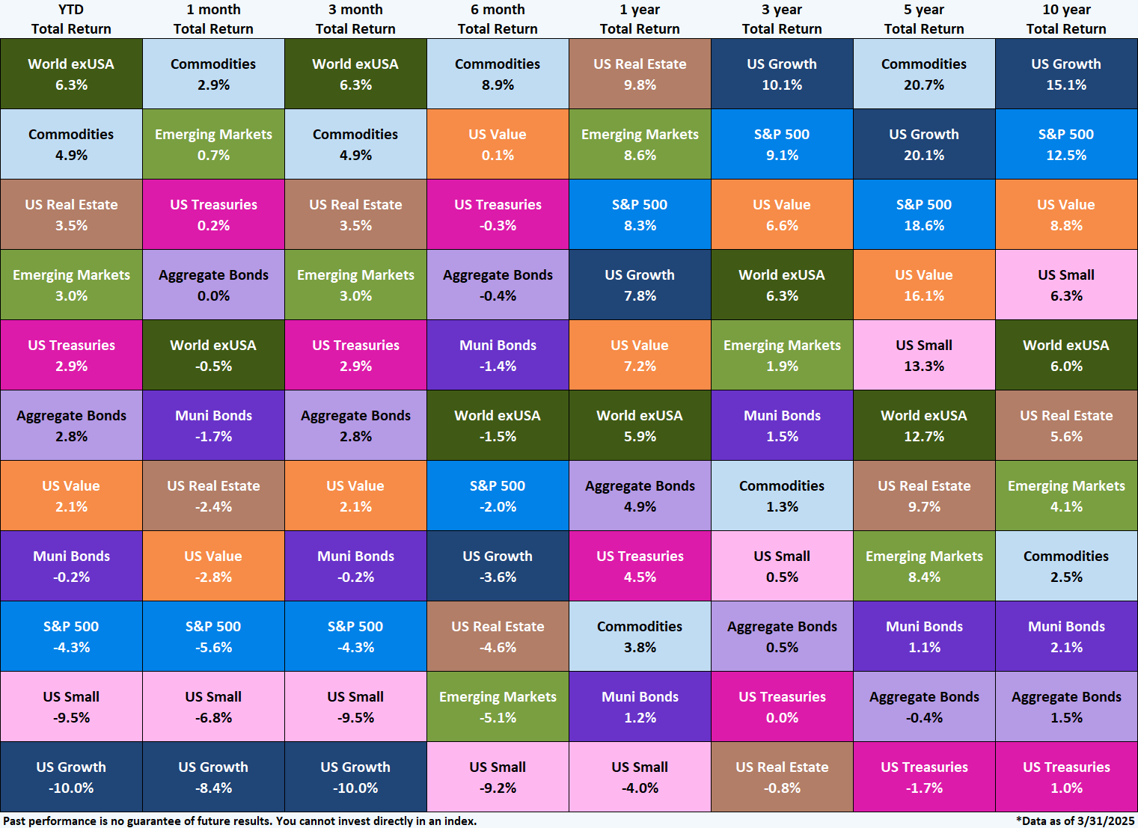
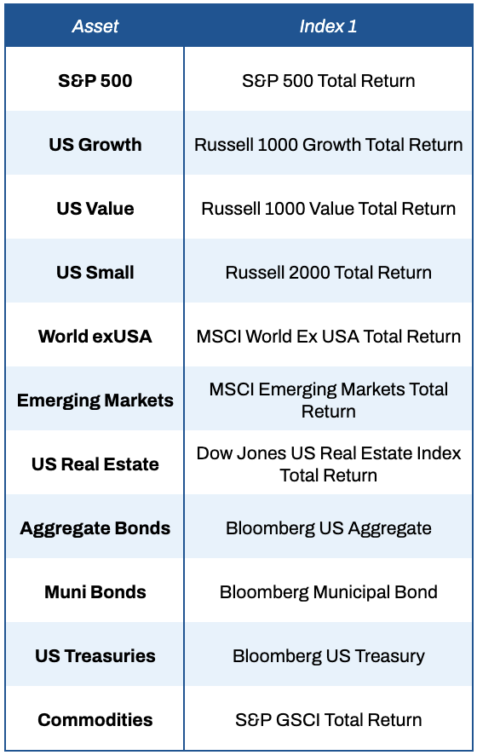
Asset Class Performance – Trailing Periods
3Y, 5Y, 10Y total returns annualized
Notes:
This table shows the performance of asset classes over different time frames. (YTD Total Return = 3 month Total Return)
Domestic stocks took a hit in Q1, with the S&P 500 falling 4.3%, US Small Caps tumbling 9.5%, and US Growth losing 10.0%. World exUSA was the best performing asset class on this heatmap with a 6.3% total return in Q1, and the Emerging Markets asset class was not far behind at 3.0%. Commodities and US Real Estate were the second- and third-best performers as market participants sought asset classes outside of stocks in Q1. Investors also fled to fixed income, as shown by the 2.9% and 2.8% gains in US Treasuries and Aggregate Bonds respectively.

Slide 9
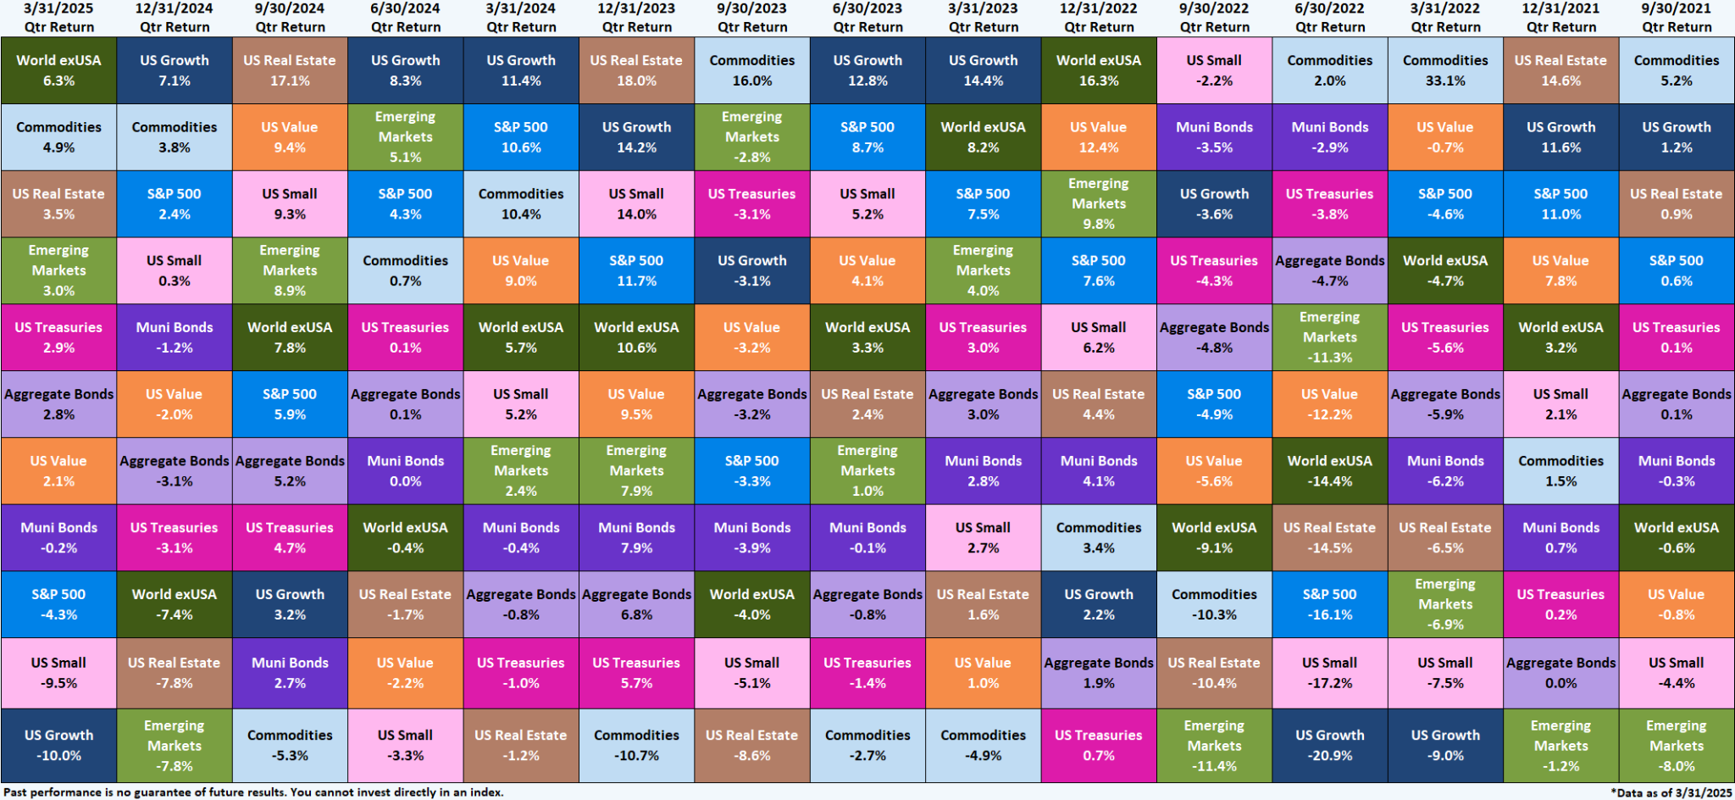
Asset Class Performance – Quarter by Quarter
Contact support@ycharts.com to access these asset class performance heatmaps
Notes:
This visual shows historical quarterly asset class performance for the last 15 quarters.
Q1 2025 Total Returns:
World exUSA: +6.3%
Commodities: +4.9%
US Real Estate: +3.5%
Emerging Markets: +3.0%
US Treasuries: +2.9%
Aggregate Bonds: +2.8%
US Value: +2.1%
Muni Bonds: -0.2%
S&P 500: -4.3%
US Small Caps: -9.5%
US Growth: -10.0%

Slide 10
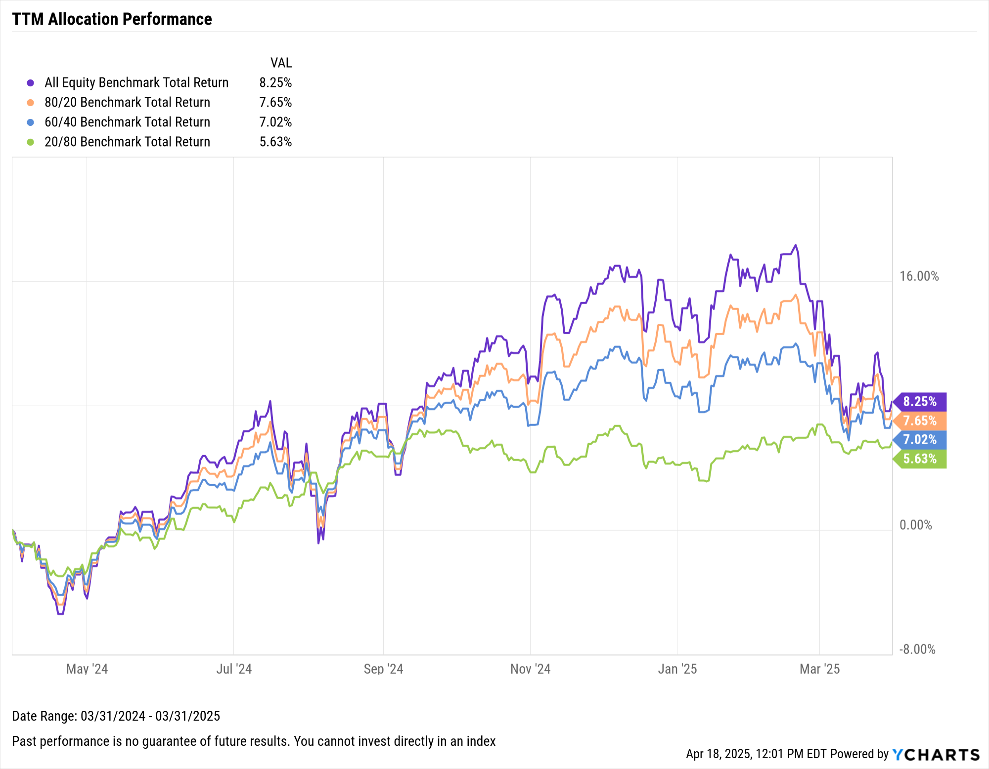
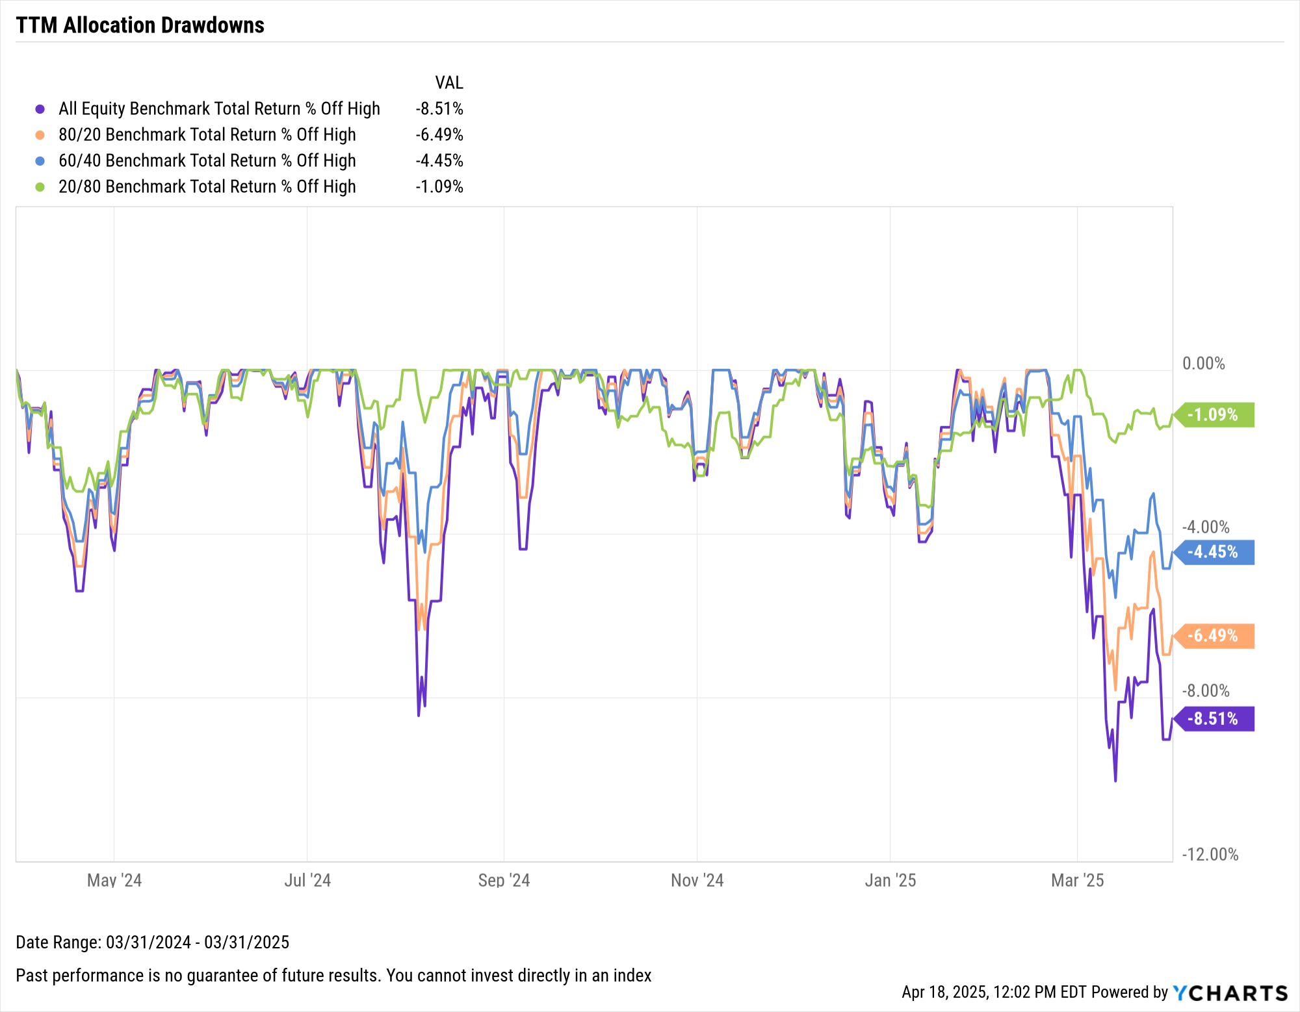
Performance of Diversified Portfolios
Notes:
This slide points out TTM total returns and max drawdowns of various risk vs. return strategies, including S&P 500/Bloomberg US Aggregate allocations of 100/0, 80/20, 50/50, and 20/80.
TTM Allocation Total Returns, 3/31/2024 – 3/31/2025:
All-S&P 500 Portfolio: +8.25%
Aggressive (80/20): +7.61%
Balanced (50/50): +7.02%
Conservative (20/80): +5.63%

Slide 11
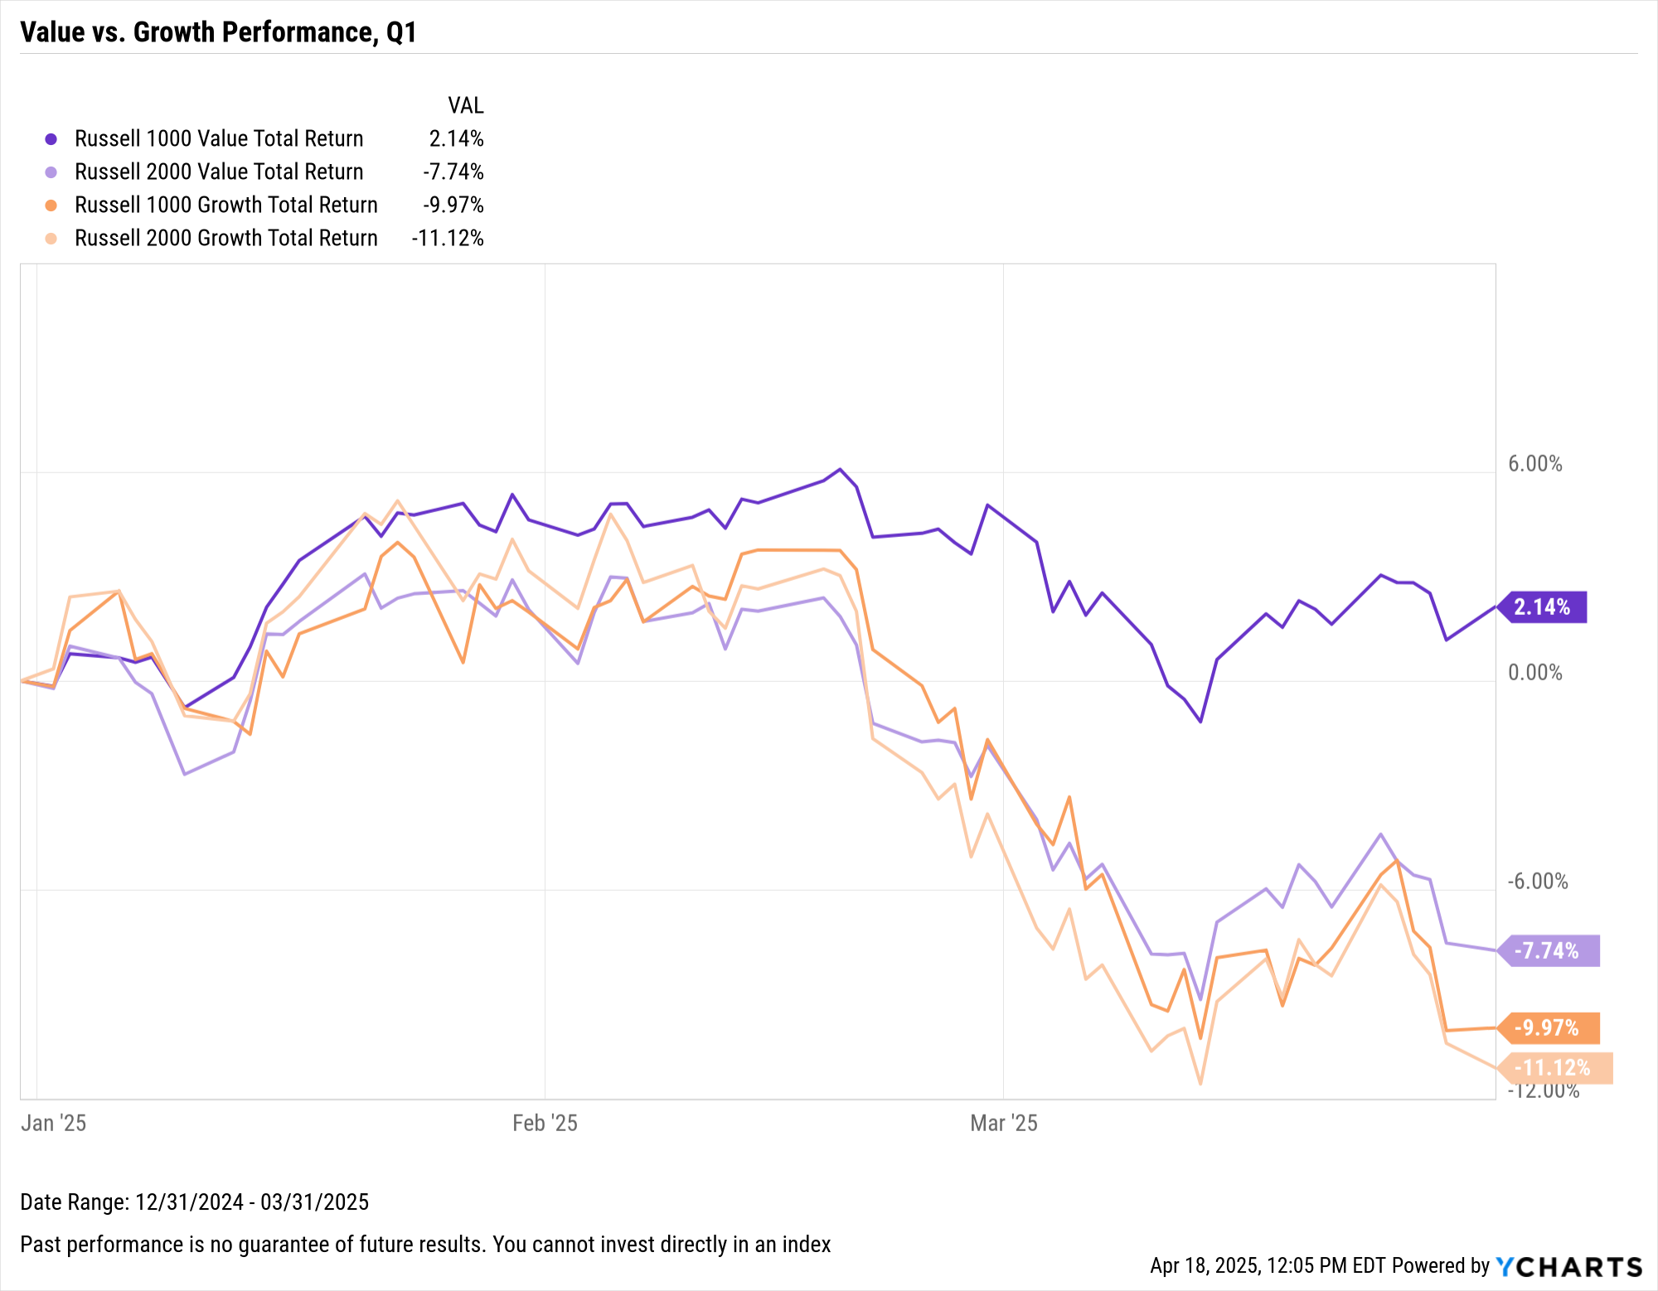
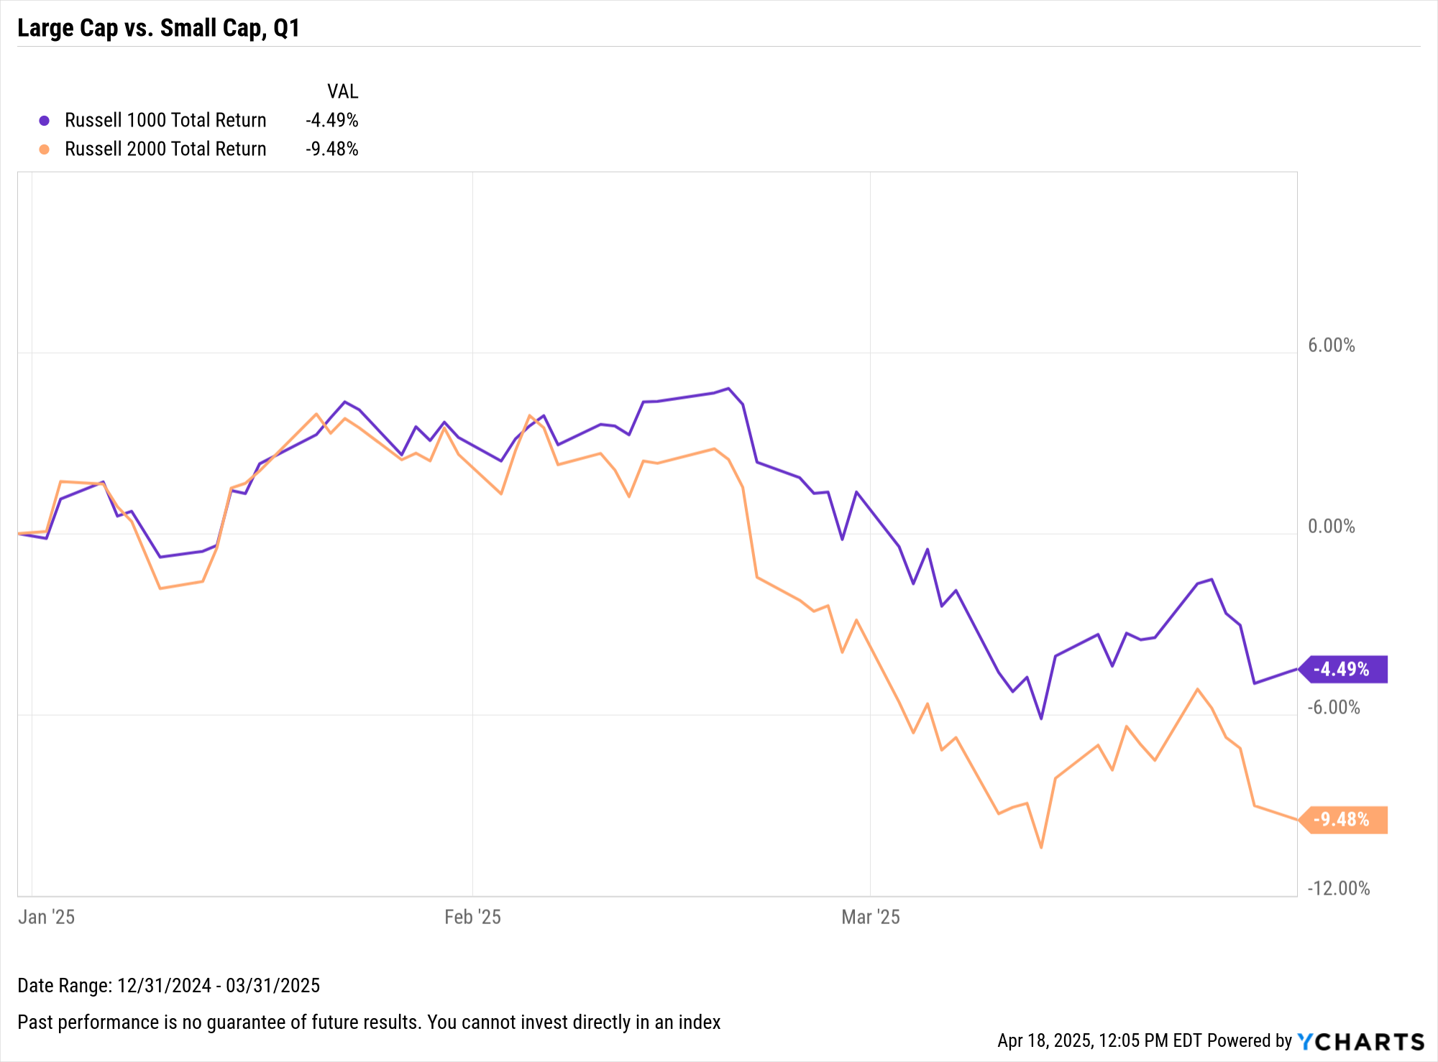
Equity Style Performance
Notes:
L: Style Box Total Returns for Q1 2025:
Large-Cap Value: +2.14%
Small-Cap Value: -7.74%
Large-Cap Growth: -9.97%
Small-Cap Growth: -11.12%
R: Index Total Returns for Q1 2025:
Russell 1000: -4.49%
Russell 2000: -9.48%

Slide 12
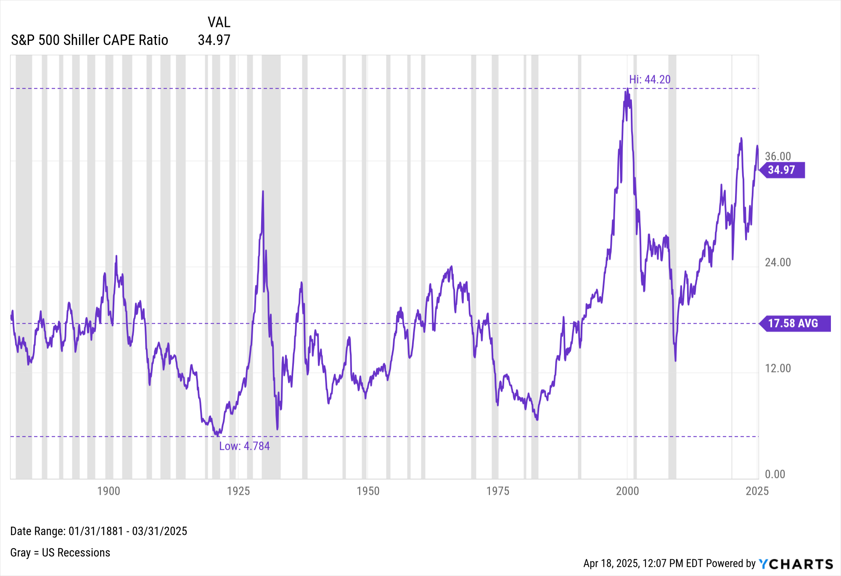
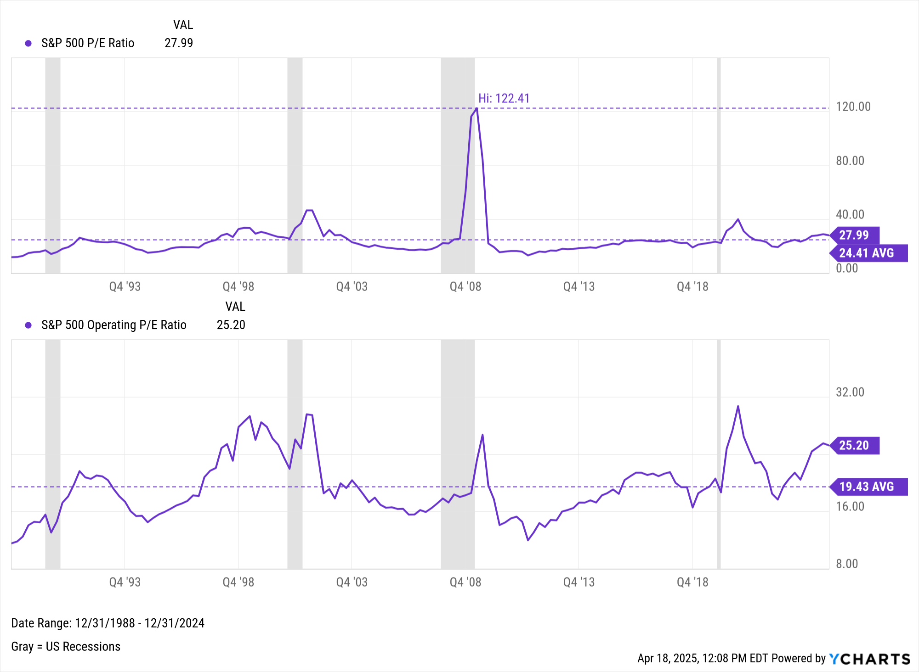
S&P 500 Valuation Measures
Notes:
S&P 500 Valuations:
S&P 500 CAPE Ratio: 34.97 as of March 31st, 2025 (Above historical average of 17.58)
S&P 500 P/E Ratio: 27.99 as of December 31st, 2024 (Above historical average of 24.38)
S&P 500 Operating P/E Ratio: 25.20 as of December 31st, 2024 (Above historical average of 19.43)

Slide 13
Macroeconomic Data
Leading and Lagging Economic Data and Trends from Key Economic Reports Published Recently

Slide 14
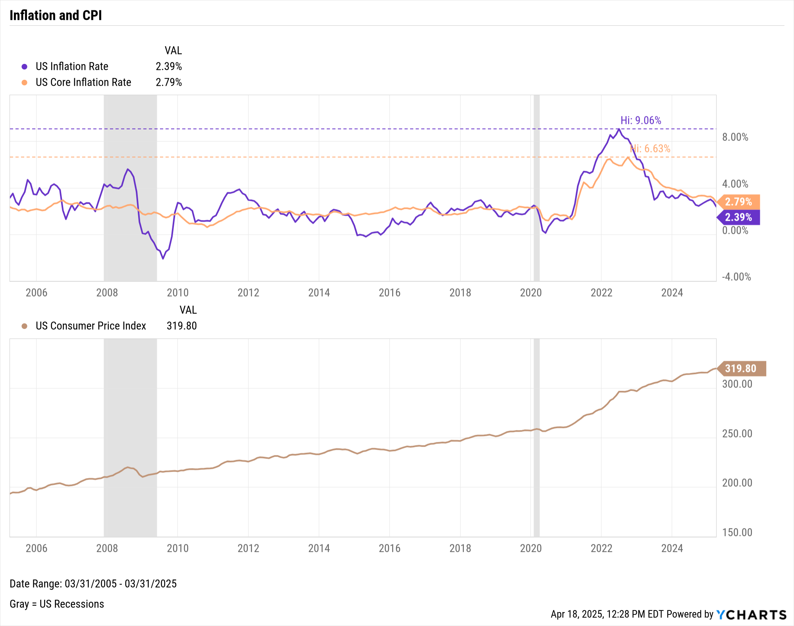
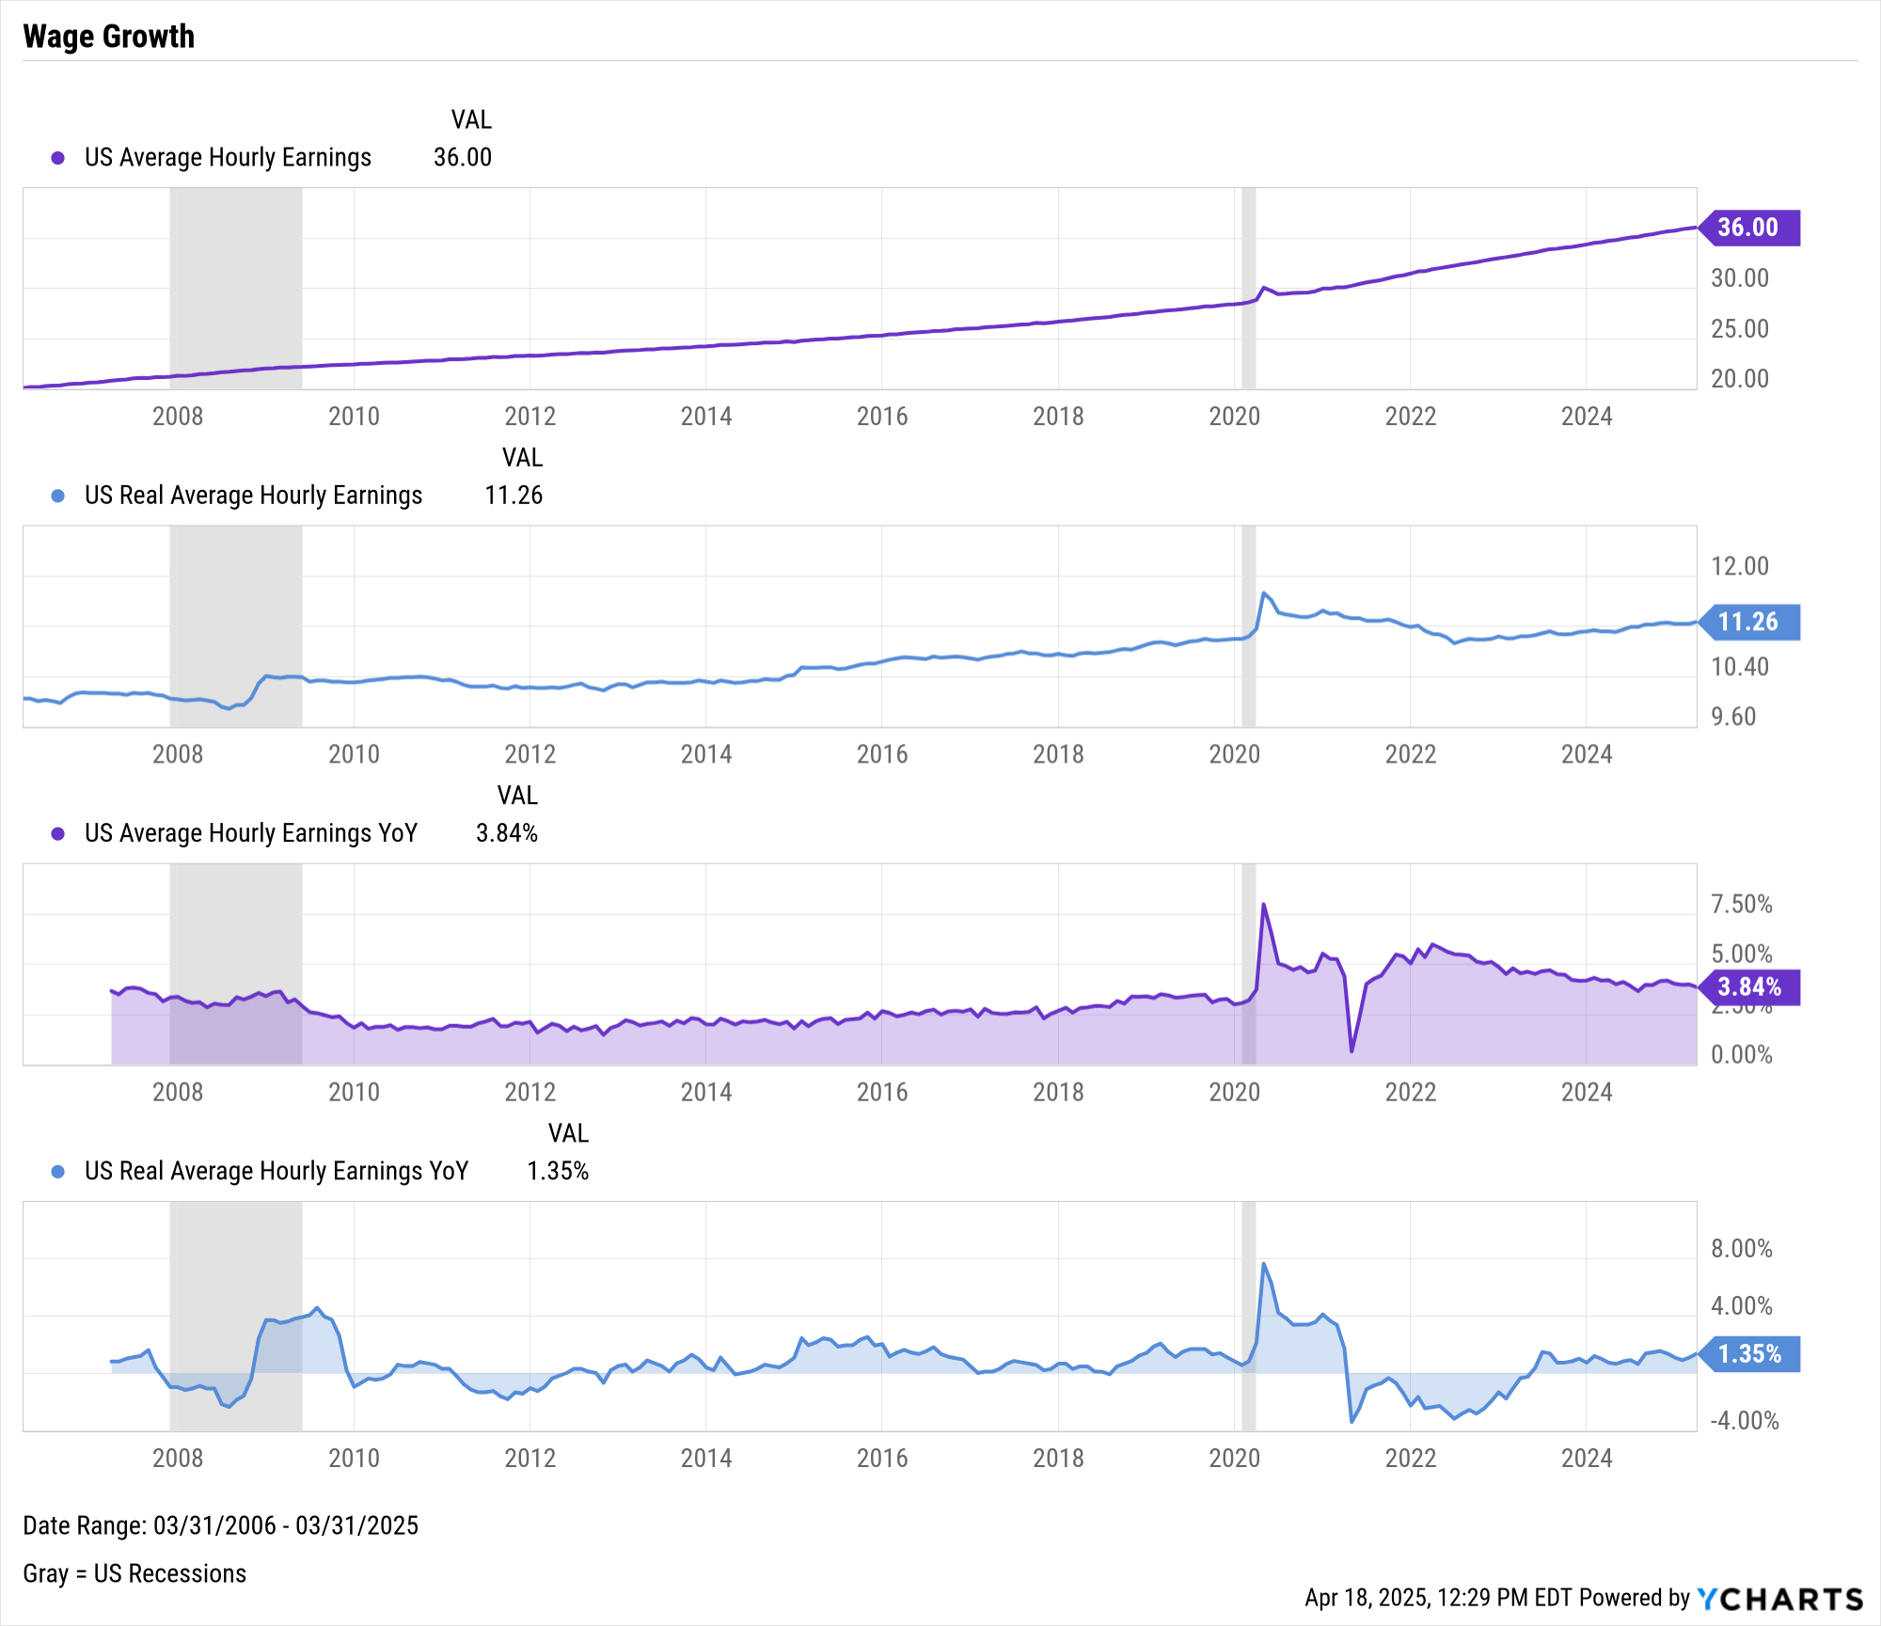
Inflation & Wage Growth
Notes:
L: As of March 2025:
US Inflation Rate: 2.39%
US Core Inflation Rate: 2.79%
US Consumer Price Index: 319.80
R: As of March 2025:
US Average Hourly Earnings: 36.00 (all-time high)
US Real Average Hourly Earnings: 11.26 (-3.9% below its high set in April 2020)
US Average Hourly Earnings YoY: +3.84%
US Real Average Hourly Earnings YoY: +1.35%

Slide 15
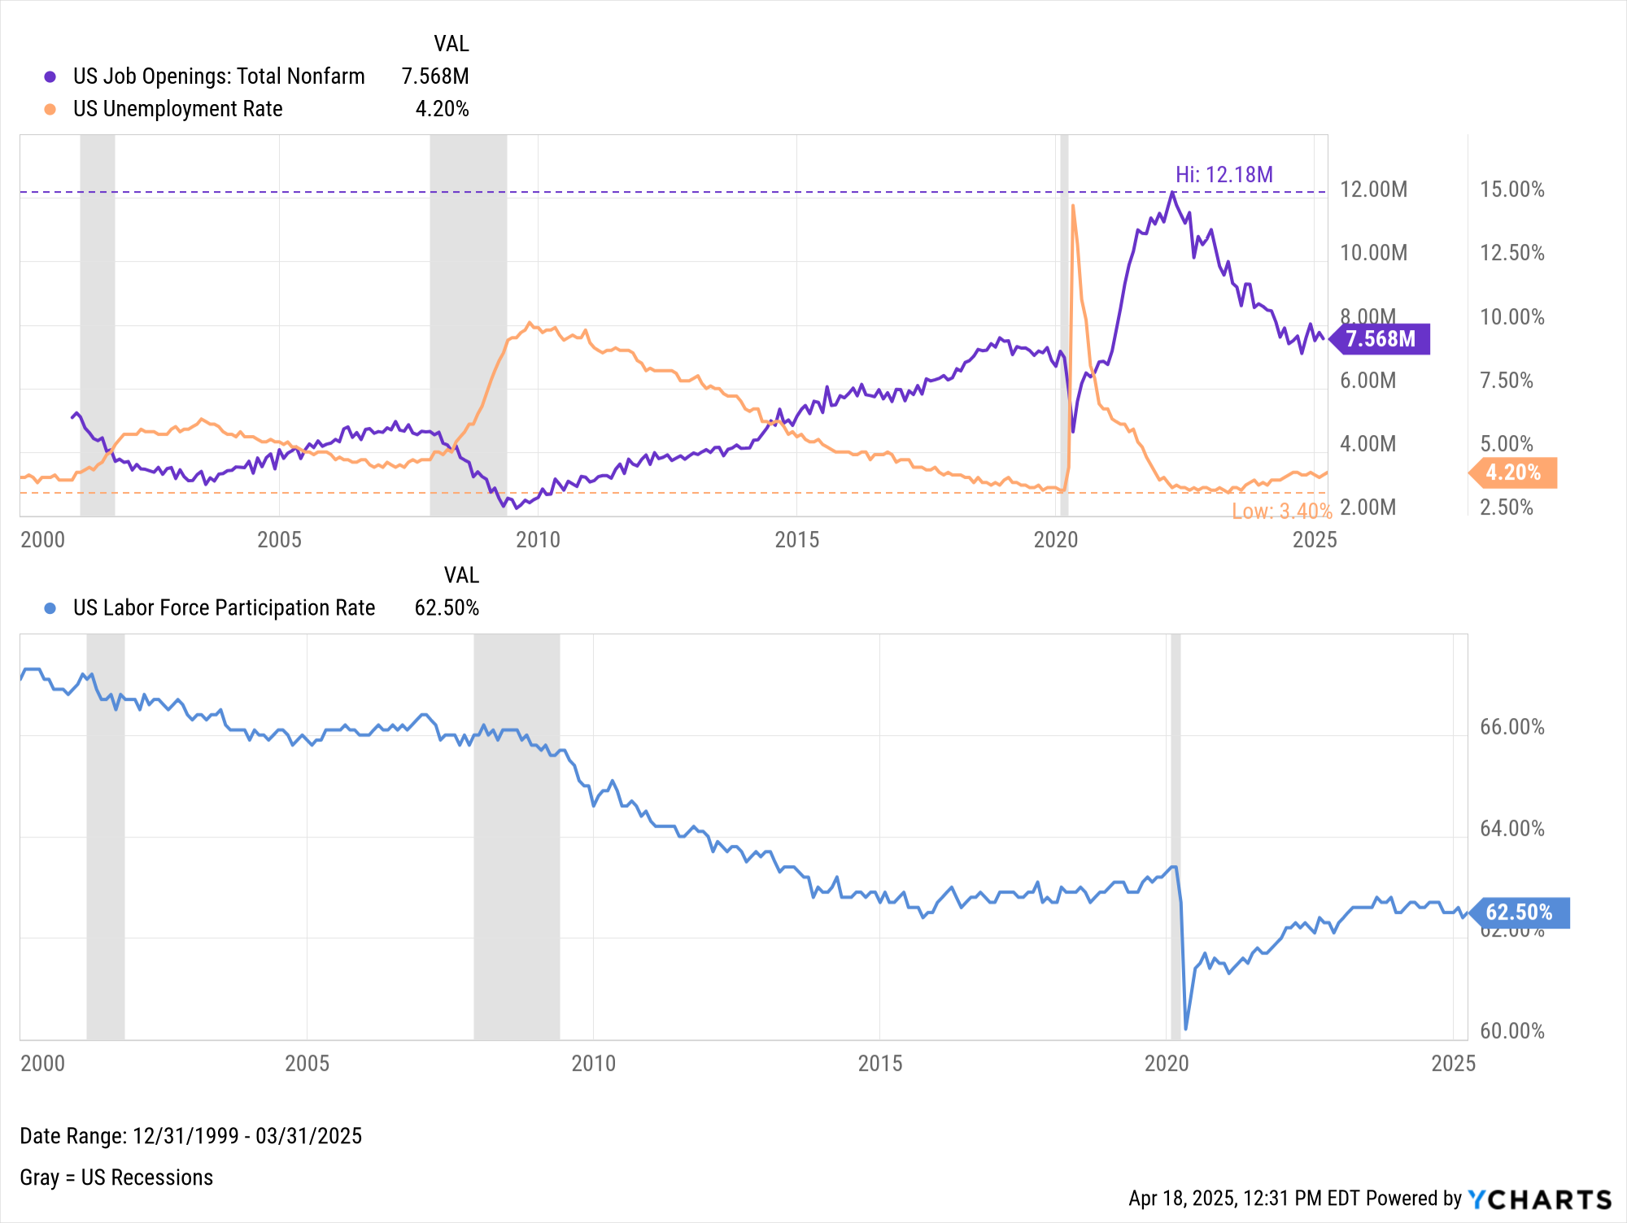
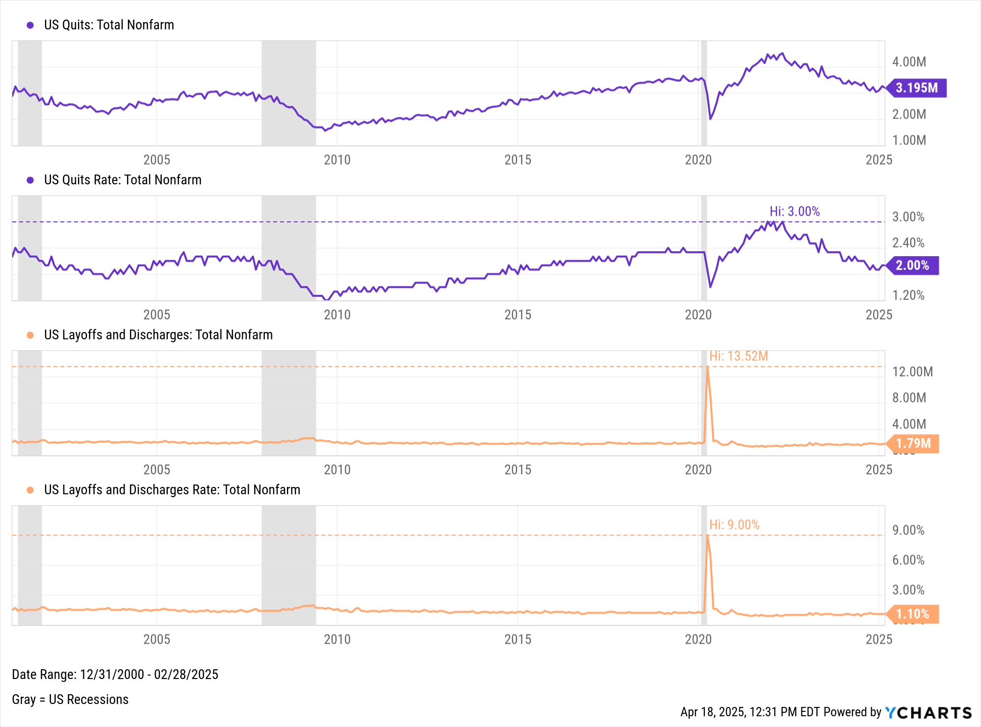
Employment
Notes:
L: As of March 2025:
Total US Job Nonfarm Openings: 7.568M (as of February 2025)
US Unemployment Rate: 4.20%
US Labor Force Participation Rate: 62.50%
R: As of February 2025:
US Quits: 3.195M
US Quits Rate: 2.00%
US Layoffs and Discharges: 1.79M
US Layoffs and Discharges Rate: 1.10%

Slide 16
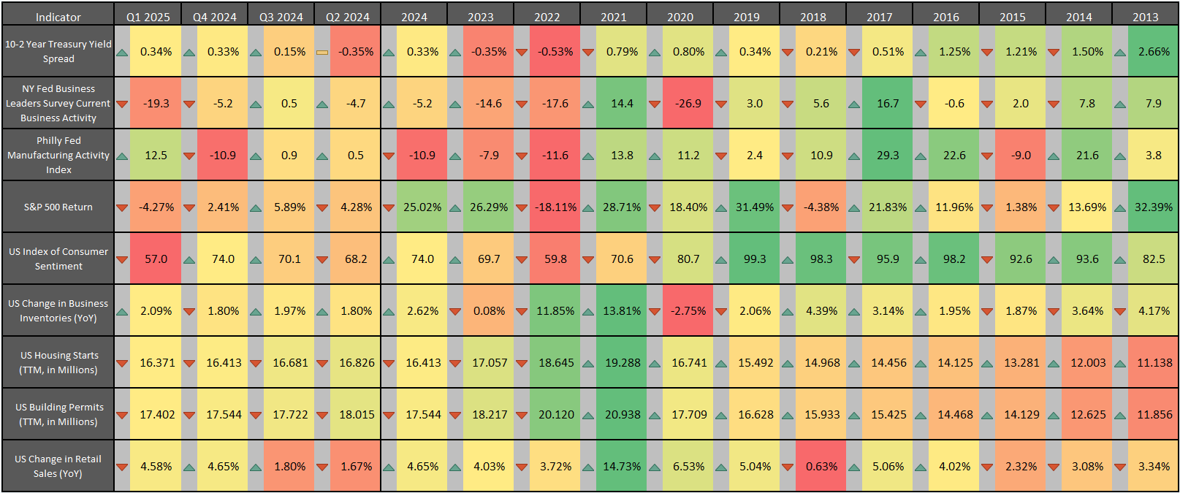
Leading Indicator Data and Trends
Contact support@ycharts.com to access this heatmap
Notes:
Latest values as of March 2025/Q1 2025:
10-2 Year Treasury Yield Spread: 0.34%
NY Fed Business Leaders Survey Current Business Activity: -19.3
Philly Fed Manufacturing Activity Index: 12.5
S&P 500 Total Return: -4.27% for Q1 2025
US Index of Consumer Sentiment: 57.0
US Change in Business Inventories YoY: +2.09%
US Housing Starts (TTM total): 16.371M
US Building Permits (TTM total): 17.402M
US Change in Retail Sales YoY: +4.58%
Last four quarters: The green/red arrows to the left of each cell indicate a higher/lower change in that indicator’s value from the previous quarter
2013-2024: The green/red arrows to the left of each cell indicate a higher/lower change in that indicator’s value from the previous year

Slide 17
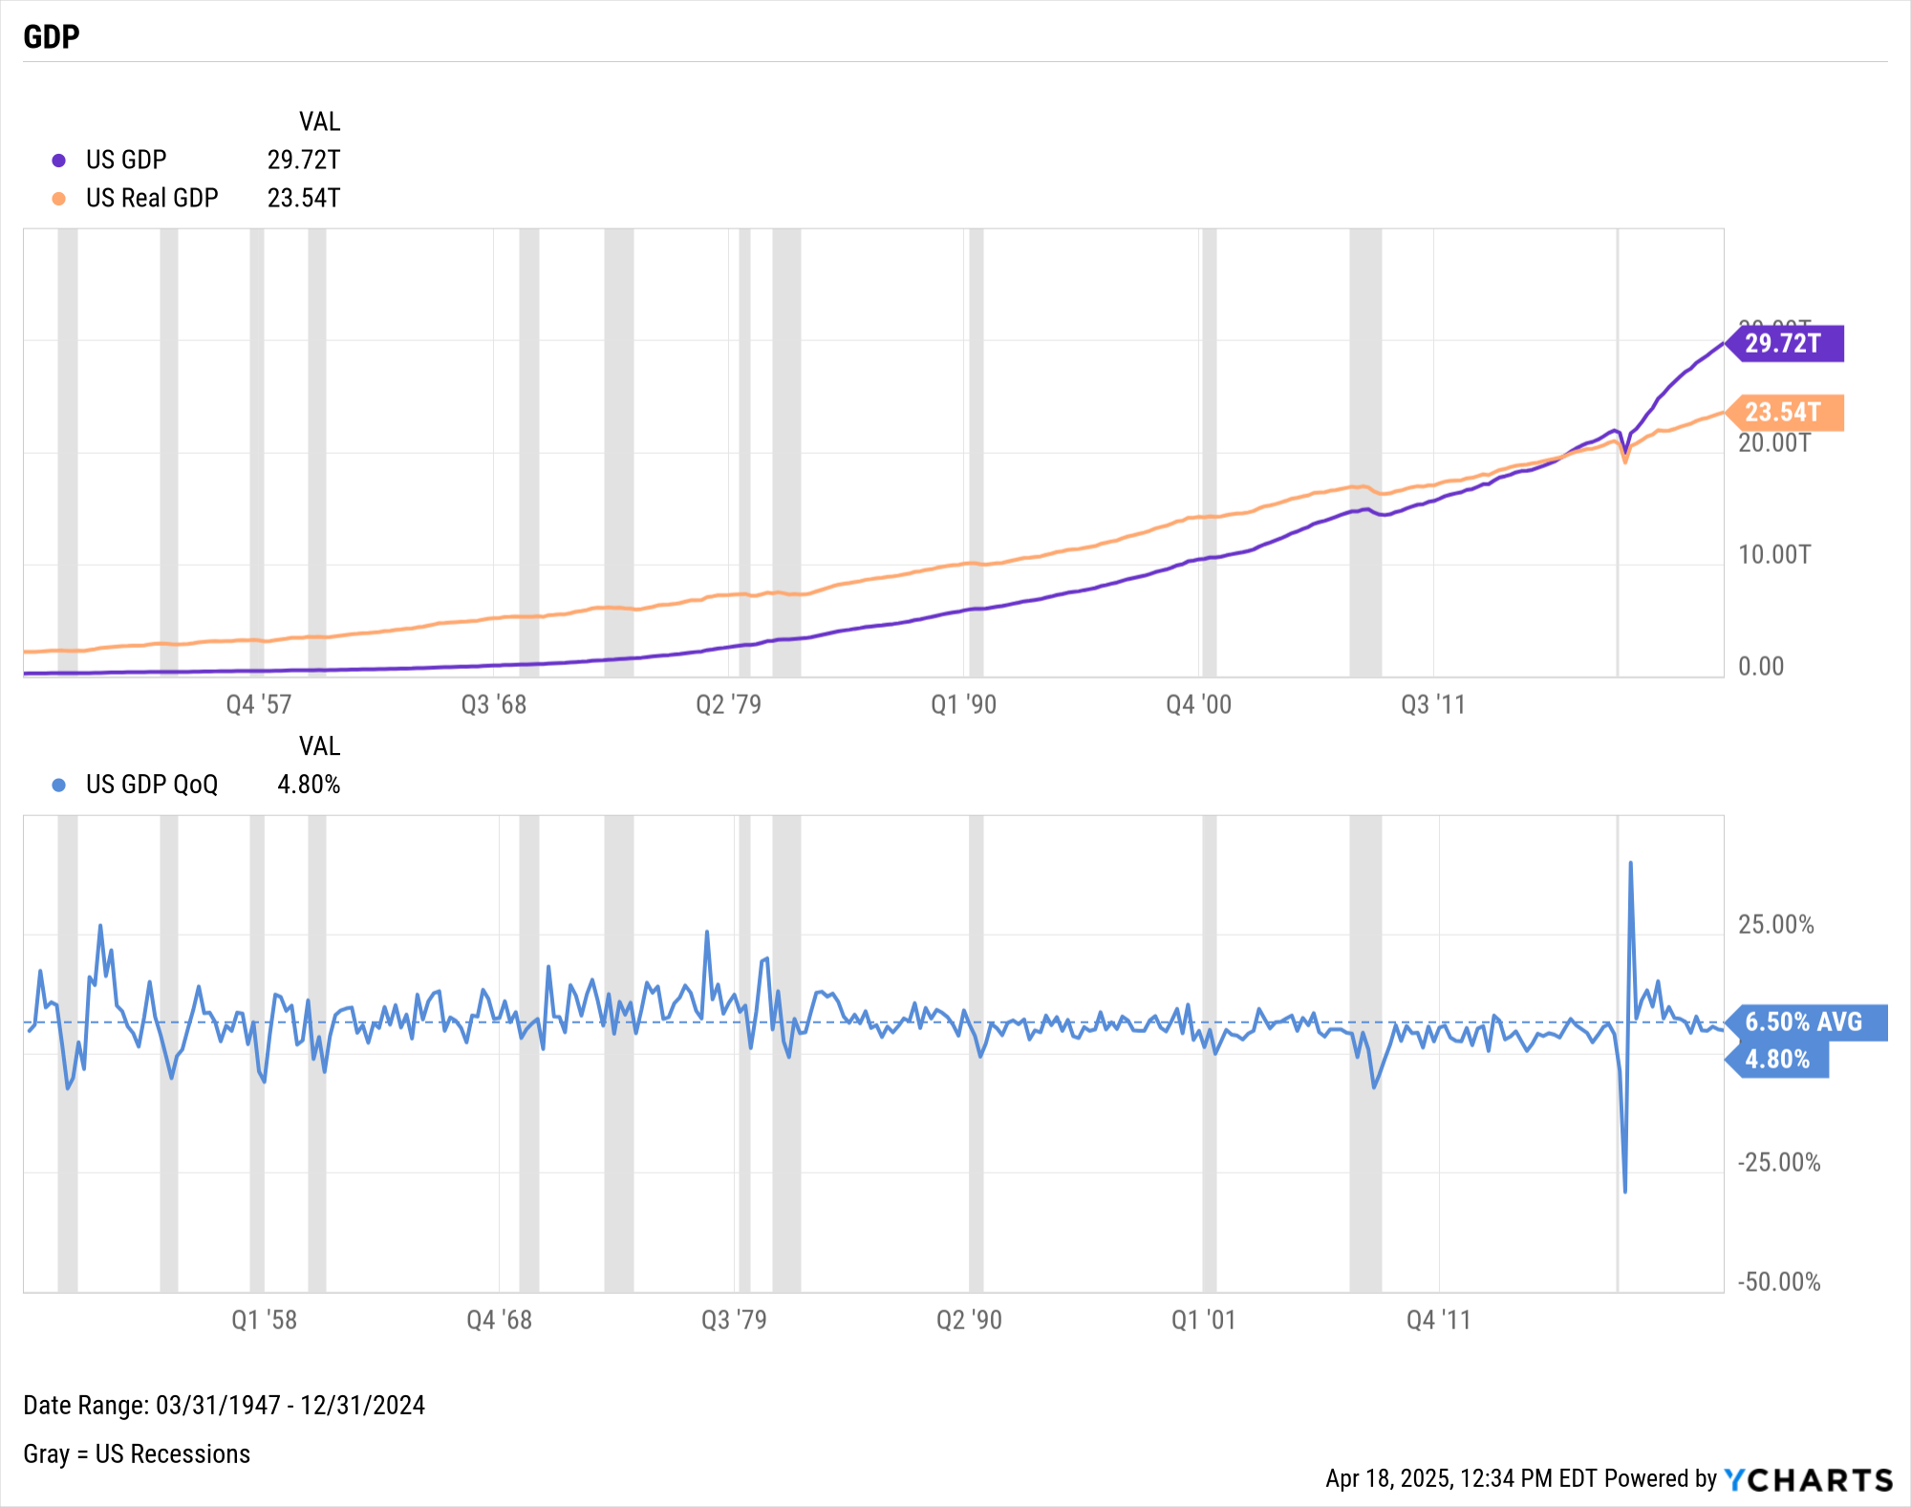
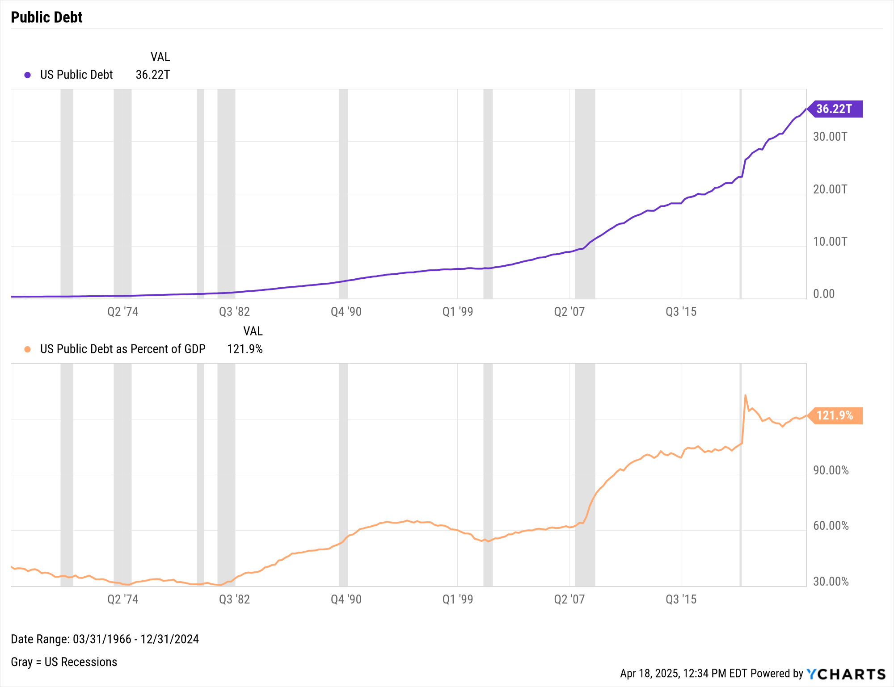
GDP & Public Debt
Notes:
L: As of Q4 2024:
US GDP: $29.72T
US Real GDP: $23.54T
US GDP % change, Q3 to Q4: 4.80%
R: As of Q4 2024:
US Public Debt: $36.22T
US Public Debt as a Percent of GDP: 121.9%

Slide 18
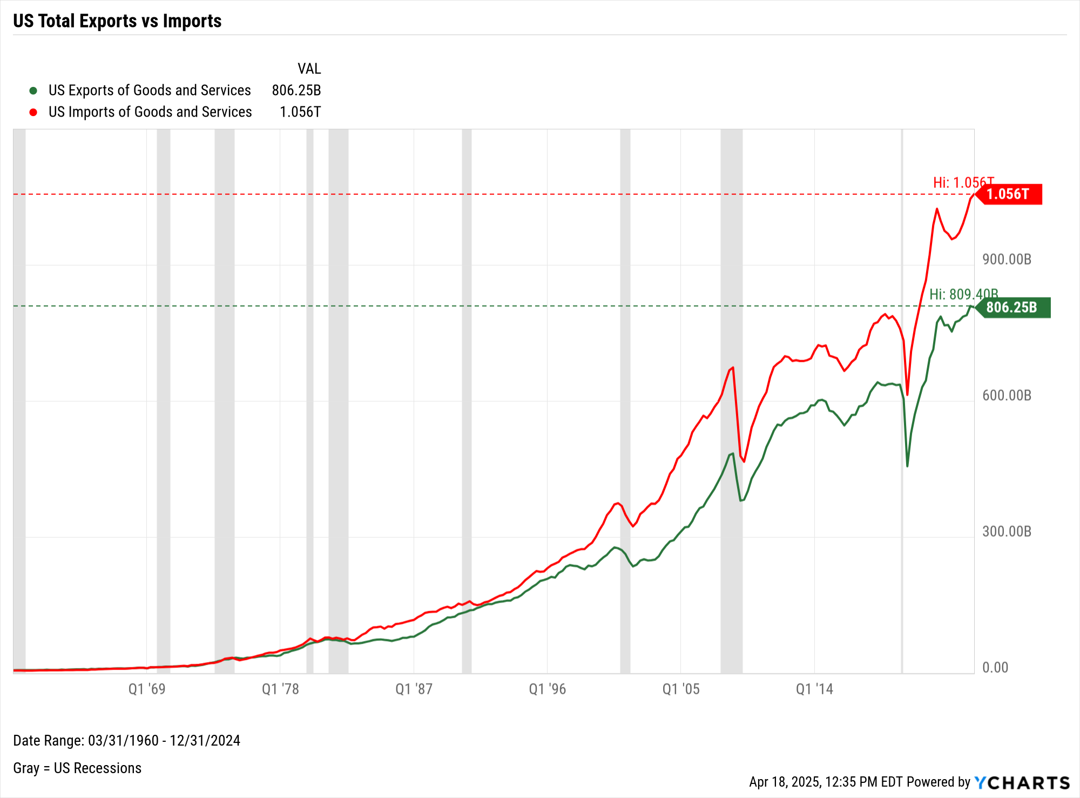
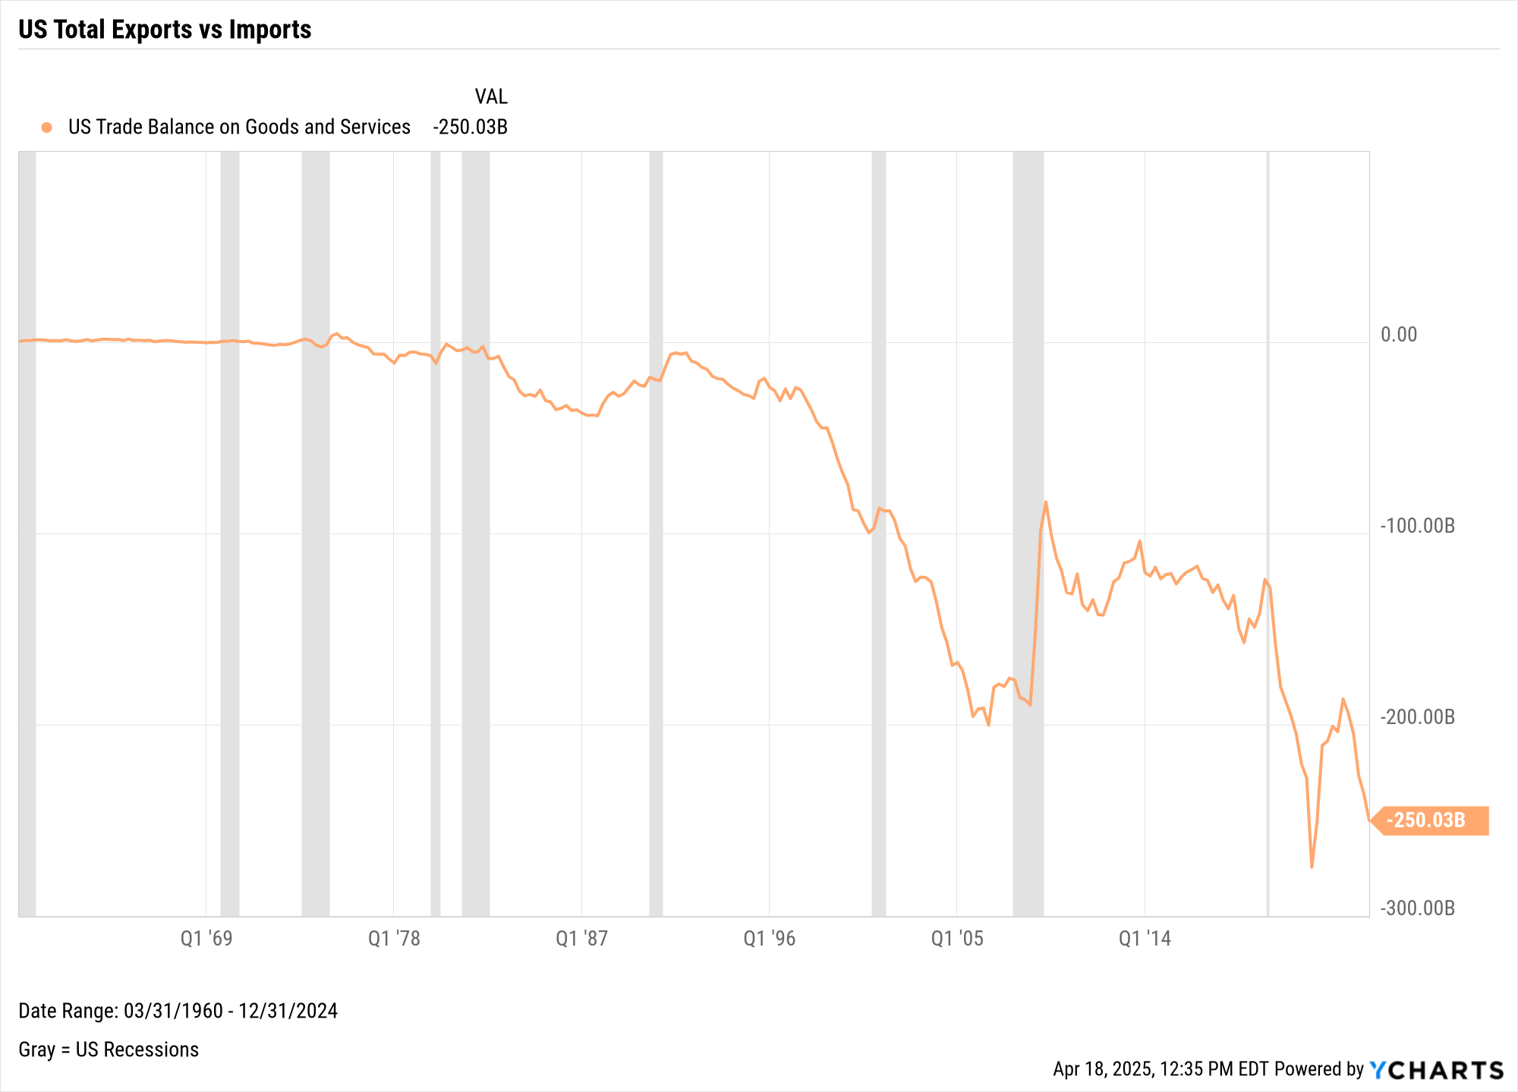
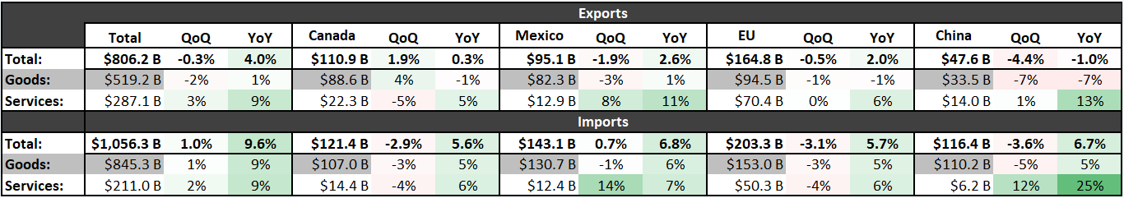
US Trade Balance
Notes:
This slide shows the US trade activity through Q4 2024 (the latest data available).
L:
US Exports of Goods and Services: $806.25B
US Imports of Goods and Services: $1.056T
R:
US Trade Balance between Goods and Services: -$250.03B
The table at the bottom shows trade activity between the USA and other key partners for Q4 2024. For example, the US saw $143.1B worth of combined goods and services imports from Mexico in Q4 2024, which is 6.8% more than that same figure a year ago from Q4 2023.

Slide 19
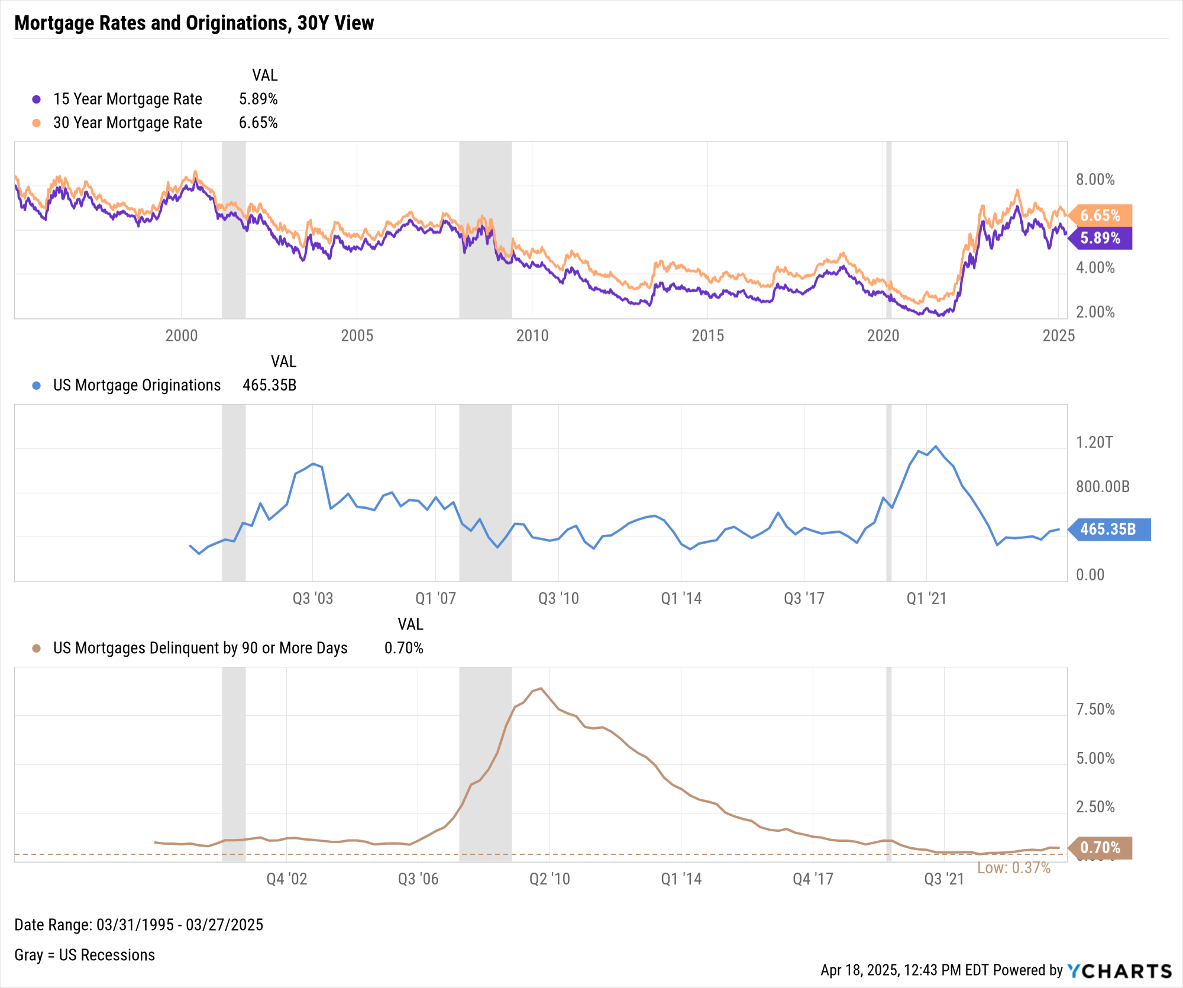
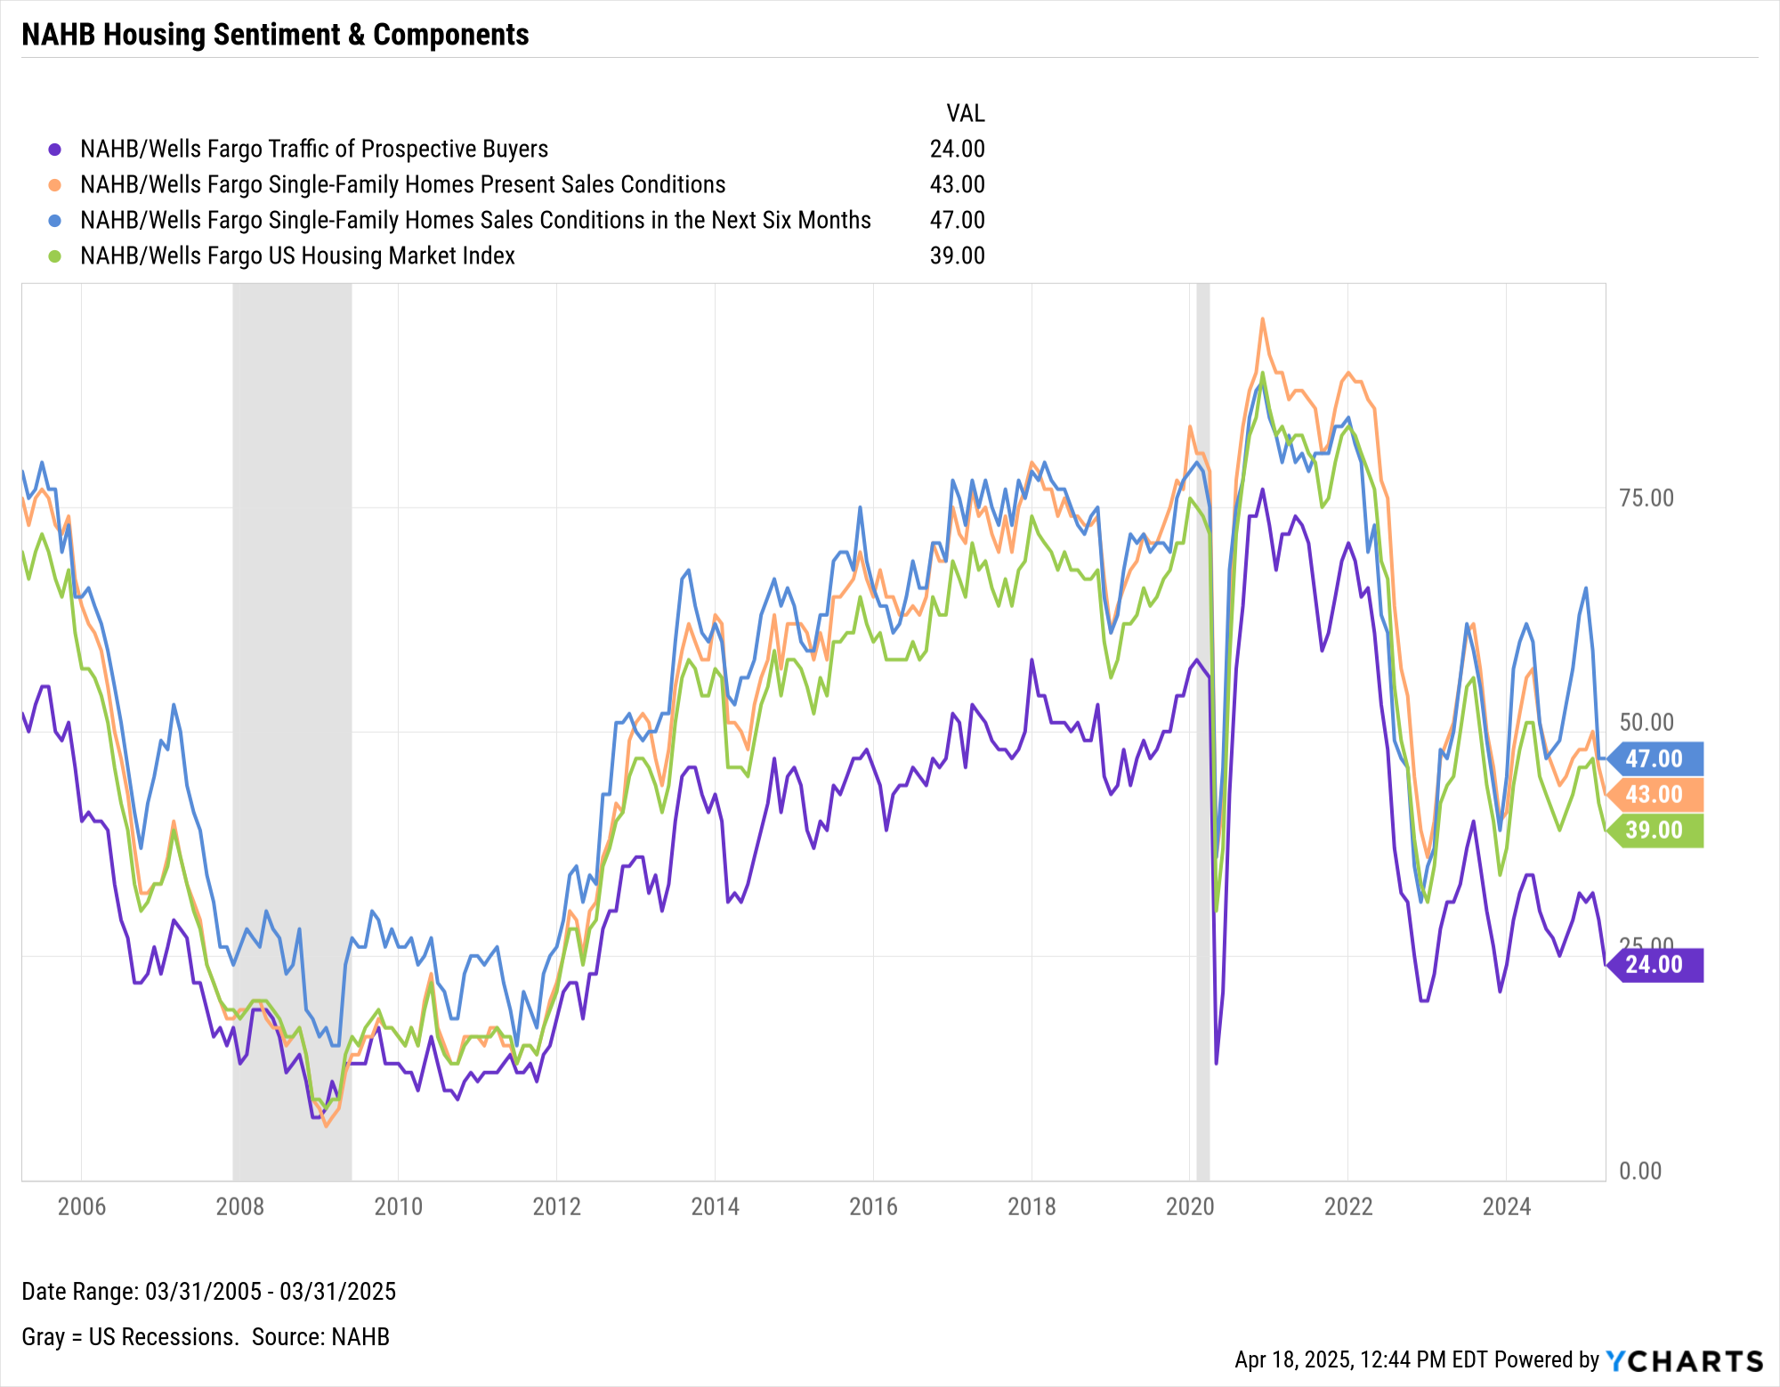
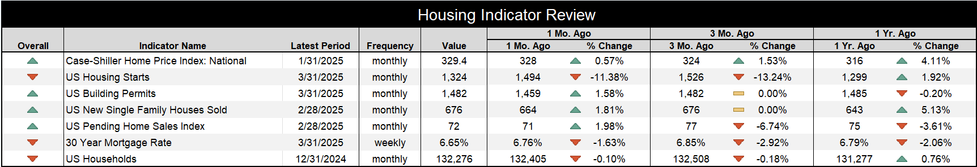
US Housing Market Data
Notes:
L: As of March 31st, 2025:
15-Year Mortgage Rate: 5.89%
30-Year Mortgage Rate: 6.65%
US Mortgage Originations: $465.35B (as of Q4 2024)
US Mortgages Delinquent by 90 or More Days: 0.70% (as of Q4 2024)
R: NAHB/Wells Fargo data as of March 31st, 2025:
Traffic of Prospective Buyers: 24.00
Single-Family Homes Present Sales Conditions: 43.00
Single-Family Homes Sales Conditions in the Next Six Months: 47.00
US Housing Market Index: 39.00
Table:
National Case-Shiller Home Price Index: 329.4 (1/31/2025)
US Housing Starts: 1,324 (3/31/2025)
US Building Permits: 1,482 (3/31/2025)
US New Single Family Houses Sold: 676 (2/28/2025)
US Pending Home Sales Index: 72 (2/28/2025)
30-Year Mortgage Rate: 6.65% (3/31/2025)
US New Households: 132,276 (12/31/2024)

Slide 20
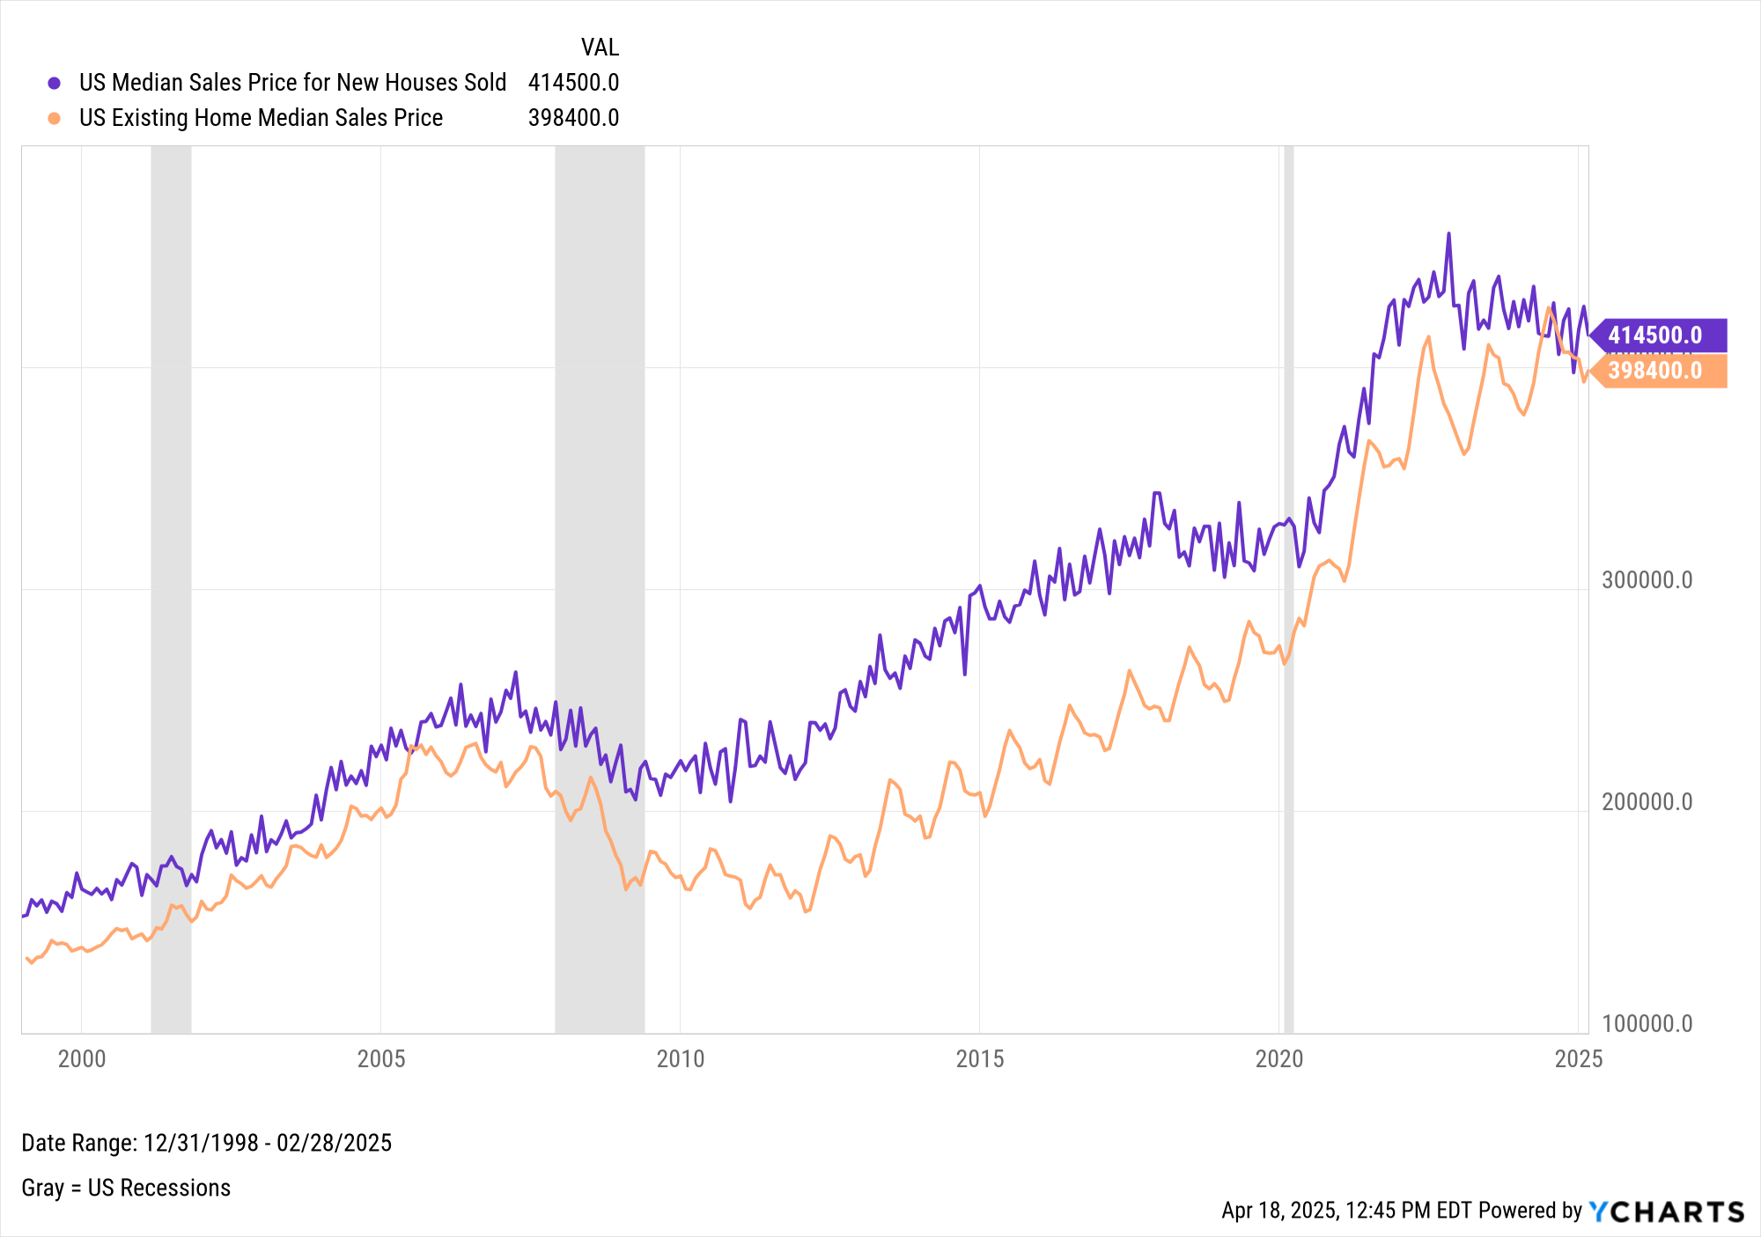
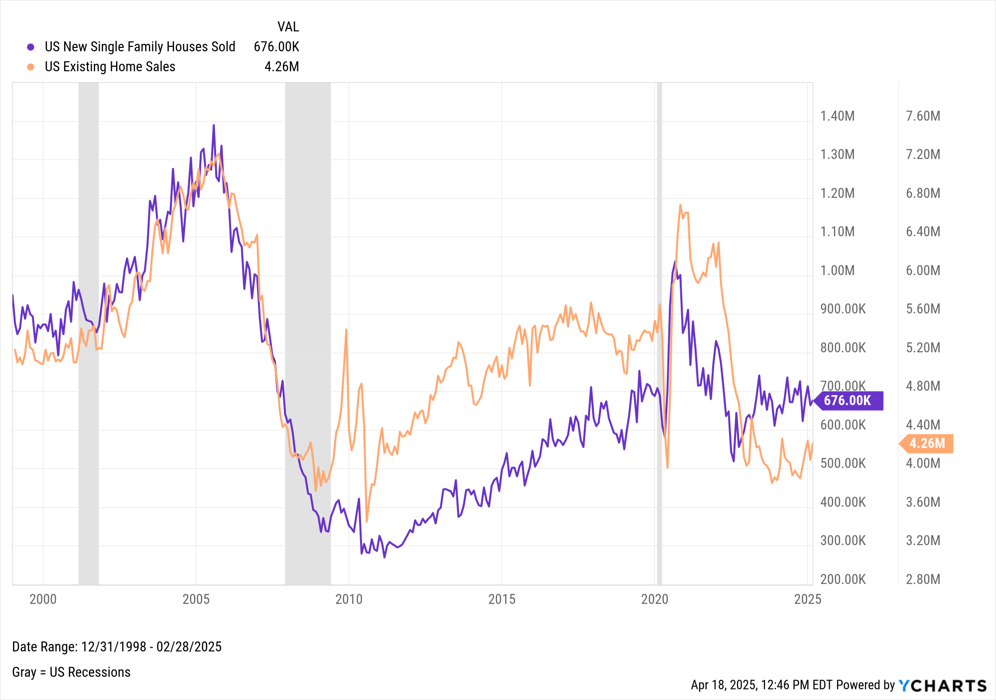
US Housing Market Data (cont.)
Notes:
L: As of February 28th, 2025:
US Median Sales Price for New Houses Sold: $414,500
US Existing Home Median Sales Price: $398,400
R: As of February 28th, 2025:
US New Single Family Houses Sold: 676K
US Existing Home Sales: 4.26M

Slide 21

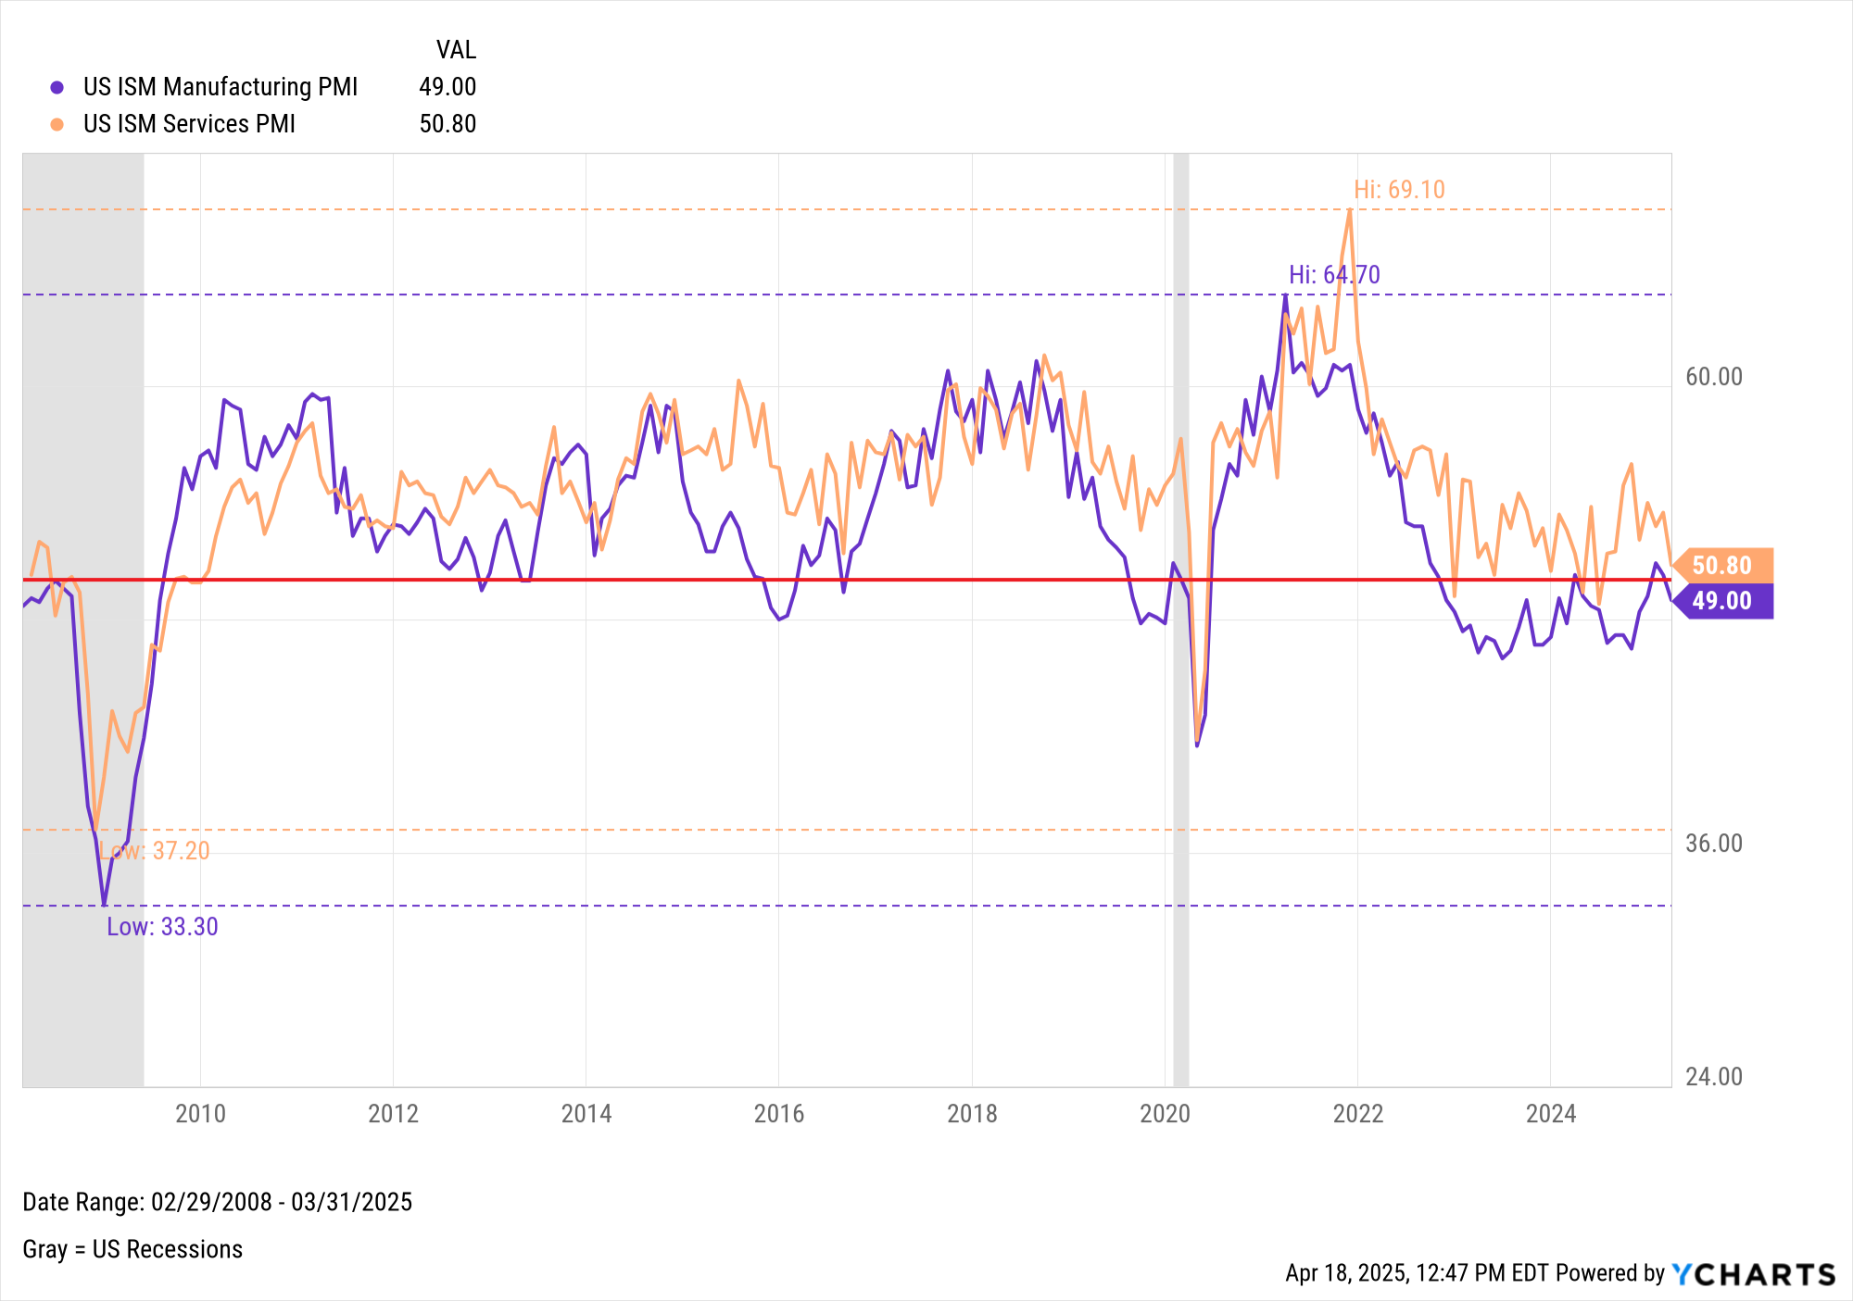
Manufacturing & Services
Notes:
As of March 31st, 2025:
US ISM Manufacturing PMI: 49.00
US ISM Services PMI: 50.80

Slide 22
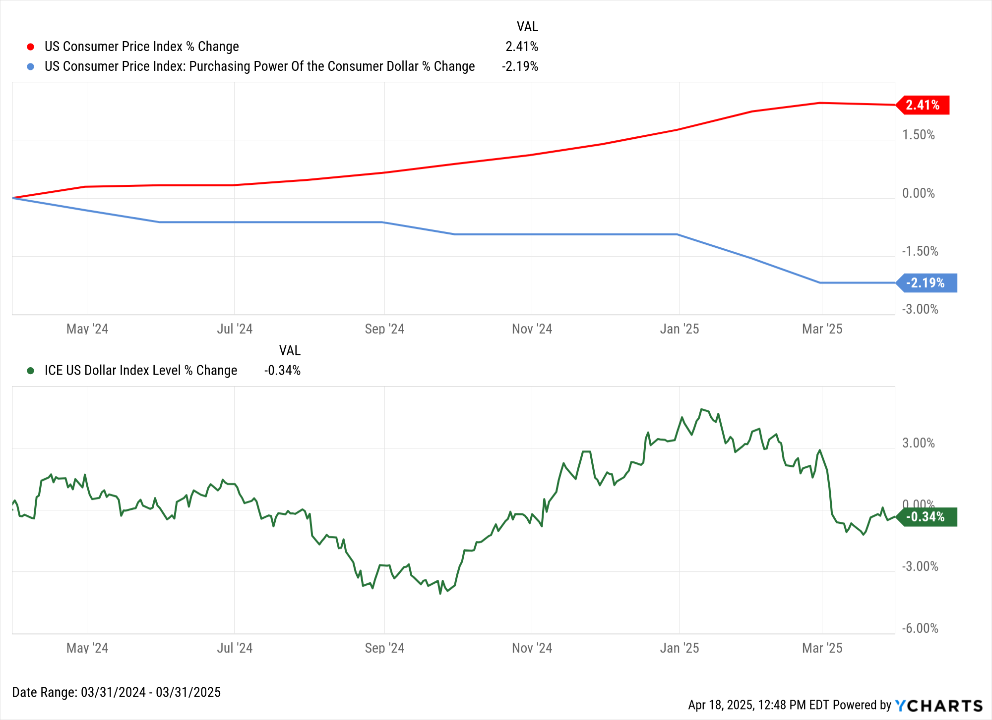
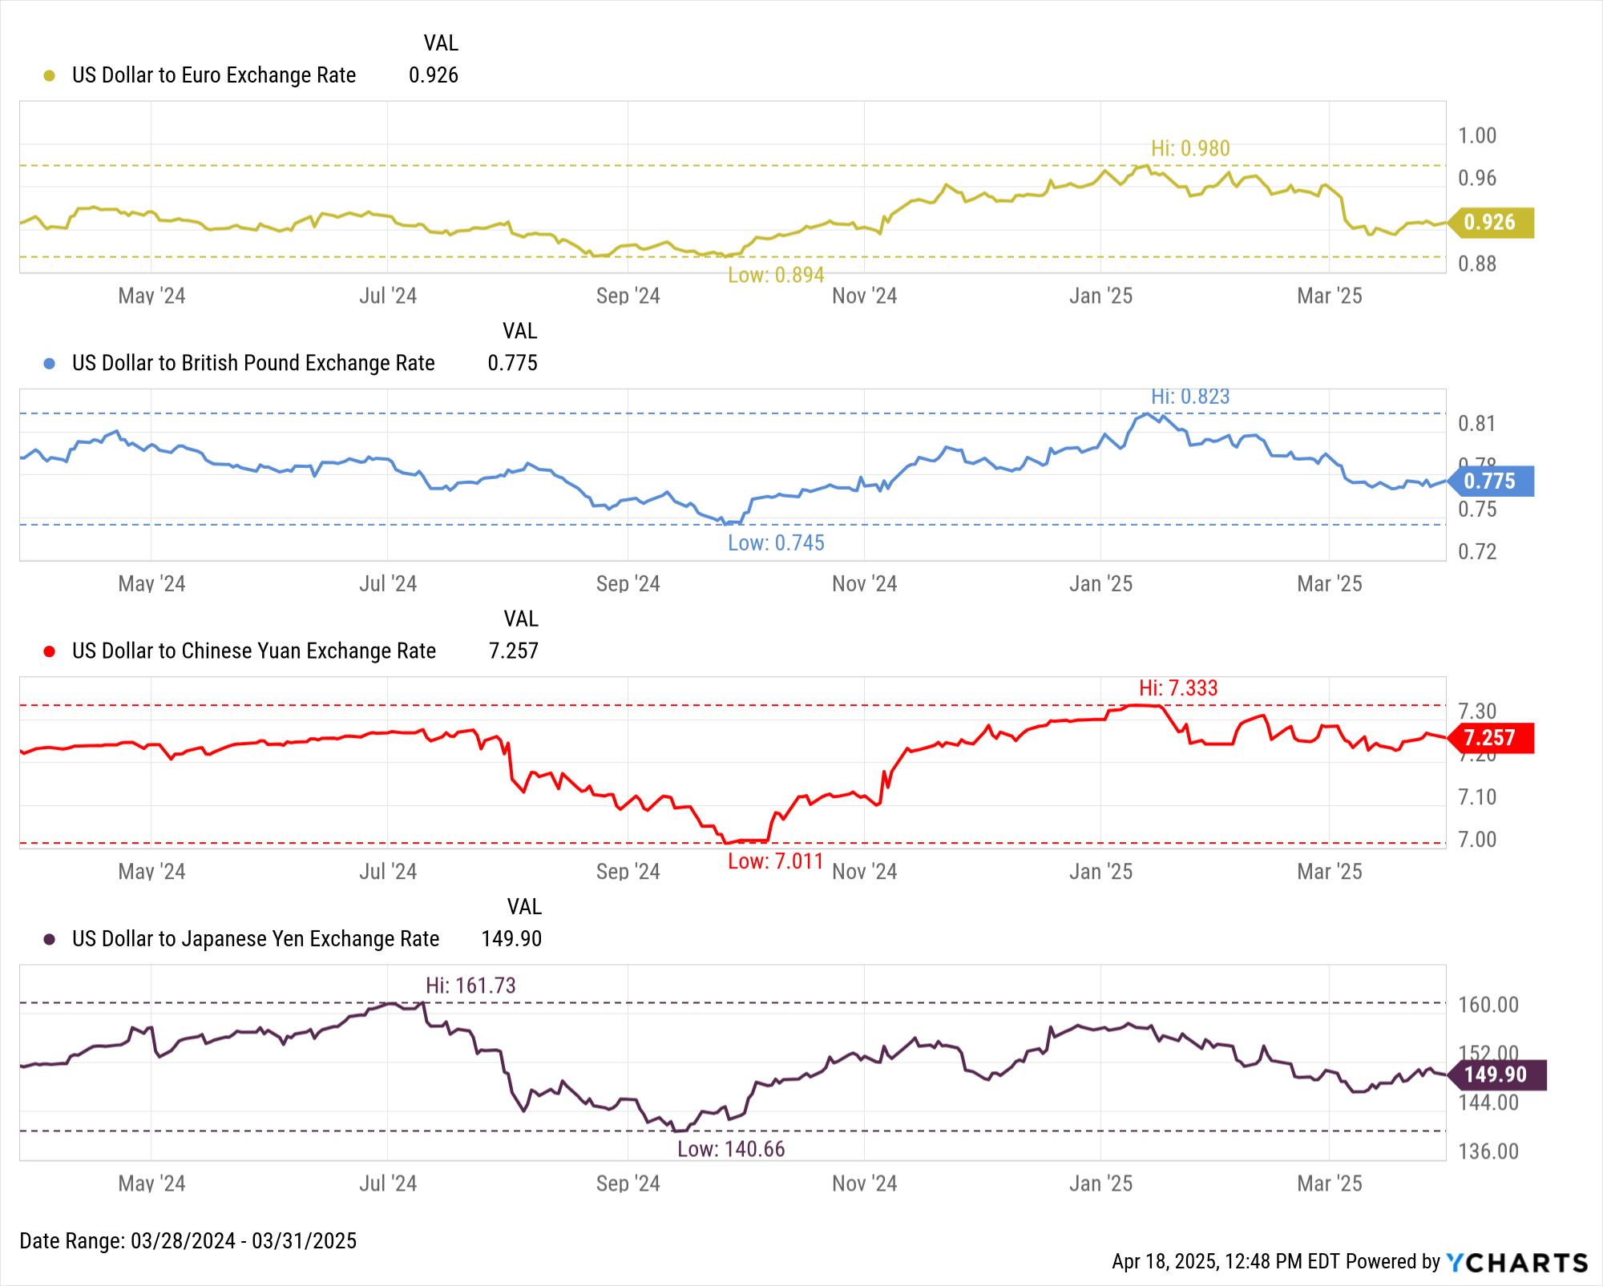
US Dollar Strength
Notes:
L: As of March 31st, 2025:
1Y US CPI % Change: 2.41%
1Y Purchasing Power of the Consumer Dollar % Change: -2.19%
1Y ICE US Dollar Index Level % Change: -0.34%
R: As of March 31st, 2025:
1 USD = 0.926 EUR (0.980 TTM high, 0.894 TTM low)
1 USD = 0.775 GBP (0.823 TTM high, 0.745 TTM low)
1 USD = 7.257 CNY (7.333 TTM high, 7.011 TTM low)
1 USD = 149.90 JPY (161.73 TTM high, 140.66 TTM low)

Slide 23
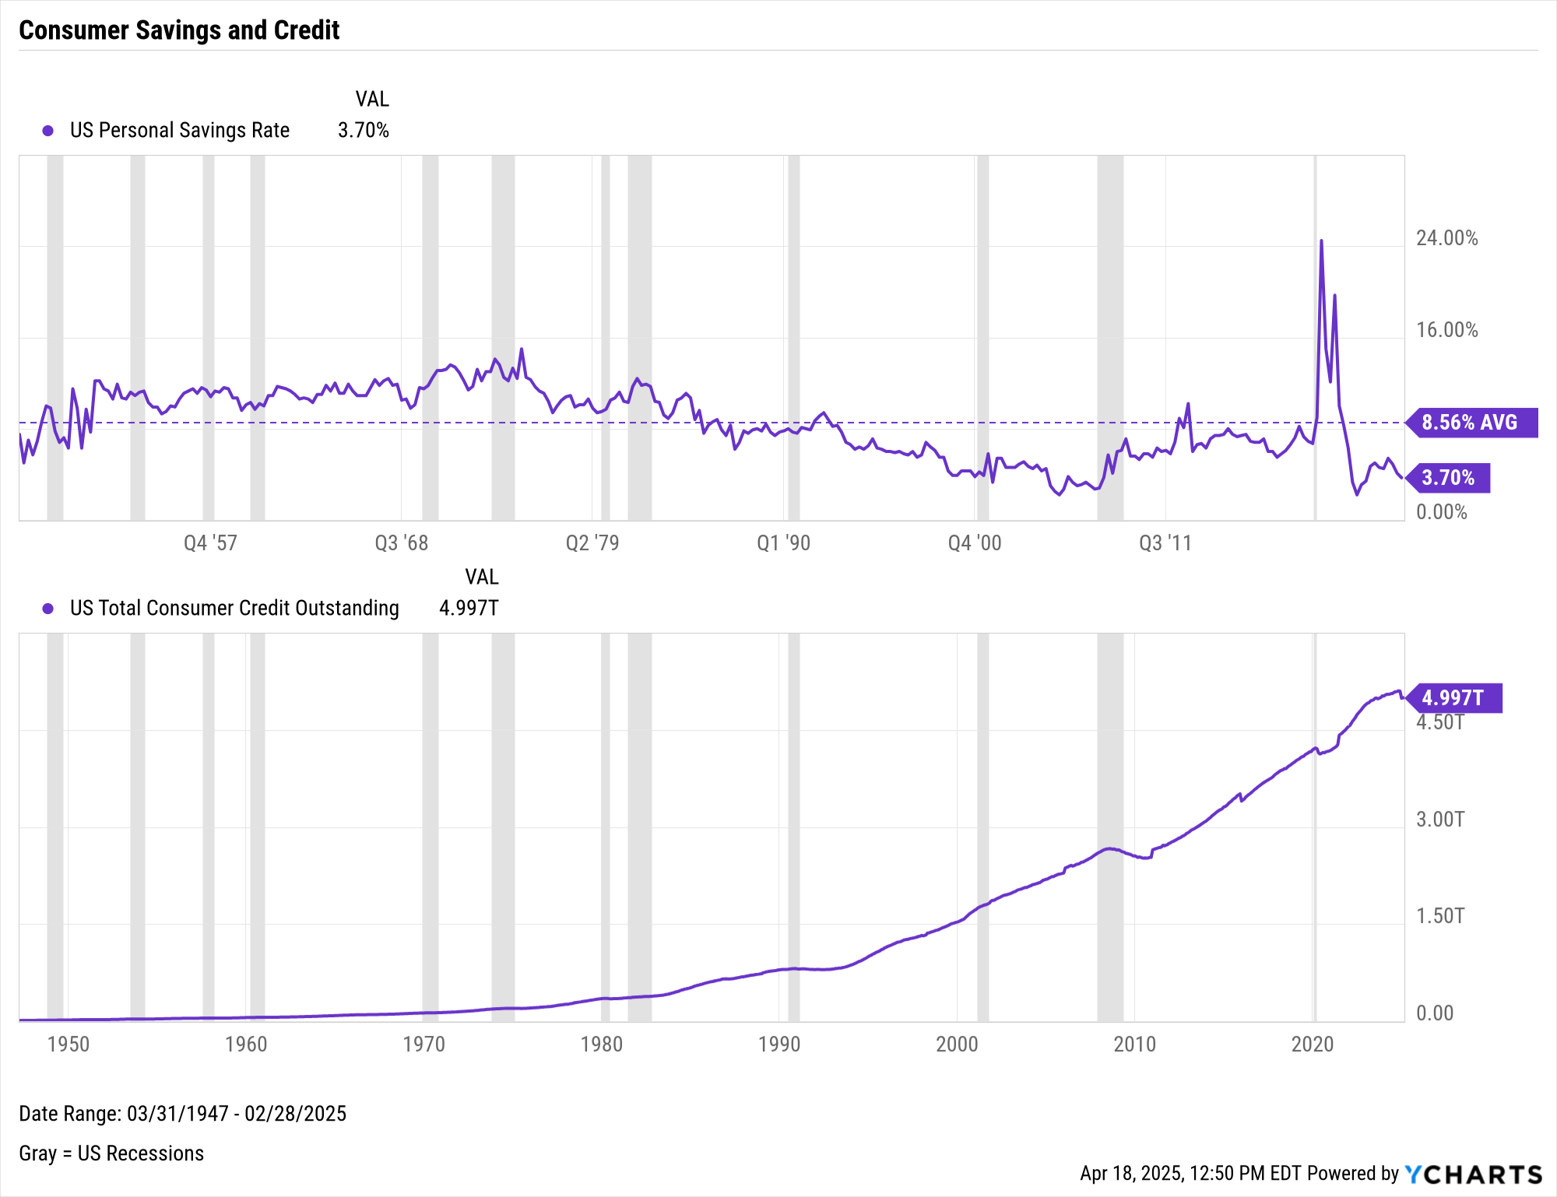
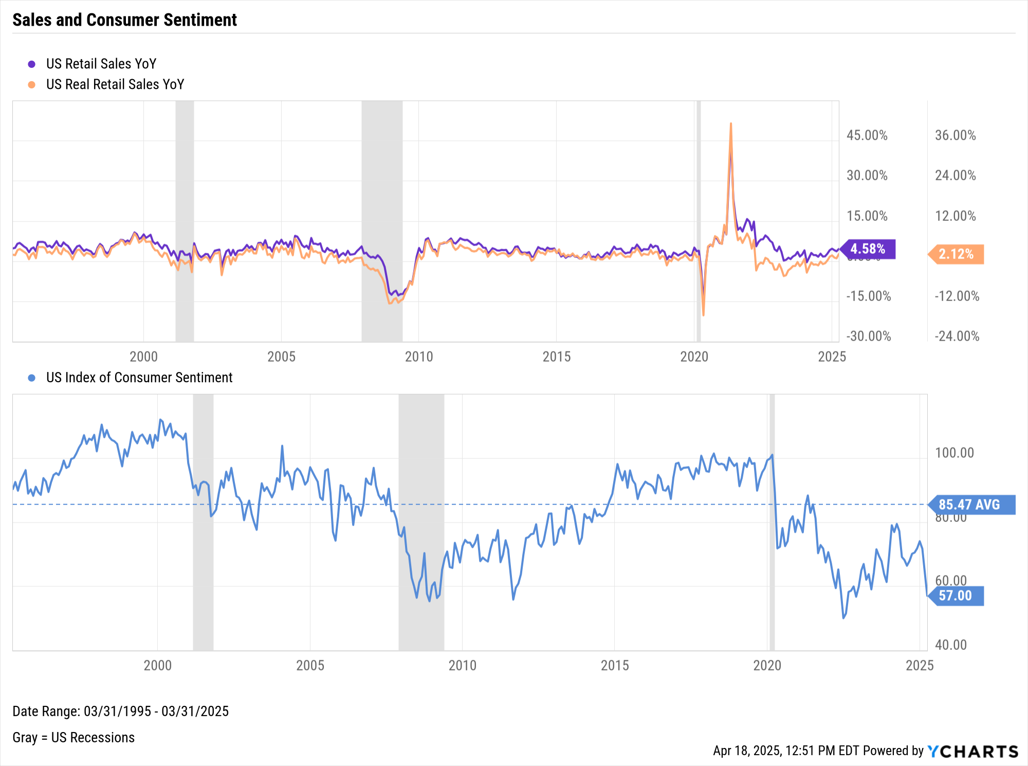
Consumers
Notes:
L: As of February 2025:
US Personal Savings Rate: 3.70% (Below historical average of 8.56%)
US Total Consumer Credit Outstanding: $4.997T
R: As of March 2025:
US Retail Sales YoY: 2.12%
US Real Retail Sales YoY: 4.58%
Spread: 2.46%
US Index of Consumer Sentiment: 57.00
-17.0 points QoQ, 28.47 points below 30-year average

Slide 24
Bonds & Interest Rates
Collection of Data Summarizing Moves in the Fixed Income Markets over the Last Quarter

Slide 25
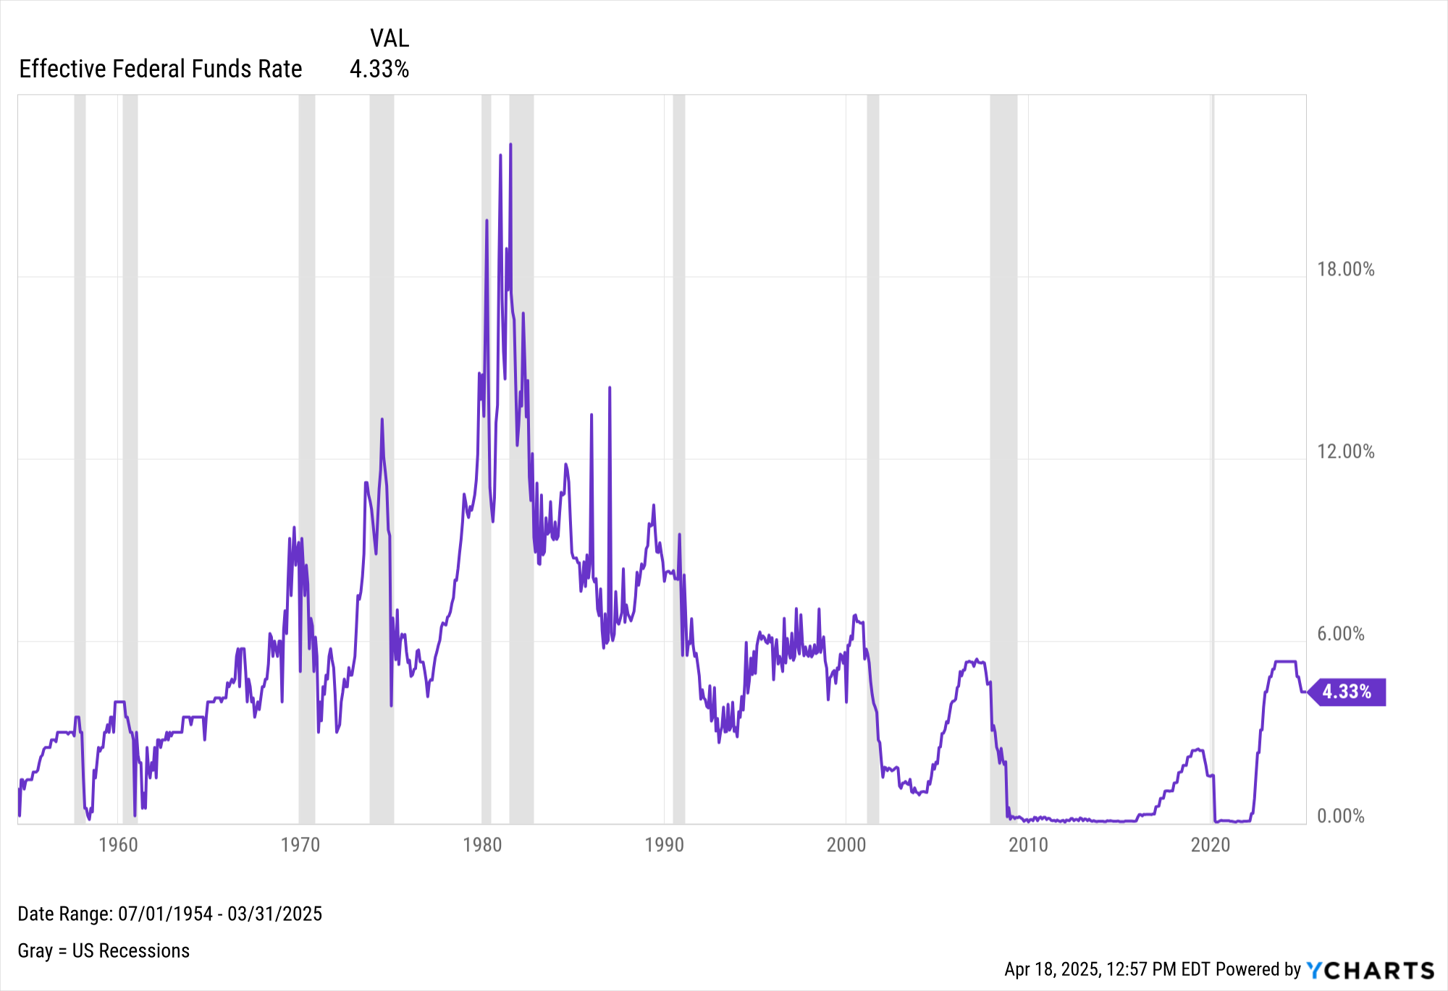
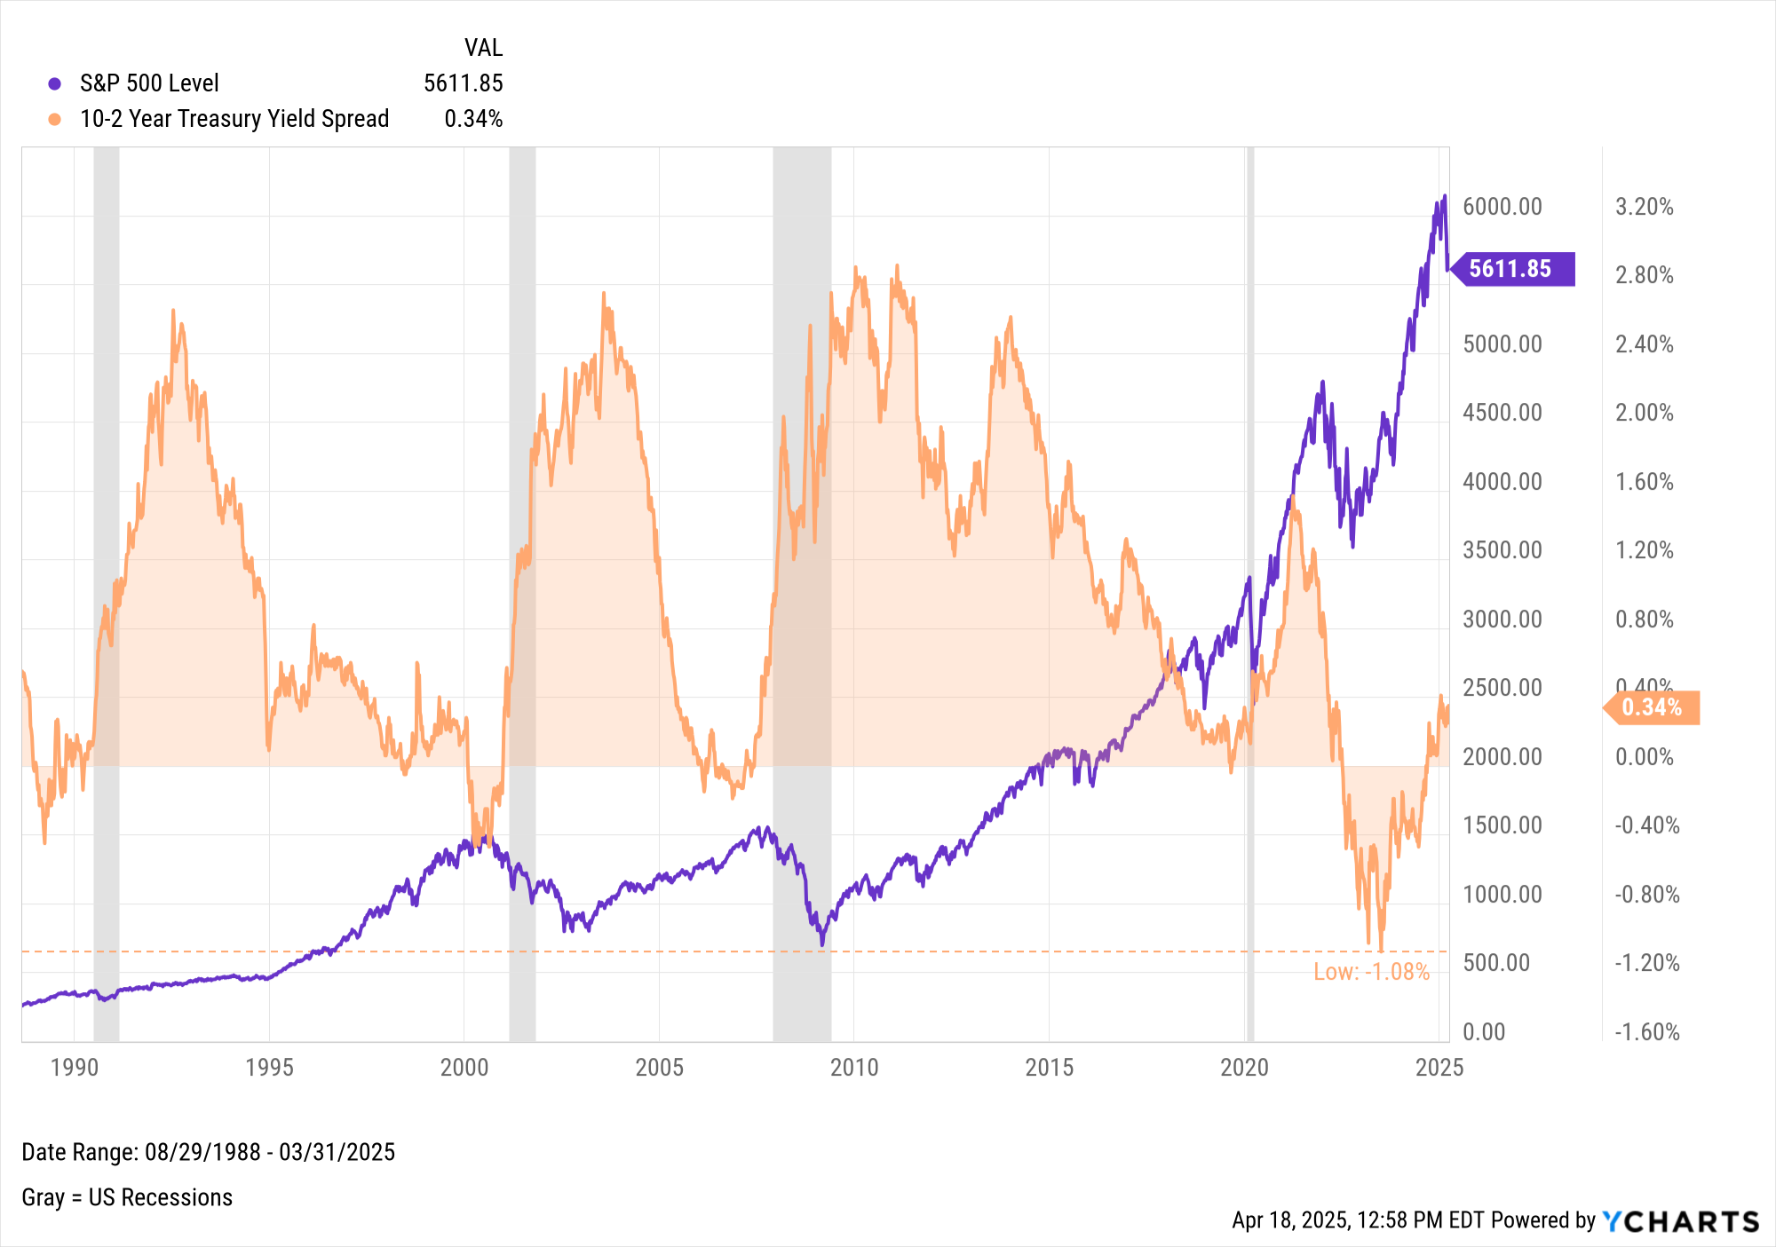
Interest Rates & Spreads
Notes:
L:
Effective Federal Funds Rate as of 3/31/2024: 4.33%
Current Target Upper Limit Fed Funds Rate: 4.50%
R: As of March 31st, 2025:
S&P 500 Level: 5661.85
10-2 Year Treasury Yield Spread: 0.34% (normalized on September 6th, 2024 after being inverted since July 6th, 2022)

Slide 26
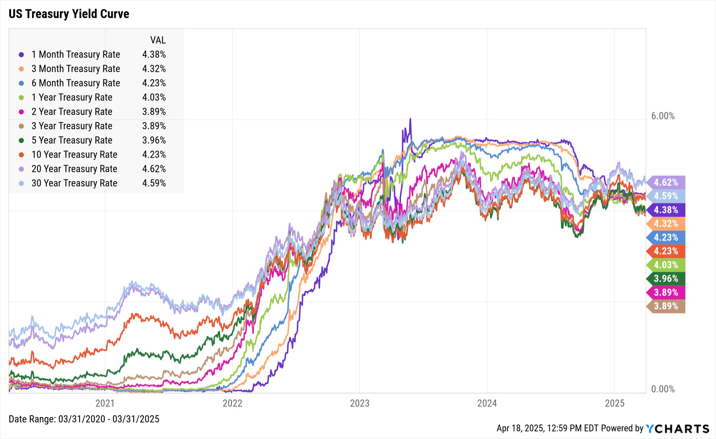
Treasury Yield Curve
Duration | Rate | QoQ Δ
1-Month | 4.38% | ▼ 2 bps
3-Month | 4.32% | ▼ 5 bps
6-Month | 4.23% | ▼ 1 bp
1-Year | 4.03% | ▼ 13 bps
2-Year | 3.89% | ▼ 36 bps
3-Year | 3.89% | ▼ 38 bps
5-Year | 3.96% | ▼ 42 bps
10-Year | 4.23% | ▼ 35 bps
20-Year | 4.62% | ▼ 24 bps
30-Year | 4.59% | ▼ 19 bps
Notes:
Duration: 3/31 12/31 QoQ ∆
1 Month 4.38% 4.40% -2 bps
3 Month 4.32% 4.37% -5 bps
6 Month 4.23% 4.24% -1 bp
1 Year Rate 4.03% 4.16% -13 bps
2 Year Rate 3.89% 4.25% -36 bps
3 Year Rate 3.89% 4.27% -38 bps
5 Year Rate 3.96% 4.38% -42 bps
10 Year 4.23% 4.58% -35 bps
20 Year 4.62% 4.86% -24 bps
30 Year 4.59% 4.78% -19 bps

Slide 27
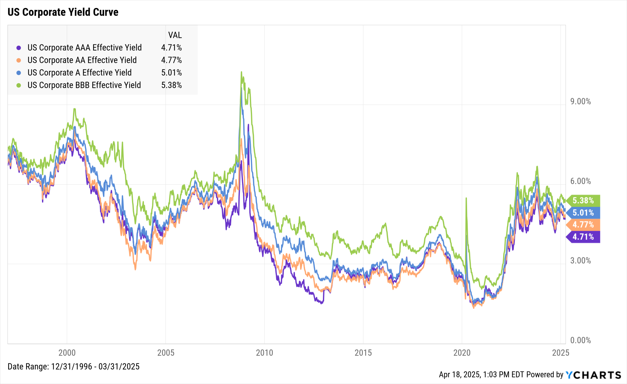
Corporate Yields
Type | Rate | QoQ Δ
AAA | 4.71% | ▼ 21 bps
AA | 4.77% | ▼ 24 bps
A | 5.01% | ▼ 21 bps
BBB | 5.38% | ▼ 17 bps
Notes:
Duration: 3/31 12/31 QoQ ∆
AAA Bond 4.71% 4.92% -21 bps
AA Bond 4.77% 5.01% -24 bps
A Bond 5.01% 5.22% -21 bps
BBB Bond 5.38% 5.55% -17 bps

Slide 28
Charts of the Moment
Visuals Depicting Trends that are Impacting the Markets and Investments

Slide 29
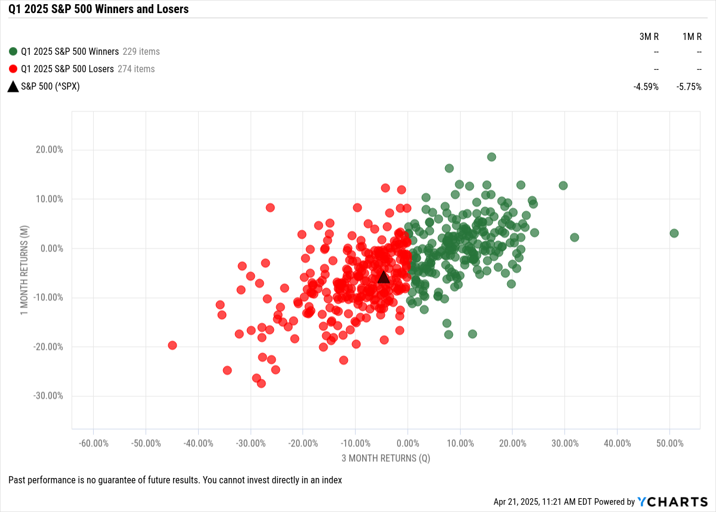
Q1 S&P 500 Winners & Losers
Notes:
274 S&P 500 constituents posted negative returns in Q1 (54% of the index), with the biggest loser being Deckers Outdoor Corp (DECK) which plummeted 45% in Q1. CVS Health (CVS) was the S&P 500’s biggest winner in Q1, surging 50.9% in the quarter.

Slide 30
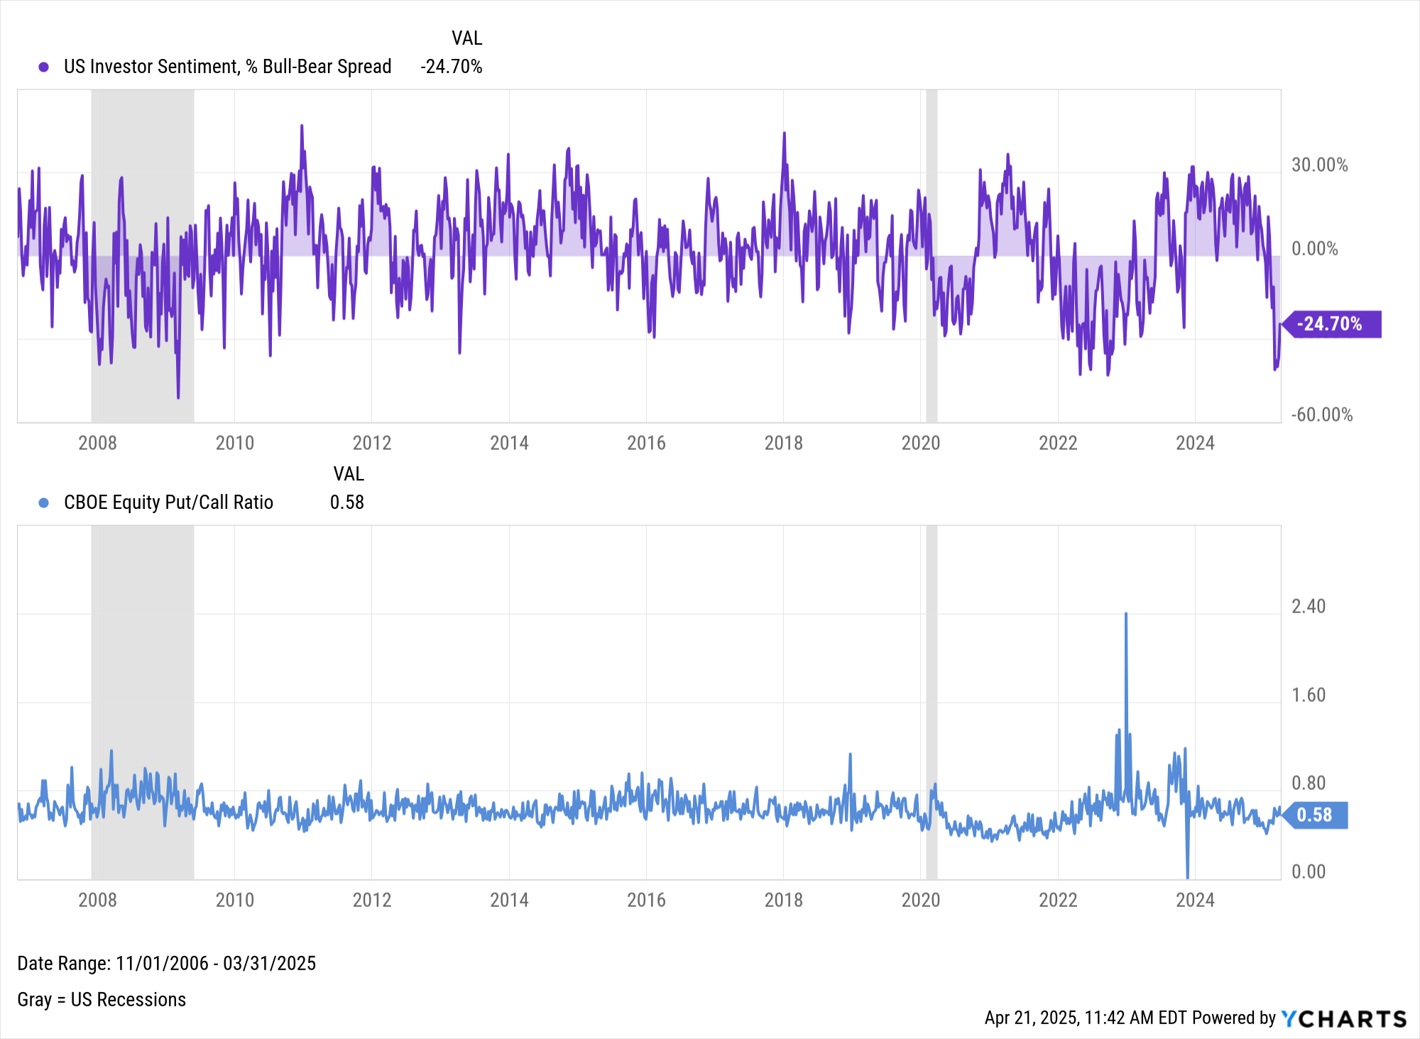
Investor Sentiment 🔻
Notes:
US Investor Sentiment plummeted to as low as -41.2% the week of February 27th, matching the level of negative sentiment recorded during the bear market of 2022. The options market has seen an uptick in puts as well.

Slide 31
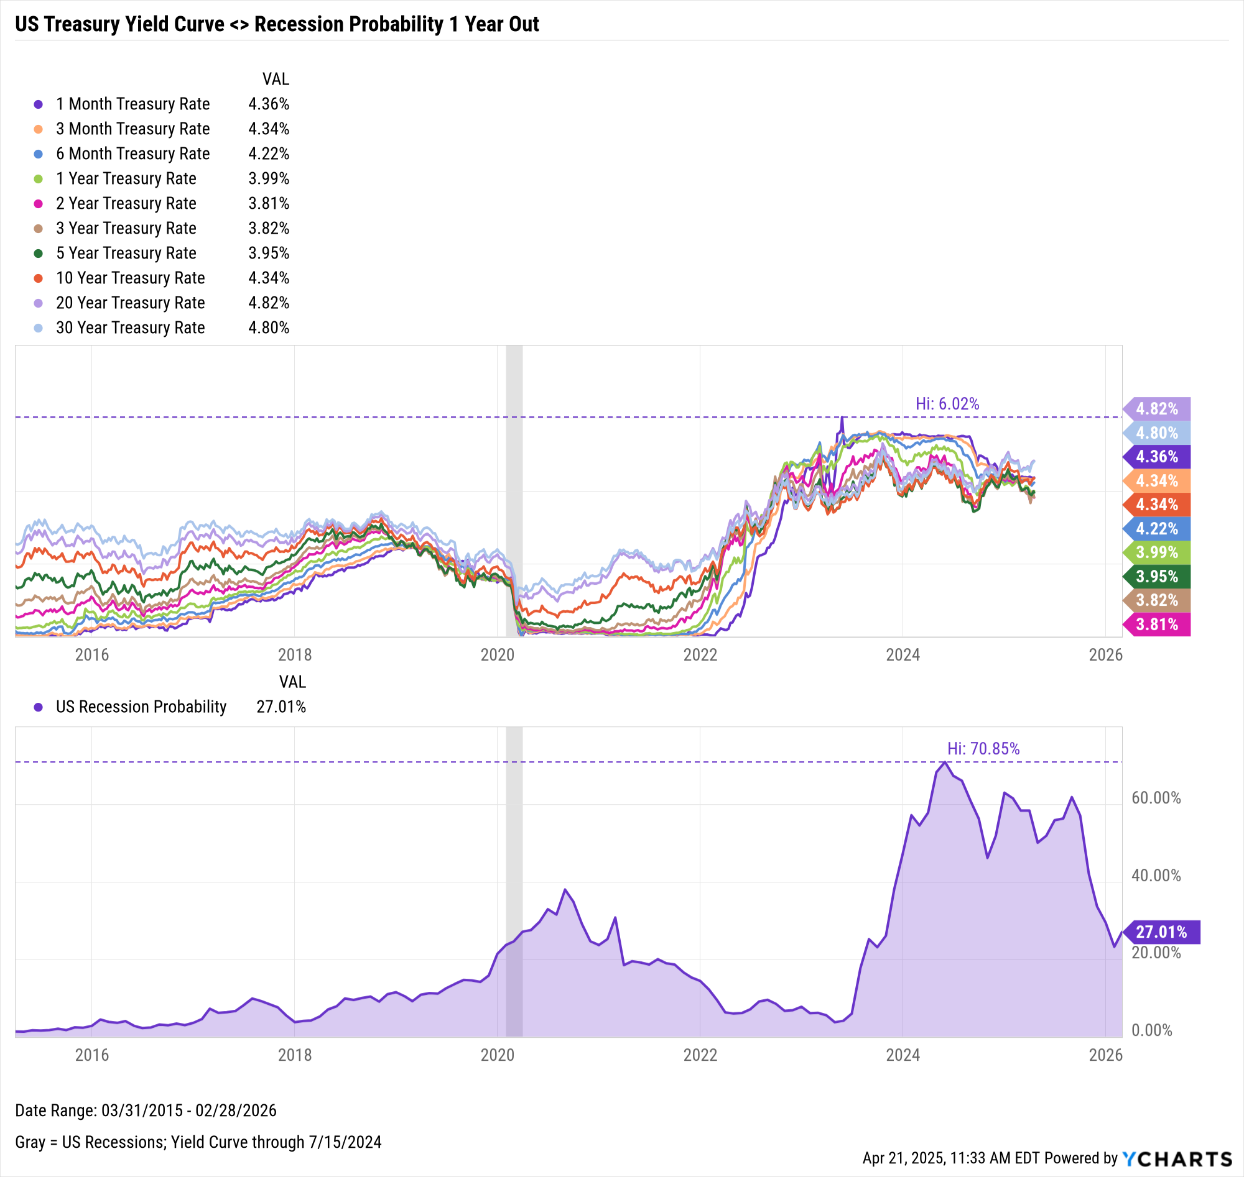
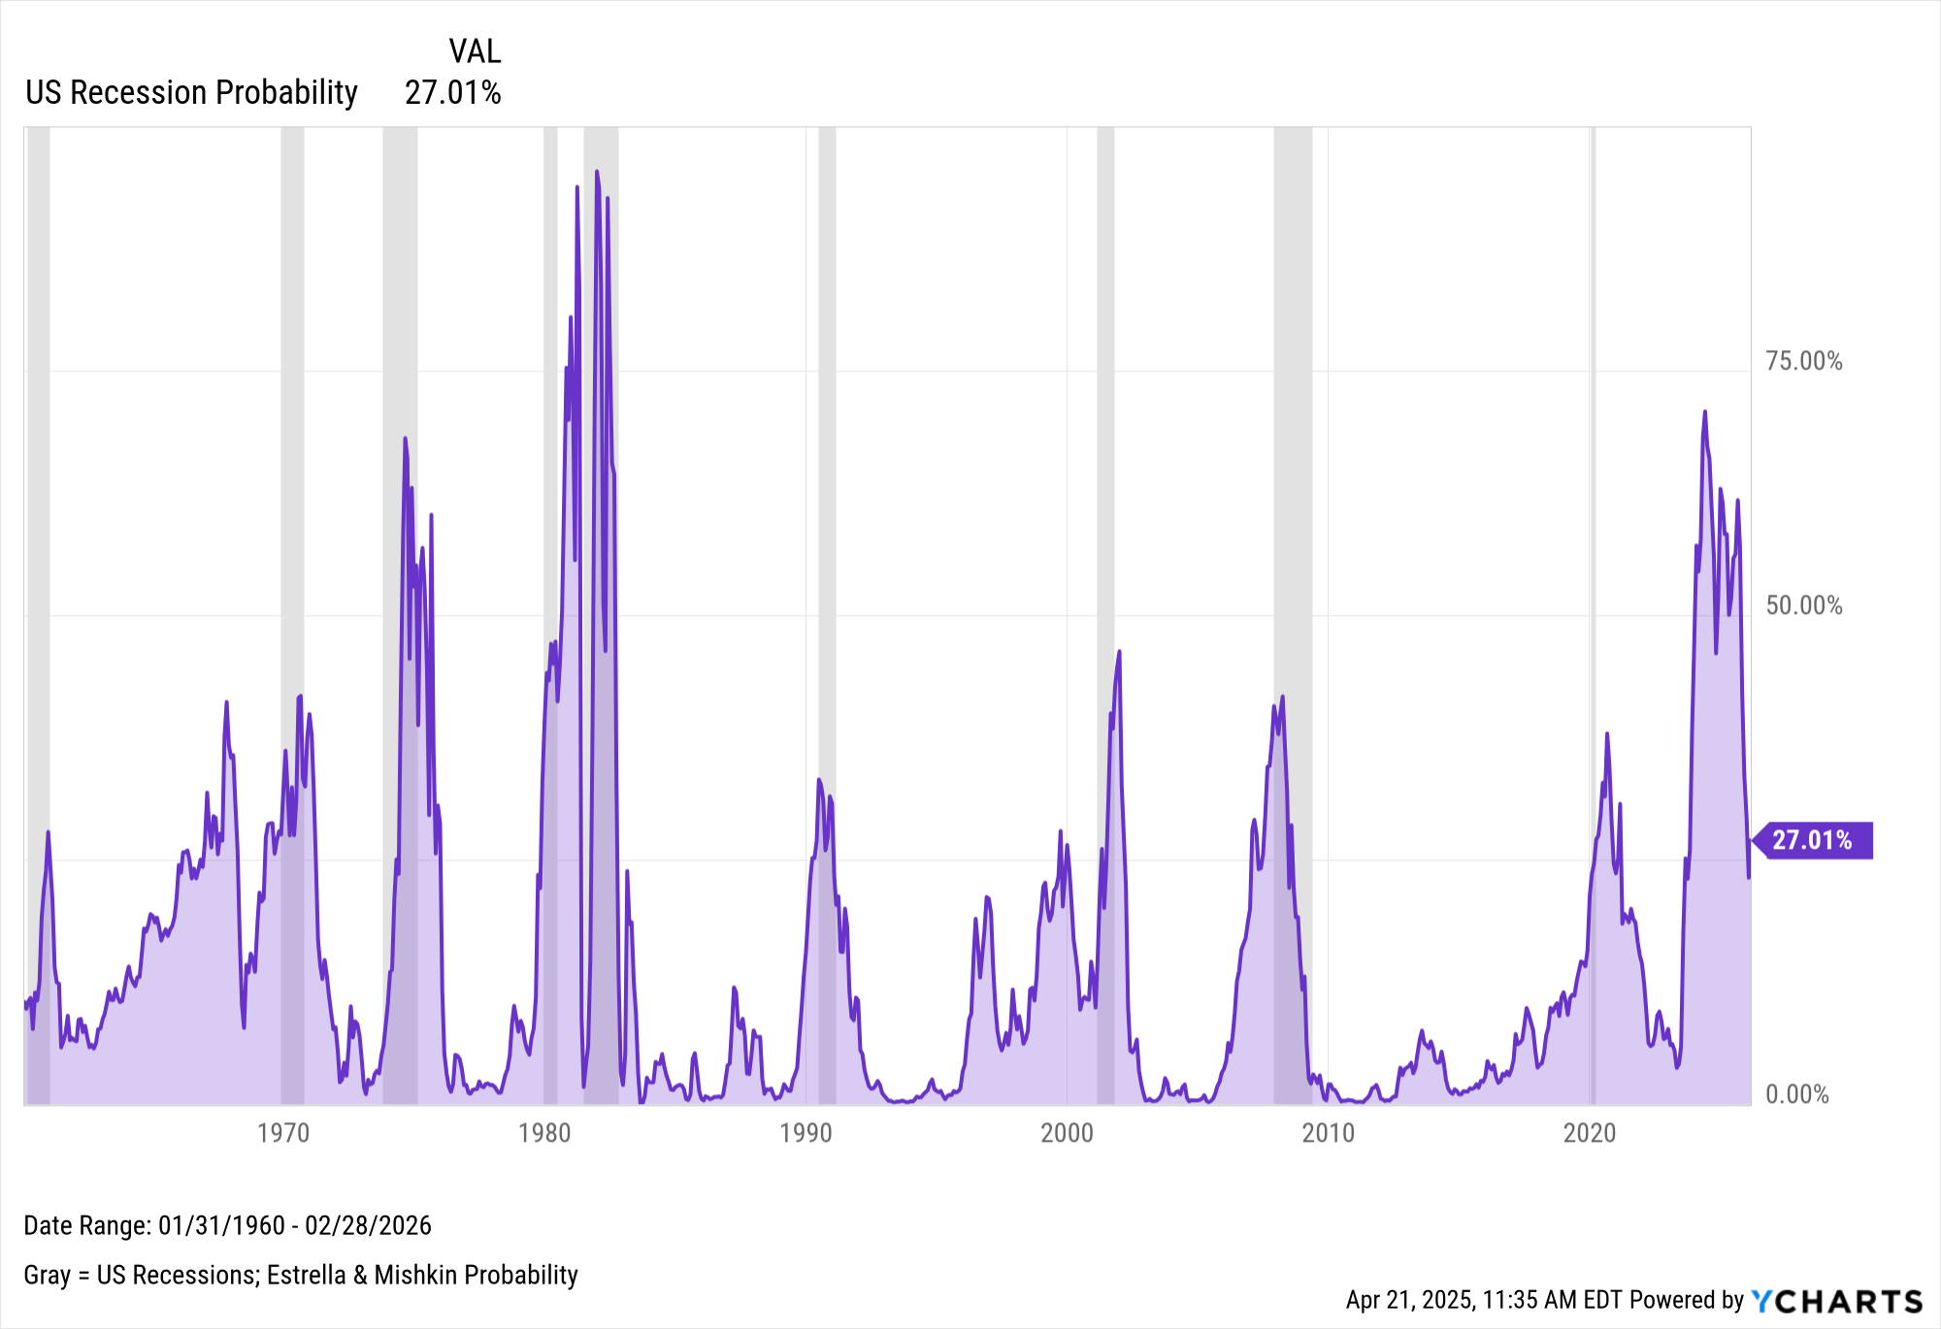
Yield Curve 🤝 Recession Probability
Notes:
The Yield Curve normalized on September 6th, 2024 after being inverted since July 6th, 2022; during the inversion, the Estrella & Mishkin yield curve-based US Recession Probability indicator spiked to a high of 70.85%. The current forecasted figure of 27.01% for February 28th, 2026 is well below that recent high of 70.85%. But unlike the last eight recessions (recorded by the gray bars), no recession has occurred during these elevated levels of probability. Did the US economy stave off a recession? Or is there one lurking around the corner?

Slide 32
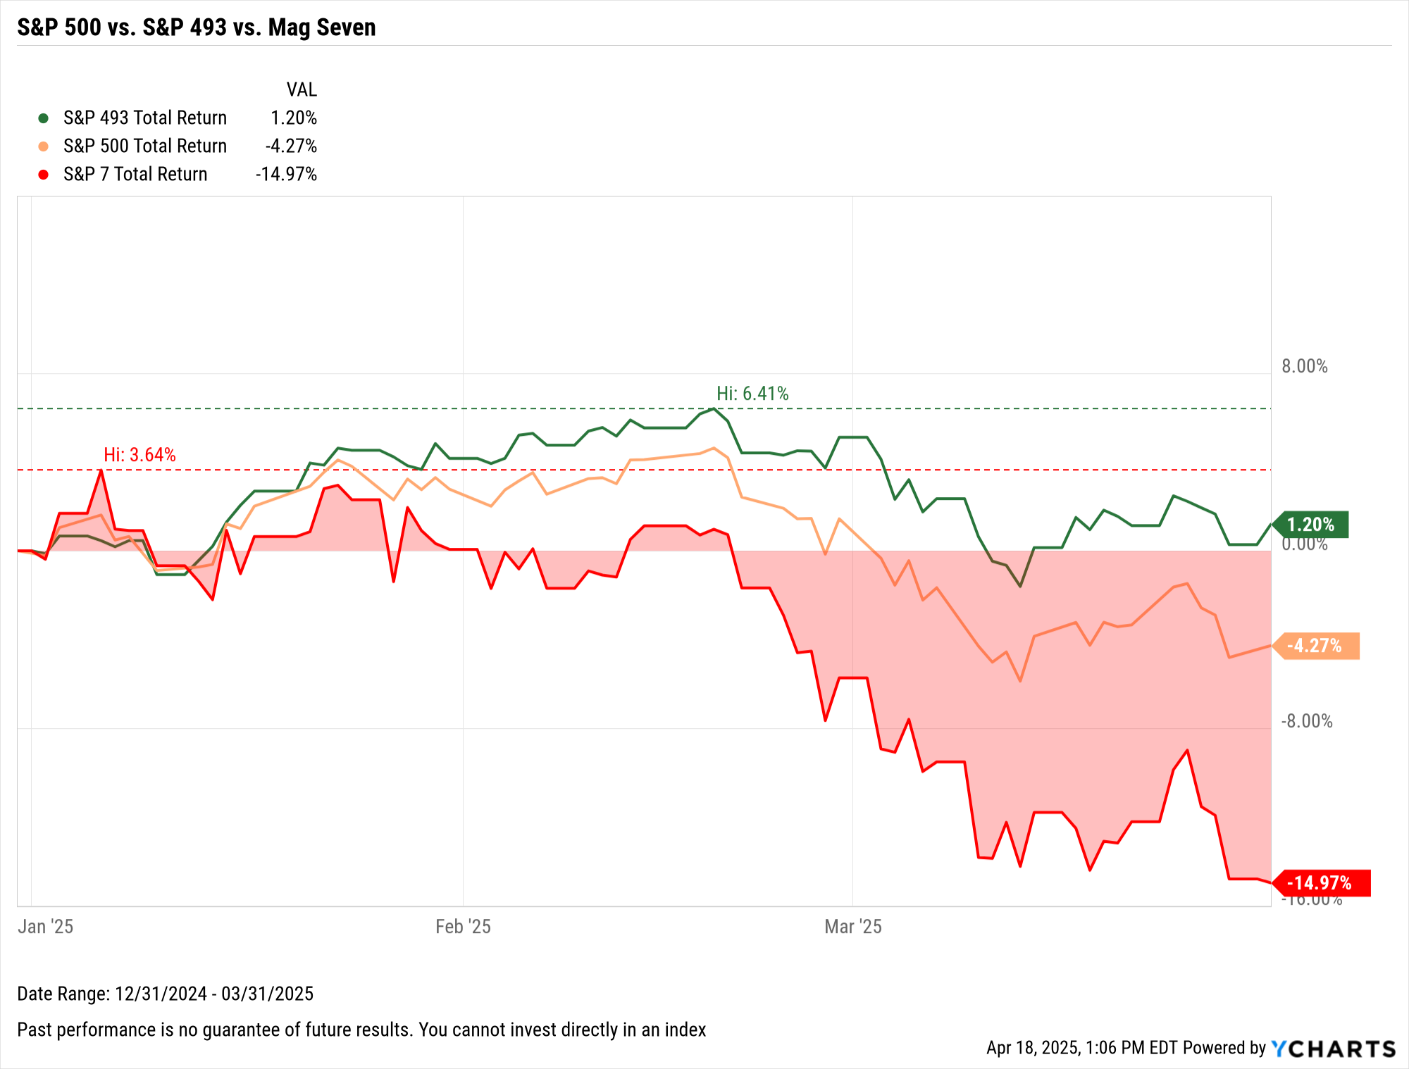
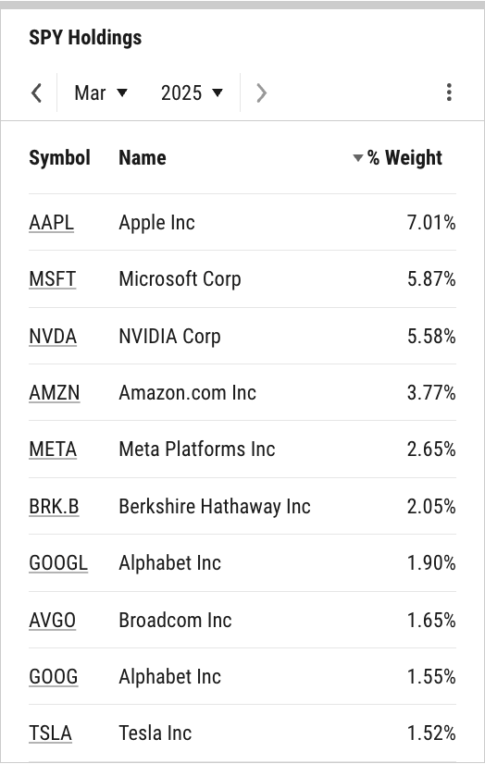
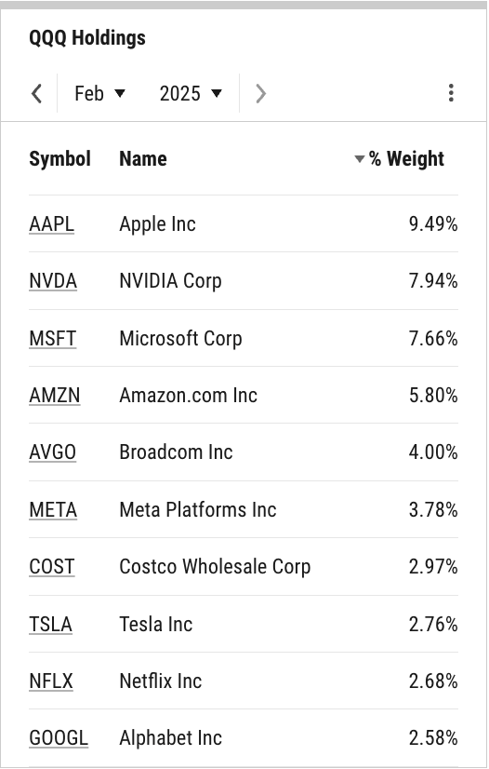

Index Concentration
SPY Top 10 Holdings
QQQ Top 10 Holdings
Top 10 = 33.55% of SPY
Top 10 = 49.66% of QQQ
Notes:
L: SPY’s Top 10 Holdings comprise 3.77 percentage points more of the S&P 500-tracking ETF QoQ; at 33.55%, this cohort still makes up over a third of SPY in its entirety. Concentration in QQQ’s Top 10 Holdings declined by 1.42 percentage points QoQ, making up about half (49.66%) of the Nasdaq-indexed ETF.
R: The “Magnificent Seven”, sometimes referred to as the “S&P 7”, is comprised of Apple (AAPL), Amazon.com (AMZN), Alphabet (GOOG, GOOGL), Meta Platforms (META), Microsoft (MSFT), NVIDIA (NVDA), and Tesla (TSLA). After surging 46.3% in 2024, the S&P 7 as a collective was down 15% in Q1 alone––whereas the remaining constituents (the “S&P 493”) actually gained 1.2% as a whole in Q1, helping to buoy the S&P 500 index overall from destruction.

Slide 33
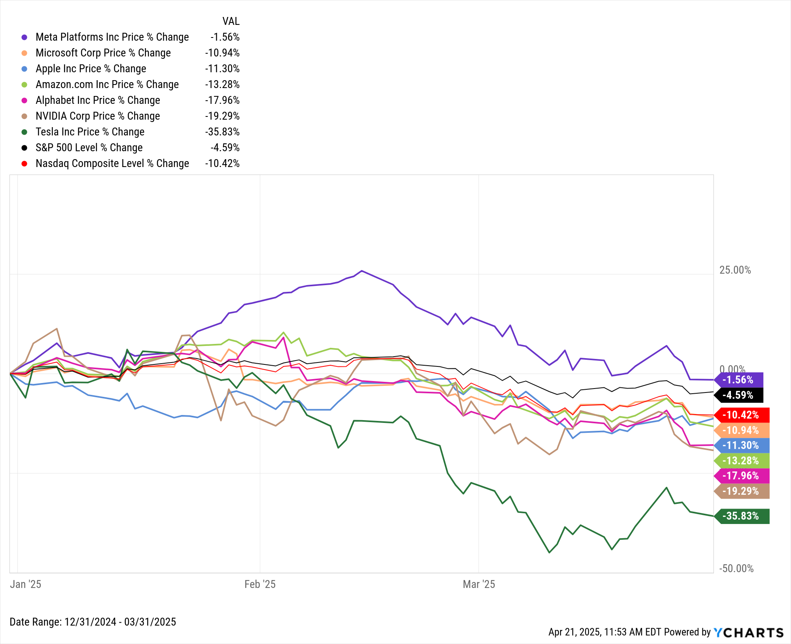
How the Mag Seven Have Fallen
Notes:
All “Magnificent Seven” or “S&P 7” stocks – Apple (AAPL), Amazon.com (AMZN), Alphabet (GOOG, GOOGL), Meta Platforms (META), Microsoft (MSFT), NVIDIA (NVDA), and Tesla (TSLA) – are dragging U.S. indices lower. Meta Platforms was the relative outperformer in Q1, while Tesla took the largest hit, plummeting 35.8% in the quarter.

Slide 34

Start a Free Trial
Book a Demo
YCharts is not registered with the U.S. Securities and Exchange Commission (or with the securities regulatory authority or
body of any state or any other jurisdiction) as an investment adviser, broker-dealer or in any other capacity, and does not purport
to provide investment advice or make investment recommendations by or through the Content found on the Site or otherwise. The
Site and the Content are provided for the sole purpose of enabling you to conduct investment research. Other uses of the Site and the Content are expressly prohibited. Full disclosure https://ycharts.com/about/disclosure

